Slide 1
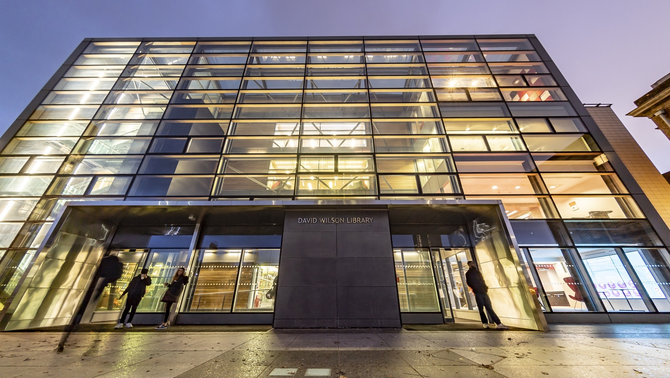
Procuring an institutional data discovery platform
Laurian Williamson, Head of Research Services, The University Library lw173@le.ac.uk

Slide 2
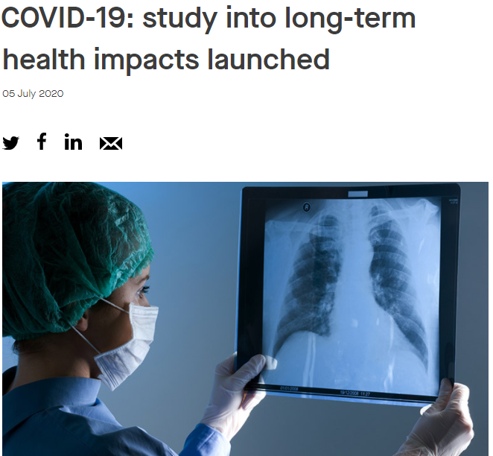
Citizens of Change.
Together we tackle today’s global challenges from pandemics to our world’s environmental issues, to the societal issues of our time, helping us to live healthier lives, supporting the UK recovery through space and Earth research, addressing inequality and supporting societies and communities locally, nationally and internationally.
https://le.ac.uk/research/stories
Notes:
The PHOSP-COVID study has been awarded £8.4million jointly by UK Research and Innovation (UKRI) and the National Institute for Health Research (NIHR). This study is one of a number of COVID-19 studies that have been given urgent public health research status by the Department of Health and Social Care.

Slide 3
Internal stakeholders (some of many..)
RDM project group (Library, IT, Research and Enterprise Division)
Senior IT Business Analyst
IT Enterprise architect
Senior Leadership team in the Library and Research Office
Deans of Research; marketing and comms; website steering group
University Research Committee and Research Infrastructure Group
Finance, Legal, Data protection and security, and procurement
Most important: research community (PhD, ECRs, and PIs)

Slide 4
Lesson learnt 1: managing stakeholder expectations

Slide 5
Timeline (February – March 2016)
Successful business case and funds secured to procure:
  research data storage infrastructure
  research data discovery platform
New role Open Access and Research Data Manager in February 2016
Arkivum data storage procured through Jisc Janet data archiving framework 50tb & two on-site appliances
Preparation for EU tender and procurement process for data discovery platform (Procurement Strategy – Competitive Dialogue)

Slide 6
Pre-tender activities (Feb – September 2016)
Establishment and agreement of high-level mandatory functional and non-functional requirements
Research data management survey of all research staff and students
Individual research data pathfinder interviews across all three Colleges (Health and Life Sciences, Science and Engineering, and Social Science and Humanities)
IT services RDM PM in addition to the RDM project manager (Library)

Slide 7
Lesson learnt 2: Requirements gathering and documenting is significant and takes time

Slide 8
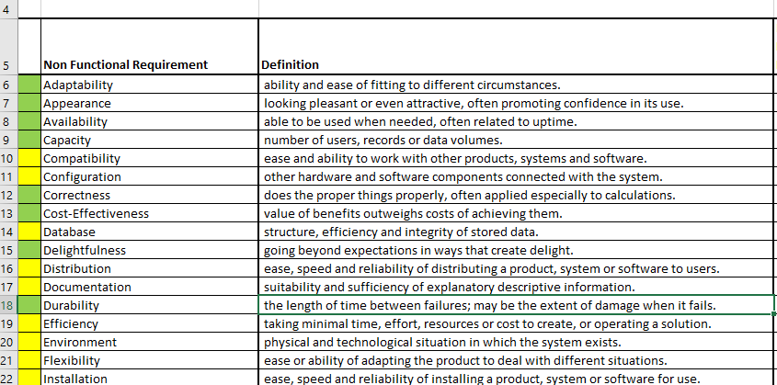

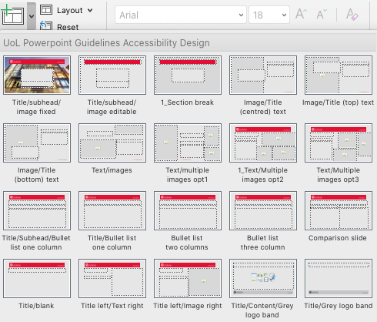
Shortlisting and evaluation criteria
To add a slide to your presentation click on the arrow next to New Slide and select which layout you require.
Scroll down for layouts with dark backgrounds if required.
Click on Layout to change the layout of an existing slide.

Slide 9
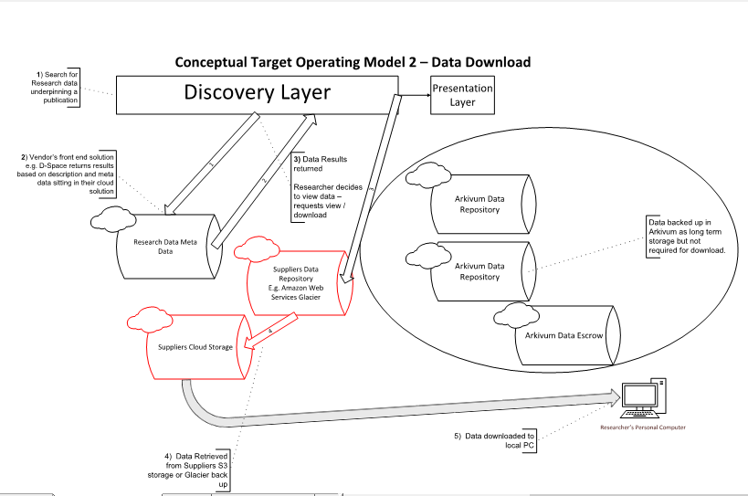
Conceptual operating models & refining requirements

Slide 10
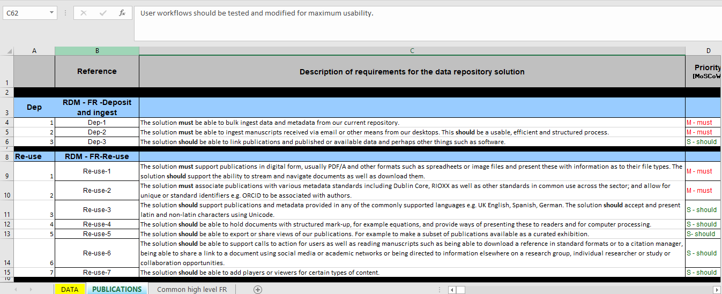
Requirements documented and agreed

Slide 11
Lesson learnt 3: Expect the unexpected..

Slide 12
What about publications and theses?
The University of Leicester wishes to engage publications and research data management system suppliers and developers (from commercial providers, academic institutions, non-commercial organisations etc.) with previous experience within the Higher Education Sector, to develop a repository platform/service to enable our research community to comply with funder, publishers, and institutional requirements and drivers around open access and discoverability of research outputs (both publications and research data).

Slide 13
Tender by numbers
Prior Information Notice (PIN) published in the OJEU which set out our purchasing intentions (high level mandatory requirements for data and publications)
23 Expressions of Interest (from start-up to established providers)
3 companies shortlisted (all fulfilling as a minimum the mandatory criteria)
Competitive dialogue
  Face to face 2 day meetings with each vendor & key UoL stakeholders
  Line by line responses and clarifications to every single functional and non-functional requirement
  PhD student invited to every meeting with the vendor
Notes:
Official Journal of the European Union (OJEU) – early notice of intent to procure

Slide 14
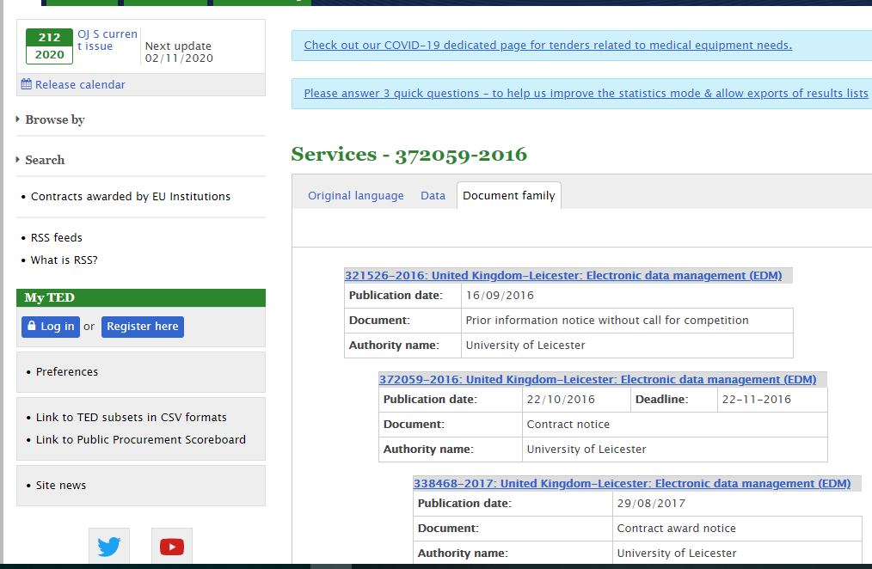
Out to tender…

Slide 15
Weighting and award criteria
Quality criterion | Weighting score value
High level requirements | 5
Functional requirements | 34
Non-functional requirements | 24
Service requirements | 4
Delivery and implementation | 3
Cost | 30

Slide 16
Lesson learnt 4: Institutional importance of the weighting criteria of COST

Slide 17
Lesson learnt 5: Split the implementation into two projects: data and then publications

Slide 18
Lesson learnt 6: provide useful feedback to the unsuccessful vendors

Slide 19
Lesson learnt 7: expect project timelines to change; local drivers remain important during implementation

Slide 20
Lesson learnt 8: procurement workflows and processes – useful to have a procurement manager leading this. Thanks Naomi Nortey!

Slide 21
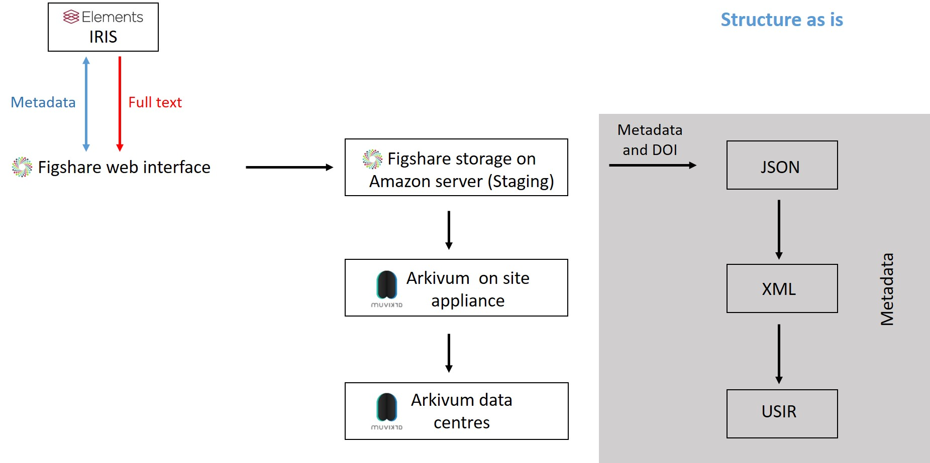
Delivery and infrastructure 2017 - 2019

Slide 22
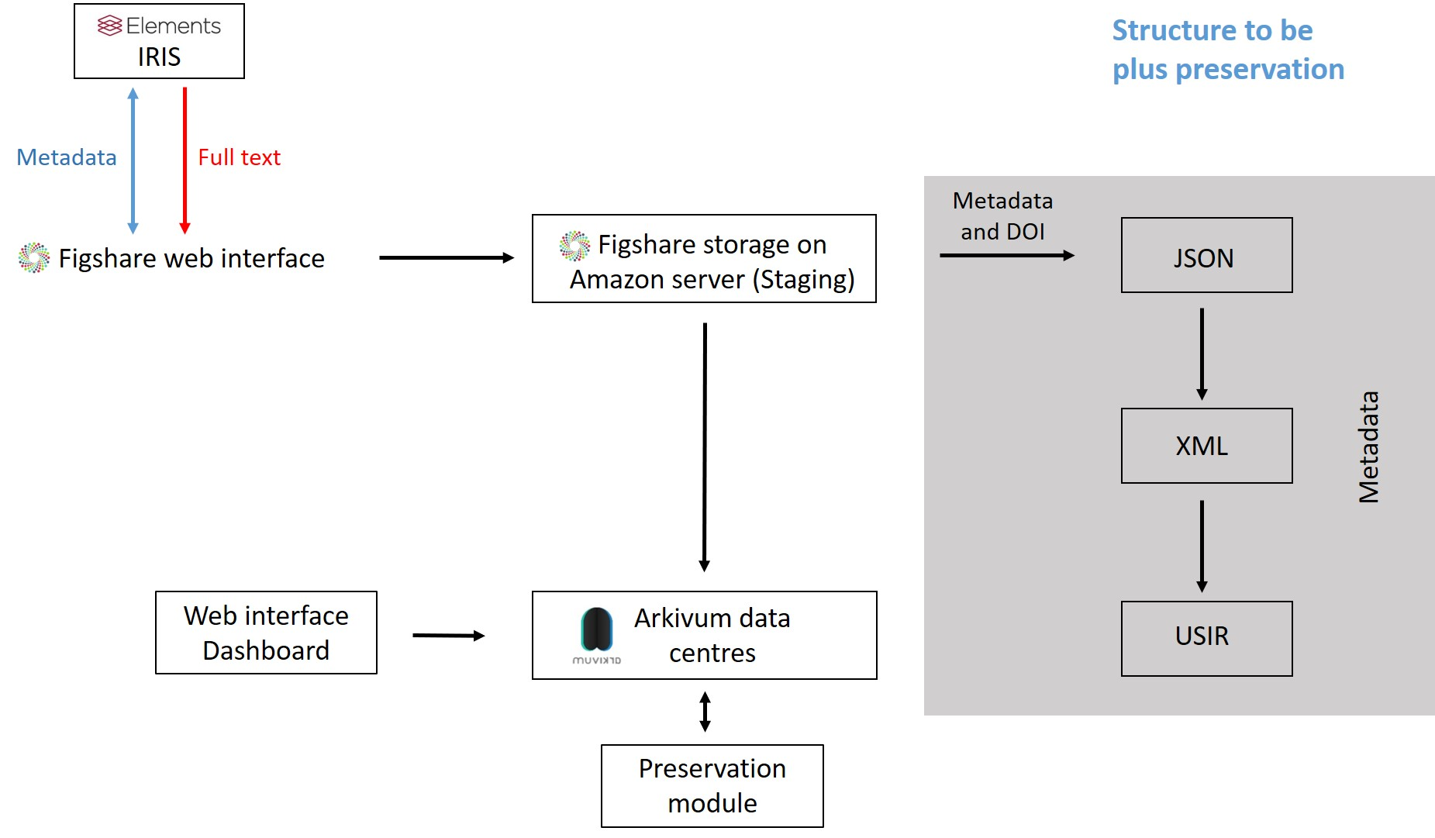
Service development beyond the project (2020)

Slide 23
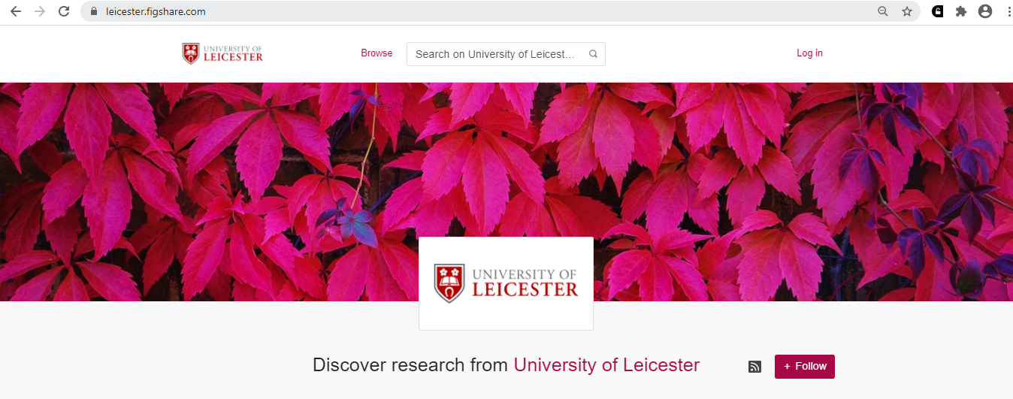
Figshare discovery@Leicester

Slide 24
Lesson learnt 9: procuring the infrastructure is only the beginning of the hard work around building RDM services

Slide 25
Thank-you. Happy to chat about this in more detail during the breakout session.

