Slide 1


National models for service delivery
Susanna Mornati, 4Science
RDM Services
https://wiki.geant.org/display/EV/RDM-Services
Online Conference, 2-6 October 2020

Slide 2
About me
Librarian, Director of Physics Library, Vice Director of Libraries at two universities in Northern Italy, 1988-2003
Associate at CERN Scientific Information Service, Switzerland, 1994-1996
Head of business units for Institutional Repositories and CRIS/RIMS at two inter-university consortia for ICT in Northern Italy, 2003-2016
Chief Operating Officer at 4Science, Italy, 2016-current.

Slide 3


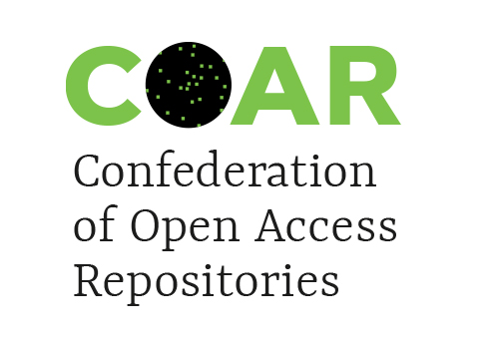
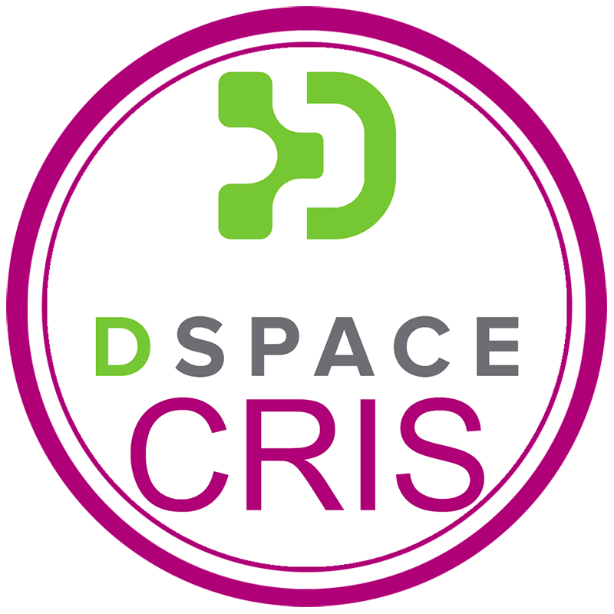



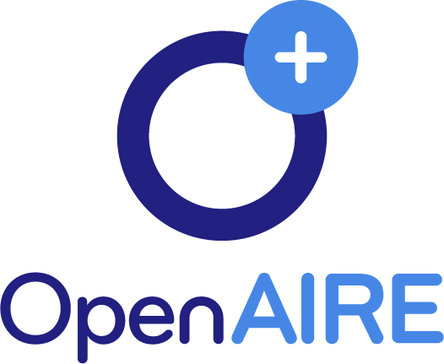


About my organization
4Science is a company providing services for open-source IRs and CRIS/RIMS based on DSpace(-CRIS), participating in open-source communities, promoting interoperability and contributing to open standards, open protocols, open technologies.

Slide 4
National Models for Service Delivery
This presentation will reflect on two experiences of coordinating adoption of a CRIS platform at the national level.
In 2014-2015 I was the project director of an initiative that involved sixty-six Italian institutions, which adopted the same distributed platform, a version of DSpace-CRIS called IRIS, customized for the Italian research evaluation exercise, and the IRIdE project for ORCID.
Since its start in June 2020, I am the project director of the #PeruCRIS knowledge platform, based on DSpace-CRIS, adopted by the Peruvian National Council for Science, Technology, and Innovation to implement a centralized national CRIS platform.

Slide 5
Distributed model (Italy)

Slide 6
CRIS adoption in Italy: the challenge
2006: two systems feeding the national database: UGOV Research(44) and SURplus (11) (total 55 installations)
  Critical issues: closed data, no visibility (UGOV)
  Poor metadata and duplicated records
  No validation processes (poor quality of data)
Spring 2014: the universities ask their Consortium to find a solution
Autumn 2014 – Summer 2015: all installations migrated to IRIS, the new CRIS based on DSpace-CRIS, plus 11 new (total 66)
  Advantages: open repositories and other opportunities (researchers’ profiles)
  Richer metadata and shared records
  Validation processes and better quality of research information

Slide 7
Benefits of country-wide adoption of
DSpace-CRIS
DSpace-CRIS is open source (independency from providers)
CERIF compliance (CERIF-XML import and export)
Increased visibility of national research production (national harvester PLEIADI)
Consistent data uploaded to the national database
3,5 million publications available on the Internet (>10% with open-access full-text)
More transparency for national research evaluation procedures

Slide 8
The «persistent-identifier» approach
April 2015: the Italian National Evaluation Agency for University and Research announced ORCID to be mandatory
June 2015: national agreement signed with ORCID
September 2015: central Italian register (ORCID hub) launched (IRIdE project
November 2015: over 60,000 Italian researchers have an ORCID (> 90%)
DSpace-CRIS is populated with ORCIDs but also with DOIs, Scopus IDs, WoS IDs, PubMed IDs, interoperable with Datacite, born to be interoperable with any external data source or target
The CRUI (Council of Rectors) signs a national contract with Datacite for DOIs.

Slide 9
Lessons Learnt
The adoption of the same CRIS platform is a first step towards stronger harmonization and sustainability
The built-in open repository supports Open Access to publications and datasets
Support for PIDs enhances data quality through disambiguation and contributes to a new architecture of research information infrastructure
The huge amount of available data makes it possibile to conduct significant research and analysis

Slide 10
Centralized model (Peru)

Slide 11
The CRIS national project in Peru
In 2017, the Government of the Republic of Peru approved a project for the improvement and expansion of the National System of Science, Technology and Technological Innovation (SINACYT)
To improve SINACYT's performance (which, among other benefits, implies better management, better prioritization and allocation of resources for Science, Technology and Innovation, more applied research) will:
  contribute to Peru's economic diversification and competitiveness
  help reduce the vulnerability of the productive apparatus of Peru
  help achieve sustainable development in time based on knowledge

Slide 12
#PeruCRIS technical goals
The #PeruCRIS projects aims to harmonize and connect research information across a variety of separate databases:
National Directory of Researchers and Innovators (DINA), storing information declared by individuals about their own activities, capacities and experiences in STI
National Directory of Institutions in Science, Technology and Innovation (DANI), storing information on public and private legal entities that are related to STI, such as universities, institutes and companies
National Directory of Institutions in Science, Technology and Innovation (EVA), a database that registers scientists, technologists, businessmen and/or professionals with a recognized background in areas related to knowledge and development of STI activities, who have the status of evaluators
National Digital Repository of Science, Technology and Innovation of Open Access (ALICIA) the centralized site where digital information resulting from scientific, technological and innovation production is maintained (books, publications, articles from specialized journals, technical-scientific works, computer programs, processed data and monitoring statistics, academic theses and similar).
Project Bank is an application that allows the visualization of relevant information on research projects
REGINA is a registry of individuals who possess established capacities in accordance with a qualification, to carry out scientific research and/or technological development

Slide 13
Main features of the centralized platform
The #PeruCRIS Platform will be composed of five directories: human talent, scientific production, projects, institutions and infrastructure
It will provide timely and reliable information services on the actors, activities and capabilities in the field of R & D & I with national coverage
It will feature a CV of Human Resources, a federated authentication API, a national observatory of Science, Technology, and Innovation (STI), access to sources of scientific information and funding opportunities
It will provide the tools for the monitoring and evaluation of the national system for STI (Sinacyt)
It will be based on DSpace-CRIS and will adopt international standards and recommendations, such as CERIF for interoperability of research information

Slide 14
Expected benefits
Harmonization and connection of varied information sources
Enhanced control on research information and its quality
Better knowledge of research assets and performance at the institutional and national level to inform prioritization and allocation of resources for research
Economic diversification and competitiveness of the country
Sustainable development based on knowledge

Slide 15
Conclusions
Two different models:
Bottom-up collaboration in the distributed model
Top-down organization in the centralized model
Same goals:
Better information -> data -> control and resource allocation
Enhanced opportunities (open access, open science, development)
Same outcomes:
Visibility (open CRIS/RIMS portals)
Sustainability (collaborative/centralized initiatives based on free sw)

Slide 16
Many thanks for your attention
Susanna Mornati
susanna.mornati@4science.it
4Science
www.4science.it

