Slide 1




DMPonline – responding to procurement
A Whirlwind Tour
#DeliverRDM
Kevin Ashley
Director, Digital Curation Centre
www.dcc.ac.uk
@kevingashley
Kevin.ashley@ed.ac.uk
With thanks to Magdalena Drafiova, DMPonline customer development manager
DMPonline, DCC, and the associated logos are registered trademarks of the University of Edinburgh

Slide 2
Some context & history
DMPonline is a web-based service that helps researchers and those they work with to create and maintain data management plans
Launched in 2010 by the DCC – which was then a national body funded by JISC (now Jisc)
Initially just for researchers, and aimed at the UK
We saw international potential – and added US funder requirements from the outset
Free to use – and international interest exceeded our expectations

Slide 3
The first 5 years
We made major revisions, including services & interfaces for organisational administrators
We made the code open-source
We thought hard about how to attract international funding to support an international service
  Initial assumption was that we would look to national funding bodies (we were wrong)
We could also see our national funding was under threat
  We pursued other grants to support feature development
  We got our host university to invest its own money
By the end of 2015 we had our first paying overseas customers
  We needed contracts, service agreements, and lots of legal and administrative support
We also knew our predictions about losing national funding were right

Slide 4
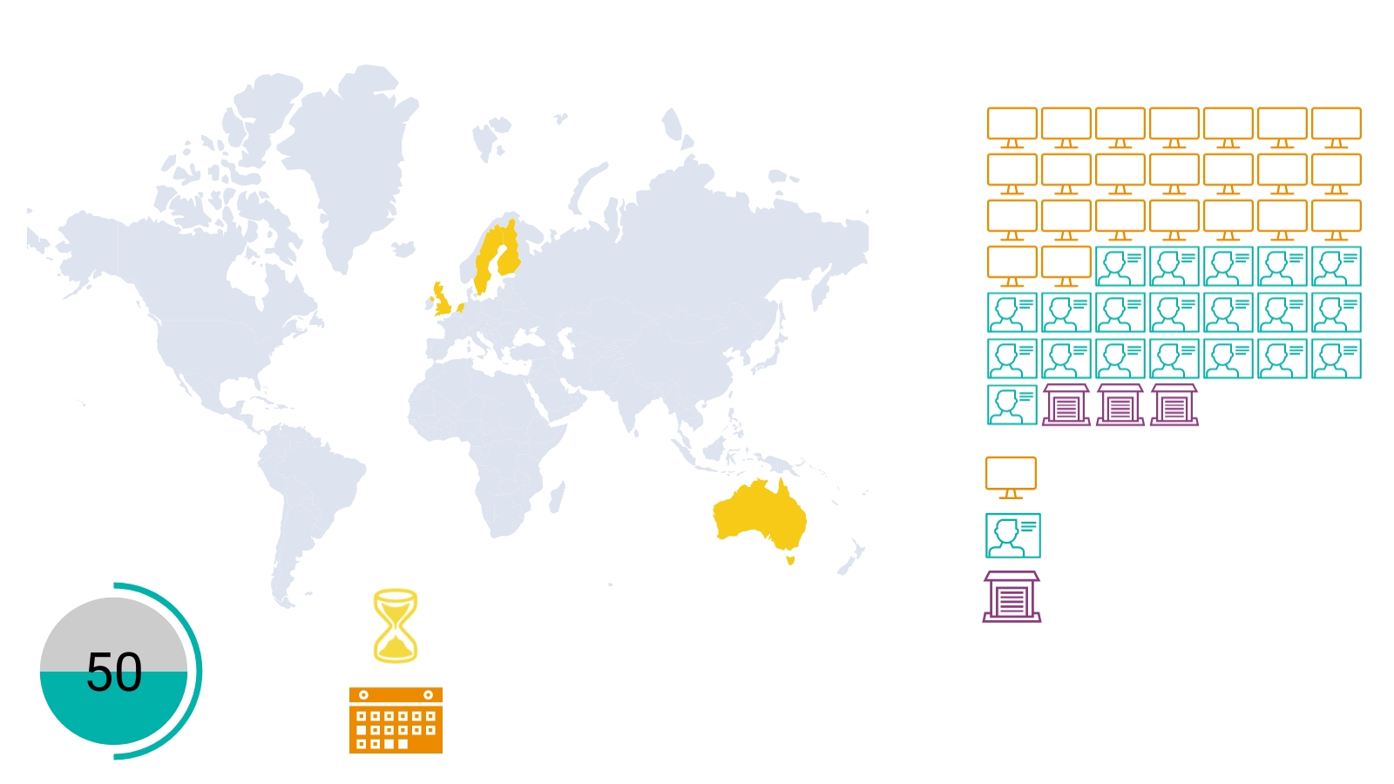

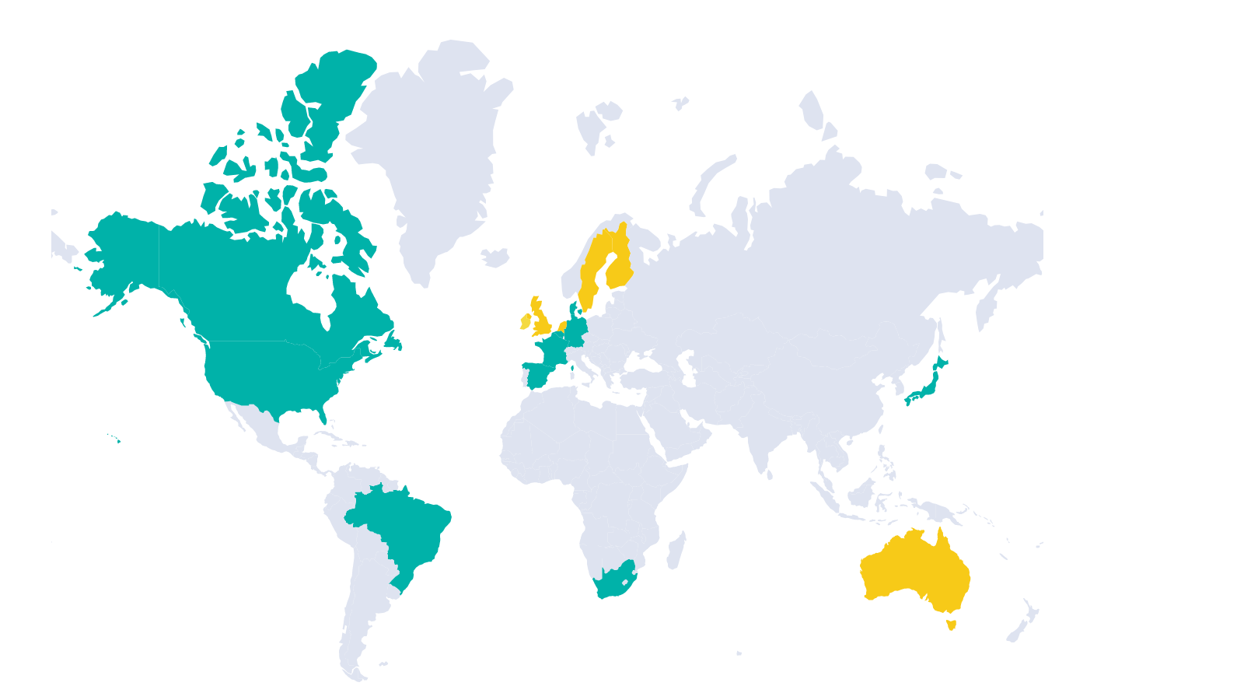
Fast forward – the present day
DMPonline is used by 203 organisations in 83 countries – over 17,000 registered users
The service (DMPonline) is paid for by research organisations and funding bodies – over 50 so far
The code (DMPRoadmap) is still open-source
It’s still free to use for researchers, whether or not their organisation or funder subscribes
The development and service team is bigger than it ever was when we had national grant funding
Annual subscription: 26
3 years subscription: 23

Slide 5
I thought you were going to talk about procurement?
Most of our sales don’t go through formal procurement – the price per institution is low enough to escape the requirement
Contracts, pricing regimes, SLAs, sales & much more are still essential
Procurements are needed for larger agreements – with funders, national bodies, consortia
  We’re in two right now – I can’t say who with
Procurement places significant time pressures on all involved
Unlike our other agreements, every one is a special case
  This adds significant costs to the initial service provision
  Larger organisations have teams who do nothing else but seek out and respond to procurements
  Luckily (?) we also have procurement experience in other areas of our work

Slide 6
Common pain points
Standard procurement procedures often require lots of up-front evidence you may not expect
They often use templates aimed at a different type of supplier (e.g. sole trader) or product (e.g. on-site services)
They can require pricing models far from the ones you have developed
Communication is constrained – and not always effective
Some provide very clear questions to respond to – others don’t
Without good, responsive legal backup (which we have) you can make expensive mistakes

Slide 7
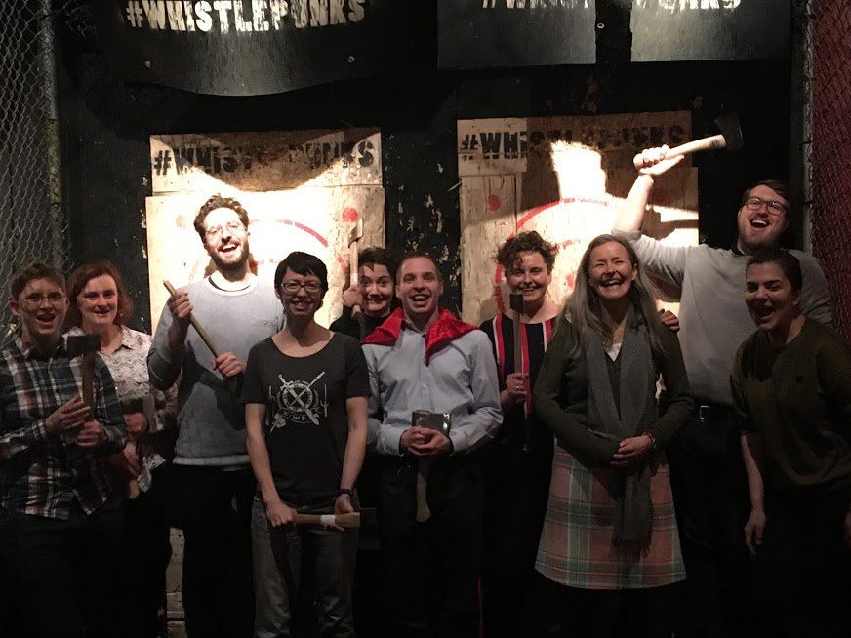

But we mustn’t grumble
Can’t always promote some of the more esoteric aspects of the service
The procurement is just the beginning – supporting the customer in the following years is the real goal

