Slide 1
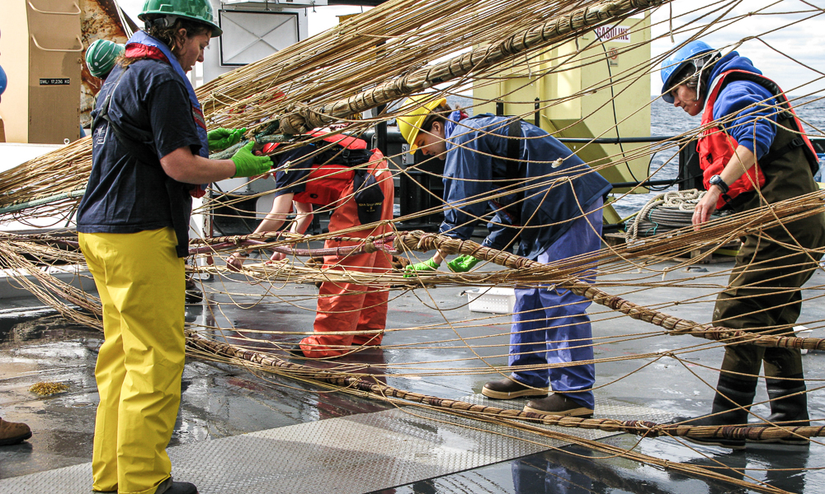
Project Connectome: federating repositories and partnering across universities
Kurt Baumann
kurt.baumann@switch.ch
GEANT RDM Service Workshop
Zurich, 05.11.2020

Slide 2





SWITCH
Education, Research & Innovation (ERI) Community
Swiss universities on tertiary level (academic sector) and their research institutions
extended ERI community
Internet Community
Internet Service Providers, Hosters, Domain Registrars
Critical infrastructure organisations (CIO)
Banking, Industry & Logistics, Energy; Healthcare, Government

Slide 3














Connectome – Building Blocks
Community Governance
Decentralised
Repositories
Open (Research) Data Hub
Service
Portfolio
METADATA
HARMONISATION
Knowledge
Graph
Discover
Organise
Insights & Analytics
Generic Services
Specialised Services
Secure Basic Infrastructure

Slide 4
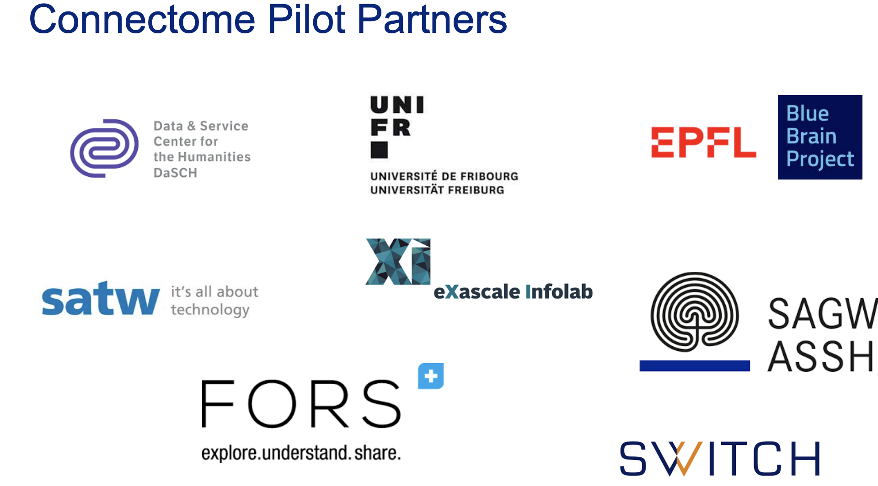
Notes:
Organisation

Slide 5
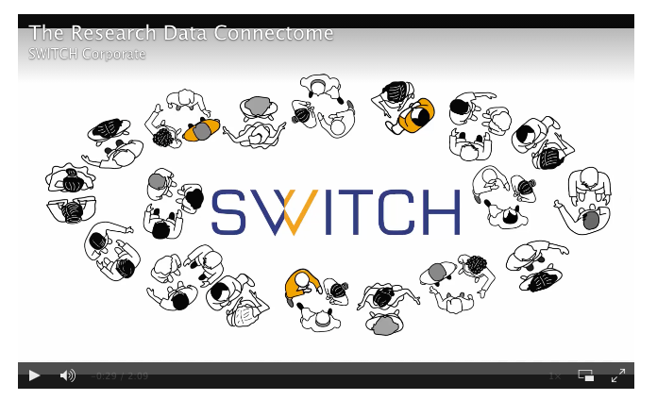
Connectome - Partnership
Connects and organizes (open) scientific (meta)
data sustainably across disciplines to make it
widely accessible, interoperable and valuable
Linked Date is our Vision

Slide 6

Working for a better digital world

