Slide 1
Research Data Canada: Partnerships and Collaborations
November, 2020: RDM Services Workshop

Slide 2

CANARIE – Research Data Canada’s Parent
Accelerates Canadian innovation
Drives the adoption of transformative technologies
Ensures Canada continues to develop a vibrant knowledge economy

Slide 3
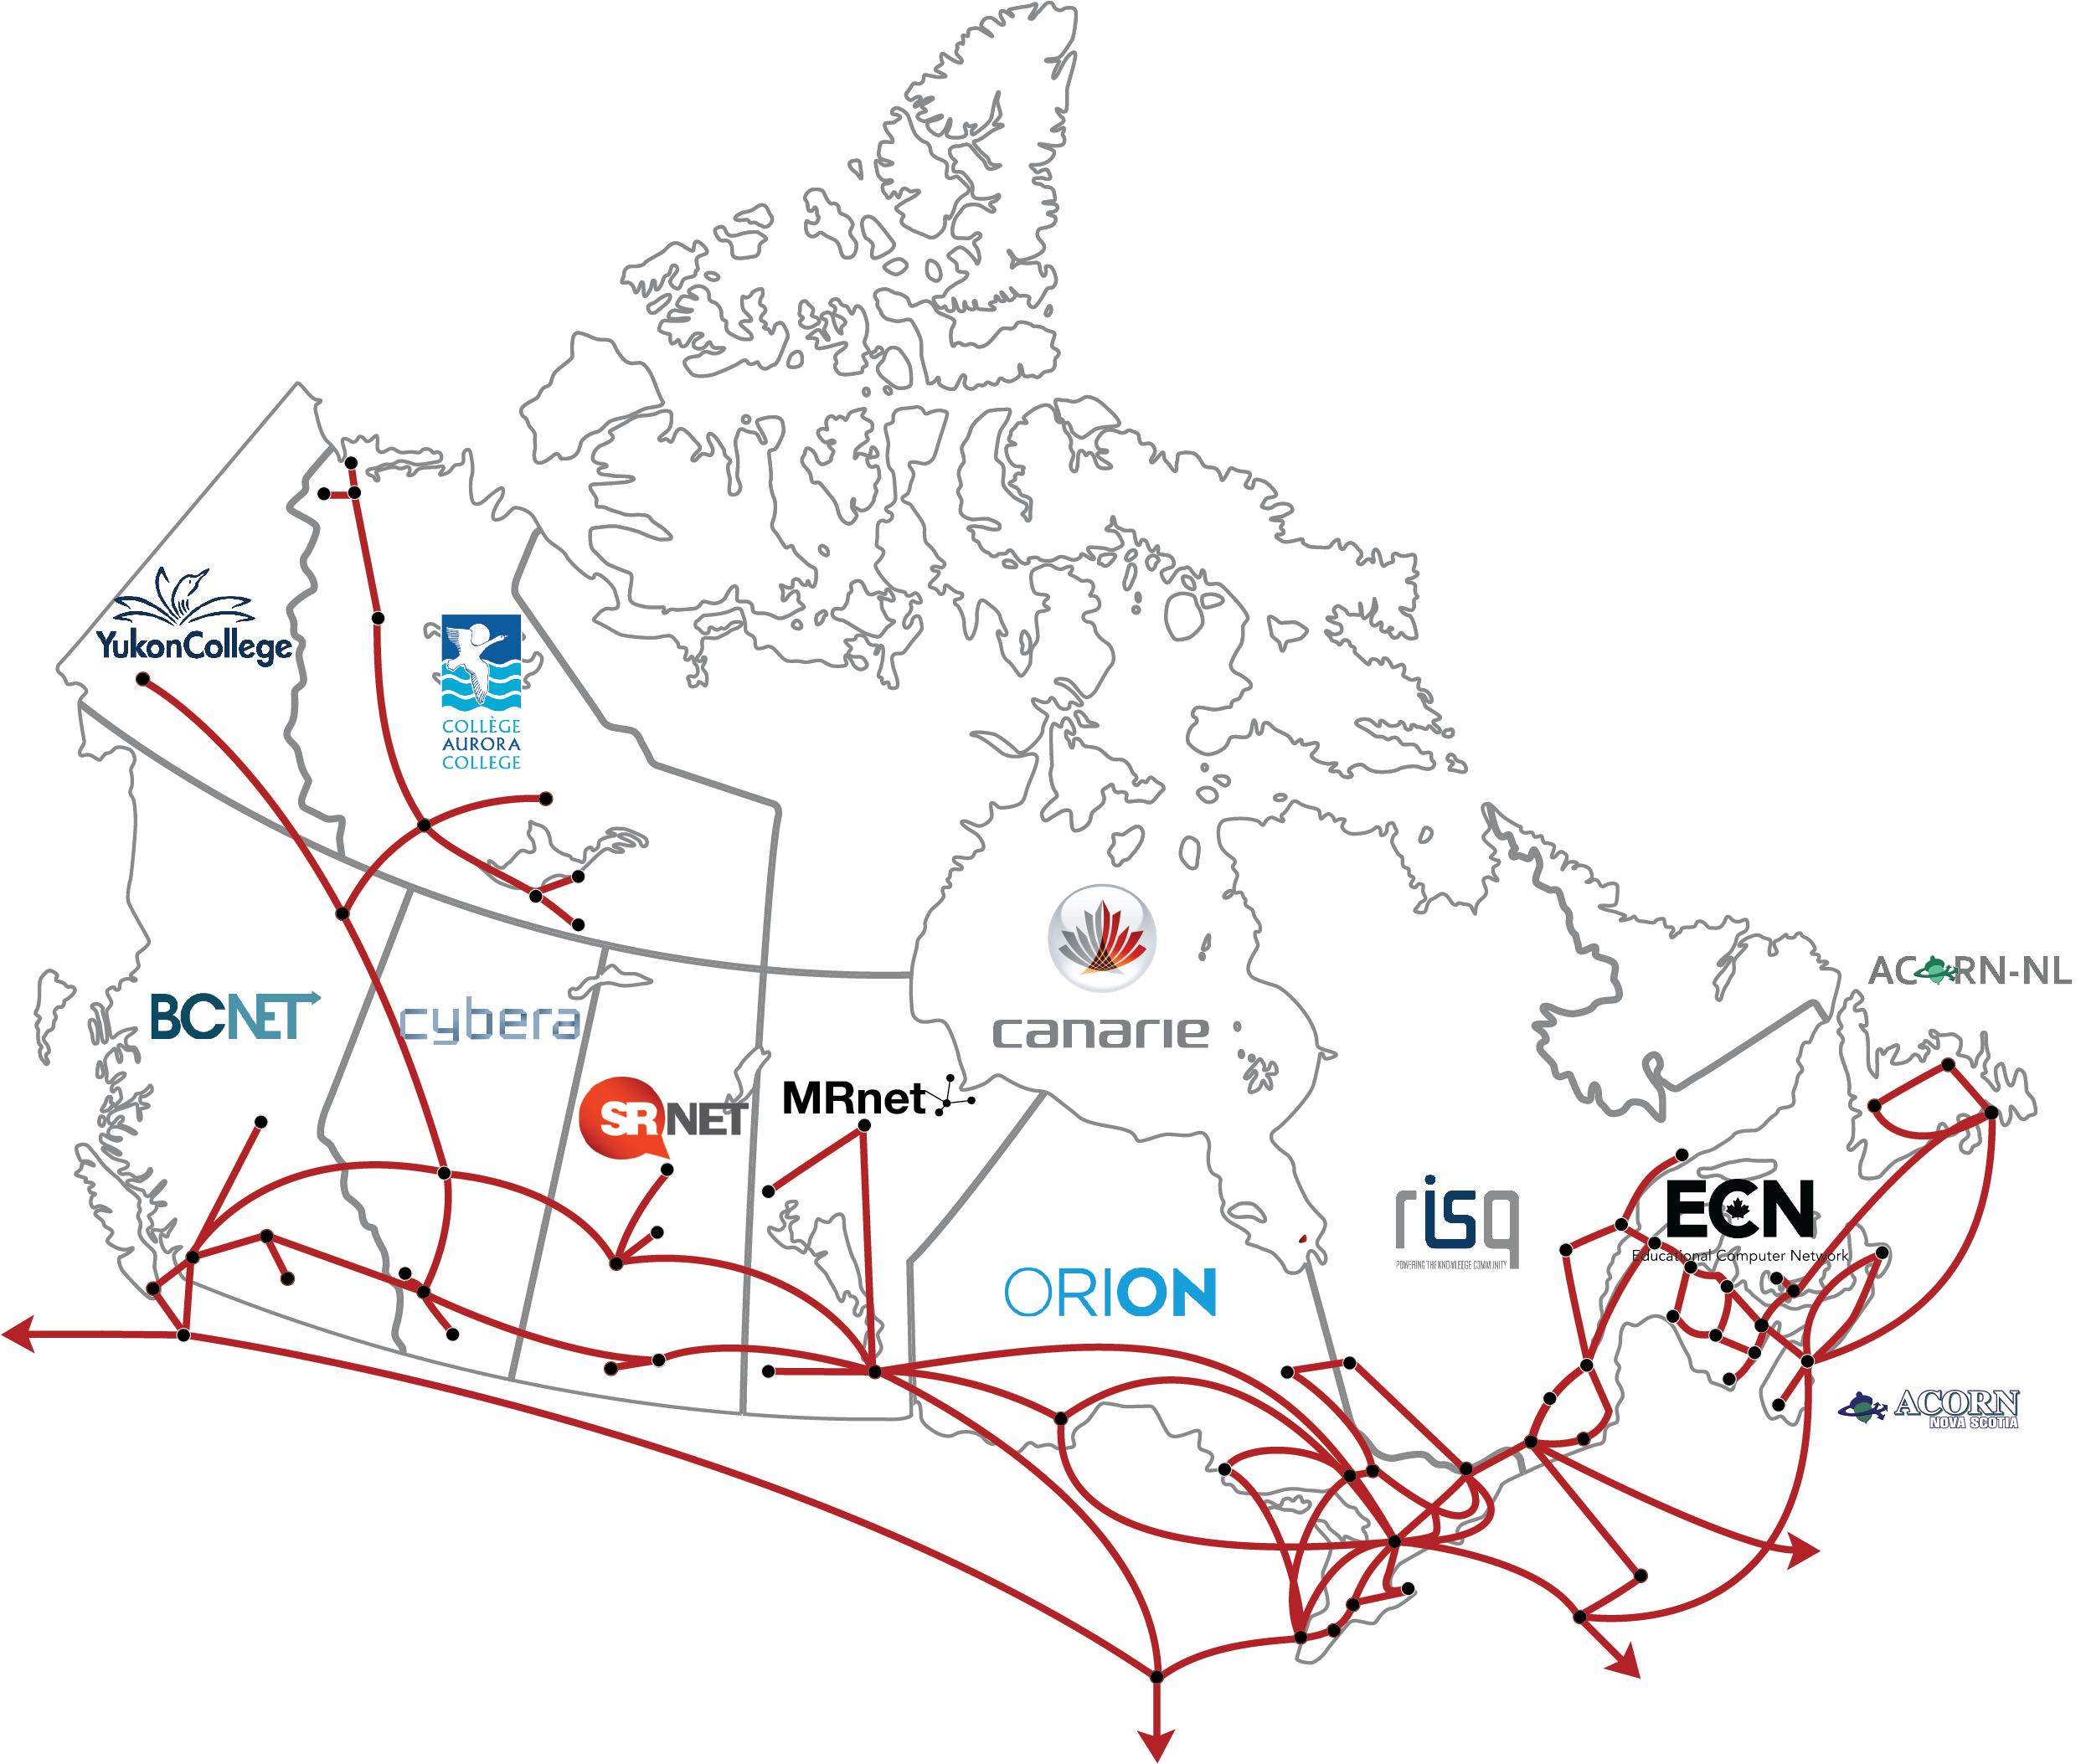
Canada’s NREN

Slide 4
Research Data Canada
Vision
  Canadians have access to national and international collections of publicly-funded research data.
Mission
  Work with stakeholders to ensure research data is re-usable in support of innovation that benefits all Canadians.
Strategies
  Facilitate the development of a collection of integrated National Data Services that support researchers through all stages of the research lifecycle and promote compliance.
  Focus on enabling activities – increasing stakeholder alignment, promoting support for data reusability and/or addressing gaps in enabling technologies.
  Facilitate international collaboration.

Slide 5
RDC Strategy 2020-22
Embedding the National Data Services Framework (NDSF)
Strengthening the RDM Ecosystem During NDRIO Transition
Building International Linkages and Partnerships

Slide 6
NDS/NDSF Definitions
National Data Services
  A service that provides one or more data-related functions to applicable stakeholders and disciplines in a specific national context.
National Data Services Framework
  a conversation with all stakeholders at all levels;
  agreement on best-practices, standards and protocols;
  a suite of interoperable services and resources.

Slide 8
Kanata Declaration 2020 Version
Process defined to refine/enhance the 2019 Kanata Declaration
Background Info: DM Roadmap & DM Backgrounder
Survey Monkey version of the Declaration
  Solicits feedback on each of the 18 declarations
  Solicits feedback on developments in communities of practice regarding intersections/updates for each statement
  Allows document upload with any additional information
Feedback + 2020 Summit discussion will inform creation of Version 2020.

Slide 9
2. National Digital Research Infrastructure Organization (NDRIO)

Slide 10
NDRIO (New DRI Organizations)
$375M of funding over five-years to establish a new national not-for-profit
NDRIO responsibility for funding/support of High-Performance Computing (HPC) <Compute Canada>, Research Software (RS), RDM (< CANARIE)
Developing plan over next 6-12 months for activities to end of 2024 FY
Inaugural Board elected by Members in mid-March
Researcher Council in place, defining how best to engage researchers
Outreach underway with Position Papers & Whitepaper process
International partnerships, services and models are one focus in the current phase of activity, and how Canada can engage with colleagues

Slide 11
RDC & Portage and Examples of National Work
The Portage Network came from the university library sector, now in NDRIO
RDC & Portage Network will merge into NDRIO by Mar/2022 at the latest
National RDM Training Working Groups (already merged)
  Recommendations regarding best practices for RDM & Data Science Training, including option of a Train-the-Trainer version of CODATA-RDA Data Science School
Data Repositories Expert Group (struck as a broad effort)
  MulDiscussions around a more sustainable approach to funding and support for national Canadian data repositories, including provision of support and funding for CoreTrustSeal Certification
RDC/Portage/NDRIO also partnered with WDS-ITO to facilitate their efforts using the national context, and co-location at the University of Victoria/ONC

Slide 12
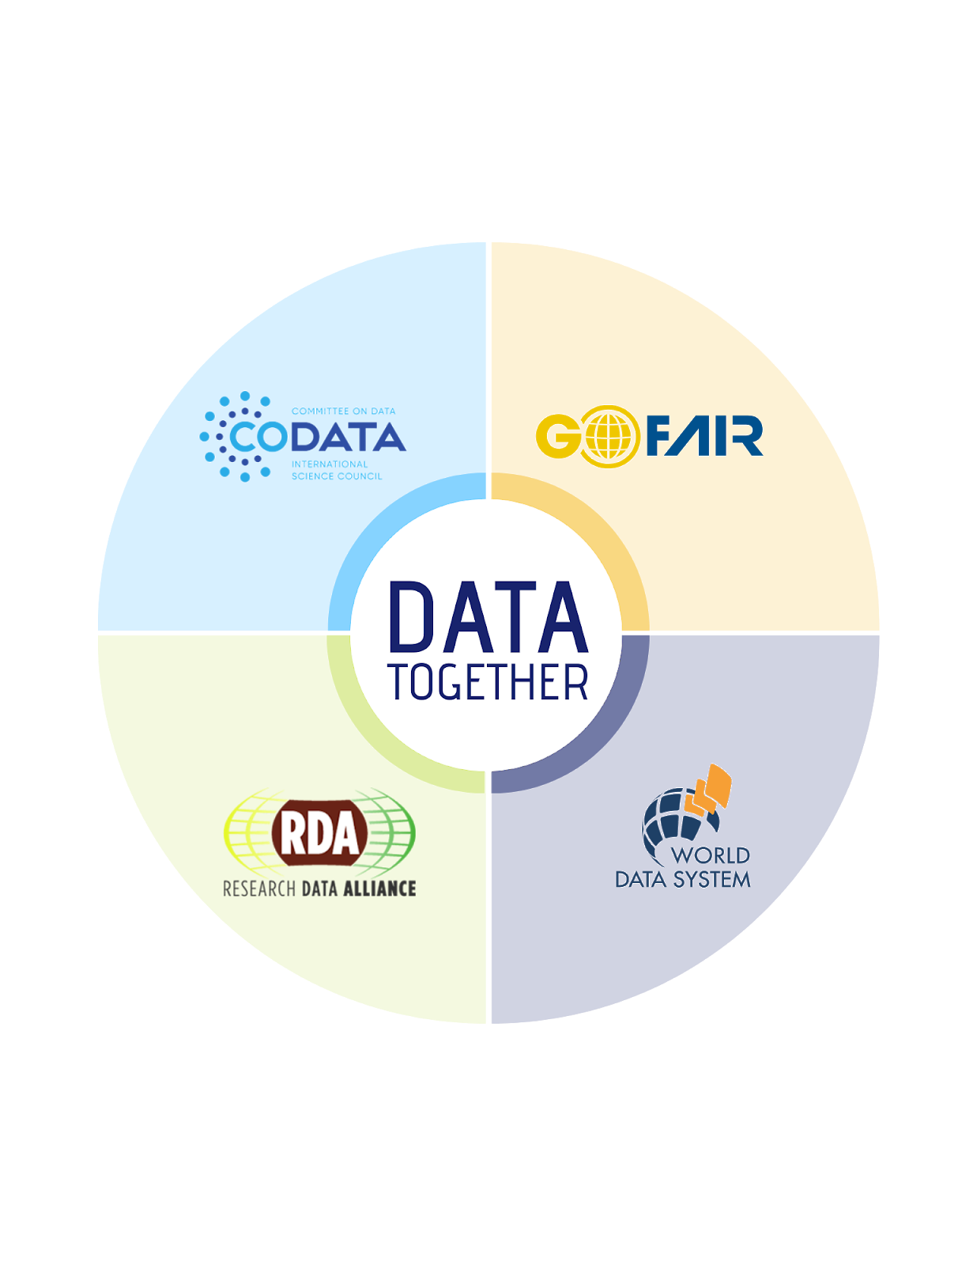
New effort to promote the efforts of key international RDM organizations, and highlight:
  Roles and mandates
  Areas of complementarity
  Opportunities for moving ahead together
One example is a new RDA COVID-19 Working Group, which includes experts all 4 organizations.

