Slide 1
The NII Research Cloud for
National Data Services
Kazu YAMAJI
National Institute of Informatics, Japan
RDA Workshop on Delivering research data services
Thursday 5th November: Partnerships

Slide 2







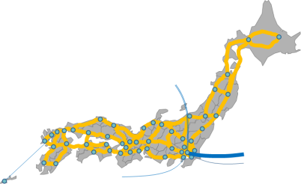
SINET5
21st Century Academic Information Infrastructure
for Advancing Open Science
Collaboration and Promotion in Research and Education
Resource
Federation
Promotion of academic information circulation and open access
Collaborative promotion of institutional repository expansion
Collaborative enhancement of authentication between universities
GakuNin
Federation
Cloud
Security
Flow Analysis
Dramatic cost reduction and enhancement of research and education environment by tailored cloud services
Network flow analysis and dynamic control
Raise of security level for SINET users
GakuNin-Cloud
Direct Connection
VPN
Network
Nationwide 100-Gbps backbone network and scalable network expansion
High-speed direct international lines to USA, Europe, and Asia
Introduction of new technologies such as SDN in response to user needs
Notes:
As the Japanese NREN, National Research and Education Network, NII provides high speed 100Gbps network throughout Japan.
On top of the network, we have security service, cloud service and identity access management service.
Base on these middleware, we also have scholarly communication like discovery service and repository cloud service.

Slide 3






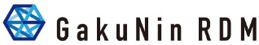







What can be seen from Recent Movement
De facto Service Layer Stack of Recent e-Infrastructure
Integration for More Useful Infrastructure
  Service Integration: Between Services and Domains
  Organizational Cooperation: Business Plan and Budget
Common Discover Service
Domain Centric Services
by
Common Services and Tools
Cloud Computing / HPC
Virtual Organization Platform
Identity and Access Federation
Network
Improve UX and Cost Effect by Integrating existing E-Infrastructures
Hard to Develop by the Single Institution
Require to Facilitating in National and Regional Level Cooperation
Notes:
Here is the recent de facto service layer stack of E-infrastructure, IMO.
On top of the network, Identity federation and VO service can connect different types of services.
And Cloud computing and common service and research tools are located in the middle, then build up domain-specific service.
The final top is the Common Discovery Service, in the case of the EOSC, it is the OpenAIRE.
As has already been explain, in out case, we have these kinds of services and then trying to build up current research data cloud service
I will let you know about our new RDM service in seconds but what I want to emphasize it that I could see a tendency in terms of service integration and organizational cooperation rather than competition.
I guess this is because the infrastructure and service becomes bigger and complex meaning that it hard to develop by the single institution, resulting national or regional level cooperation.

Slide 4




Relationship with External Community and Committee
Bottom Up
Top Down
  Committee on Open Science at Cabinet Office, Ministry of Education and Research and Science Council of Japan
Network
ID Federation
Cloud
RDM
Repository
IT Center Community
Library Community
(Open Access Repository)
SIG ID Federation
SIG Cloud
SIG Research Data Management
etc
Research Data WG
Contents Working Group
Community Empowerment WG
Training WG
Notes:
In order to meet the requirements and needs from institutional users, we have these cooperation in both IT center and library communities in Japan.
AXIES is the EDUCAUSE in US like organization in Japan and I could say it is the community for university IT center.
They have these special interest groups which is strongly related to our service and cooperate each other.
For instance, this SIG RDM publicized the document named principle of the university RDM and then now writing more specific policy guidelines.
On parallel with that we are now preparing a new service for RDM.
This is happening right now, but I can introduce more advanced partnership with JPCOAR.
JPCOAR is the community for open access repository and has these working groups and we have a join operation of the cloud service of the repository named JAIRO Cloud.

Slide 5
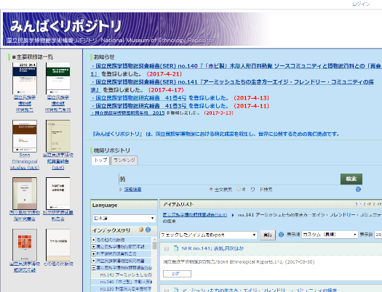
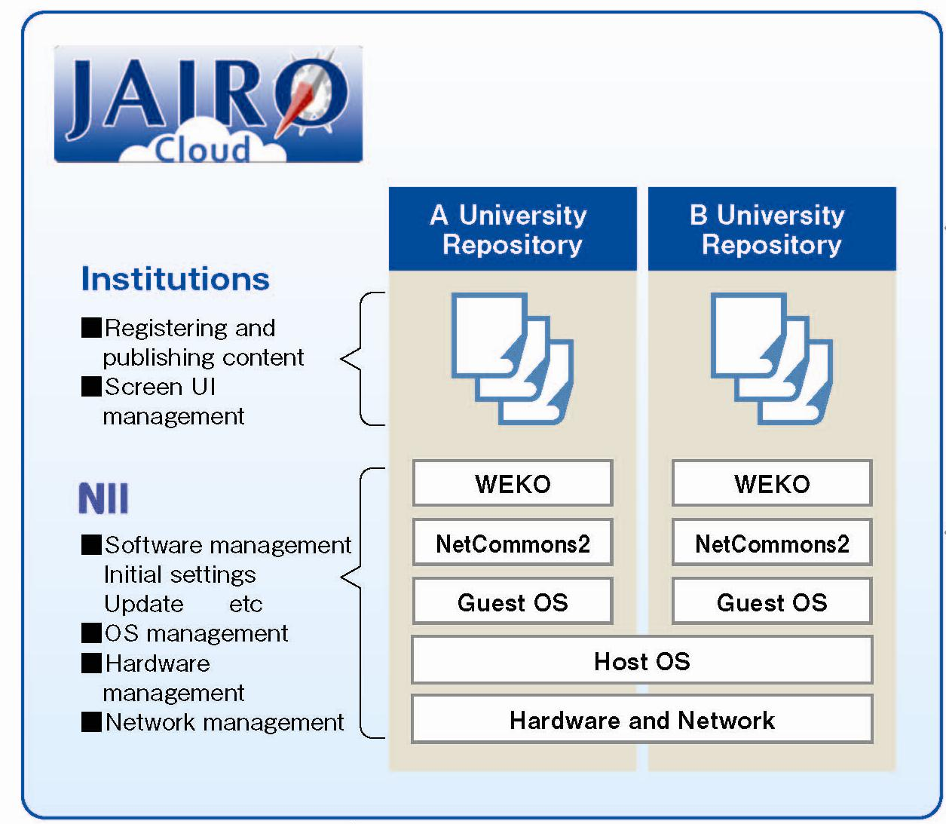
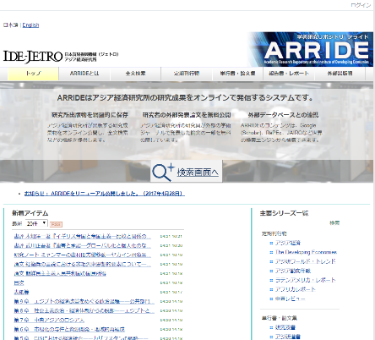
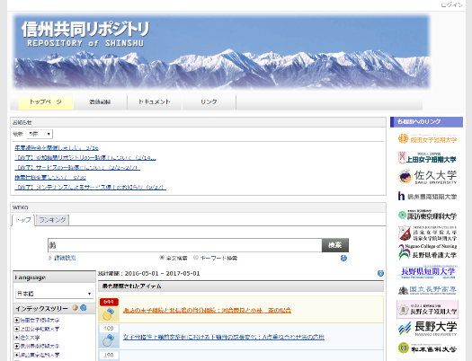
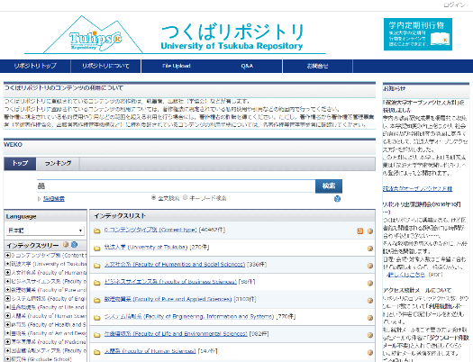
JAIRO Cloud
Background
  Limited resources and less technical knowledge hamper implementation of IR especially in small universities.
  JAIRO Cloud provides a shared instance of IR system on the virtual server hosted by NII since April 2012.
Service Architecture
Notes:
We started JAIRO Cloud in 2012 based on the request from medium and small class universities.
We developed the repository software named WEKO and its hosting service on behalf of the university.
Then university can focus on to contents itself.

Slide 6
Number of Institutional Repository in Japan
Number of Institutions
■ by JAIRO Cloud: Pilot Operation
■ by JAIRO Cloud: Production Operation
■ by University On-premise System
JC hosted to 675 Institutions as of July 2020
Notes:
This graph shows the number of the institutional repository in Japan.
Blue shows the number of institutions that operate the repository by themselves.
Orange and gray show the number of institutions using JAIRO Cloud.
More than 650 institutions in Japan are now using our cloud service.
From 2015, we started to accept migration from on-premise to our JAIRO Cloud service, and then gradually the blue bar is decreasing.
After the incubation periods, we started to apply the charging model from 2017 and also started joint operation of JAIRO Cloud with JPCOAR.

Slide 7

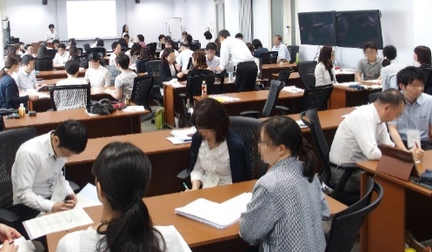
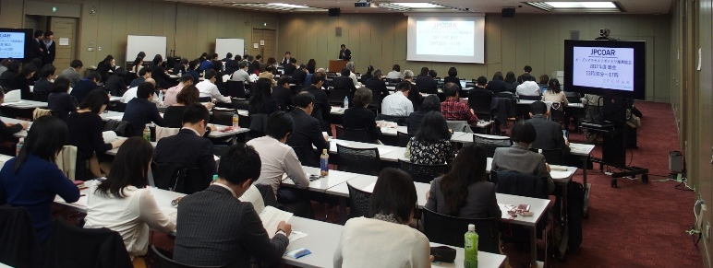
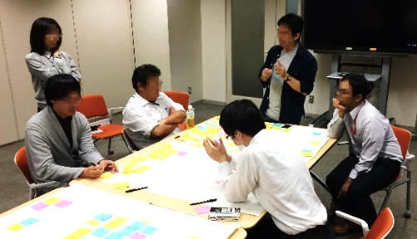
JAIRO Cloud Operation with JPCOAR
Joint Operation
Community Support
Survey of Future Development
Test of New Development
Training Course
Accounting
System Development
Service Operation
Reduce total operational costs!
Training Course
JPCOAR Annual GA
Brainstorming with Developer
Notes:
Main role of the JPCOAR is the community support.
They help each other by using Forum and Mailing list.
In order to reflect their need to our new development, they operate survey for gathering voice from users and decide priority.
After the development, they join to test the new function and based on that we improve it if necessary.
They regularly operate the training course for open access activity and repository management.
These support and of course scale merit lower the total cost of the JAIRO Cloud operation.
For instance we could provide one instance to small university by $400/year.

Slide 8

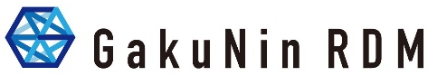
Our Current Challenge: NII Research Data Cloud
Discovery Platform
DOI
International
Metadata
Aggregator
● Linking Func between Article and Data
● Researcher and Research Project
Identification and Management Func
● Data Exchange with International
Discovery Service
Metadata Management
Subject
Repository
Discovery Service
Metadata Aggregation
User Flow
Data Flow
Re-use
Search/Find
Data User
Journal Article
Supplemental
Data
Research Data Mng
User Interface
Access Control
Metadata Mng
Data Depositor
Institutional Research Data Mng
Research Data Management System
Exp/Store
Archive
Research Data Repository
RDM Platform
Exp Data
Article
Publication Platform
Private
Shared
Public
by
● High Speed Access using SINET5
● Data Sharing Func using
Virtual NW and ID Federation
● Effective Data Storage Switcher
Hot
Storage
Hot
Storage
Hot
Storage
● Data oriented Self-Archiving Func
● Versioning and auto-Packaging Func
● User Dependent Personal Data
Pseudonym Func
Cold
Storage
Cold
Storage
Cold
Storage
Storage Area for Long-term Preservation
Notes:
And now as I said you before, we are extending our service the research data for facilitating open science.
In case of NII Research Data Cloud is composed of three different services which are research data management platform, publication platform, and discovery platform.
In case of the publication and discovery platforms, we are extending its functionalities to the research data.

Slide 9
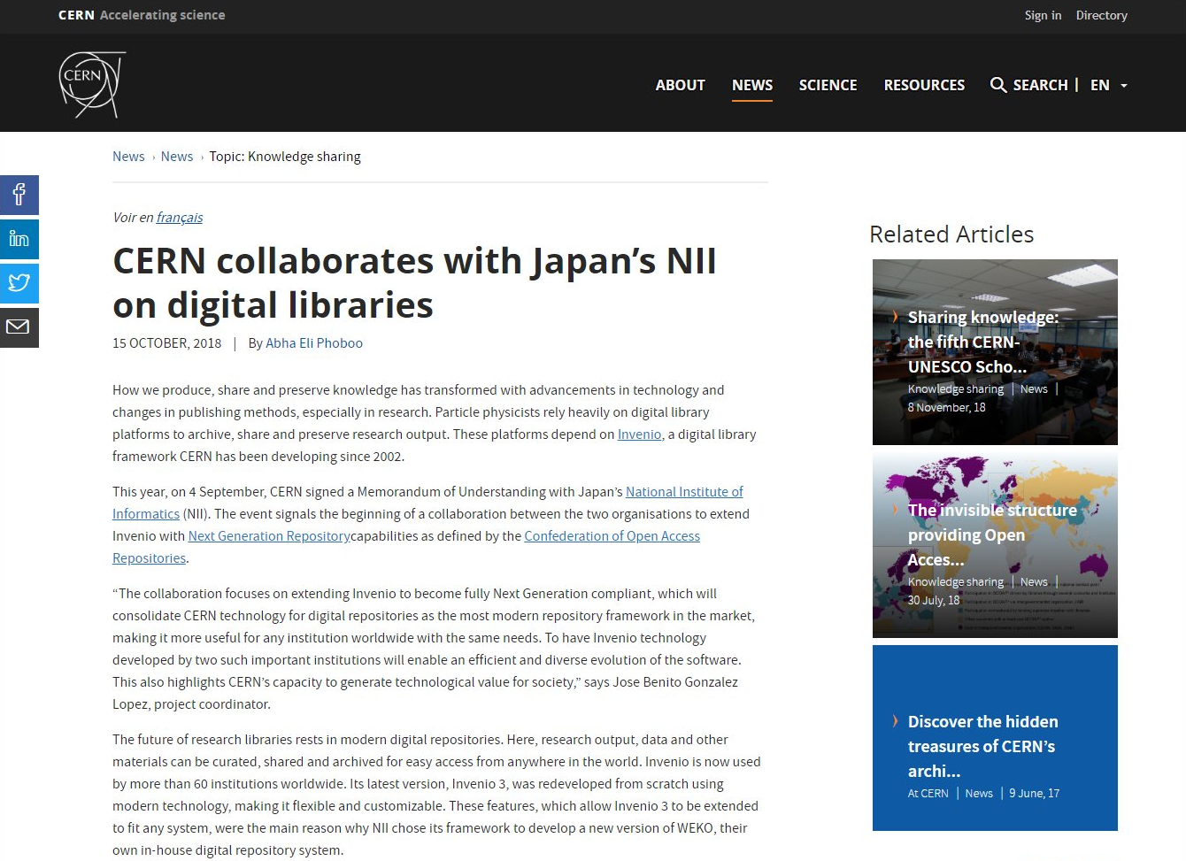
International Collaboration : Repository Software
Notes:
Since our repository software named WEKO has been developed more than 10 years, we decided to change the framework.
After the careful comparison, we finally decided to employ the repository system named Invenio, which was developed by the CERN.

Slide 10
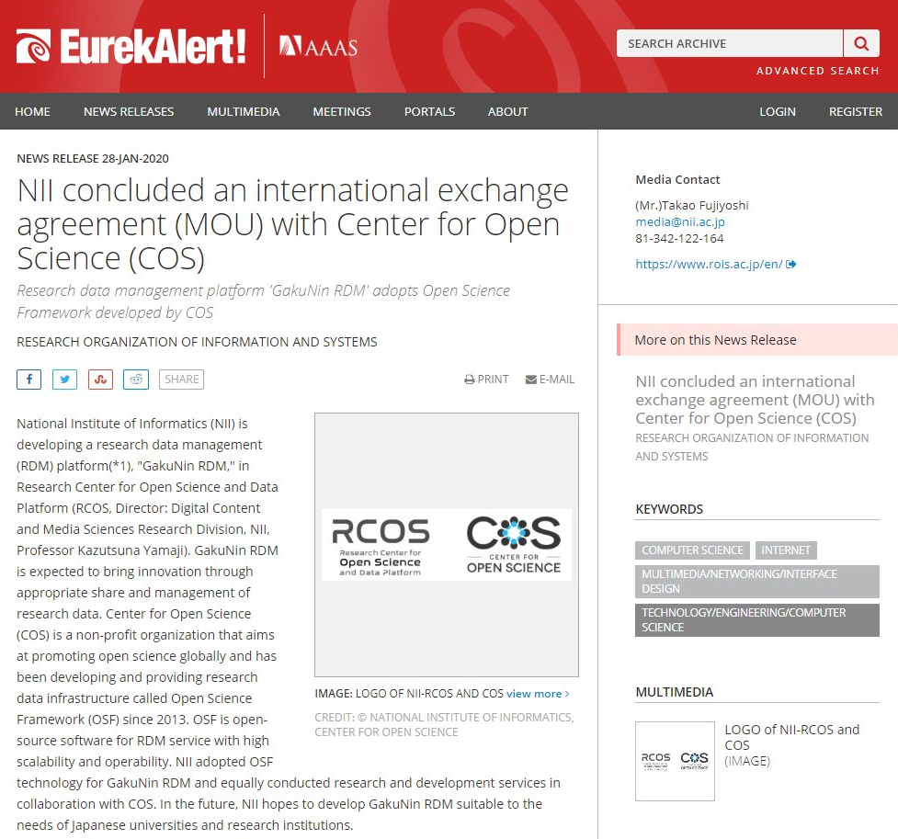
International Collaboration : GakuNin RDM
Notes:
In case of the RDM system, decided to employ the open science framework developed by the center for open science in the USA.

Slide 11
New Functions Developed in FY2018-2019
New Plugin
  New External Storage
    ownCloud, S3 Compatible Storage, OpenStack Swift
  Integration with Data Analysis Tool
    JupyterHub
  Integration with Publication Platform
  Plugin SDK
Research Data Management
  Research Footprint Management
  Metadata Management
  Workflow Management
Institutional Management
  Plugin Selection
  Statistics
  Storage Assignment
Notes:
In addition to the original open science framework, we developed these kinds of new functions based on the voice from universities.
As I said you before, in parallel with our development, the university is preparing its institutional data policy and try to maximize the function of this service.

Slide 12
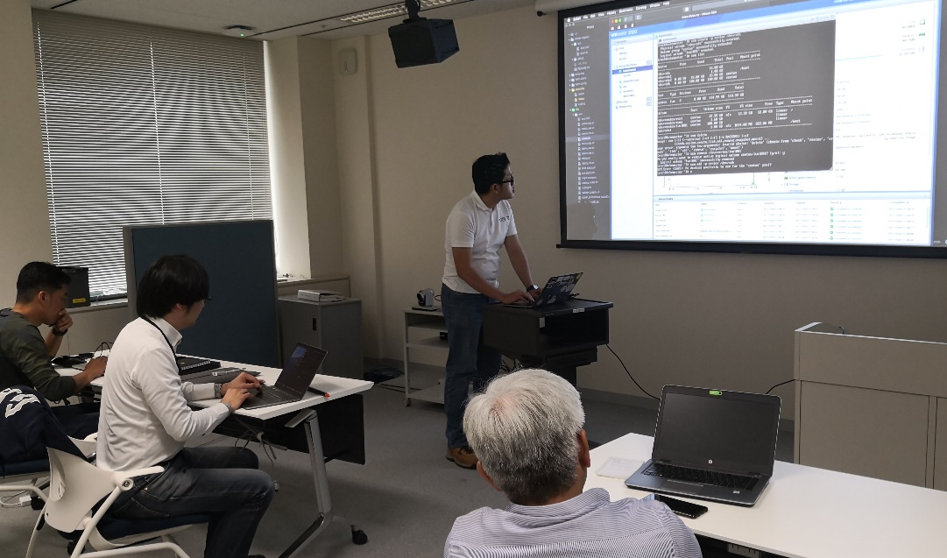
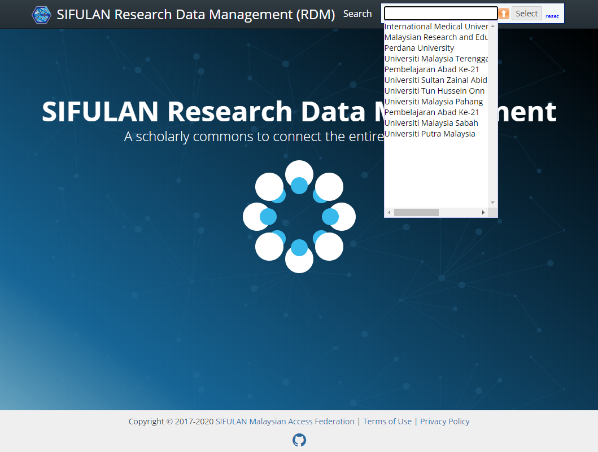
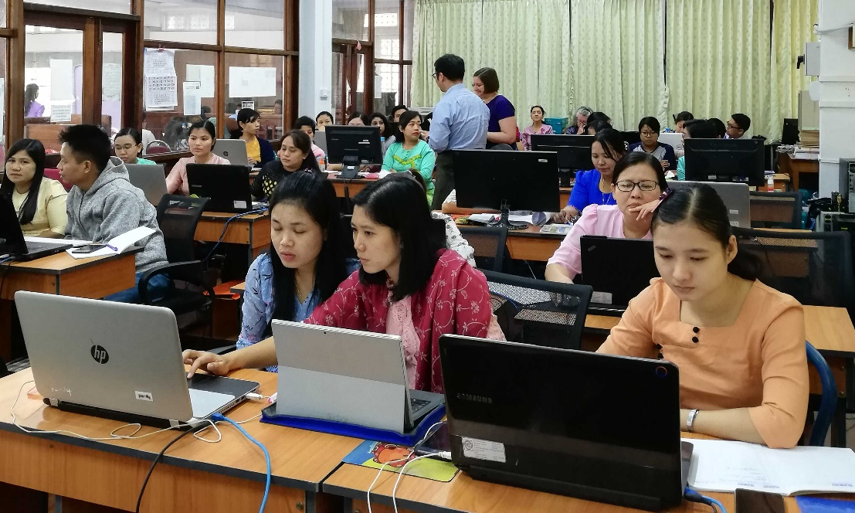
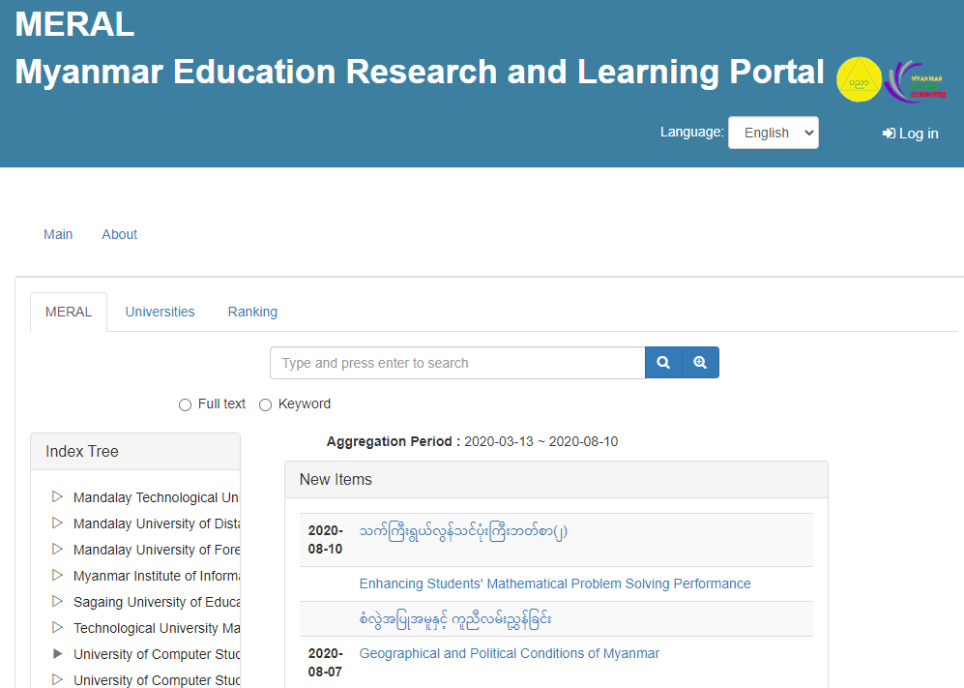
International Collaboration with Asian Countries
GakuNin RDM Workshop
with Malaysian Collaborators
WEKO3 Repository Workshop
for Myanmar National Repository
Notes:
Not only the deployment in Japan, but we are also collaborating with Asian countries like this.
Some of the Malaysian universities are testing our GakuNin RDM.
And our new repository system WEKO3 was employed by Myanmar national repository.

Slide 13
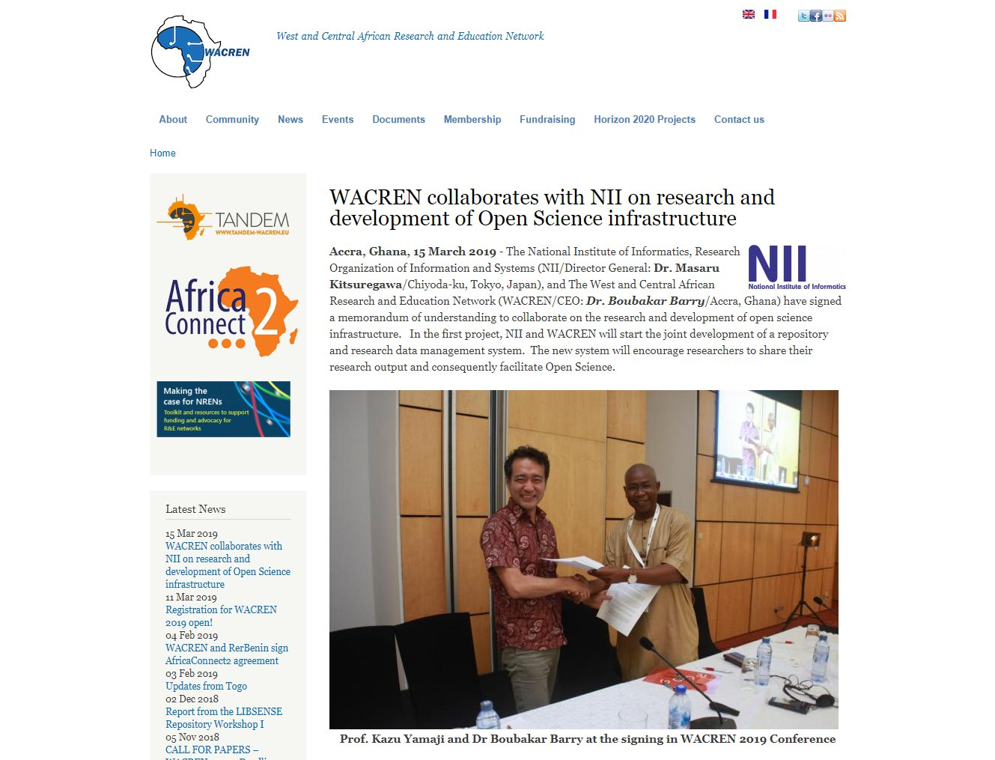
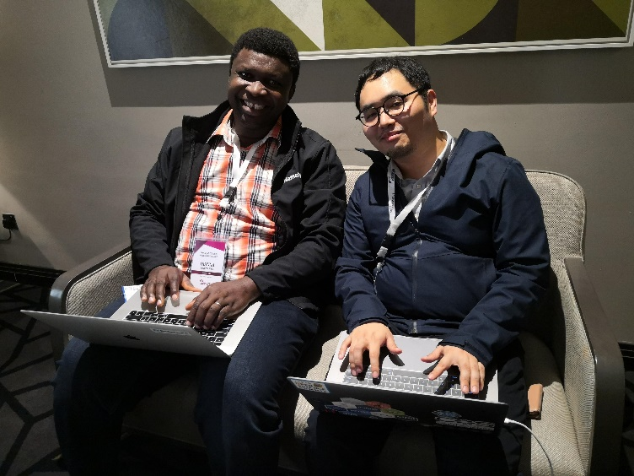
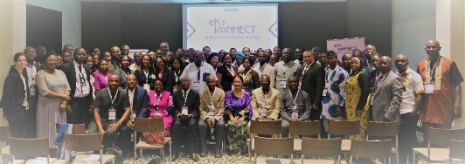
International Collaboration with WACREN
Notes:
Not only the Asian countries, but we are also supporting African activities.

Slide 14
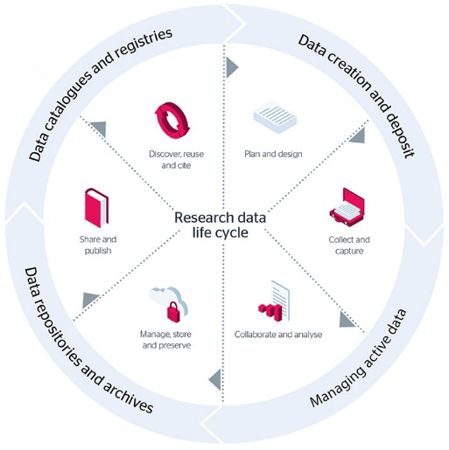
Relationship between Research Data Infrastructure and Research Workflow
Discovery Platform
RDM Platform
Project Start (Application)
Member Management
Initial Setting
Aggregation
Experiment
Data Acquisition
Publication Platform
Institutional or
Domain
Repository
Data Management
Data Analysis
Paper writing
Deposit with Supplemental Data
RDM Platform
Notes:
In this way, we are now trying to support this kind of research data life cycle by our three platforms.

Slide 15
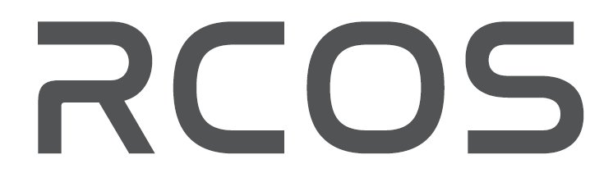
yamaji@nii.ac.jp
Notes:
If you are interested in our activity, please drop an email to me.
Thank you so much.

