Slide 1


Slide 2


DEC112
Deaf Emergency Chat and Training System

Slide 3


Project
This project has received funding from the European Union’s Horizon 2020 Research and Innovation Programme under the NGI Trust Grant Agreement No. 825618.
Generating Training Data
Purpose Based Data Sharing
Objectives
Deploying consent management technology for sensitive data exchange
Allowing purpose base data sharing during an emergency chat
Rolling out the existing solution at the European level

Slide 4
Results & Next Steps
Project finished in September 2020
Go-Live in Austria now (December 2020)
Build on results in NGI DAPSI project for
Digital Immunization Passport
  data sharing
  identity management and verifiable credentials

Slide 5
Your data is precious.

Slide 6
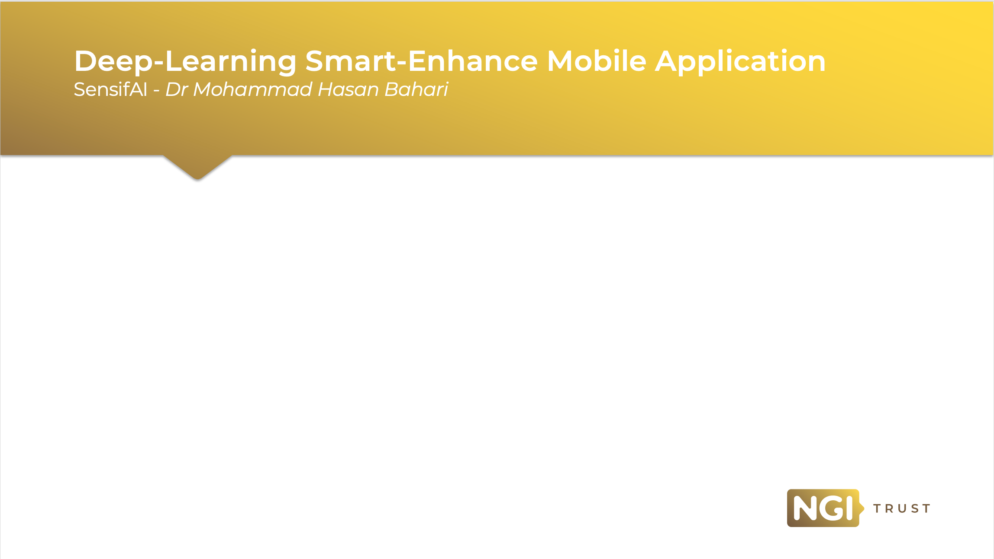

Slide 7



Protect
Your
Privacy
Sensifai video/image enhancement app upscales your images/videos completely offline using the state-of-the-art deep-learning algorithm running on smartphone chipsets.

Slide 8
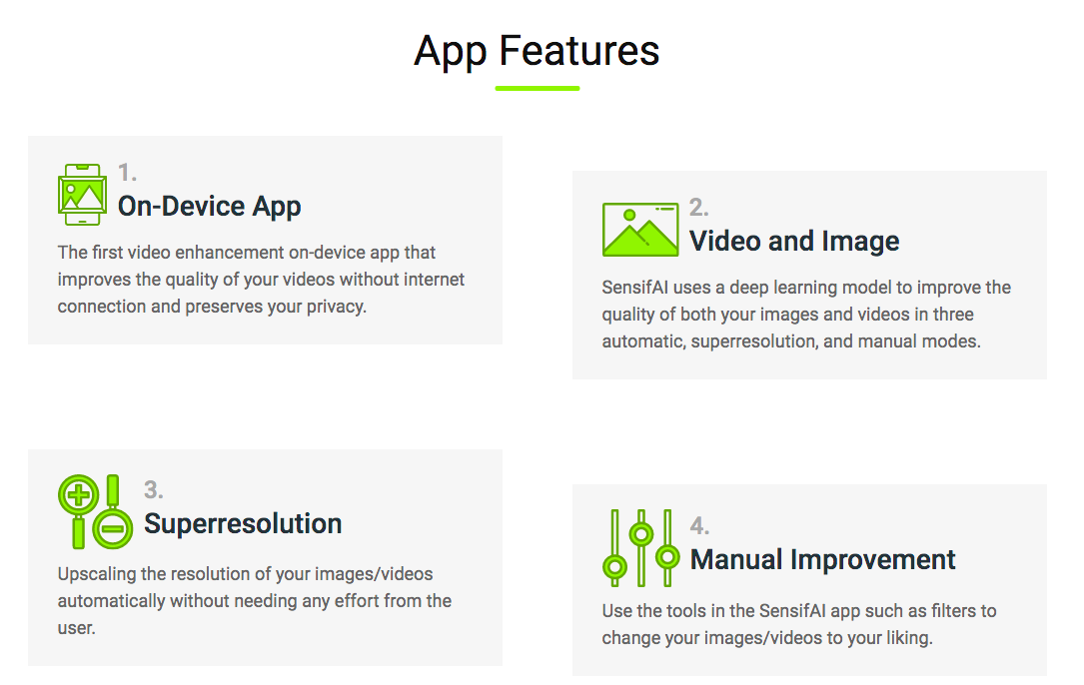

Slide 9


Slide 10




Slide 11
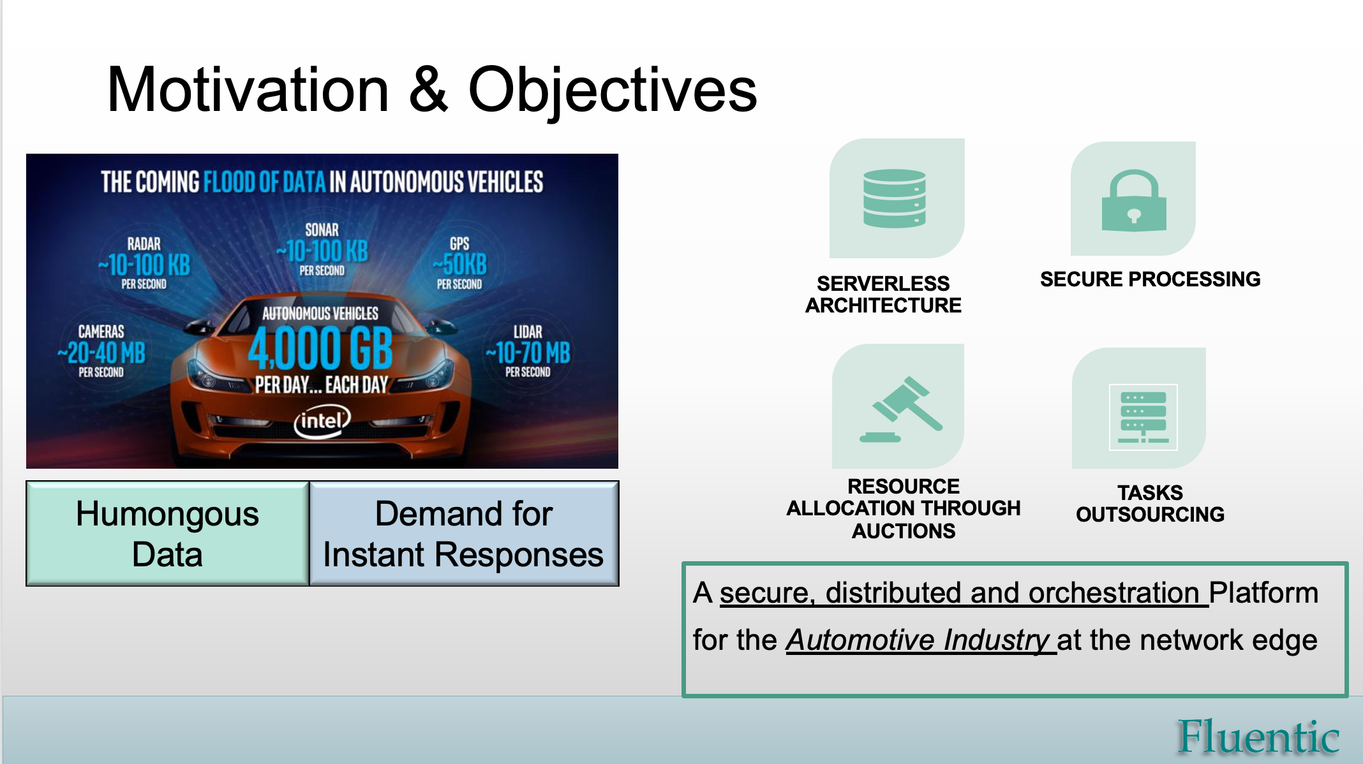

Slide 12
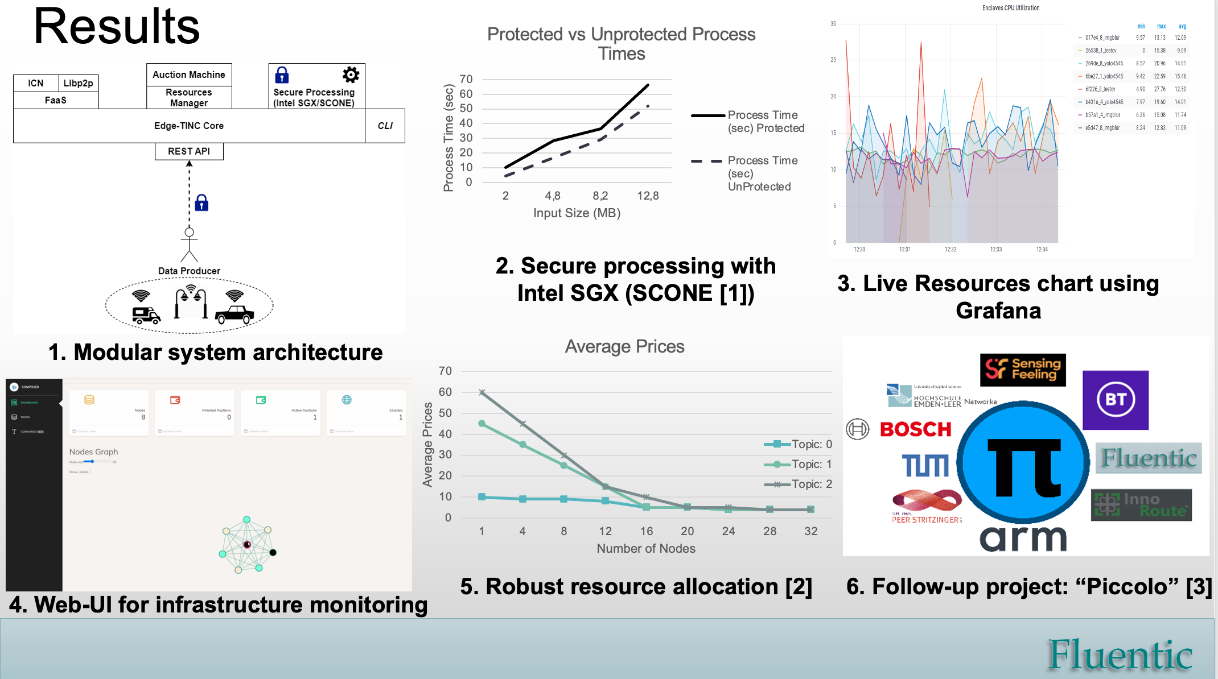

Slide 13

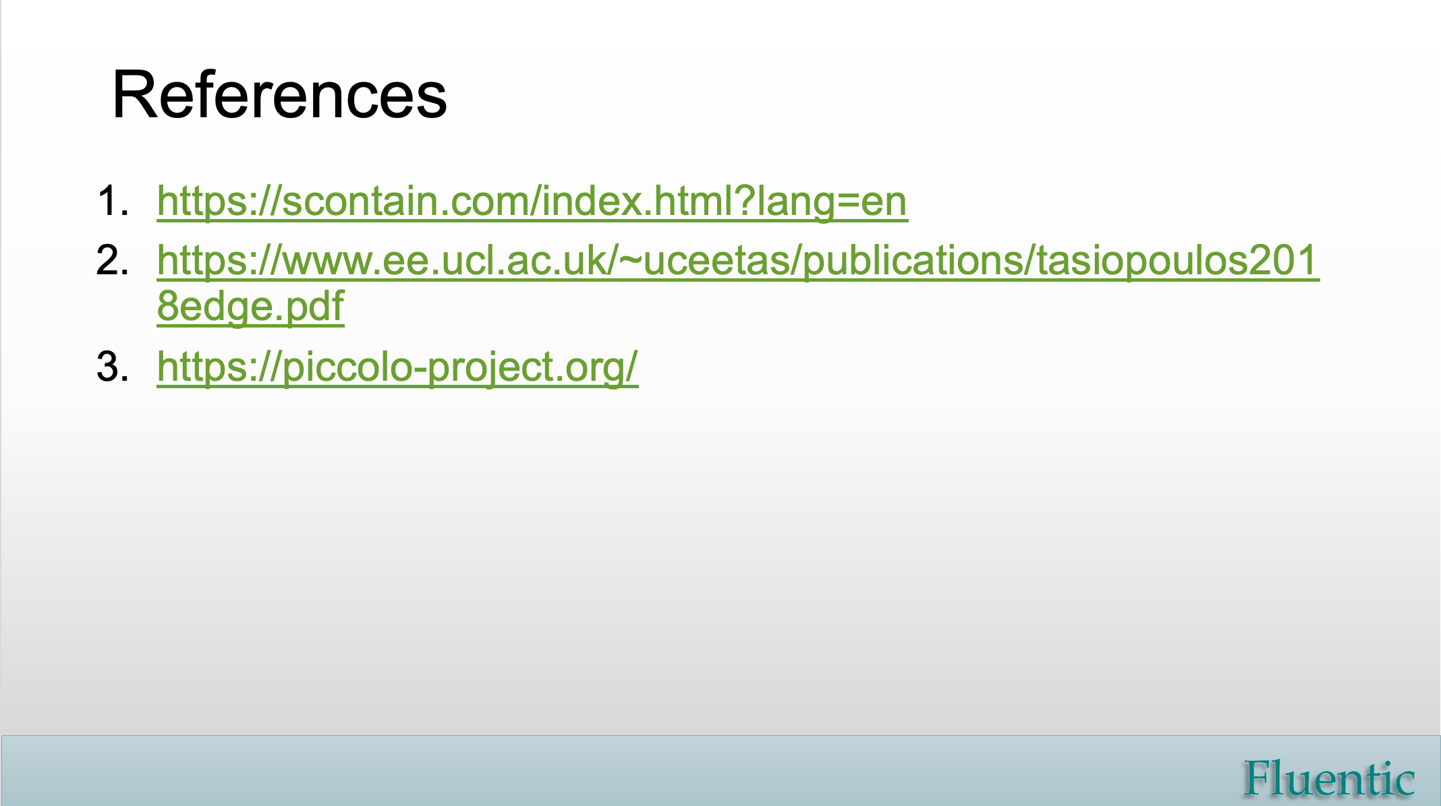

Slide 14


Slide 15

ISIBUD
Concept to:
Achieve better web searches by focusing on the user and their privacy.
Demonstrate the viability of a non-advertising revenue model.
Contribution:
A unique human-centric privacy-preserving search engine where the user is the customer (not a product to be sold to advertisers)

Slide 16
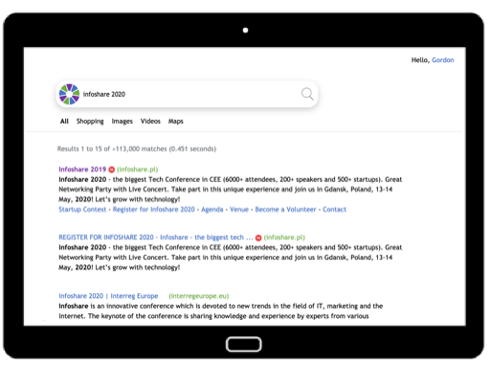
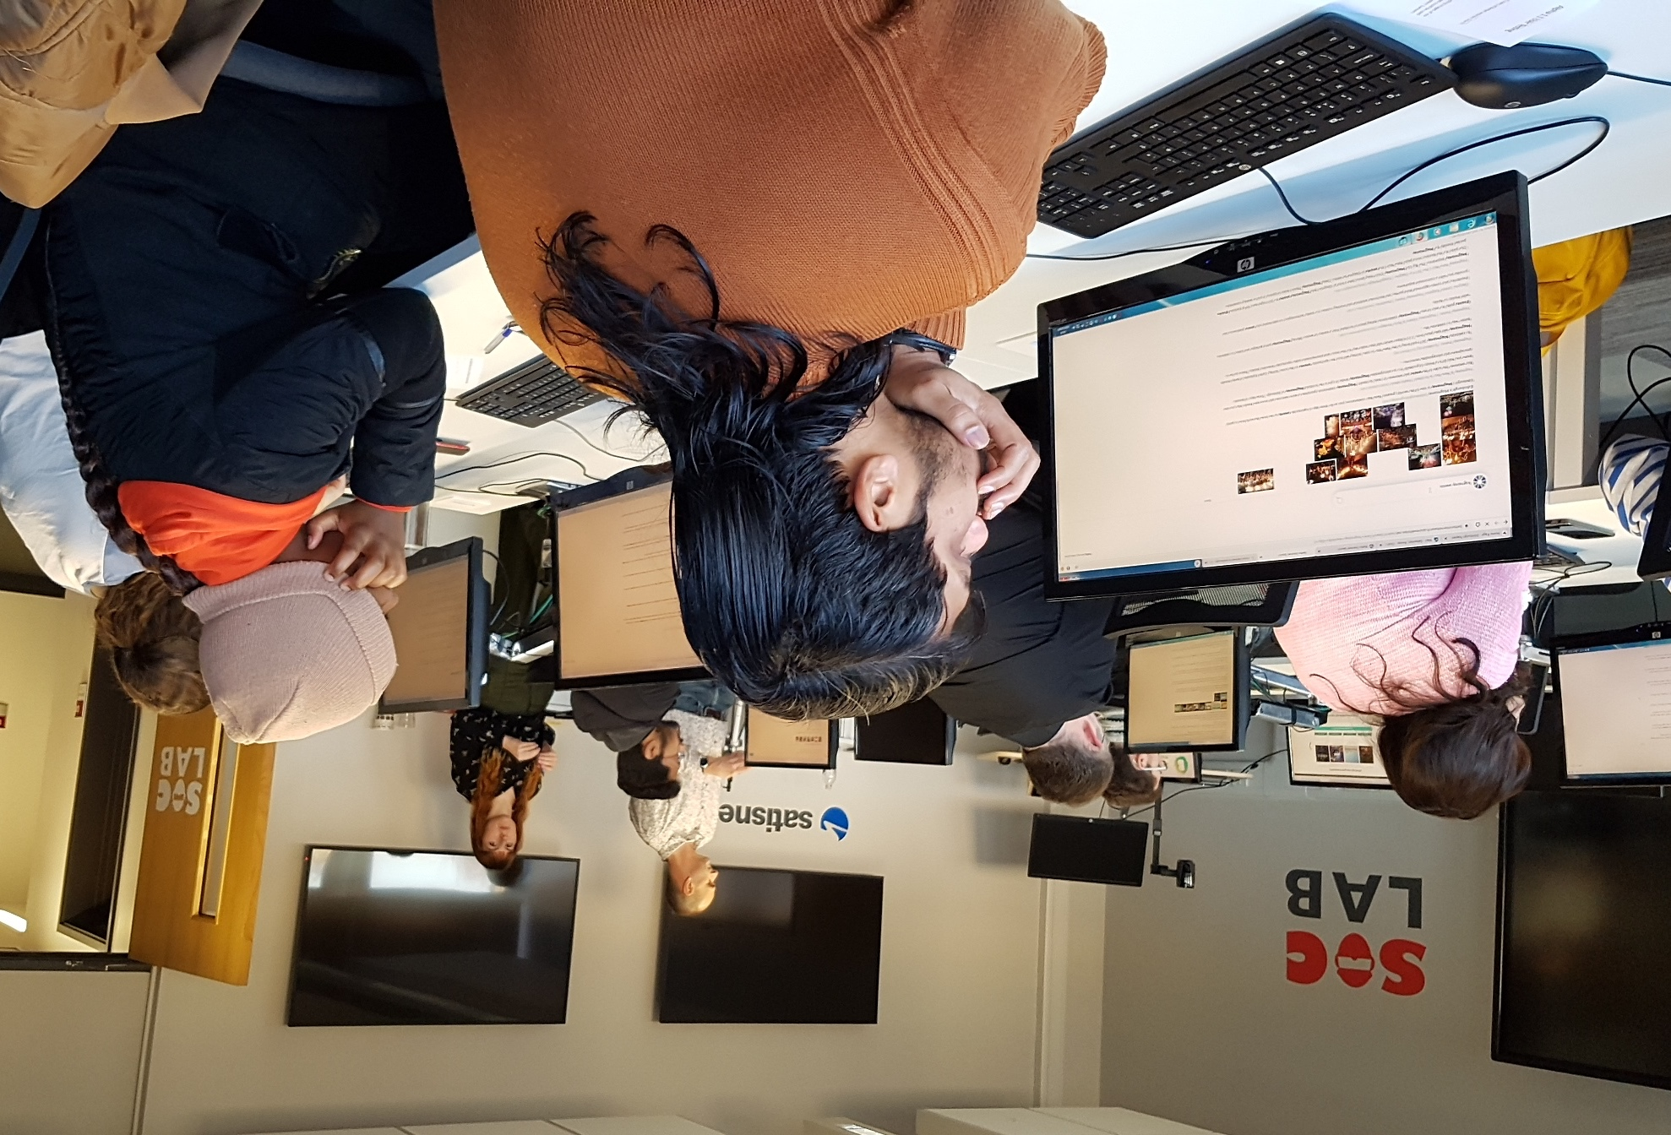
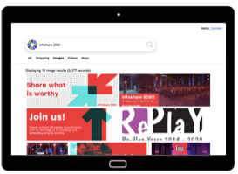
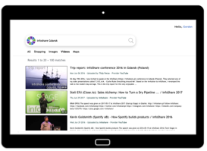

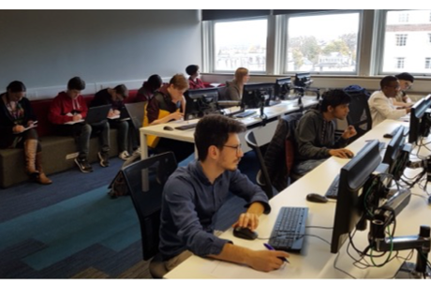

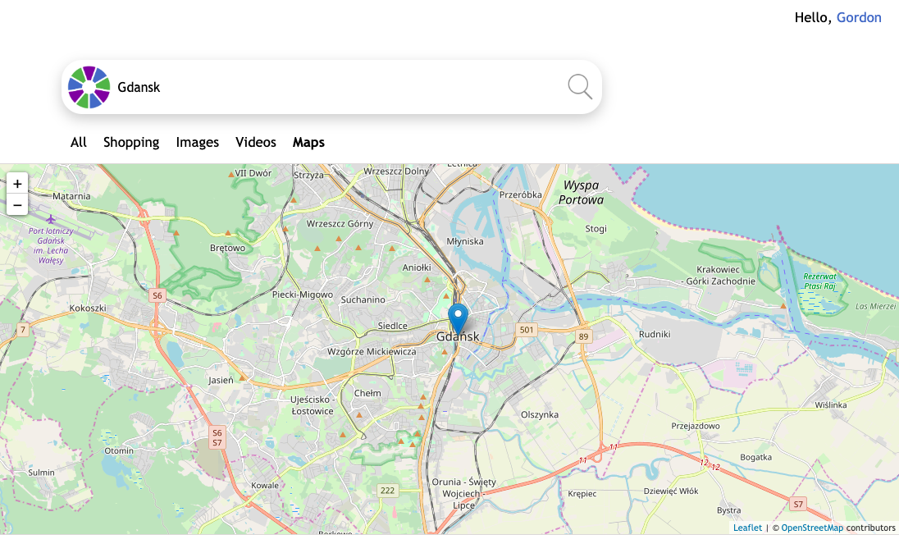

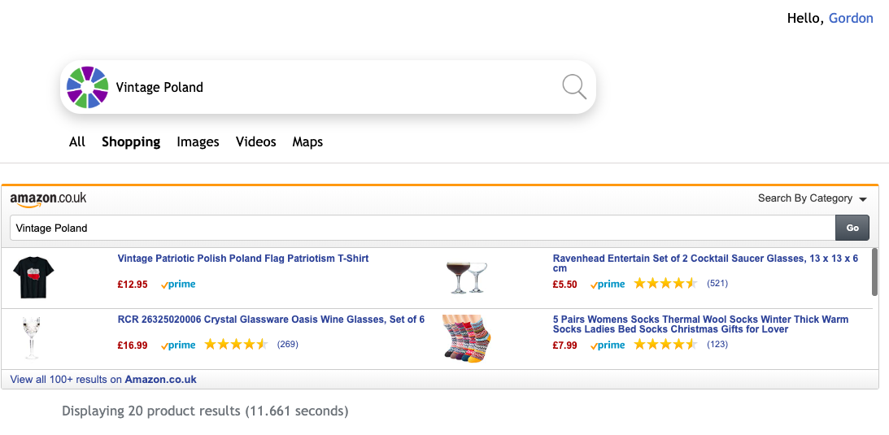

Development
Results
Next steps
Web &
News
Grant funding
Crowdfunding
Equity investment
Partnerships
Images
Videos
Maps
Lab & remote user testing
User/test driven development
Beta – 1st October 2020 – 100 users
Launch – 22nd December 2020
Alpha tests
  200+ users since Oct 2019
Products

Slide 17


Slide 18


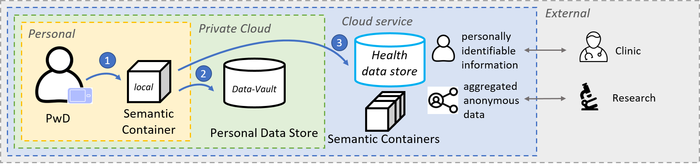
MyPCH – the project
Collect
Insights
Sharing

Slide 19




MyPCH – Results and next steps
Healthdata
Watermarking
Traceability
Semantics

