Slide 1


GEANT's operational Experiences Using GAP
Deploying Services and new Router Platform
Will Barber
Network Engineer in GÉANT Operations Centre
SIG-NOC, Prague
3 April 2025
Public

Slide 2
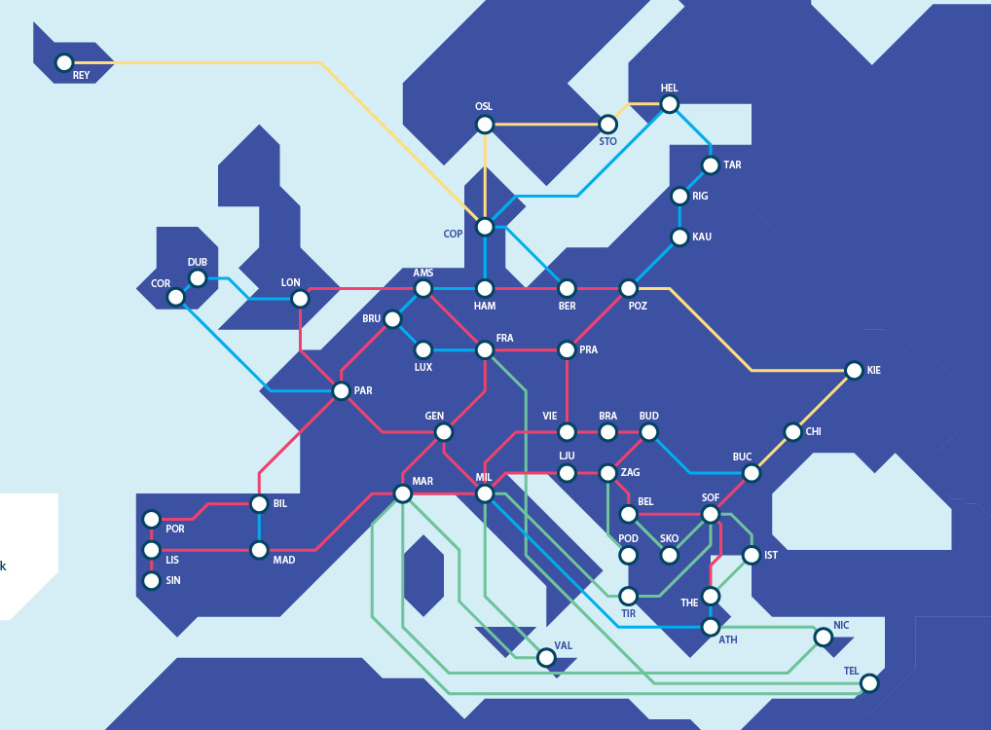
GÉANT’s use of the Automation Platform
Where we started
New Beginnings
New Platforms
What drivers for adoption
GÉANT’s GAP
Where we are
Automation of tasks
Where we’re going
Lessons learnt

Slide 3
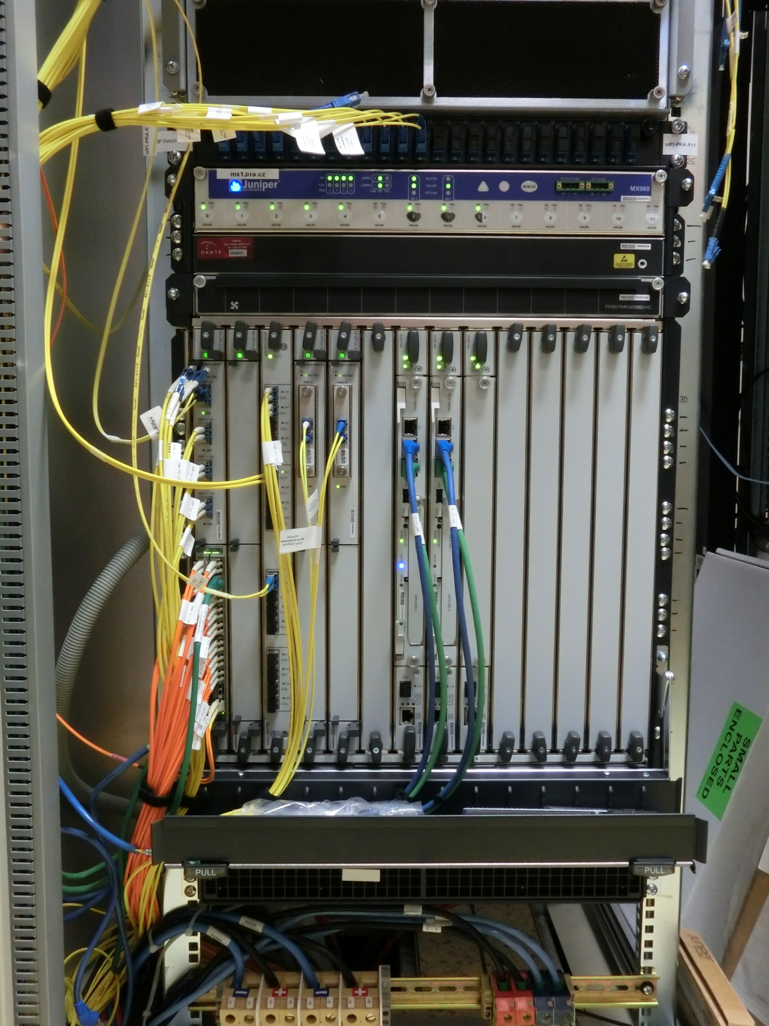
Where we started
Well known Juniper platform which had been in place for ~10 years
Manual configurations
Unicorn services and configurations
Inconsistencies across estate built up over time

Slide 4

New Beginnings
GÉANT are refreshing IP/MPLS platform
New router platform chosen
Hardware Deployment
  Scheduled to be completed by end of 2025
Greater capacity on links
Automation by design

Slide 5
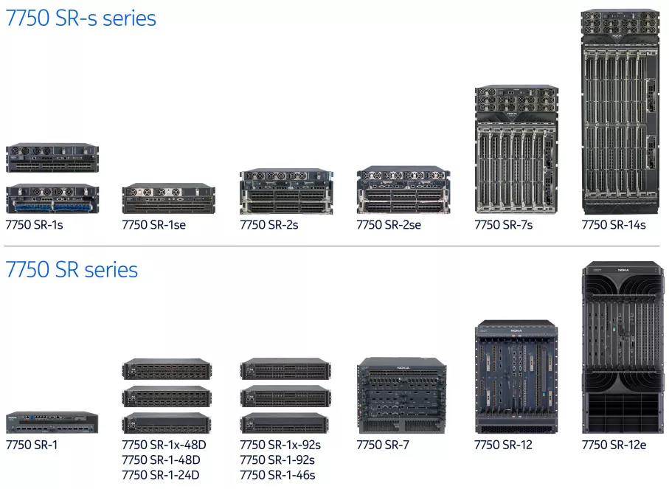

New Platform
Nokia’s running SR-OS
New CLI to master
SR-OS uses different commands in different contexts
Improved throughput available

Slide 6





GÉANT’s GAP
Based on Workflow Orchestrator Programme
Community bases programme
Mainly used by NRENs

Slide 7
Where we are
Completely automated deployment of hardware and services
  Routers
  Services
  Port Configurations
  BGP changes
  Increasing capacity
Removal of routers
  Automation reduces risks
Multi-platform support

Slide 8

Where we’re going…..
More services being added over time
Moodi monitoring
Bespoke services

Slide 9
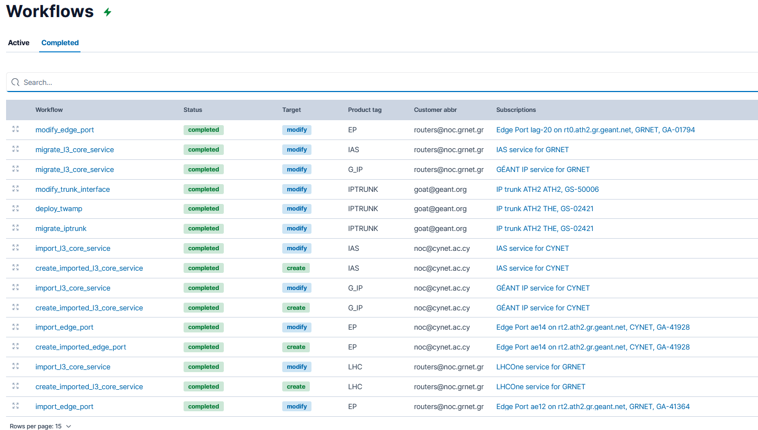
Examples of workflows
Router deployments
Checking routers are in sync
More services being added over time
Moodi monitoring
  Spins up high-res monitoring during service migrations
  On-demand is coming
Bespoke services
  NM Team requested features
  Specific work flows

Slide 10
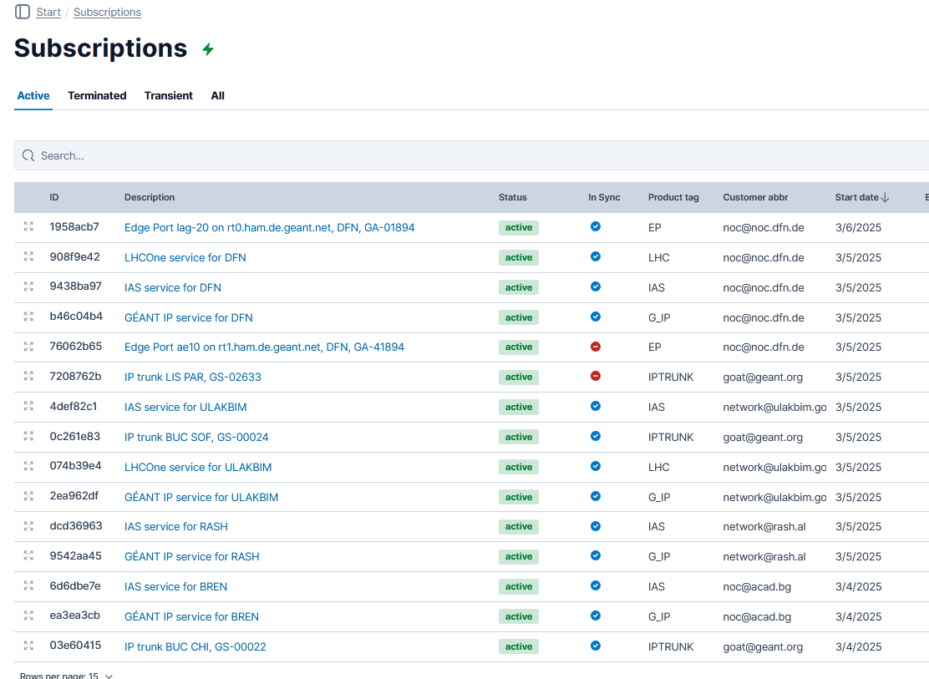
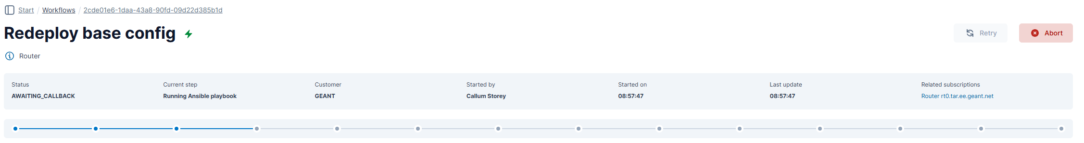
Daily Tasks
Check workflows and subscriptions are up to date
  Allows investigation into errors
  Can see services deployed
Base config redeployment

Slide 11
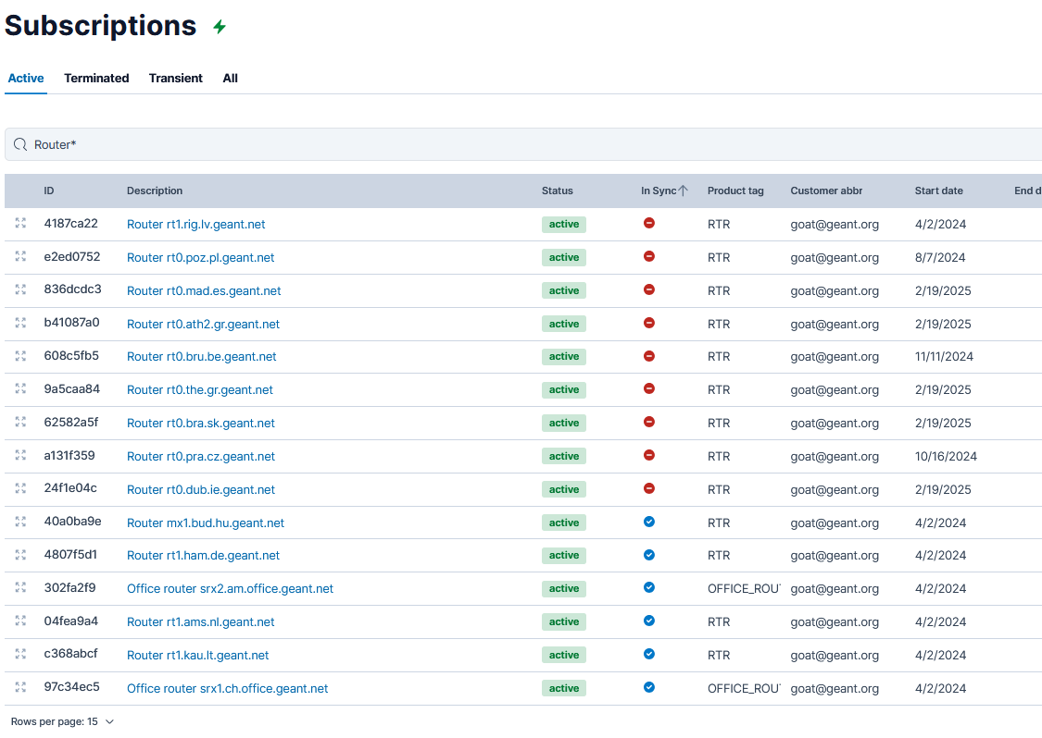
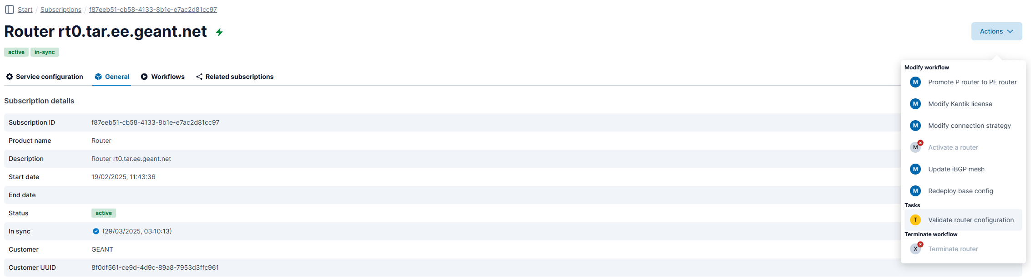
Common Tasks
Check for synchronisations of routers
Manually placing in sync allows for router validation
Workflows available

Slide 12
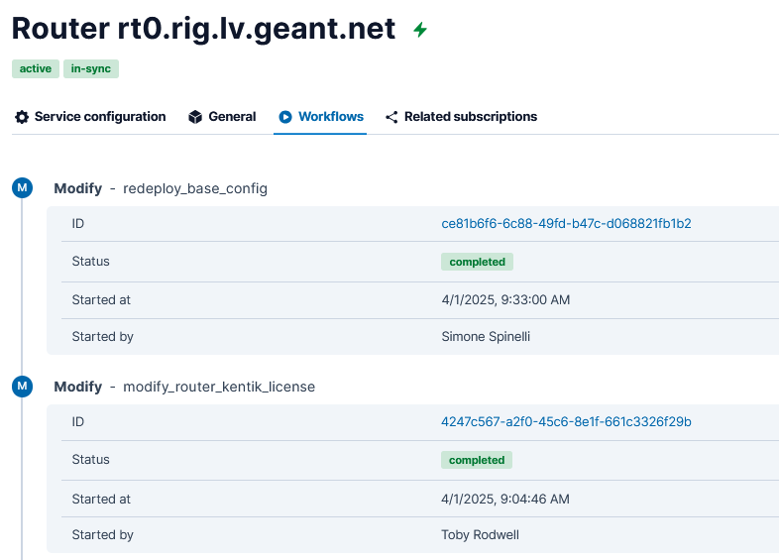
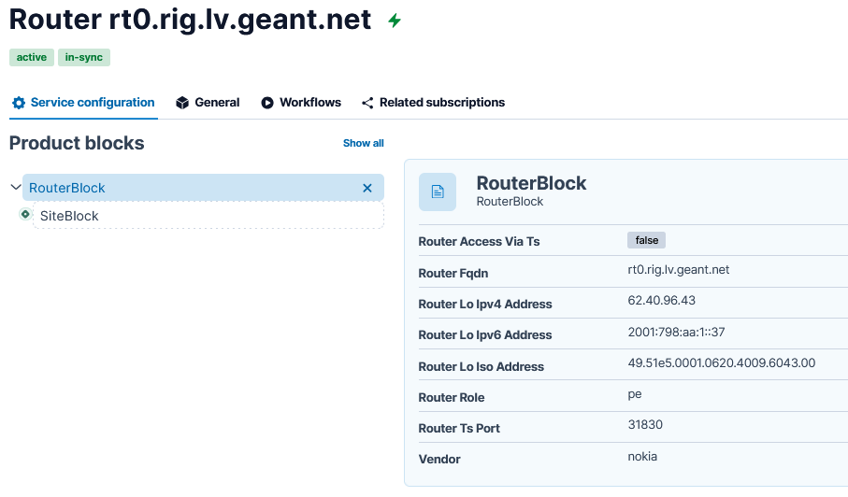
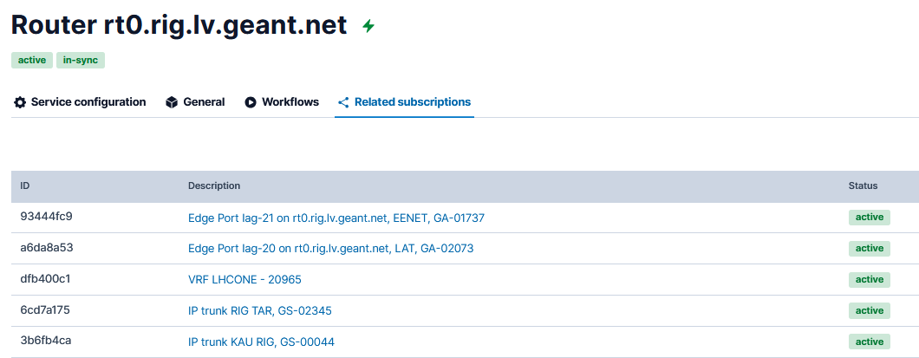
Useful Checks
Visibility of recent tasks
Easily check which services have been deployed
Check router roles

Slide 13
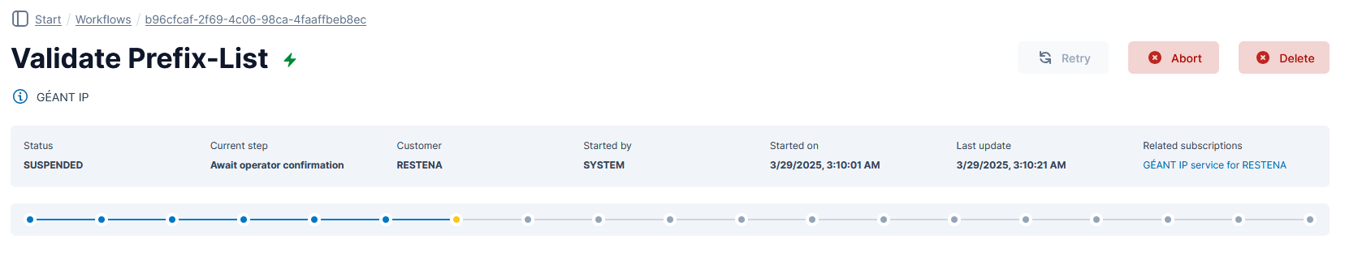
Prefix deployment
NM team deploy prefix changes
  Workflow was requested
  Allows easy deployment
Email received with link to workflow
Customised link per-NREN
Creates an audit trail
Human check

Slide 14
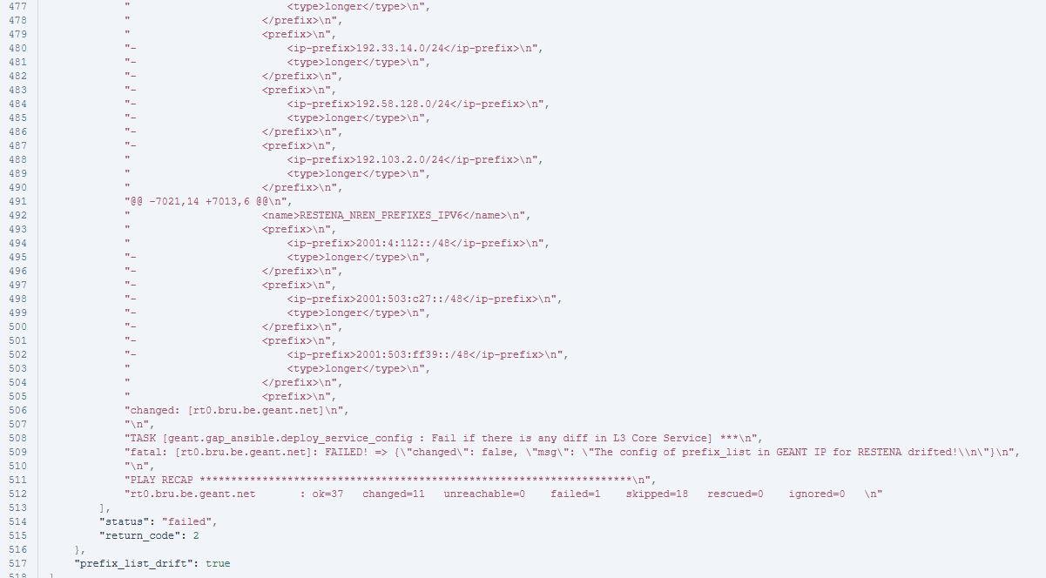
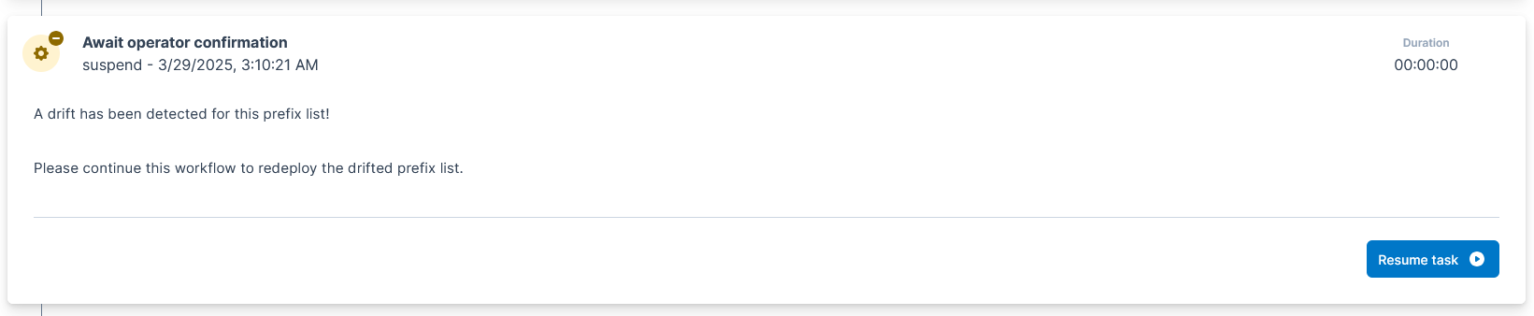
Prefix deployment
Check for changes in playbook
Example is a deletion of routes shared
If ok the workflow can be resumed

Slide 15
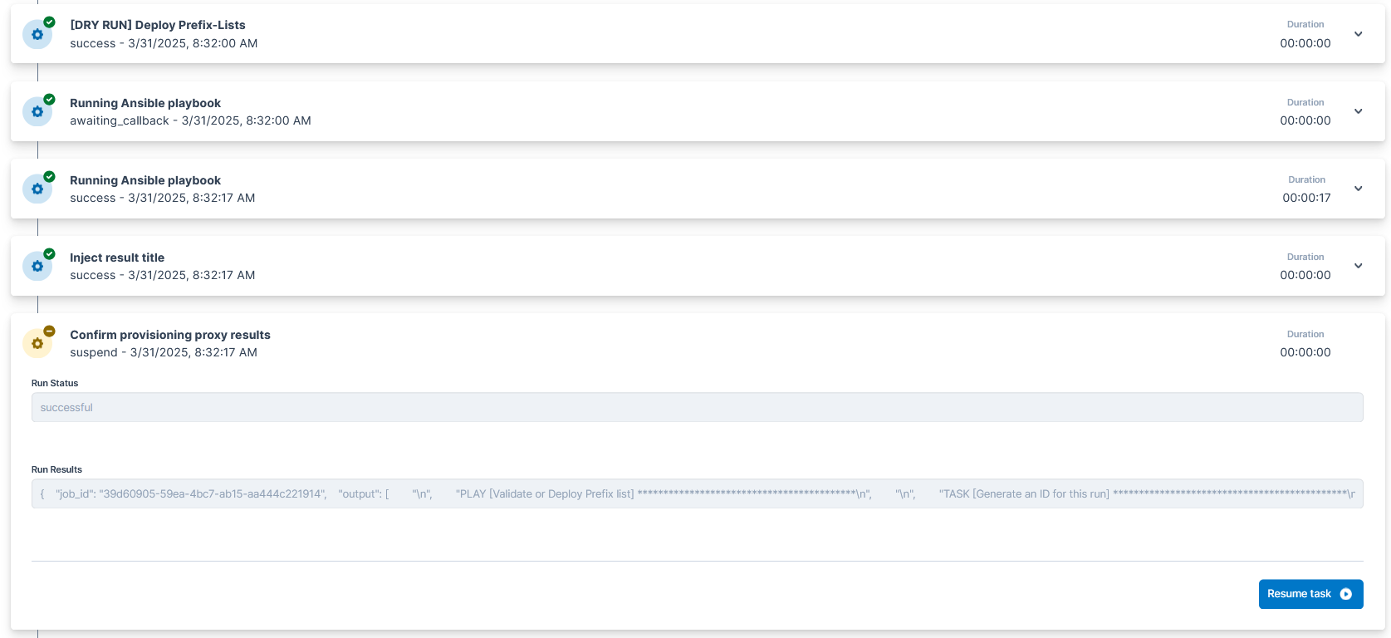
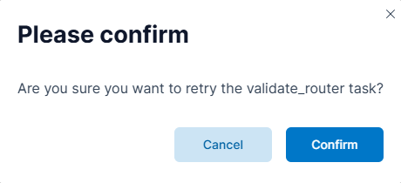
Prefix deployment
Confirming workflow
  Offers reassurance that playbook will succeed
Final confirmation deploys the workflow

Slide 16
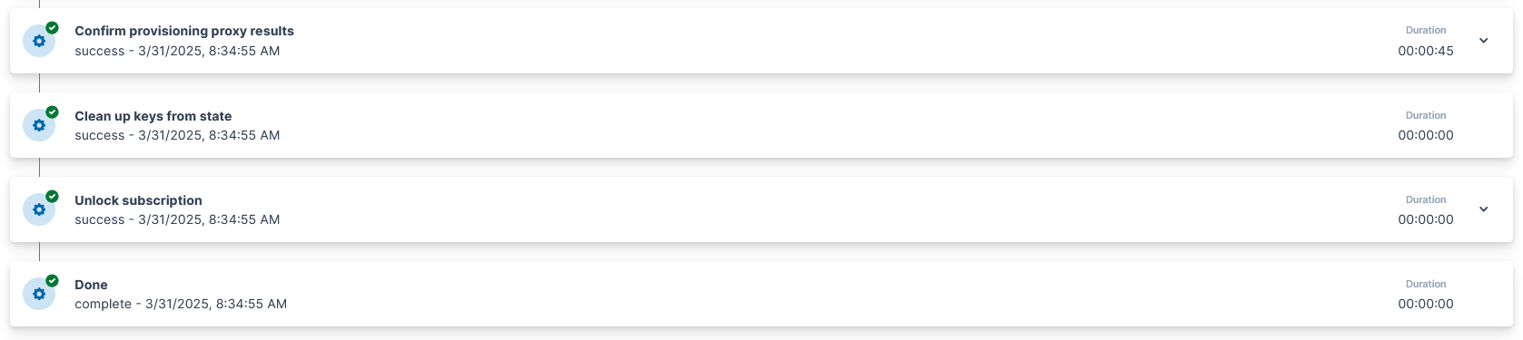
Prefix deployment
Workflow completes
Evidence that it has completed

Slide 17

Lessons learnt
Testing is important
Collaboration can improve usability
New practices take time
Service uniformity
Too much PowerPoint

Slide 18
Thank You
Any questions?
www.geant.org

