Slide 1


Introduction to GÉANT
GÉANT Trust and Identity services
Short outlook on the Future
Mario Reale
GÉANT
SENIOR RESEARCH ENGAGEMENT MANAGER
GN5-1 WP5.1 eduGAIN Business Development Task & Africa Connect3 WP2.2
Addis Ababa, January 29, 2024
Untunet FedOps Training

Slide 2




Contents
GÉANT AAI
Introduction to GÉANT
  What is it
  What it does
  What services does it provide
  What its core values and strategy are
The GÉANT Trust and Identity Services
  eduroam
  eduGAIN
  InAcademia
  GÉANT AAI
Short outlook on the future of T&I - Core AAI

Slide 3





































GÉANT is a Membership Association
GÉANT is the Association of the European National Research and Education Networks (NRENs):
It supports and represents over 38 NRENs + NORDUnet.
Together they support over 10,000 institutions and 50 million academic users.
Mission: To empower Research and Education with an Open, Innovative, and Trusted information ecosystem.
‹#› |

Slide 4
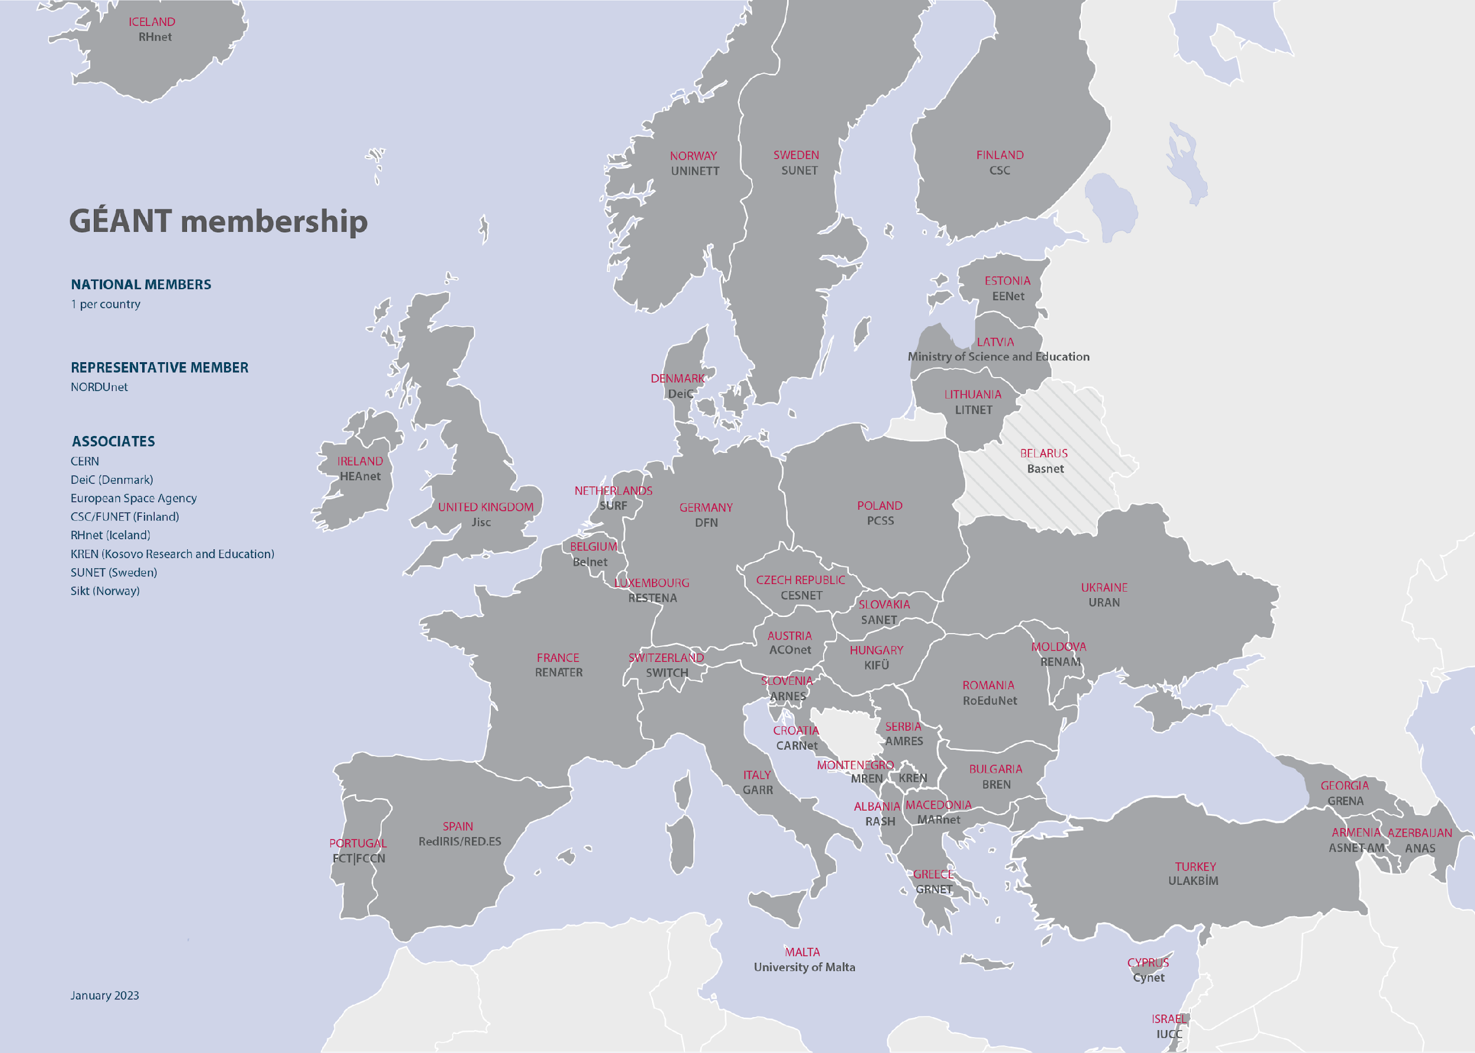
The GÉANT Community
‹#› |
Notes:
as you can see – GEANT is ubiquitous and fully pan-European.

Slide 5
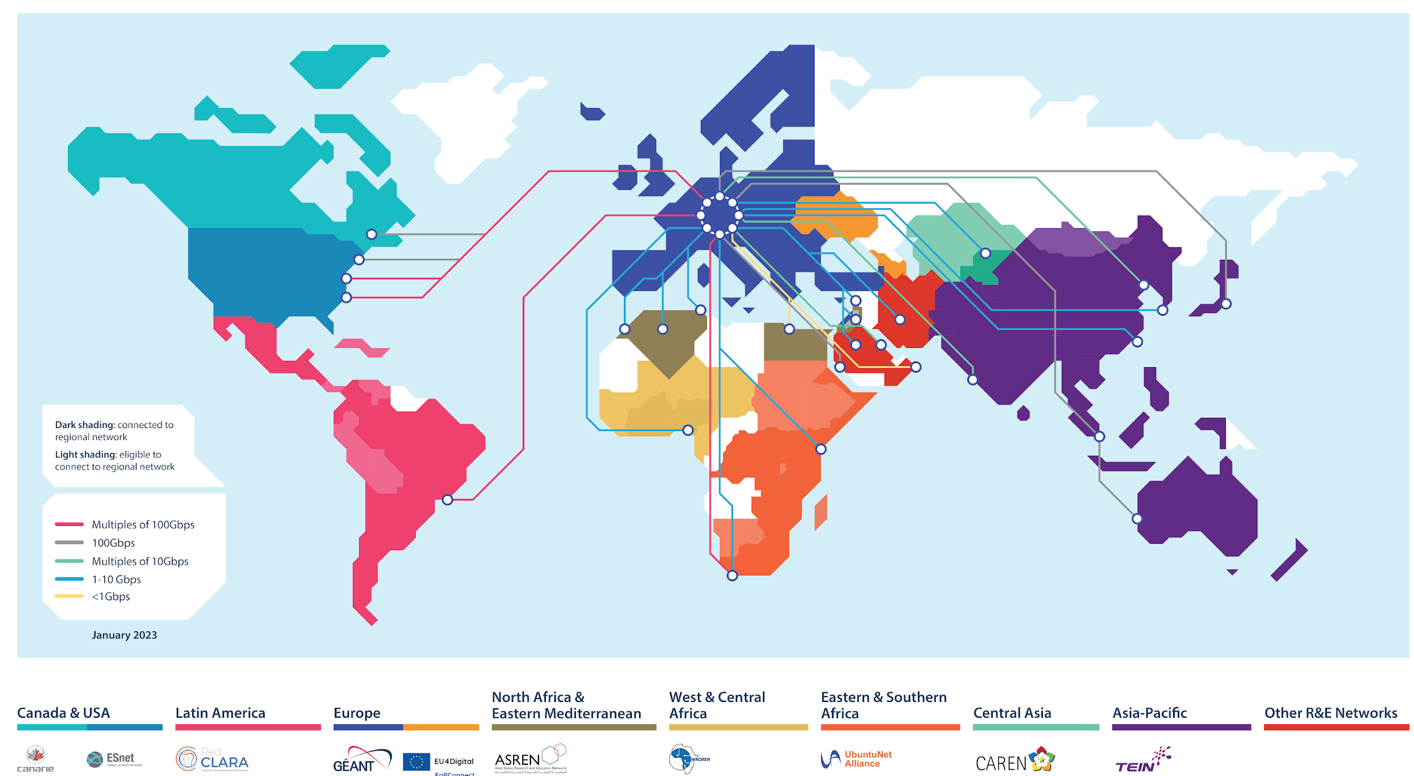

Notes:
NRENs in over 100 countries connected internationally
GÉANT connects to all regions, and via RRENs to countries in those regions.

Slide 6
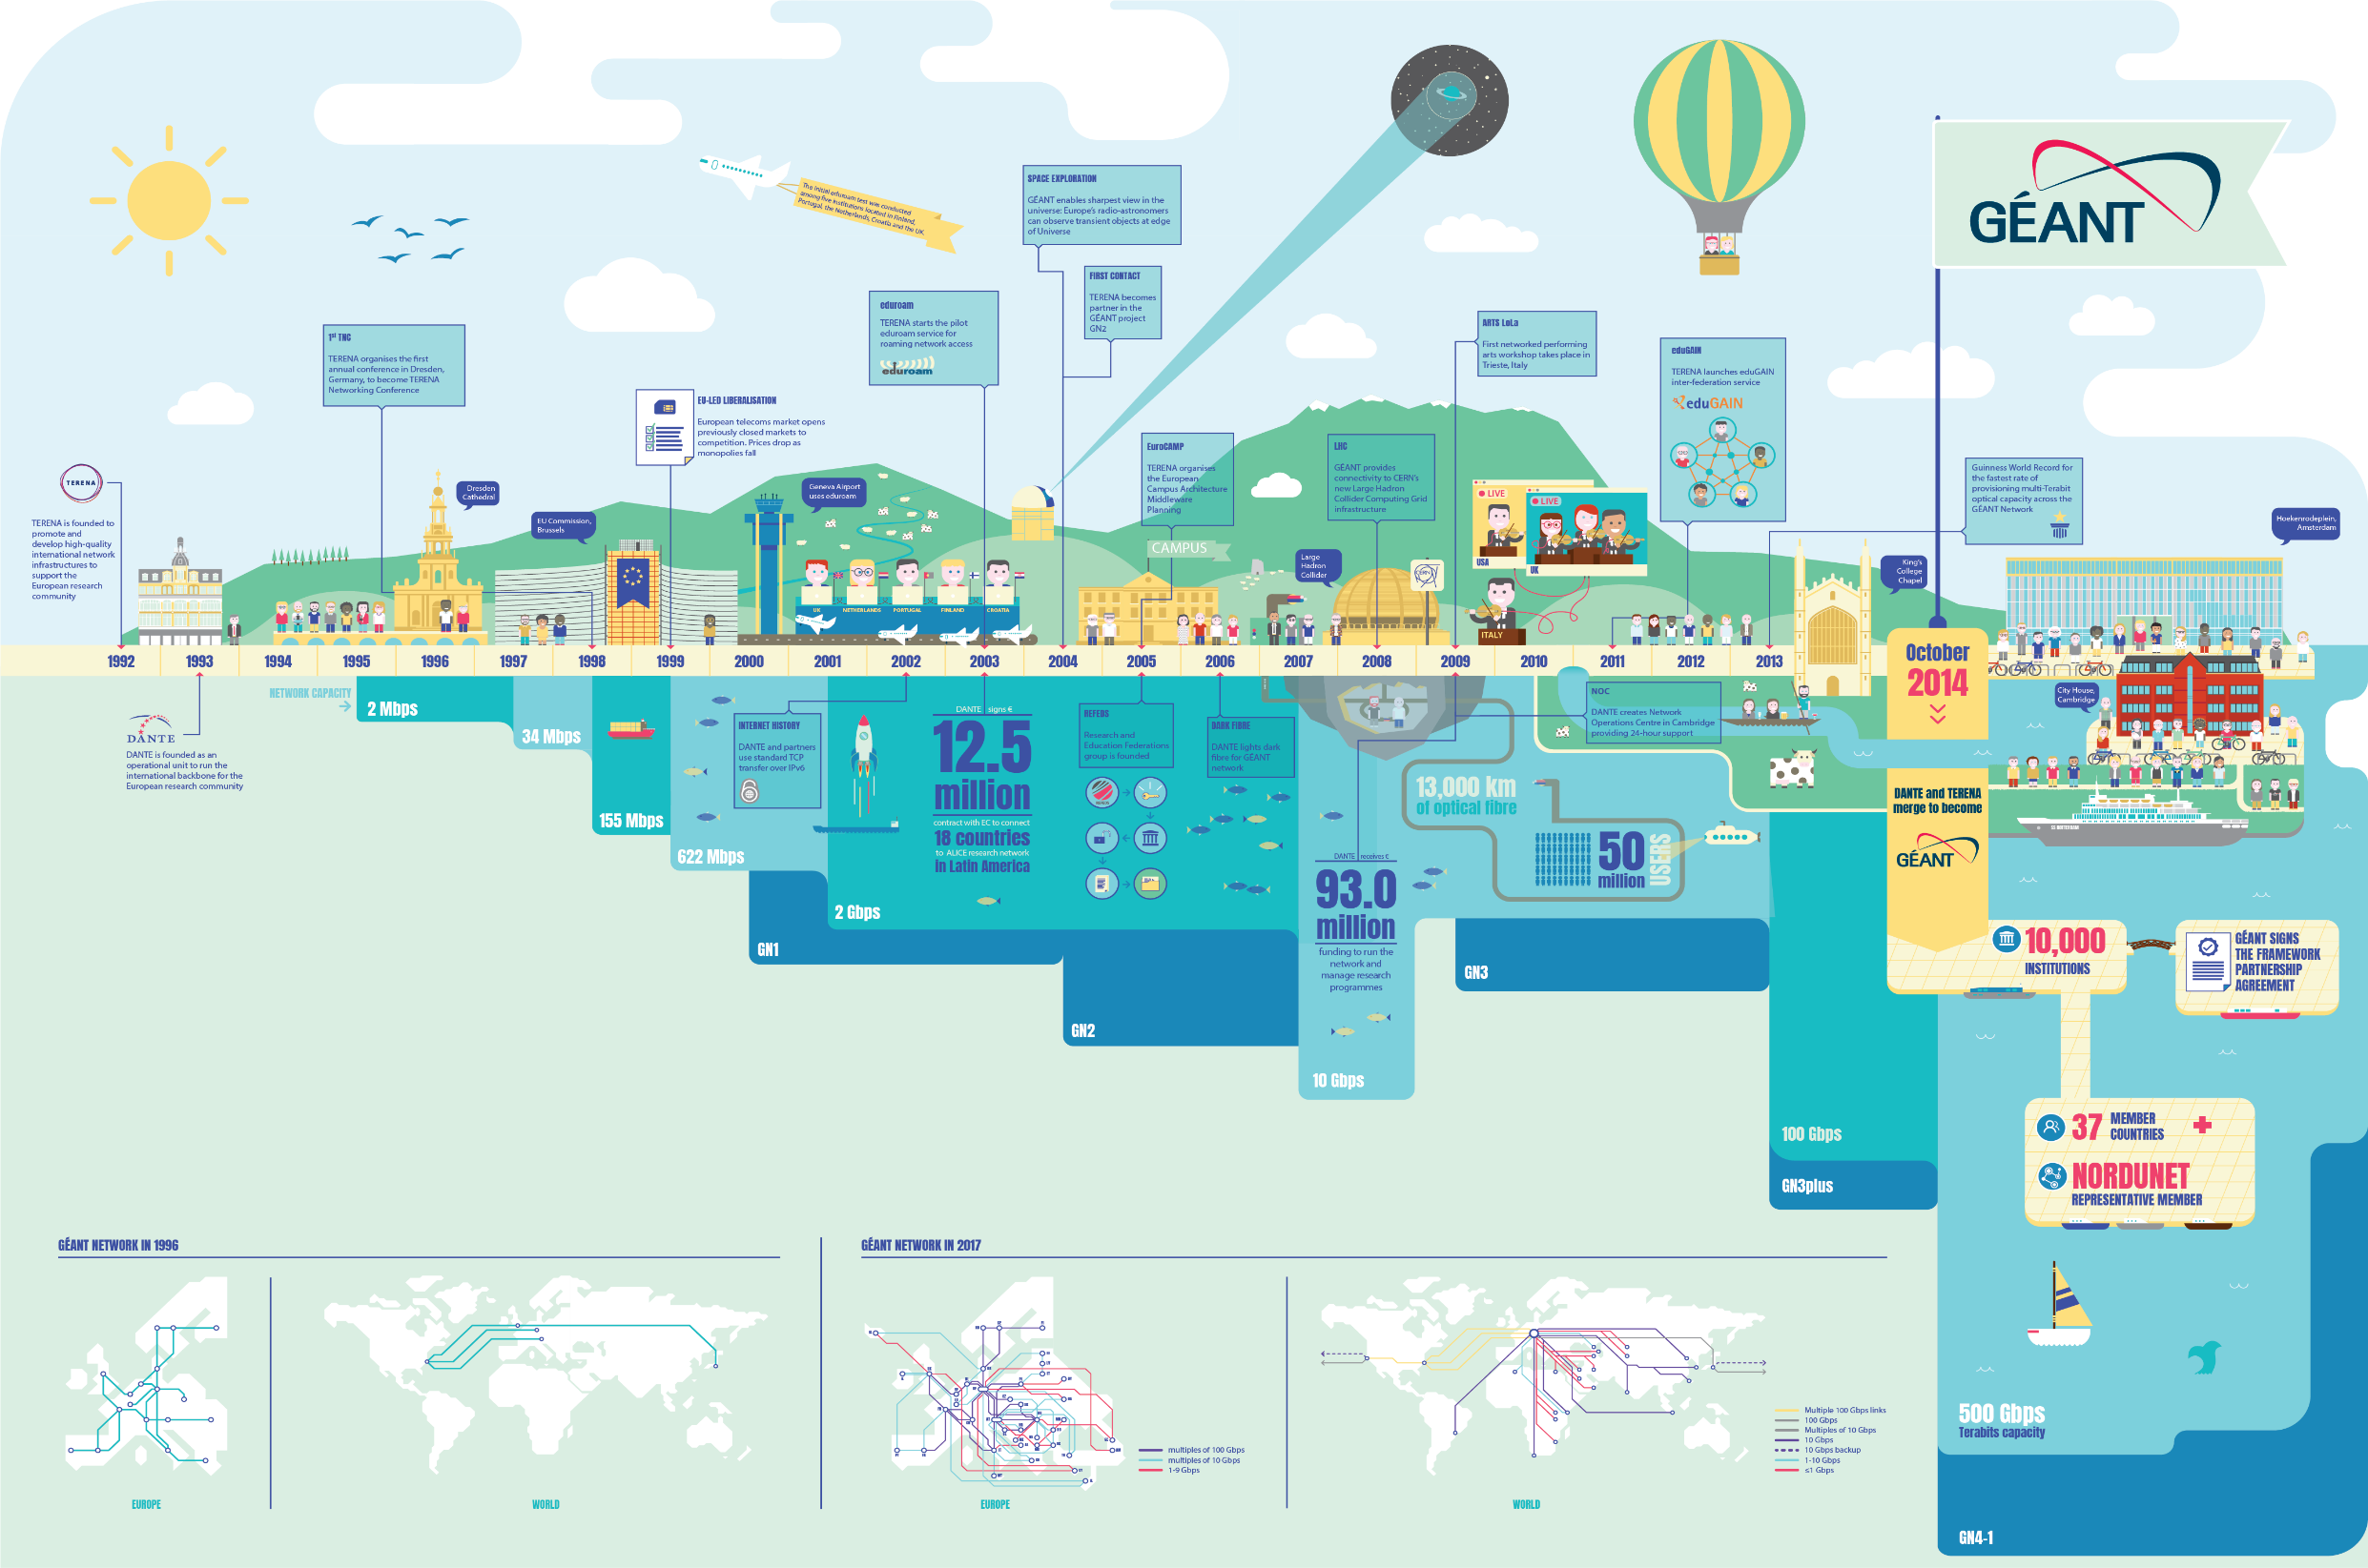
‹#› |

Slide 7





What does GÉANT do ?
Runs a membership association for Europe’s National Research & Education Networks (NRENs)
GÉANT Association
Coordinates and participates in EC-funded projects
Under Horizon Europe, Digital Europe programmes, and other EC funding programmes, aimed at securing Europe’s global competitiveness.
Operates a pan-European e-infrastructure
GÉANT network
Manages a portfolio of services for research & education
eduX
Organises and runs community events & working groups
TNC, task forces & special interest groups
Notes:
Supporting collaboration and development amongst researchers, the dissemination of information & knowledge, and providing access to a portfolio of services and infrastructure resources:

Slide 8


GÉANT Governance
Governance model
Covering both the Association and
the GN4-x projects
GÉANT Association
GÉANT projects
All European NRENs
Members / General Assembly
Subset (9) of members
GÉANT Board
GÉANT
Community
committee
Cost
Sharing
committee
Audit
And Risk Advisory
committee
GÉANT
Project
Oversight
committee
GÉANT
Programme
Planning
committee
Network Infrastructure Advisory Committee
= Committee reports to Board
= Committee report to GÉANT CEO
CEO
GÉANT
Chief Project Officer and Work Package Leaders
GÉANT organisation management team
GÉANT Executive
Project Management Board

Slide 9
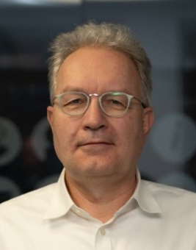

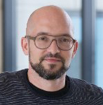


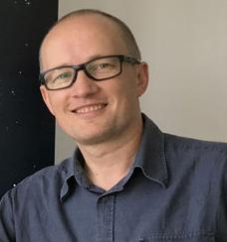

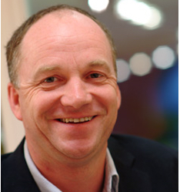
Executive Team
Erik Huizer
Who is who in GÉANT
CEO
Nathalie McKenzie
Executive Secretary
CAT team
GDPR team
HR team
Bram Peters
Klaas Wierenga
David Wrathmall
Paul Rouse
Cathrin Stover
Matthew Scott
Chief Network Operations Officer
Chief Information and Technology Officer
Chief Financial Officer(*)
Chief
Community Relations
Officer
Chief Collaboration Officer
Chief Programme Officer

Slide 10
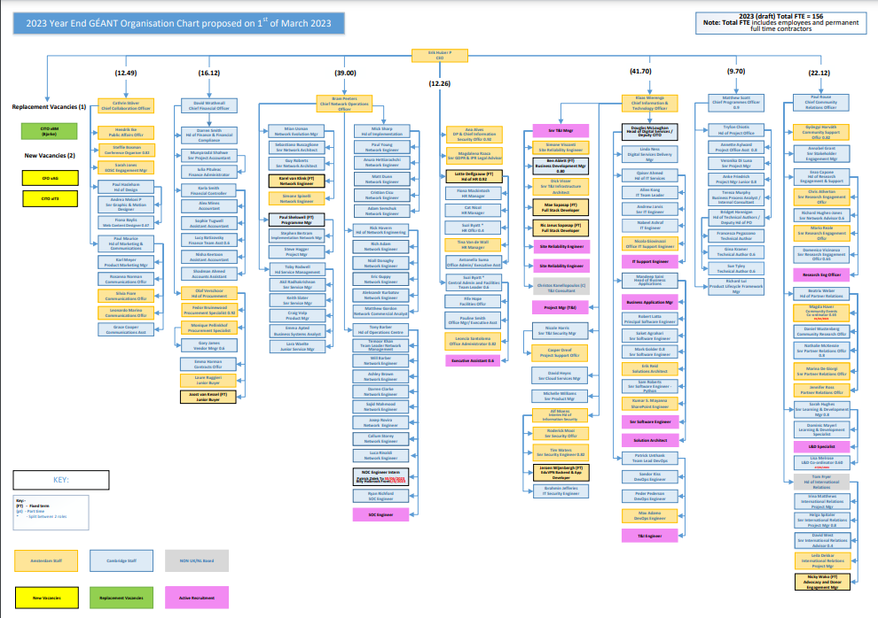
GÉANT Staff
Circa 40 in Amsterdam
Circa 105 in Cambridge
Plus active recruitment to reach circa 150

Slide 11

GÉANT Strategy and Values

Slide 12






Stronger Together
Our Values
SDGs
Our Strategy
‹#› |

Slide 13

The GÉANT Values
Community
Trust
Innovation
Passion

Slide 14





Sustainable Development Goals
Notes:
SDGs – highlight No 4 // 9 // 17

Slide 15
The GÉANT Association is the collaboration of European National Research and Education Networks (NRENs), supporting the advancement of research, education, and innovation on a global scale.
Together we deliver an information ecosystem of infrastructures and services used for communication, collaboration, exchange of data, and access to repositories, services and facilities.

Slide 16

VISION
Collaborate to deliver the infrastructures and services that enable the R&E community to excel

Slide 17

MISSION
To empower research and education with an open, innovative and trusted information ecosystem

Slide 18

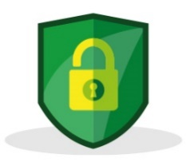





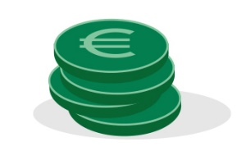
Eight Strategic goals for the GÉANT Association
THE
GÉANT ASSOCIATION
IS DRIVEN BY
EIGHT STRATEGIC GOALS
Network
We are the trusted partner for pan-European and global advanced R&E networking
Security
We provide a safe and secure information ecosystem for researchers, educators, and students
Innovation
We continually evolve key infrastructures, innovate, and develop new services in order to fulfil the needs of the R&E community in a sustainable way
Community
We are acknowledged worldwide as a leader for developing and supporting R&E networking communities, and global REN development
European Union
We are seen by the EU as an indispensable partner for their vision
Stakeholders
We forge relationships with other
e-infrastructure providers, research infrastructures (RIs), and other stakeholders, to benefit the R&E community
Governance
We have a governance structure that is agile and benefits from the diversity of our membership
Funding
We will ensure financial sustainability to benefit our members
8

Slide 19
GÉANT
Projects and Services

Slide 20


GÉANT Services
GÉANT develops the specialist services members need to support researchers, educators and innovators – at national, European and international levels.
Security and
Trust & Identity
Community Services & Procurement Services
Network and Network-centric services
European
e-infrastructure projects

Slide 21




GÉANT Services
Portfolio of in production services tailored to R&E
Network
Network Support
Security
Trust & Identity
Cloud & RTC
GÉANT IP
GÉANT Plus
10G Guaranteed Bandwidth
L3VPN
MD-VPN
Managed Wavelength
GÉANT Open
GWS
Commercial Peering
MS ExpressRoutes
Oracle FastConnect
perfSONAR
perfSONAR PMP
NMaaS
WifiMon (software)
GEANT Operations Centre
Software Tools e.g., BRIAN
Timemap
Argus
NSHaRP:
FoD
RTBH (Remote
Trigger to Black Hole)
Anti-DDoS
NeMo
eduVPN (software)
Trusted Introducer
TCS
eduroam:
Managed IdP
Managed SP
CAT
geteduroam
eduGAIN
eduTEAMS
InAcademia
Campus IdP Toolkit (software)
Filesender Demo
IaaS+ Framework
eduMEET (software)
Bold Type = Not in core package
Notes:
Please note that it is not possible to represent everything a member receives as part of their annual fees on just two slides
A complete list can be found in the Service Listing document that was shared with the General Assembly at the November 2022 meeting
This includes things like:
Procurement support e.g., the Dynamic Purchasing System and frameworks (OTE, Kentik, SDN-WAN Ethernet Switches…)
Training e.g., TRANSITS, eAcademy (OAV, CNaaS, Data Plane Programming etc), subject specific training
Support for Task Forces and Special Interest Groups etc

Slide 22




GÉANT Project Initiatives
Activity within GN5-1
Network
Security
Trust & Identity
PLUS Incubators in Trust and Identity, Cloud and Network Support
Submit ideas to the Work Packages!
Whiteboxing
RARE
GÉANT P4 Lab
QKD
OTFN
DTN
100+ Network Monitoring and Performance Testing
Security Management:
Baselining & Benchmarking
Business Continuity
Best Practice
Security Tools:
Treat Intelligence
SOC Tools
Vulnerability as a Service
DDoS Tooling / NeMo
Securing High Speed Networks
eduGAIN:
F-ticks for eduGAIN
Exploration phase
Development phase
Pilot phase
Notes:
Items listed here are being looked at across the GEANT project.
It is not guaranteed that anything listed here will form a service or tool etc in the GEANT Association portfolio. More information can be found on the relevant wiki pages.
The status of the service within the PLM process is available here: https://geantprojects.sharepoint.com/sites/gn4-3/management/plm/Lists/Geant%20Service%20Status%20Dashboard/AllItems.aspx

Slide 23
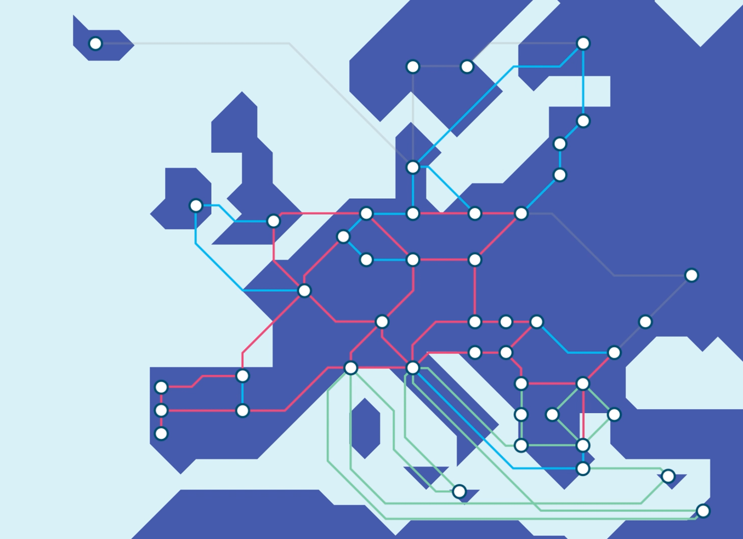

GÉANT
Funded by the EU

Slide 24
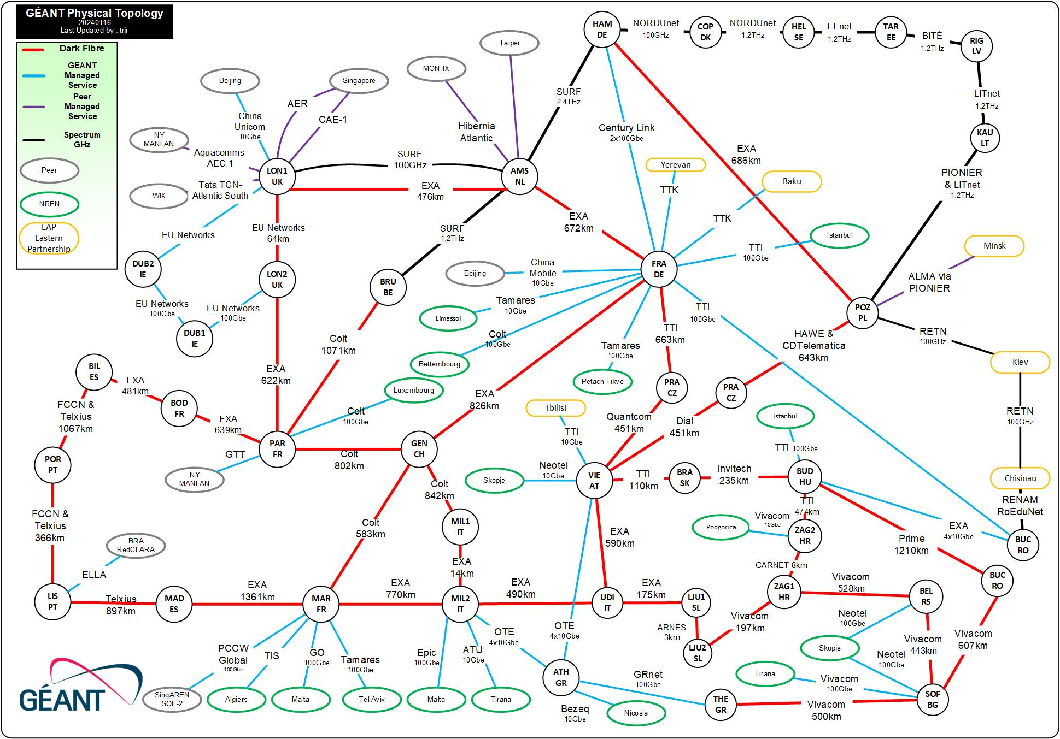
GÈANT
Network
Physical
Topology
Map

Slide 25
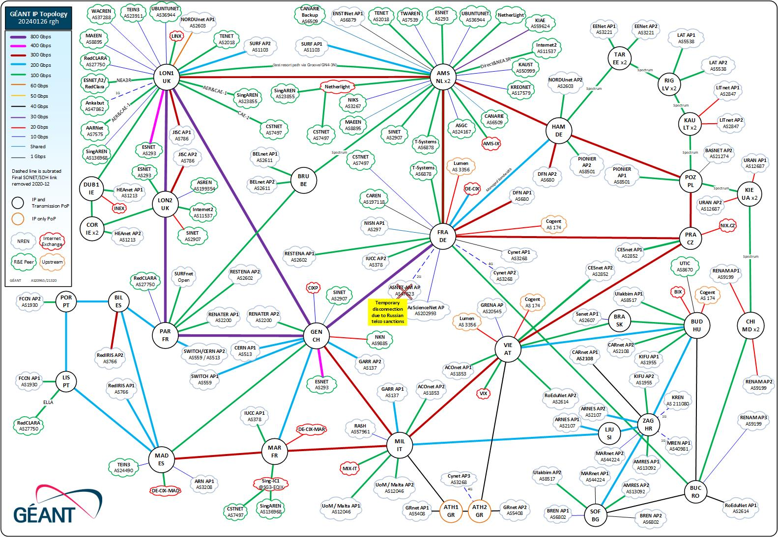
GÈANT
Backbone
Network
IP topology

Slide 26
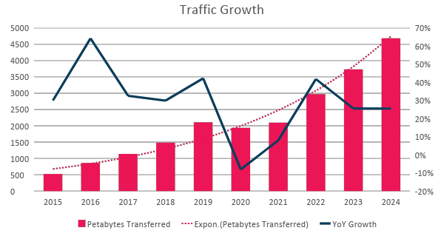
Traffic growth on GEANT Backbone
Long-term Backbone Traffic Growth
(on GÉANT network driven by scientific instruments)
Total: 2010 –2022 growth of over 30% YoY
2015–2019: Traffic growth of 40% YoY
2015–2022: Traffic growth of 27% YoY
Estimated
10x in 10 Year
Petabytes
Total Backbone Trunk Capacity
February 2019 2.7 Tbps
Now 2022 9.4 Tbps
YoY change in traffic in %

Slide 27
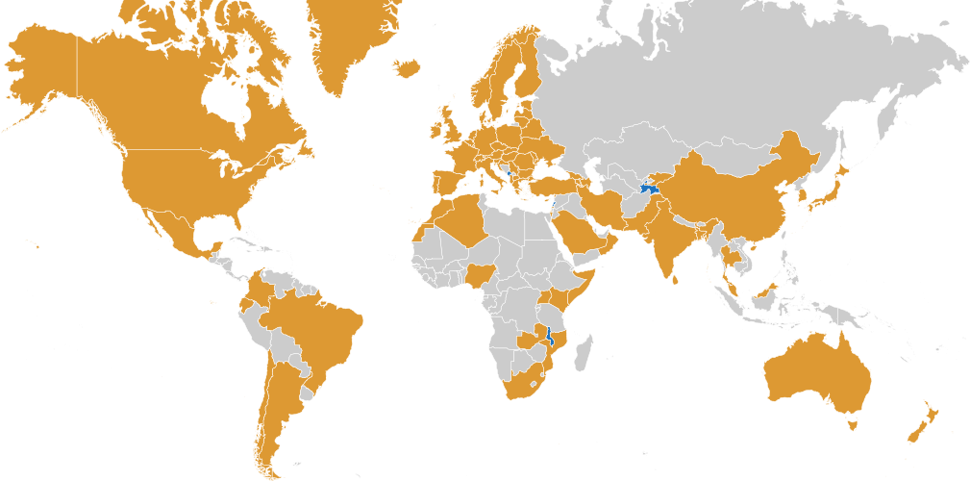
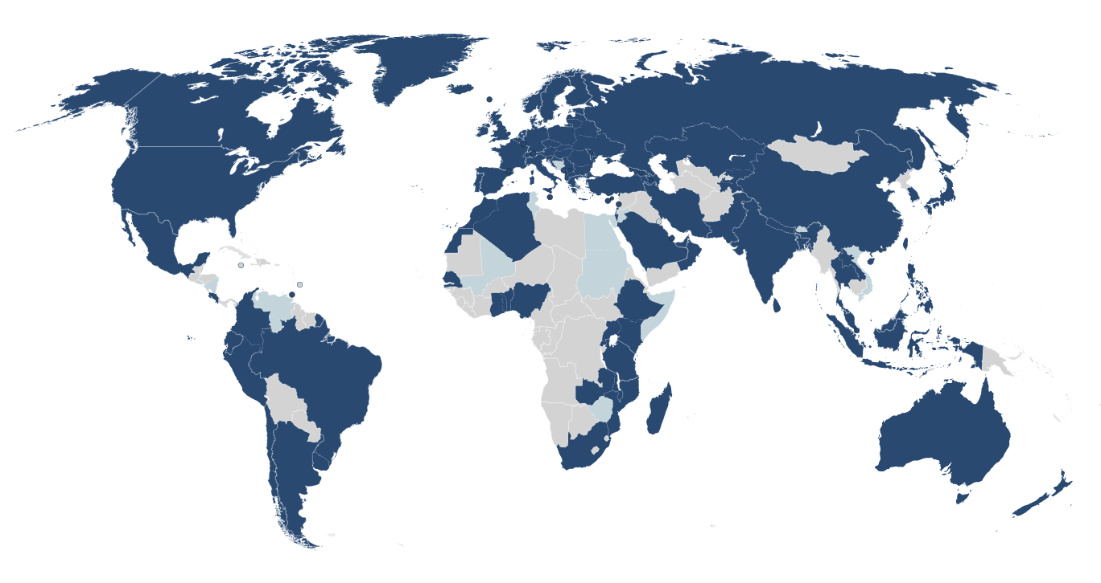


Federated Identities in Research and Education - Globally
79
Countries
110+
Countries
5000+
Institutions
9500+
Institutions
36500+
eduroam WiFi
Locations
3500+
Web Services
‹#›

Slide 28
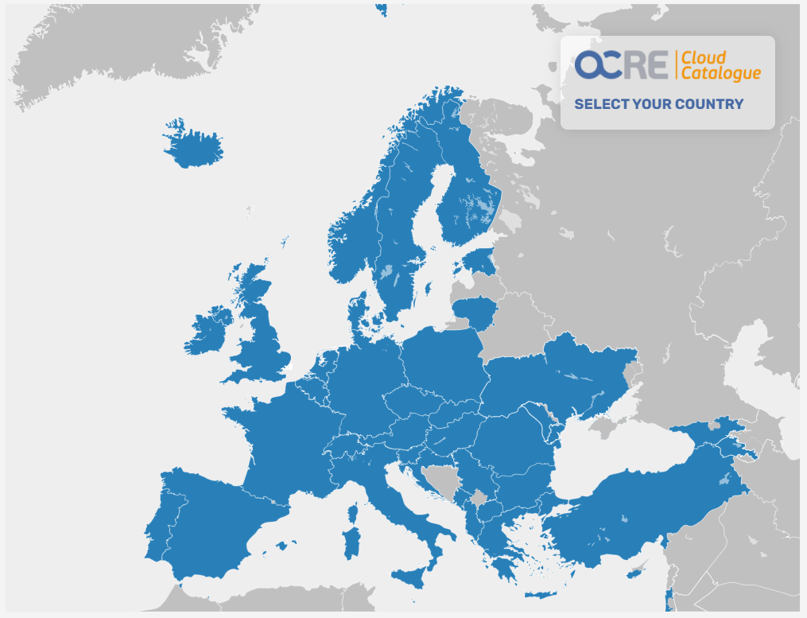
Procurement for Universities and Research Institutes in Europe
GÉANT brings down cost of cloud services
36 participating countries
R&E institutions act as a
Single Digital Market
12 different IaaS solutions (providers)
20 suppliers,
incl. Amazon & Microsoft resellers
473 framework contracts

Slide 29














































GÉANT Research Engagement
Astronomy/Physics
Earth Observation
DOMA
eInfras
Life Science
Arts and
Outreach
Humanities
Notes:
Some of the communities we are supporting

Slide 30
Current GÉANT EC Projects overview
GEANT FPA GNx Projects
GN4-3N
GN5-1
GN5-IC1
EOSC Projects
4. EOSC Future
T&I Projects
EDSSI2
DC4EU
AARC TREE
Other Connectivity Projects
7. CLONETS-DS
8. SUBMERSE
International Projects
9. EaPConnect2
10. AfricaConnect3
PLUS
Submitted: EOSC Nudge; EOSC Beyond
Notes:
Additionally there are continuously project proposals being submitted.
For more info contact pmo@geant.org

Slide 31
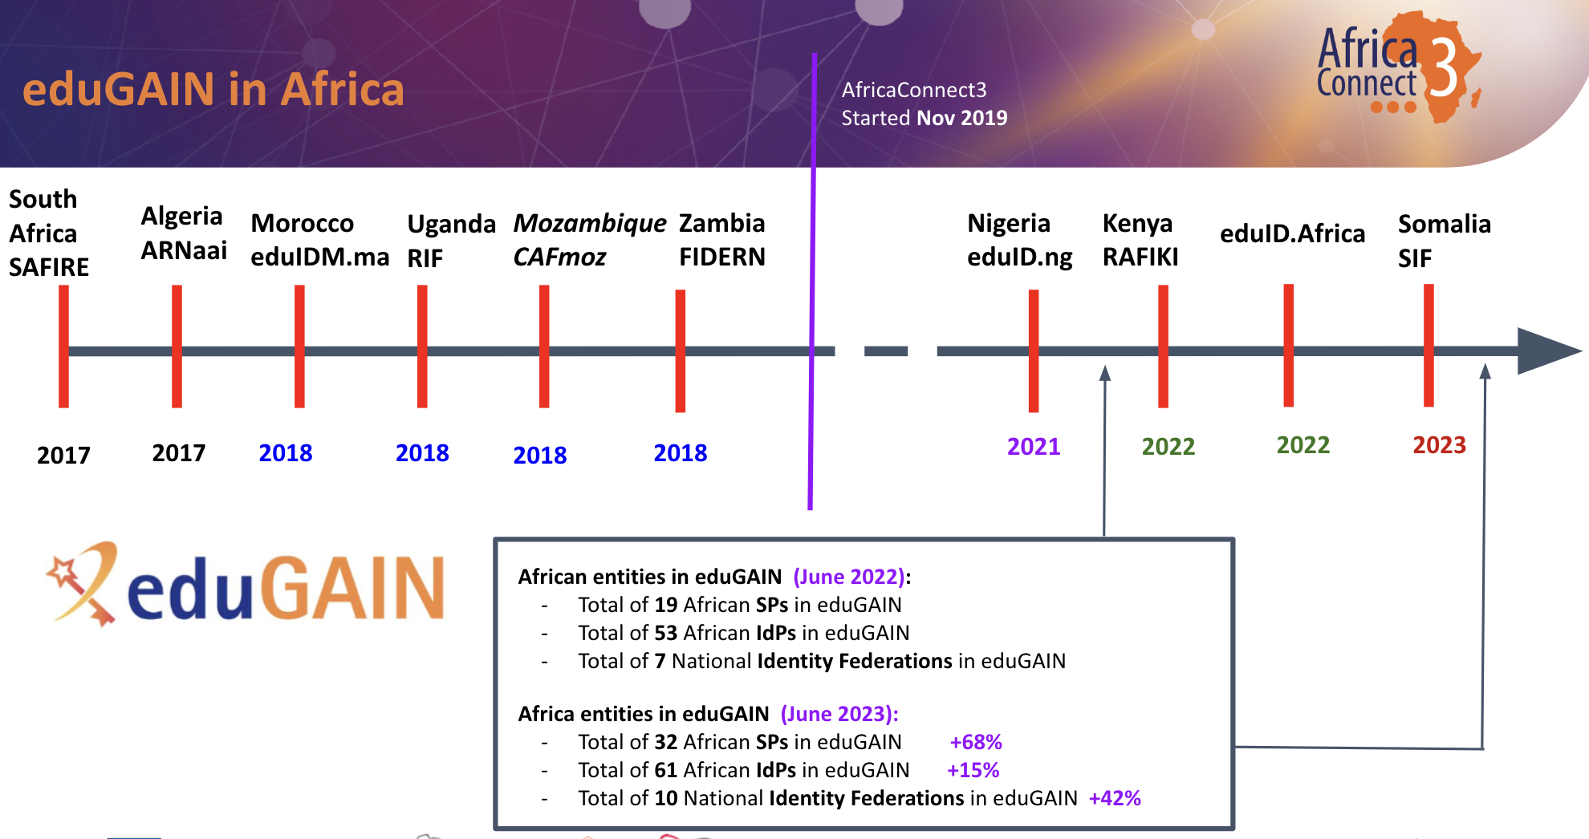
Togo
Burkina Faso
Ghana
Ethiopia
Malawi
Tanzania
[..]

Slide 32
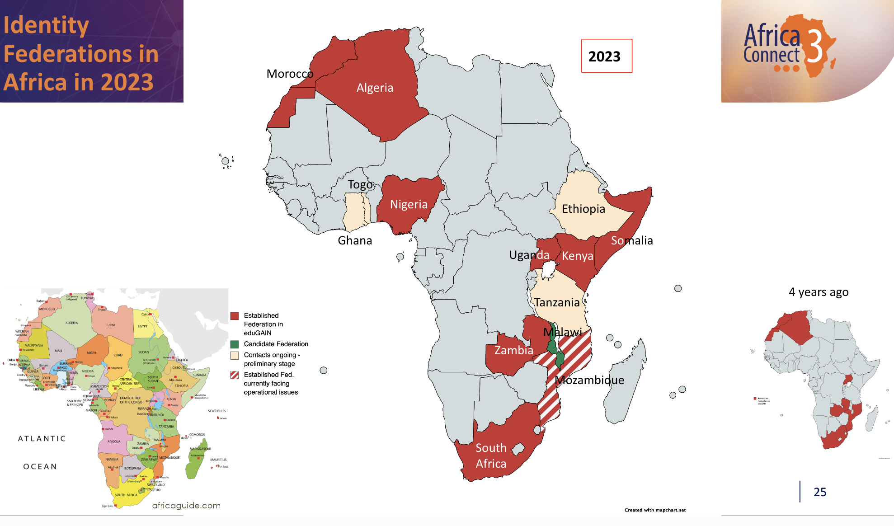
AfricaConnect3 establishing new federations in Africa

Slide 33
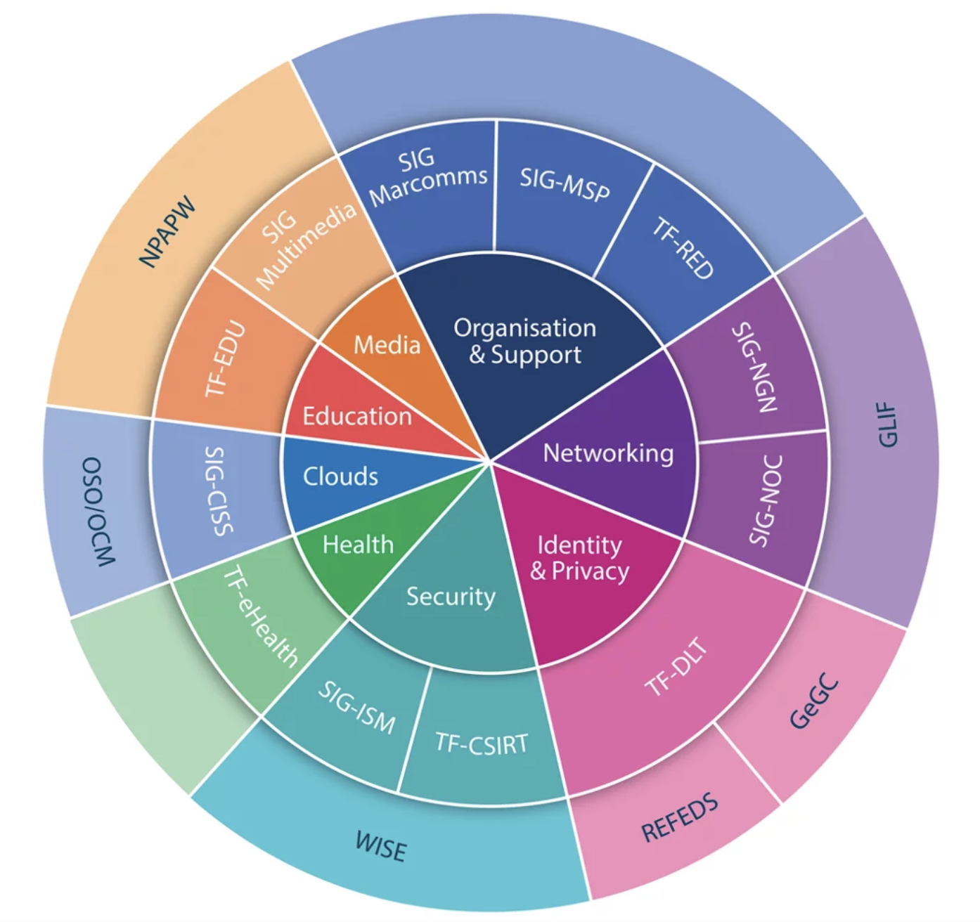
The GÉANT Community
Programme
Main goal is to exchange experiences, best practices, share hands-on expertise in various domains involving the NRENs, their services and their connected community of users
Implemented through Special Interest Groups and Task Forces
https://community.geant.org/
Notes:
Thematic Areas
Thematic areas are formed and continuously evolving from the needs of the GÉANT community. Special Interest Groups (SIGs), Task Forces (TFs), specialised workshops and collaborative projects are all activities within the thematic areas.
Security
Media Services
Support Services
Identity & Privacy
Cloud Services
Organisational Services
Educational Services and Technologies
Network Services and Technologies
Health Services

Slide 34
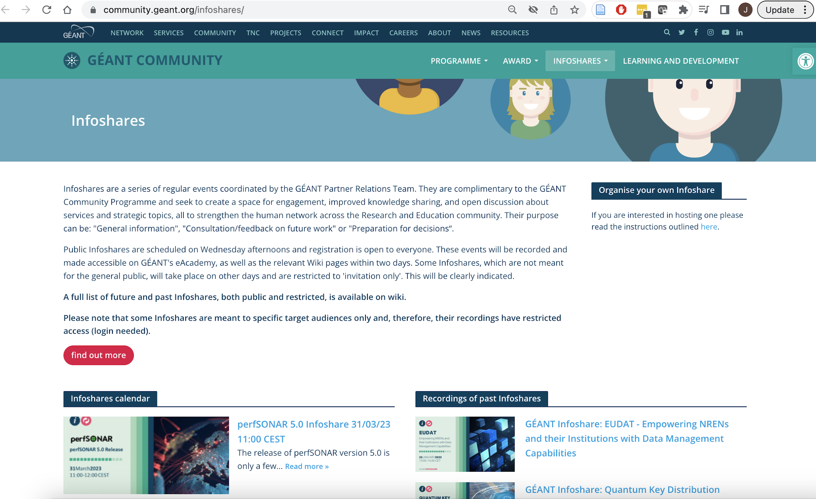
GÉANT Infoshares
  2022: 25 Infoshares with 926 participants , YouTube views: 1,557
  See : → https://community.geant.org/infoshares

Slide 35
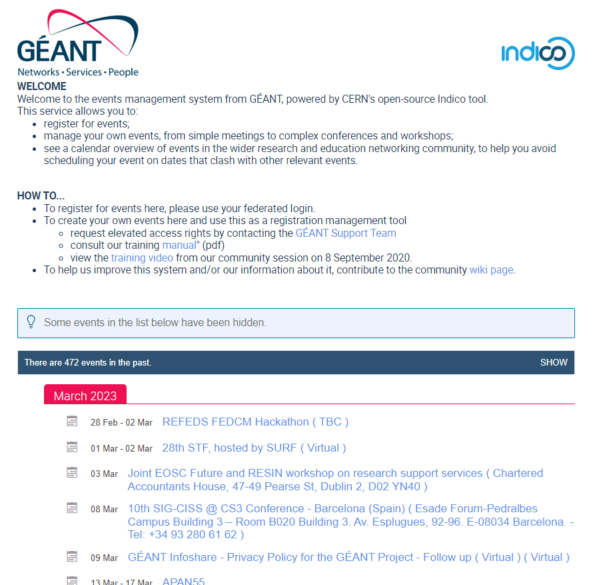
GÈANT Upcoming Events
https://events.geant.org

Slide 36







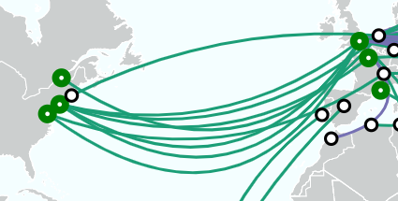
Advanced North Atlantic (ANA) Collaboration
ANA:
  A collaborative effort to provide multiple, diverse links to support R&E collaboration across the North Atlantic
  Individual Transatlantic links are provided on diverse paths by:
100 Gbps
PAR-NY
100 Gbps
AMS-MONT
100 Gbps
LON-WASH
2 x 100 Gbps
NY-LON
NY-AMS
4 x 100 Gbps
WASH-GEN
BOST-AMS
2 x NY-LON
100 Gbps
AMS-NY

Slide 37
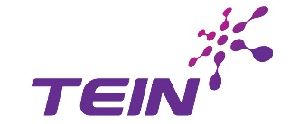


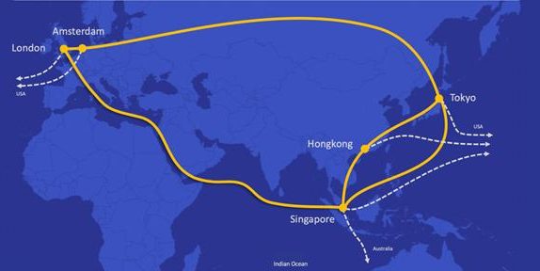

CAR-1 and the Asia-Europe Ring
CAE-1
    A 10-year collaboration starting in 2019 to connect Europe and Asia-Pacific at 100 Gbps between London and Singapore
Asia-Europe Ring (AER)
    A collaboration of eight R&E networks to provide mutual back-up between Europe and Asia-Pacific across diverse links

Slide 38


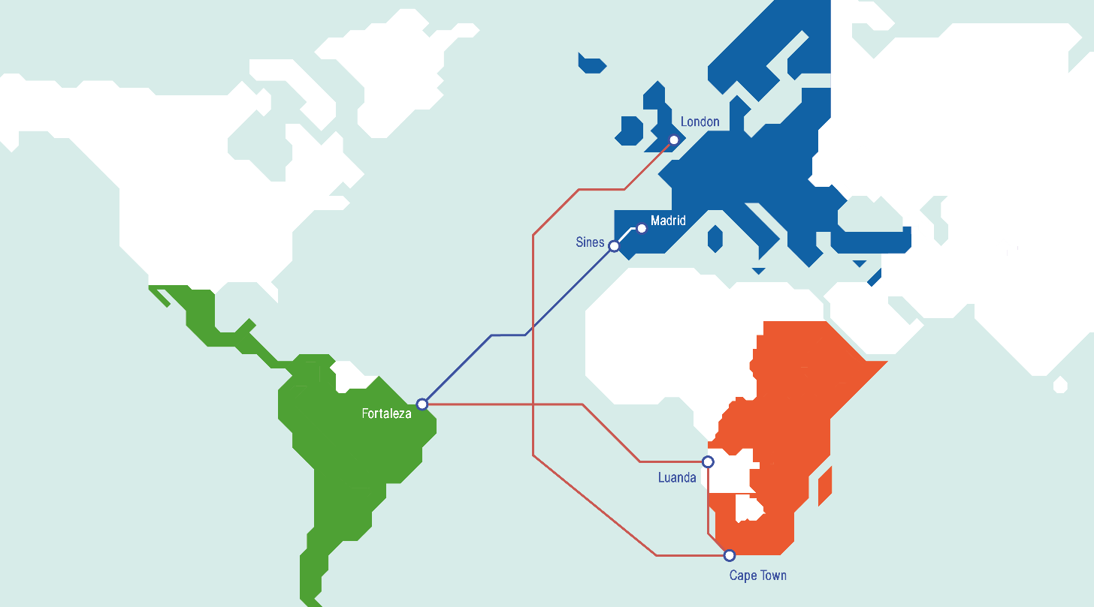






Bridging Europe, Africa and the Americas (BEAA)
BEAA:
A collaboration of R&E networks in Europe, Africa and the Americas to provide mutual back-up via diverse links in the Southern Atlantic

Slide 39
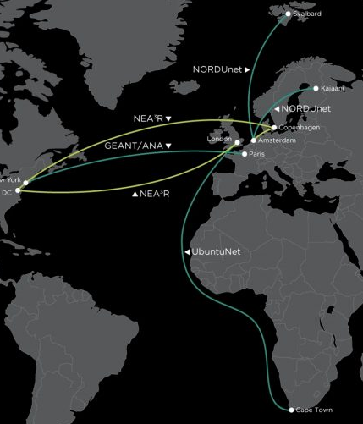
Networks for European, American, African, and Arctic Research (NEA3R)
Funding Source: | US National Science Foundation International Research Network Connections (IRNC) programme (Core: Improvements)
Objective: | Support R&E collaboration between the US and Europe, Africa and the Arctic
Activities: | Delivers 2x 100Gbps transatlantic connectivity NetSage Measurement and Monitoring Framework Science Engagement Routing Anomaly detection Support for Network Experimentation
Duration: | Five years (2020-2025)
Budget | US$ 4.75 million
Web Presence: | https://internationalnetworking.iu.edu/projects/NEA3R/index.html http://portal.netsage.global
Coordinator: | International Networks at Indiana University
Supporting: Partners | GÉANT; NORDUnet; UbuntuNet Alliance

Slide 40
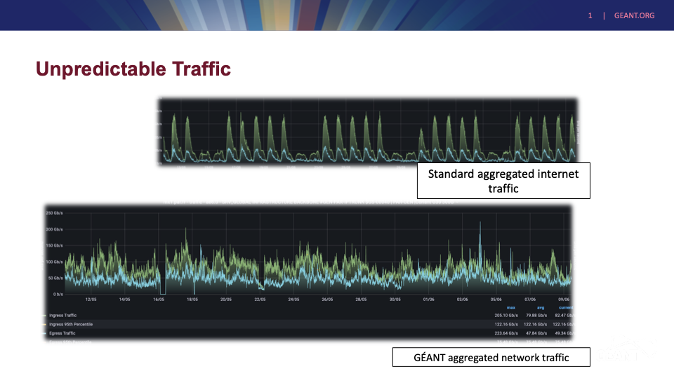

Slide 41
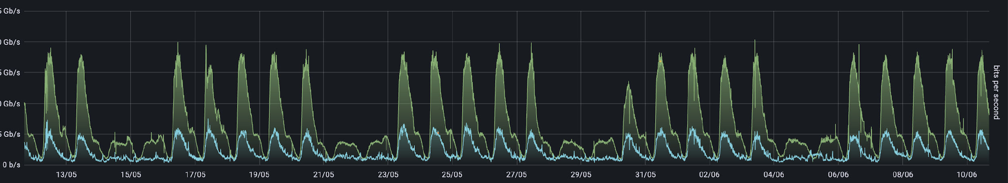
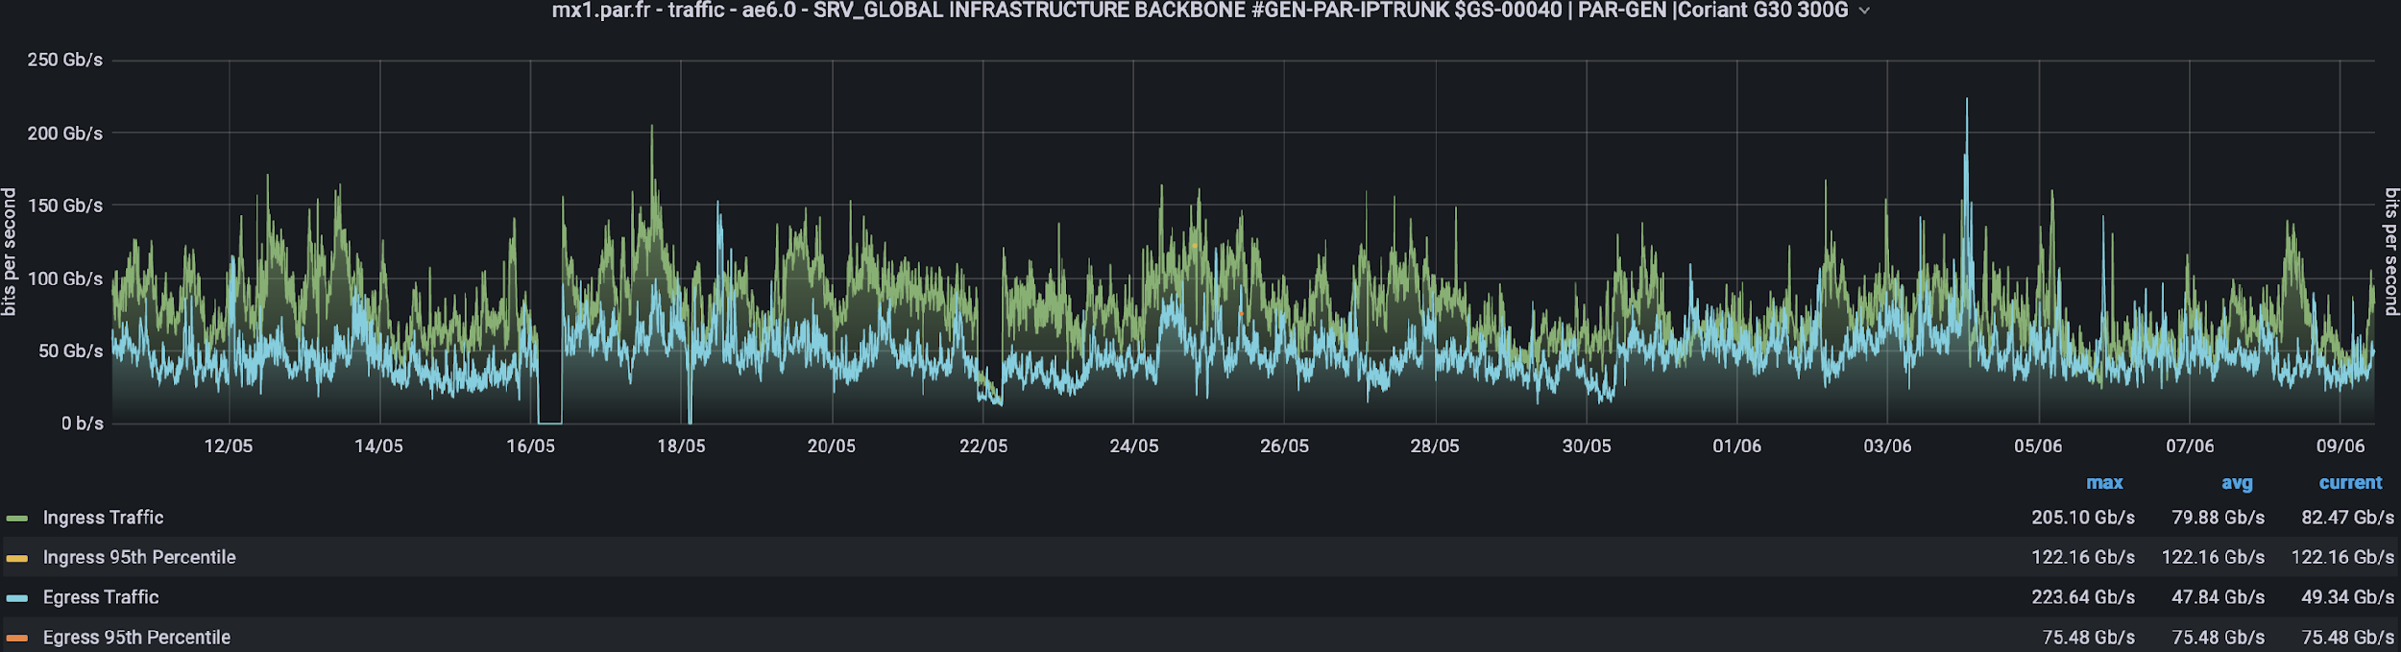
Unpredictable Traffic
Standard aggregated internet traffic
GÉANT aggregated network traffic
Notes:
They require petabytes of data to be moved from different world regions at many different times of the day.

Slide 42
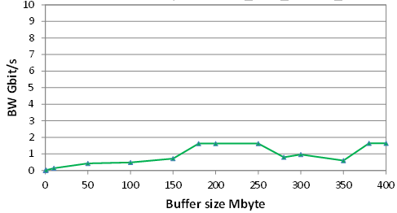
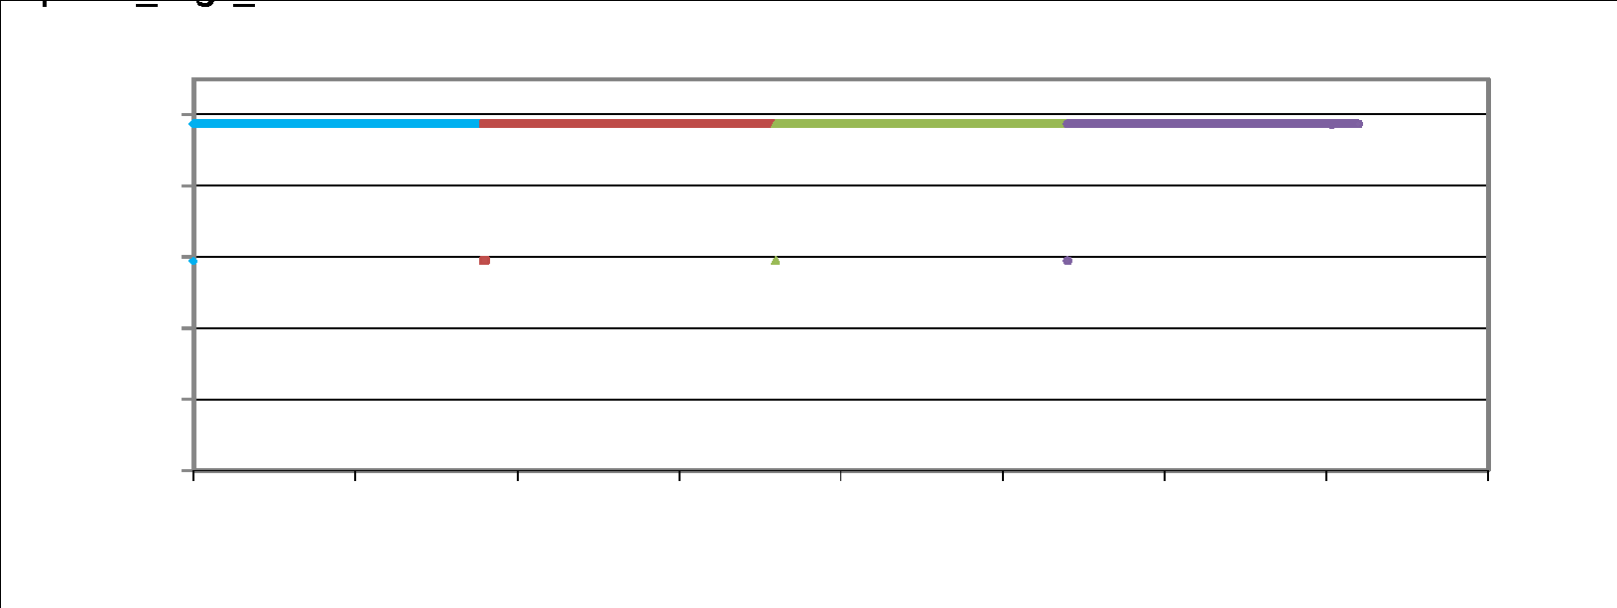
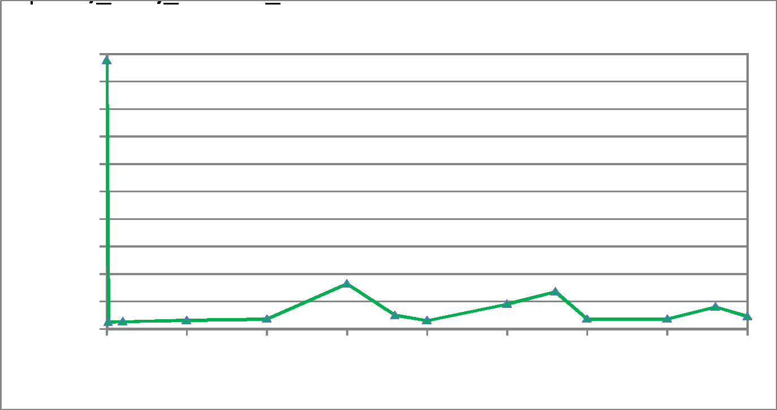
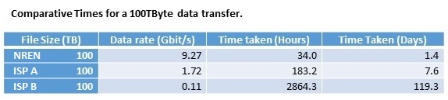
Optimised for research data transfers (2017)
Public Internet
GÉANT and R&E partners
Geneva to Canberra
Geneva to Canberra GÉANT + R&E networks US to Australia
Geneva to Canberra
R&E networks are designed for different
goals than the Internet
Notes:
Commodity internet connectivity does not meet the requirements of researchers.

Slide 43
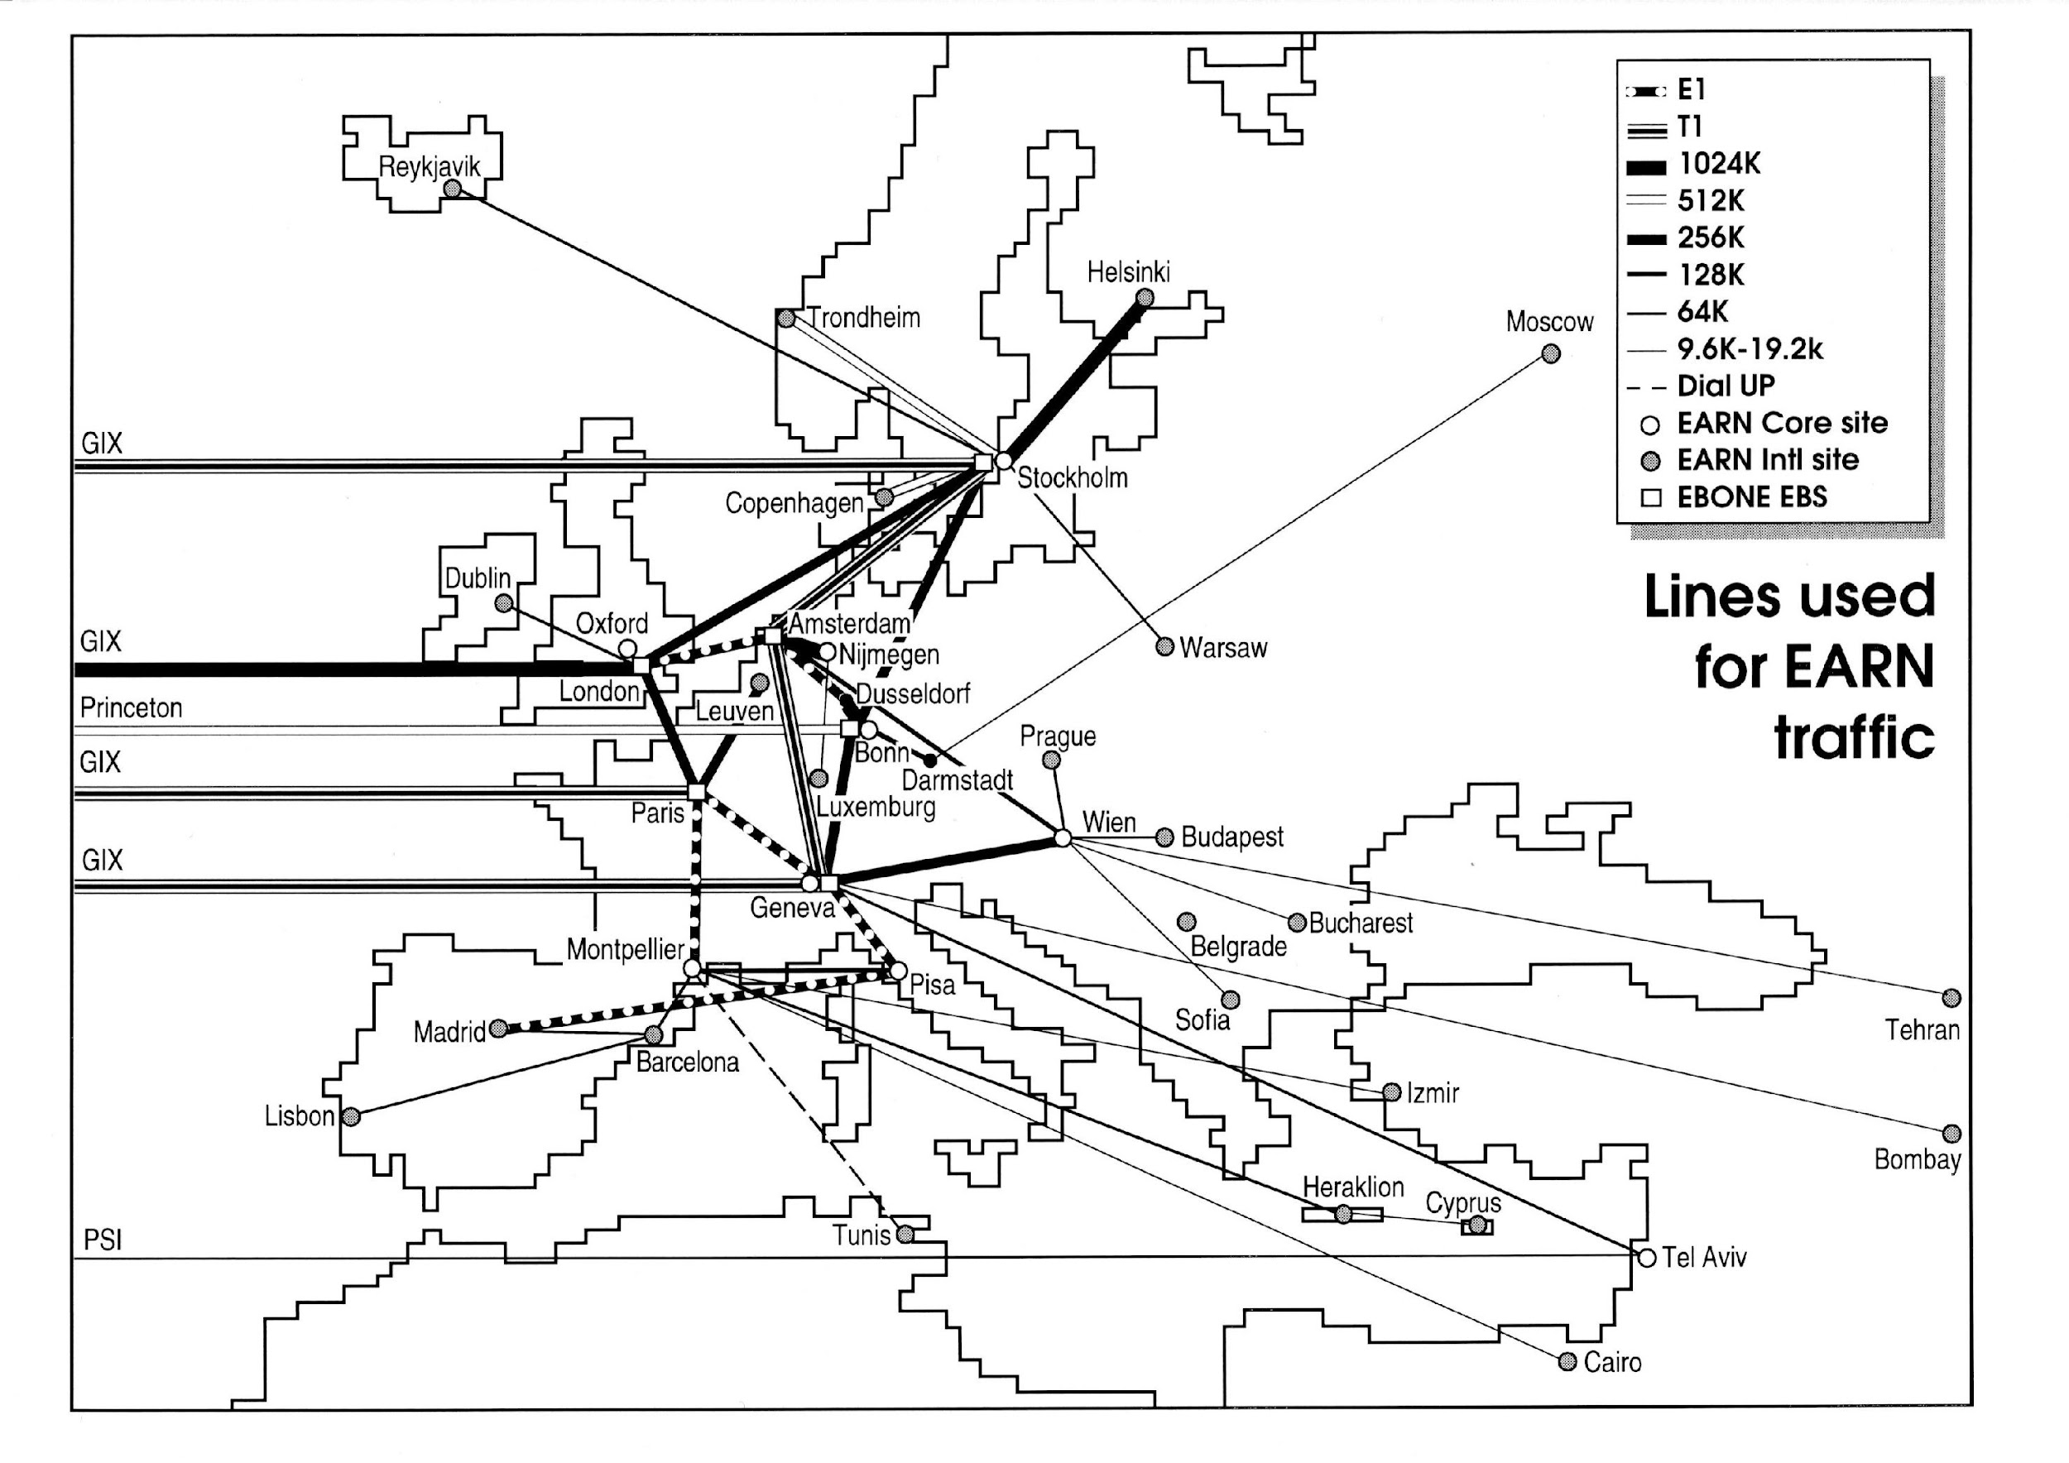
Where GÉANT came from
1991
Notes:
This is why research and education networks were established.
Back in the 80’s when data needed to be transferred from CERN to participating countries, National Research and Education Networks were used.
From the European Academic Research Network, GÉANT was born. It was also the network that the internet started over.

Slide 44
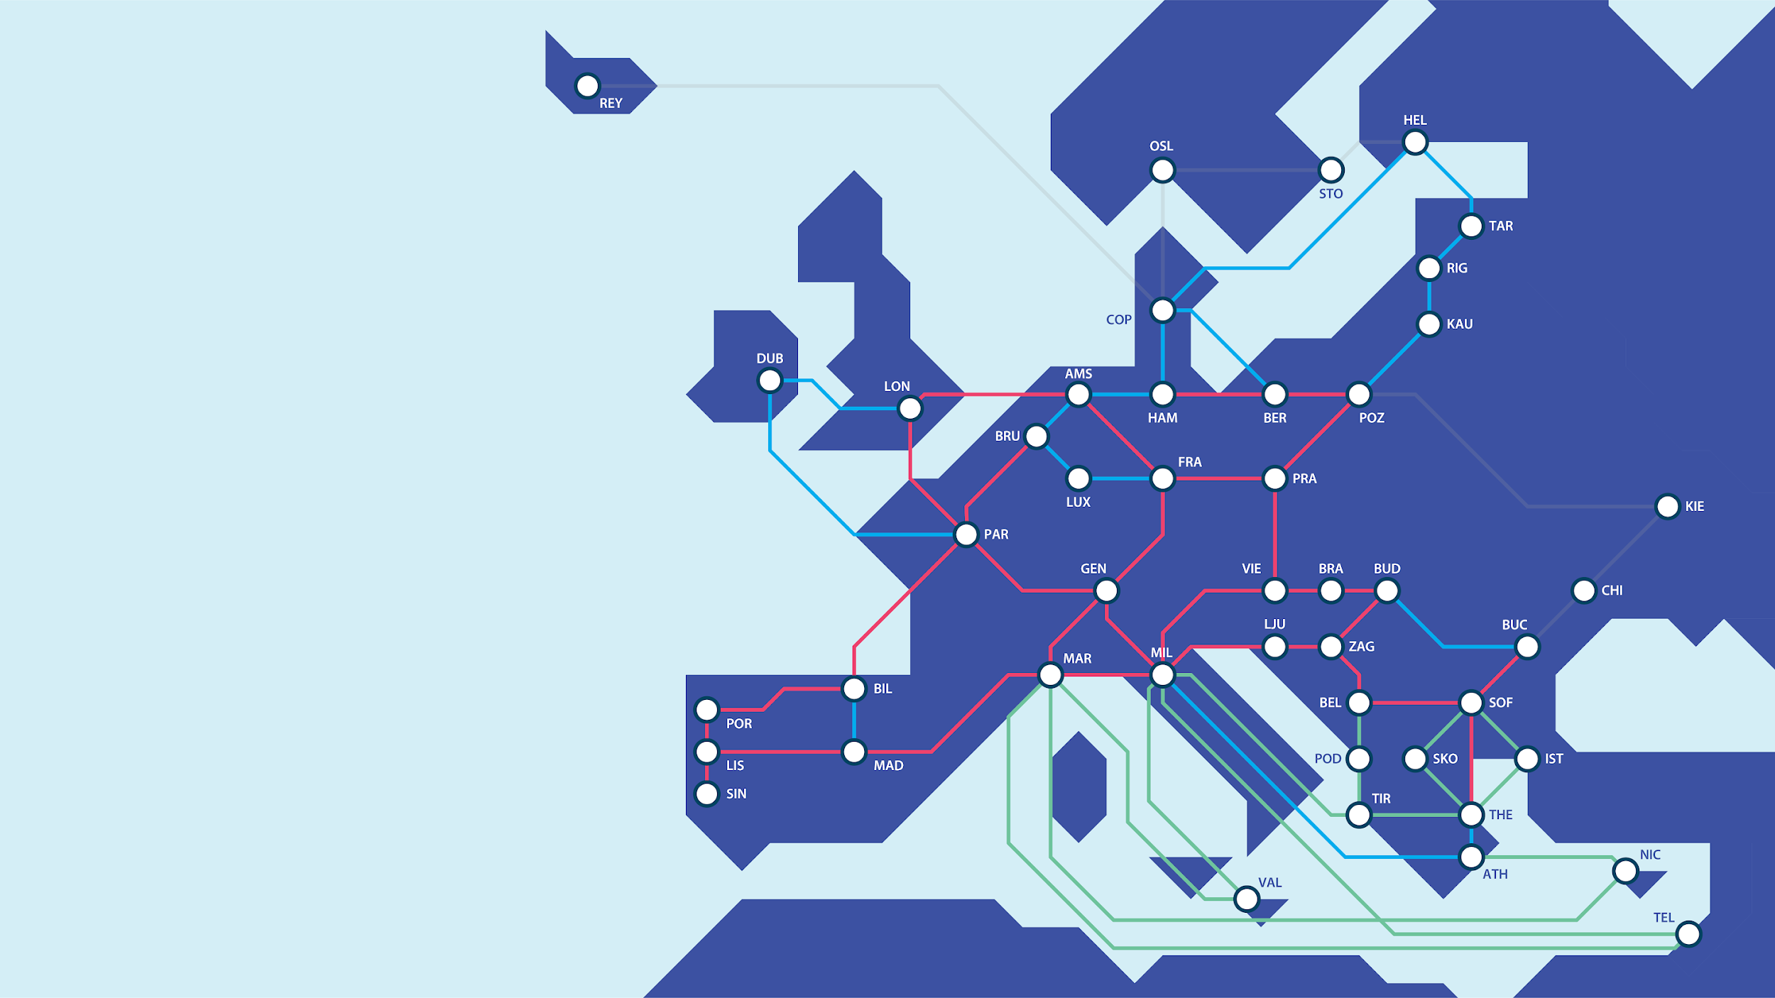
GÉANT Network upgrade – GN4-3N
Routes:
29x deployed
11x delivered
9x being evaluated
14x in planning
18,000km fully equipped
18 countries
26 Providers (9 NRENs)
Built/delivered
Leased capacity
Being planning
Affiliated routes
Notes:
Our network which connects all of the NRENs together has expanded massively. We’re currently upgrading the network via an EC funded project, to make the network fit for exa-scale computing which will come in the next few years. This has been achieved through long term indivisible rights of use for spectrum on cable systems from a multitude of commercial providers, covering Europe. We currently pass over 1 Tb/s, our new network will allow us to achieve much higher performance.

Slide 45
GÉANT Trust and Identity Services

Slide 46
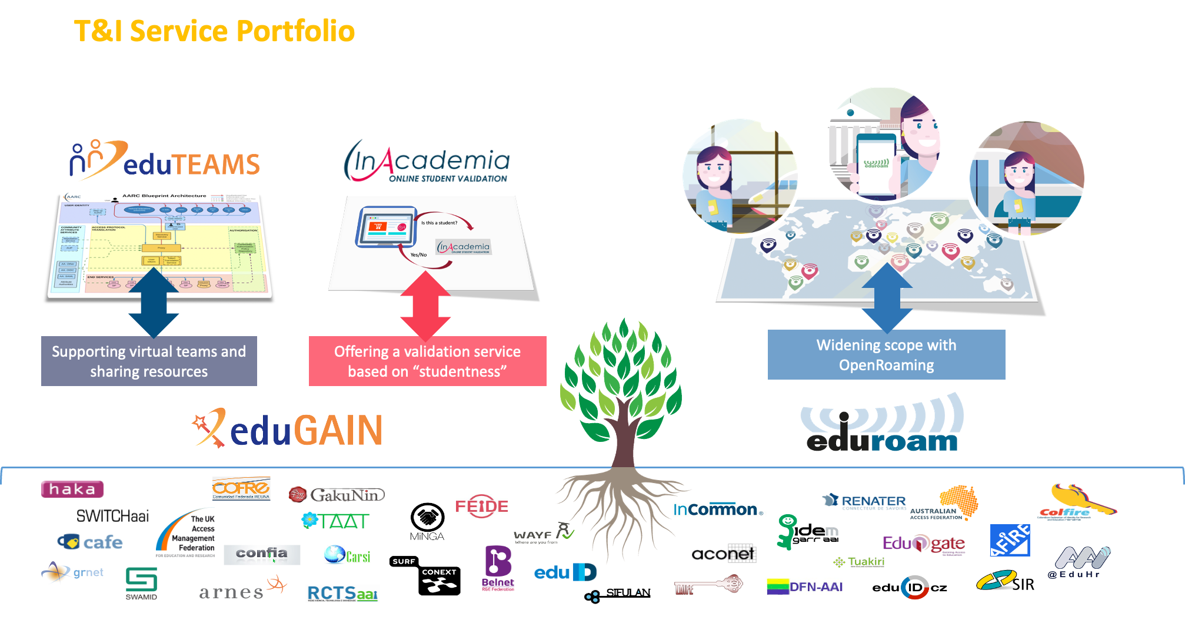


Slide 47


eduroam

Slide 48
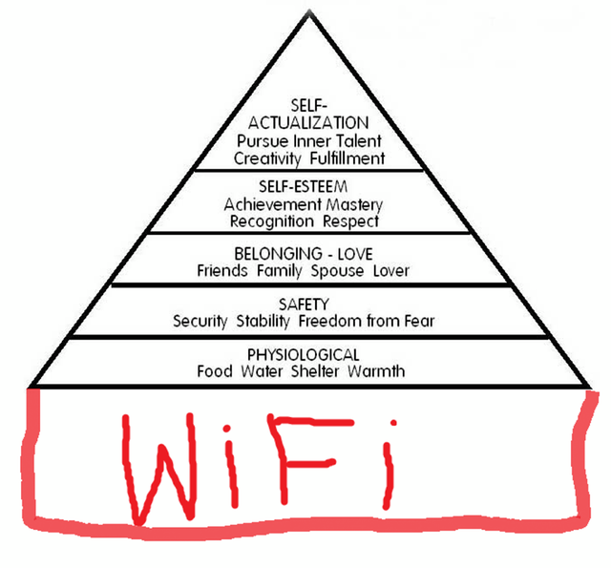
eduroam
Being online is ever more important
eduroam is a blueprint for deploying WiFi (which is likely present)
  Clear what to expect
  Good connection, no portal/Ads, reputation
  Secure and easy
  Open up your laptop and bang! You’re online!
Based on mutual access, hospitality: give and take
Based on future proof standards

Slide 49


eduroam is big and global
eduroam is the biggest federated roaming-infrastructure
  7200 IdPs
  30000 locations
  110 countries
Service we all build together
  Campuses, IdPs, SPs
  National Roaming Operators
  Regions
  Global eduroam, governance
Last year, #eduroam was used over 7.5 billion times in over 100 countries!
As staff, researchers and students resume travel and collaborations then eduroam becomes even more important to help users stay connected.
To find out more about where you can eduroam visit https://eduroam.org/where/
#love2eduroam #research #education #academia #HigherEducation #connectivity #students #university #universities #NRENs

Slide 50
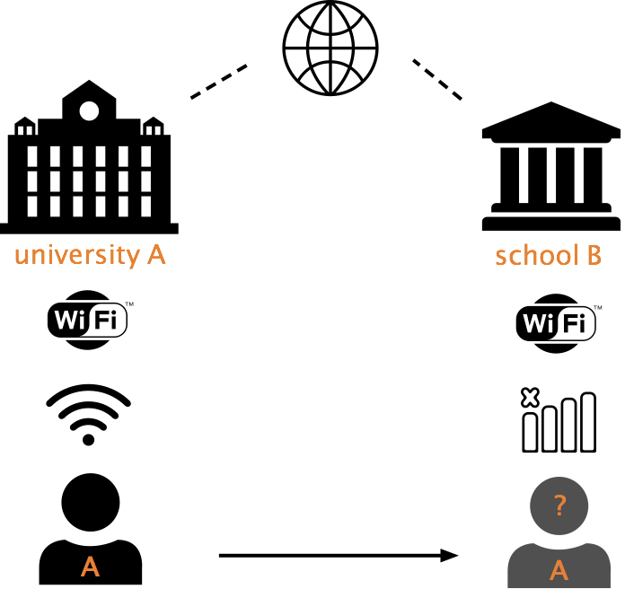

Slide 51
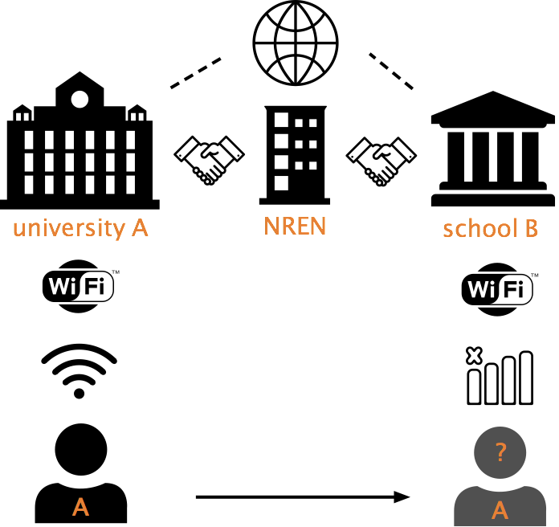

Slide 52
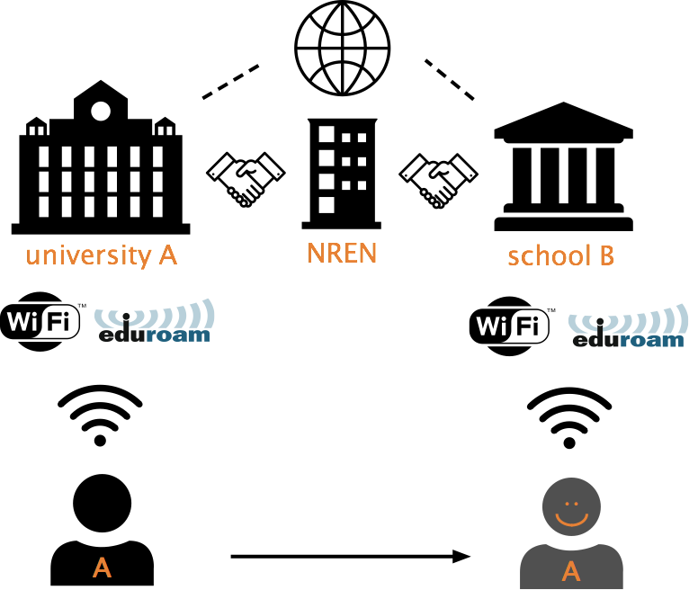

Slide 53
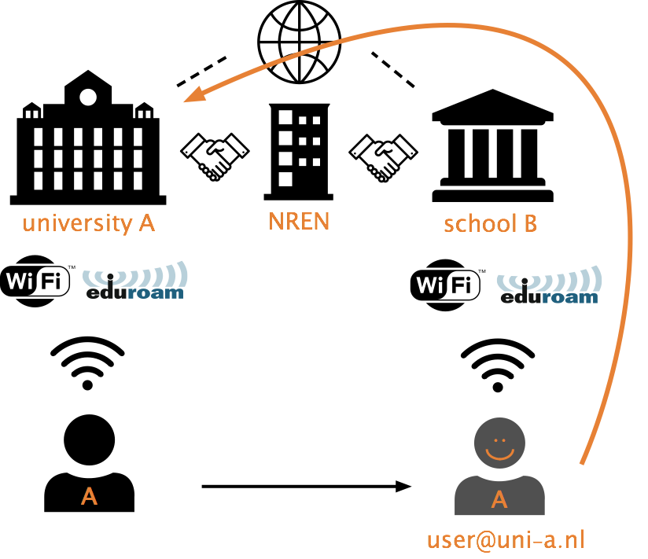
In NL:
10 million authentications a day of this kind

Slide 54
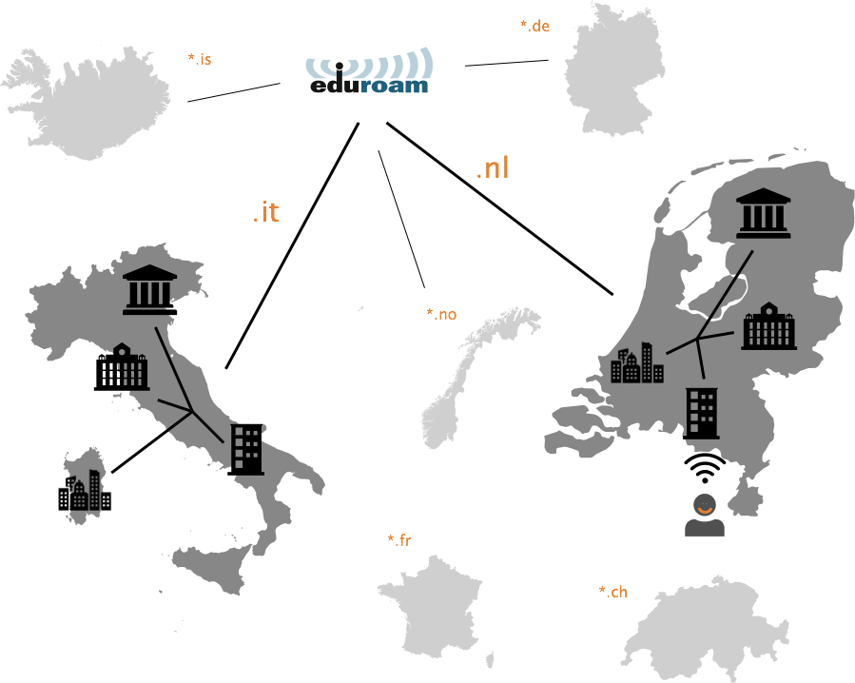

Slide 55
eduroam, the edu Wi-Fi standard
Concept originated at SURFnet,
developed with international TERENA (now Géant) community in 2003.
In use at primary-, secondary-, academic- and research
Large community, working on blueprints, knowledge, documentation, …
Mutual access with eduroam participants:
authentication using existing account at home-institution
authorization is easy: just one single purpose
Future-proof technology, tried and true concept.

Slide 56
Why did we start eduroam (1/2)
Security problems,
traditional wireless LAN is not safe:
  who is (ab)using the (wireless) network?
  are people eavesdropping?
  weak (or no) encryption, no authentication
Difficult to allow guests
  User-identification
  Distribute secrets? Maybe not.
Users are mobile, across borders

Slide 57
Why did we start eduroam (2/2)
Ease of use!
Always connected (like 2/3/4/5G? *))
Even on busy places, in cities, …
Open up your laptop and bang! You’re online
*) mobile data doesn’t always work well on crowded locations or in buildings,
Wi-Fi / eduroam can be used for seamlessly offloading data
4G, 5G won’t replace Wi-Fi, they both have their own roadmap

Slide 58

WiFi name is “eduroam”
Security settings the same
(WPA2-Enterprise)
Username is like e-mail
user@institution.tld
Authentication is forwarded
Give and take
A provides eduroam
A uses eduroam
B provides eduroam
B uses eduroam
Global trust
agreements, policies

Slide 59
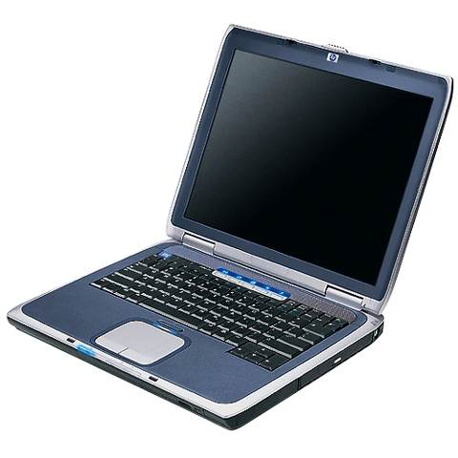
Bolting technologies together:
Eduroam end-to-end security, mutual authentication
Secured tunnel
Supplicant
Authenticator
(AP or switch)
RADIUS server
institution A
RADIUS server
institution B
User DB
User DB
Guest
user@institution-B.nl
Internet
guest
VLAN
regular
VLAN
Central RADIUS
Proxy server
A secure tunnel is established from the user’s computer to his home institution through which the actual authentication information (username/password etc.) will be carried (EAP-TTLS or PEAP)
Notes:
What technology does eduroam use?
In eduroam, communication between the access point and the user's home institution is based on IEEE 802.1X standard; 802.1X encompasses the use of EAP, the Extensible Authentication Protocol, which allows for different authentication methods. Depending on the type of EAP method used, either a secure tunnel will be established from the user’s computer to his home institution through which the actual authentication information (username/password etc.) will be carried (EAP-TTLS or PEAP), or mutual authentication by public X.509 certificates, which is not vulnerable to eavesdropping, will be used (EAP-TLS).

Slide 60
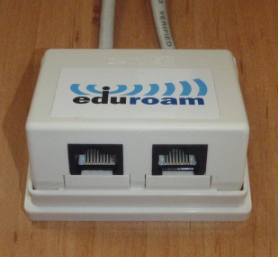
eduroam can be wired
In fact, 802.1x port-based authentication was designed for wired:
just not very popular, used in very few places

Slide 61
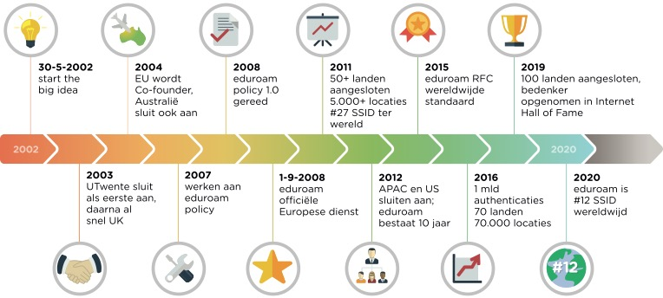
eduroam’s history until now

Slide 62
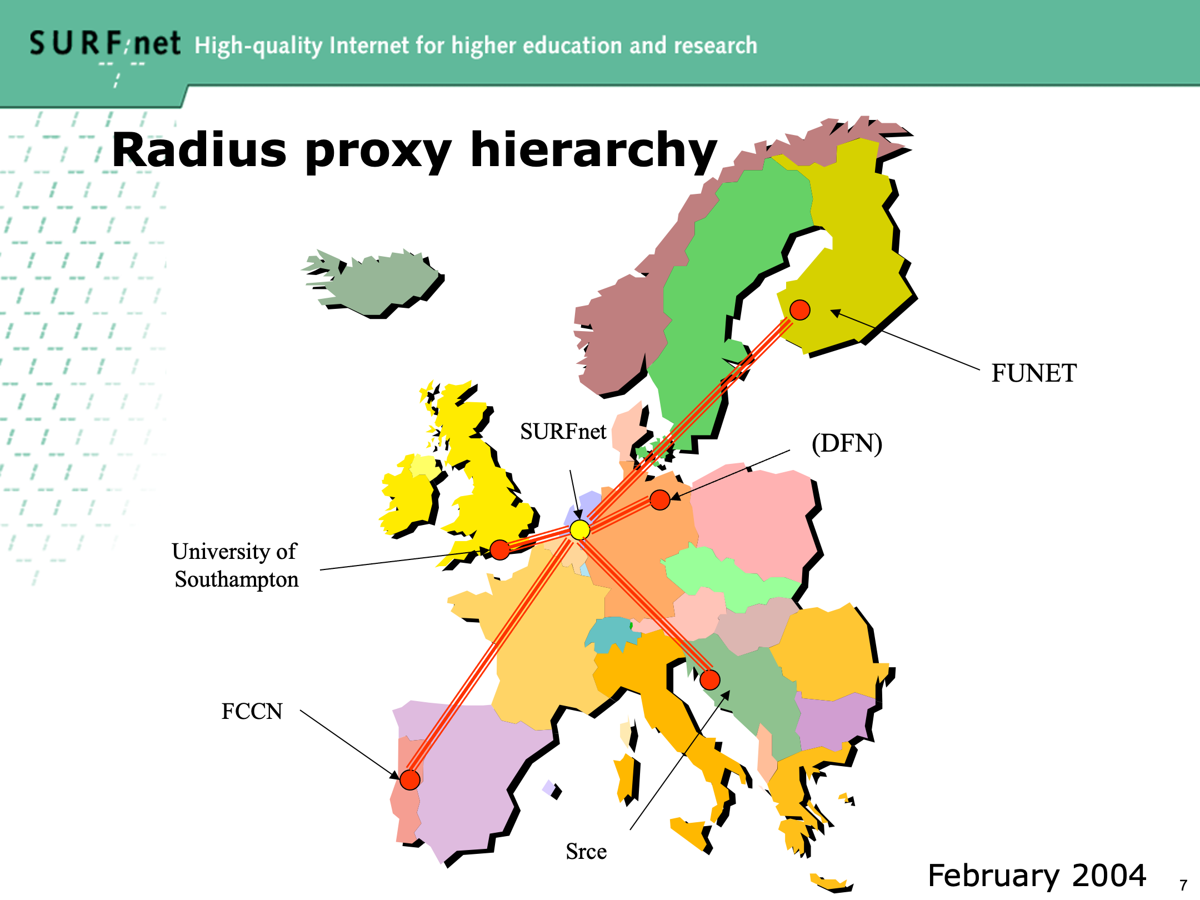

Slide 63
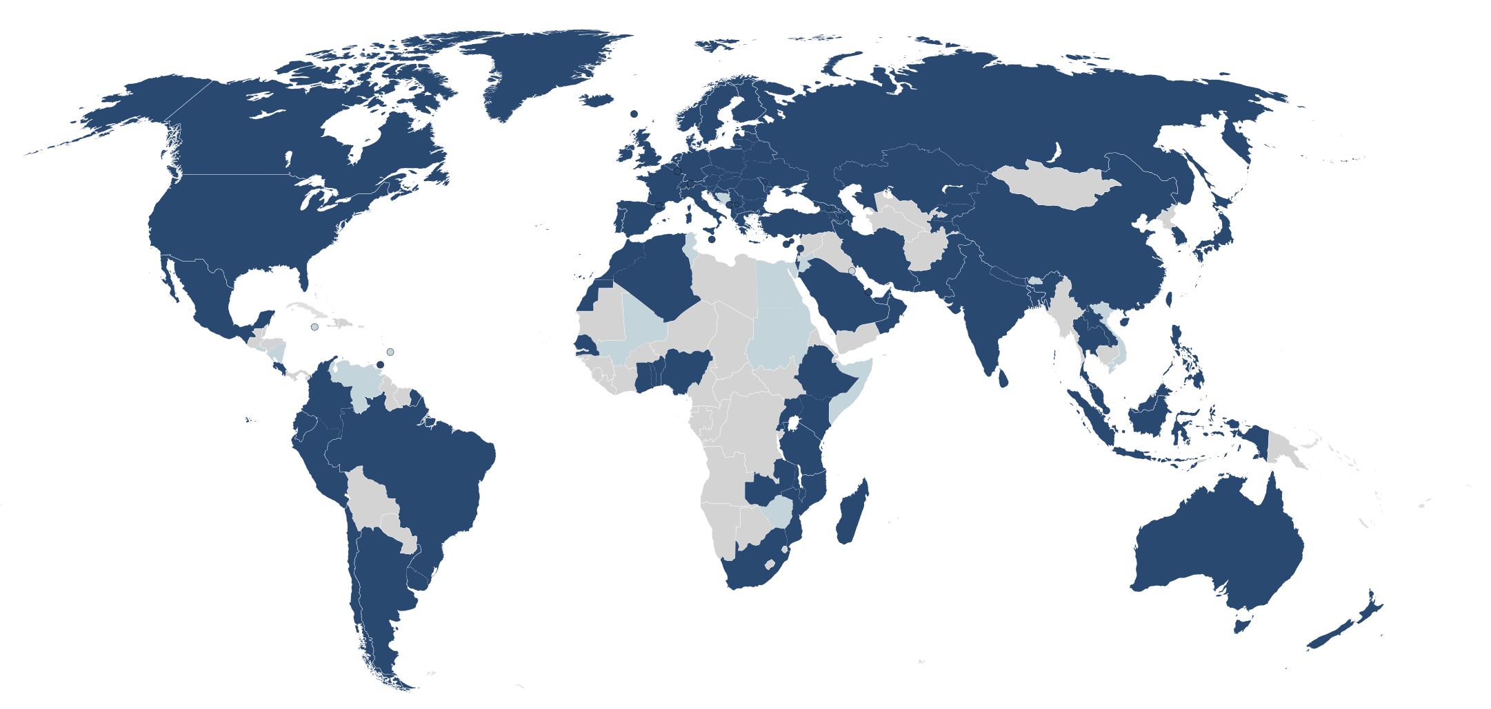
Now: 110 countries, 30.000 locations, 23 million users

Slide 64
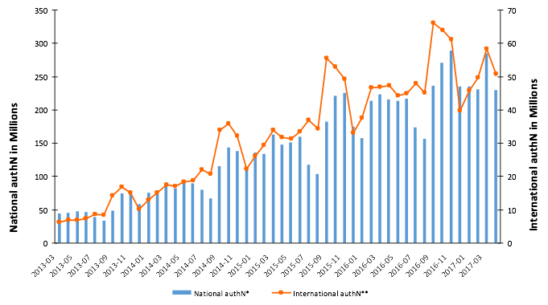
Huge international growth
billionth announced!

Slide 65
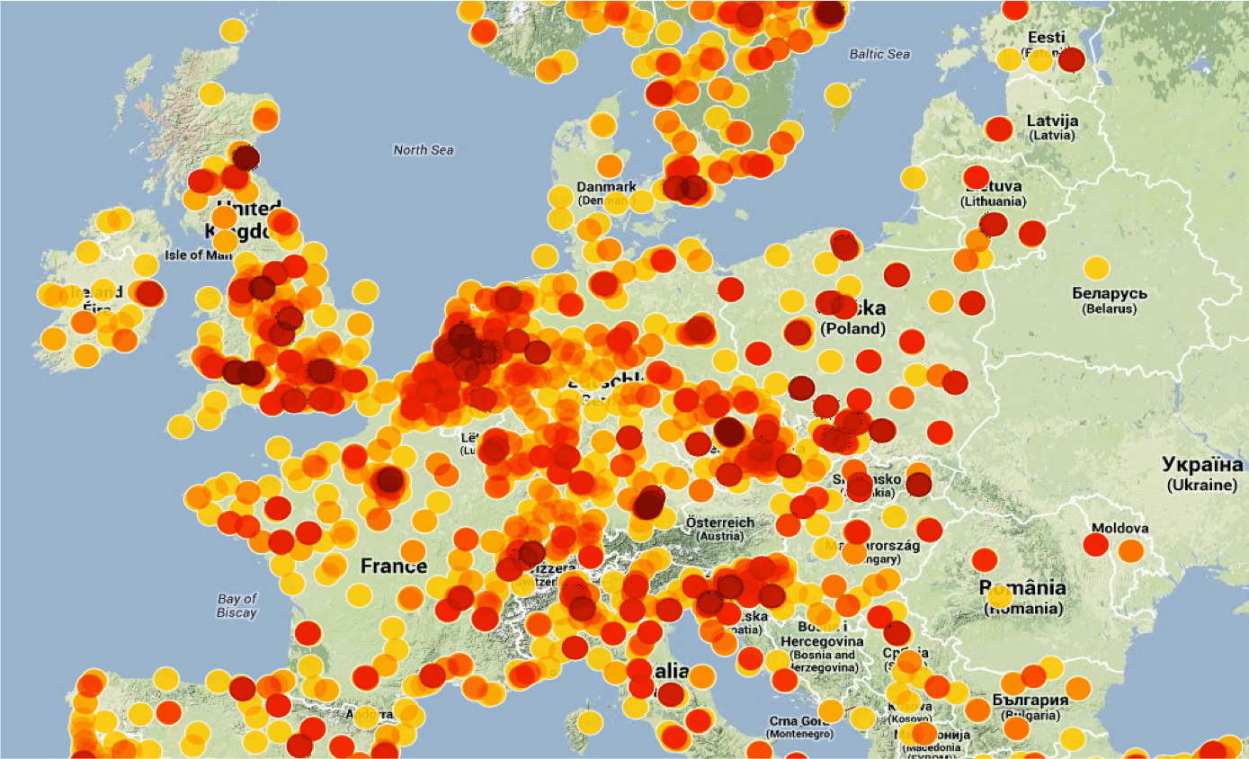

Slide 66



eduroam is visible

Slide 67

eduroam is welcoming
eduroam outside research and education:
cities, libraries, shops, hotels, restaurants, at 36 airports, train stations, busses, …
Digital divide, education everywhere
often receives support from the government

Slide 68

eduroam
eduroam is a popular and rewarding service;
everybody needs and loves Wi-Fi, strong community
Can’t go wrong going eduroam
  a lot of international support and knowledge
  Immediate benefit for end-users
  Just little extra work for administrators
NRENs, NROs required to operate eduroam

Slide 69
InAcademia

Slide 70

What is InAcademia?
SP proxy
A service in eduGAIN
Connects OIDC-based services
…pseudonymises eduGAIN persistent identifiers towards retail services
Non-linear: InAcademia cannot see the user’s shopping cart
Pseudonymises IDs
eduGAIN
Removes attributes

Slide 71
Why InAcademia ?
Protects user privacy:
  helps IdPs minimise PII sacrificed by users in return for discounts
Lightweight option: when services only need validation of user’s affiliation
Helps identify non-conformity
Alternative source of sustainability for T&I (we hope!)

Slide 72


Architecture
Core
OpenID Connect OpenID Provider
Filter removes PII
SAML Service Provider
Retailer (RP)
Identity Providers
IdP hinting
OpenID Connect
SAML2.0 SP in eduGAIN
Statistics Portal
Discovery Service
Demo Shop
Invoicing, etc
https://inacademia.org/technical-overview/ https://inacademia.org/inacademia-for-identity-federations/
https://demoshop.inacademia.org/shop/

Slide 73


























Downstream Services
Independents

Slide 74

Uptake/Participating Federations
Operating in:
SURF/the Netherlands
DFN/Germany
WAYF/Denmark, Iceland, Greenland
SIR/Spain
RENATER/France
IDEM/Italy
SWAMID/Sweden
YETKIM/Turkey
eduID.at/Austria
HAKA/Finland
Also registered in:
GRNET
Feide

Slide 75


Slide 76


eduGAIN is an inter-federation service

Slide 77
What is eduGAIN about ?
Building a secure and Worl-Wide Community of Services and Users
Sharing online resources, roaming users across the web, across institutions
Web Single Sign On
Level of Assurance associated to User Identities
Sharing of Metadata of Entities
Trust
Security
TechEx23, Minneapolis, September 2023
Making life of researchers easier, enable collaboration
The national trusted third party: the National Identity Federation

Slide 78


Inter-federated Access
Federation Blue
Federation Green

Slide 79

A complex ecosystem
Full mesh federation
SP
Federation A
SP
Hub and spoke distributed federation
AAI Proxy
SP
IdP
IdP
SP
SP
IdP
SP
SP
IdP
SP
IdP
SP
Research Infrastructure AAI
IdP
SP
IdP
IdP
SP
SP
IdP
Federation C
Federation B
Hub / Proxy

Slide 80






































The eduGAIN contributors & stakeholders

Slide 81
eduGAIN Global Coverage
79 Federations
9059 Entities
5456 Identity Providers
3622 Service Providers

Slide 82

eduGAIN Trust model
Users trust Home Organisation
HomeOrg/Providers trust Federations
Federations trust eduGAIN

Slide 83

GÉANT AAI
The GEANT Service Provider Proxy (GEANT SP Proxy) is a service provided by GEANT that allows GEANT Services to use federated authentication for identifying users from Academic Identity Providers.

Slide 84

GÉANT AAI Services Enrollment: how to connect a service to the GÉANT AAI
GÉANT AAI
https://wiki.geant.org/display/GSPP/How+to+connect+a+new+service+to+the+Geant+AAI+Service

Slide 85

Ongoing and future T&I developments
in the GÉANT R&E Community

Slide 86

The world around us is changing, evolving
Increasing Student Mobility and Erasmus+
The EU eIDAS2 regulation
The European Open Science Cloud (EOSC) and the whole galaxy of all EOSC projects
The growing uptake of Artificial Intelligence
The new EU Digital Wallets, implied trust model and the Large Scale Pilots
The Common European Data Spaces ( EHDS, DE,...)
The Digital Twins, Virtual Digital Human, Earth Digital Twin, …
The EuroHPC JU and HPC infrastructures
ESFRI Roadmap and new Research Infrastructures
OpenID Federation
Standard established

Slide 87
Outlook on the future:
eduGAIN is the current Global Trust Fabric for Research & Education
Specific Identity Layers have/are-being developed for HPC (MyAccess ID), for Student Mobility (MyAcademicID)
The GEANT AAI is omnipresent in the European Research & Education space
EU Identity Wallets and the eIDAS2.0 regulation will provide a new Identity model for online Trust, impacting on the online life of millions of European Citizens
GÈANT and the NRENs will keep providing a Data Infrastructure for education is delivered by the NRENs
The EOSC will establish its EOSC federation making use of the services provided by the R&E Community (won’t re-invent the wheel)
A new standard has been established for OIDC based federation

Slide 88




The eIDAS2 Regulation and the EU Identity Wallets
Large Scale Pilots

Slide 89


Towards a common AAI for HPC
HPC Data Centers are in the process of transforming to Infrastructure Service Providers with a diverse Service Portfolio
These infrastructure services become available in different administrative and policy domains, which we call Infrastructure Service Domains
A common Identity Layer enables uniform accessibility to scientists and engineers at European scale

Slide 90
Towards a common AAI for HPC
For users
  One identity to access resources across HPC sites and other infrastructures
  Ability to link multiple external identities (e.g. institutional accounts, national eIDs etc)
  Easy for novice users, unlocks new capabilities for advanced users.
For Infrastructures:
  A common way of authenticating users
  Strong identity assurance
  Multi-factor authentication
  Multi-protocol support (OIDC, SAML)
  Improved access management including terminal access

Slide 91



EOSC AAI Baseline Architecture
Based on the AARC Blueprint Architecture
Community AAI
The purpose of the Community AAI is to streamline researchers’ access to services, both those provided by their own infrastructure as well as the services provided by infrastructures that are shared with other communities.
Infrastructure Proxy
The Infrastructure Proxy, enables
Infrastructures with a large number of resources, to provide them through a single
integration point, where the Infrastructure can maintain centrally all the relevant policies
and business logic for making available these resources to multiple communities

Slide 92


Slide 93

Bringing everything together

Slide 94

Bringing everything beyond

Slide 95



Federated Identity Management and eduGAIN are useful !
Core AAI
Core AAI
Core AAI
HPC
Resources

Slide 96

Some popular federated-access online services and platforms
(not claiming exhaustiveness! )

Slide 97
Welcome to eduGAIN and a world of R&E Services around it !
Enjoy your week of training on eduGAIN and Identity Federations, make the most of it !

Slide 98

Acknowledgements/Credits for some of the slides I’ve presented:
GÉANT: Klaas Wierenga, Michelle Williams, Chris Atherton,
Beatrix Weber, Jennifer Ross,Leila Dekkar, Casper Dreef, Nicole Harris
GARR: Davide Vaghetti
SURF: Paul Dekkers
SUNET: Stefan Liström
Questions ?
mario.reale@geant.org
www.geant.org
© GÉANT Association
As part of the GÉANT 2020 Framework Partnership Agreement (FPA), the project receives funding from the European Union's Horizon 2020 research and innovation programme under Grant Agreement No. 856726 (GN4-3).

