Slide 1


Linux @ the command line – Refresher Session by AUB – IT

Slide 2
What we will cover?
Day 1
Shell
File System & Management
System Information
Symbols
Filters
Hotkeys
File Editors

Slide 3
What we will cover?
Day 2
Network
Process Management
File Compression
Package Management
Services Management
Firewall Management
Date and Time Management
Java, JDK and Certificate Tools

Slide 4

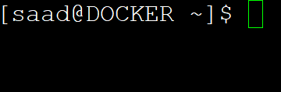

File System & Management: su,sudo,bash,ls,mkdir,cd, pwd,mv,cp,ln,touch,cat,mount,du,df,chmod,find, locate,hostnamectl,useradd,adduser
Bash Shell:
Command: su - root
Will switch user to root.
“root” user is like the “Administrator” user compared to Windows O/S and donated by the shell prompt “#”
Username
System name
Name of current directory
~ is special (home)
$ normal user (non-admin)

Slide 5

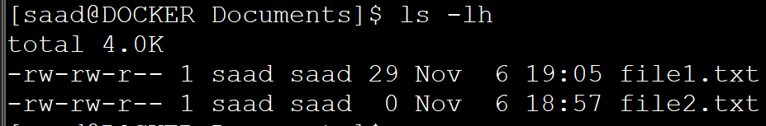


File System & Management: su,sudo,bash,ls,mkdir,cd,pwd,mv,cp,ln,touch,cat,mount,du,df,chmod,find, locate,hostnamectl,useradd,adduser
Command: pwd (Print working directory)
Command: ls -lh (can combine options -lh)
Command: ls (list directory)
Listing other directories
To list hidden files and directories type the command: ls -la
Try: ls --help will give you more info about available options

Slide 6
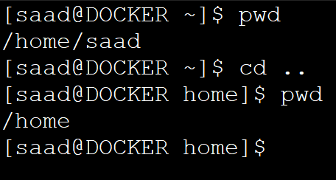
The Shell & Filesystem navigation cd:
Directories start with /<directory name>
Example: /, /etc , /home
$ cd .
(“.” means “this directory”)
$ cd /usr
(will change directory to /usr)
Tab completion: Press Tab in order to complete the command and path without typing the whole command/path only if found.
“..” means “the directory above this one”
$ cd ~
(Will take you to Home directory, as tilda ~ symbol represent home)

Slide 7
The Shell & Filesystem navigation bash, ./:
Bash: In order to run a program written in Bash (official shell for Linux) you may either run using the command bash or ./
Example: bash script.sh or ./script.sh
Bash and Shell scripts have the following lines on top of the file:
#!/bin/sh
#!/bin/bash
Bash and Shell scripts extension is “.sh”

Slide 8
File System & Management: su,sudo,bash,ls,mkdir,cd,pwd,mv,cp,ln,touch,cat,mount,du,df,chmod,find, locate,hostnamectl,useradd,adduser
Hostnamectl: hostnamectl will display information about system name, OS name, Machine ID, Kernel version and Architecture. Also it changes the name of the server.
Display info: hostnamectl status
Change server name (no reboot!): hostnamectl set-hostname name
Link: ln is a command-line utility for creating links between files. By default, the ln command creates hard links. To create a symbolic link, use the -s (--symbolic) option.
Example: ln -s /usr/local/src/jetty-src/bin/jetty.sh jetty
Try: <command> --help or man <command> will give you more info & help about available options

Slide 9
File System & Management: su,sudo,bash,ls,mkdir,cd,pwd,mv,cp,ln,touch,cat,mount,du,df,chmod,find, locate,hostnamectl,useradd,adduser
Useradd: useradd will create a new user on the system.
Example to create a new user and add it to the same group:
useradd --system --home-dir /usr/local/src/jetty-src --user-group jetty
Adduser: adduser will create a new user similar to useradd with no additional options.
Example: adduser jetty
*useradd is more granular and for manual specific requirement upon creating a new user.
Try: <command> --help or man <command> will give you more info & help about available options

Slide 10
File System & Management: su,sudo,bash,ls,mkdir,cd,pwd,mv,cp,ln,touch,cat,mount,du,df,chmod,find, locate,hostnamectl,useradd,adduser,export,clear,set
Export: export is bash shell BUILTINS commands, which means it is part of the shell. It marks an environment variables to be exported to child-processes.
Example: export JAVA_HOME=/usr/lib/jvm/java
Try: <command> --help or man <command> will give you more info & help about available options
Clear: clear command will flush the output of the terminal screen for a clean view.
Set: set command will display the current loaded environment variables to the users from /etc/bashrc (system-wide), /etc/profile.d (system-wide), /home/<user>/.bashrc (local)
I need to note system-wide means loaded to all users.
***also .bashrc starts with a “.” which means it’s a hidden file, use command ls -la to list hiddent files.

Slide 11
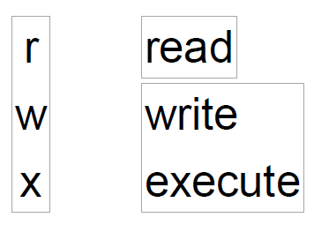
File permissions chmod & chown:
chmod: change mode file/directory permissions.
-rw-rw-r-- donates:
chmod u+rwx file1.txt will allow file1.txt to be read,write,executed by the user.
file/directory permission is divided to 3 parts in order:
Users, groups, others.
Try: chmod --help will give you more info about available options

Slide 12
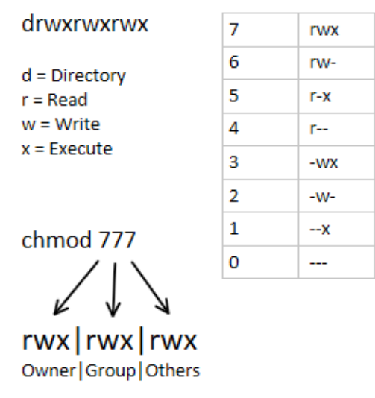
File permissions chmod & chown:
Chmod: “--- --- ---”filename.txt
To represent rwx triplet use 4+2+1=7
To represent rw- triplet use 4+2+0=6
To represent r– triplet use 4+0+0=4
To represent r-x triplet use 4+0+1=5
To only give full permission to user, use it as follows:
chmod 0700 file.txt or chmod 700 file.txt

Slide 13
File permissions chmod & chown:
chown: change ownership of file/directory.
chown -R saad:saad <directory> will change the owner recursively to the directory and its sub-directories.
chown saad:saad file1.txt will change file1.txt ownership/groupship to desired user/group.
Need to be root (administrator on the system) to change to other owner.
Try: chown --help will give you more info about available options

Slide 14
File & Directory management cp,mv,rm,mkdir,touch,find,locate,cat:
cp: will copy files & directories if you add option “-r” example: cp -r <dir1> <dir2>
mv: will move files & directories and also it can rename!
rm: will remove files only! If you add option “-rf” it will remove directories.
mkdir: will make new directory.
touch: will create new file
Try: <command> --help or man <command> will give you more info & help about available options

Slide 15
File & Directory management cp, mv, rm, mkdir, touch, find, locate, cat :
Find: search files and directories on the system.
Example: find /etc -name hosts
Locate: need to be installed it uses database to search for files and directories fast!
Commands: updatedb,locate <file>
Cat: prints output of a file.
Example: cat <file1.txt>
Try: <command> --help or man <command> will give you more info & help about available options

Slide 16
Symbols:
Pipe and redirections |, >, >>
Pipe |: | is a command in Linux that lets you use two or more commands such that output of one command serves as input to the next. Example: cat file.txt | grep “hello”
> : Redirect the input to another file.
>>: Adds additional input appending the file.
Example 1 “>”: echo “This is a test” > newfile.txt
It will add the line: This is a test to the newfile.txt.
Example 2 “>>”: echo “This is a new line” >> newfile.txt
It will append a new line (This is a new line) to the newfile.txt
Try: <command> --help or man <command> will give you more info & help about available options

Slide 17
Filters: grep, more, less, head, tail
Grep: grep search for a string of characters in a specified file.
Example: grep “hello” <file1>
More: more command is used to view the text files in the command prompt, displaying one screen at a time in case the file is large (For example log files).
Less: less is most useful for viewing the content of large files or the results of commands that produce many lines of output.
Head: head it prints the first 10 lines of the specified files.
Tail: tail returns the last ten lines of each file that it is given. It may also be used to follow a file in real-time and watch as new lines are written to it.
Try: <command> --help or man <command> will give you more info & help about available options

Slide 18
Hot keys
CTRL + C
When you have a process running in a terminal window, you can kill that process with the Ctrl + c combination.
CTRL+ALT+DELETE
If all else fails and you just need to reboot, you can hit this combination to instantly start the reboot process.
CTRL + R
When you hit Ctrl + r, you are prompted to enter a character (or string of characters). You'll have returned to you any previously issued command with that character or combination within.

Slide 19
File Editors vim and nano:
vim: Is a powerful text editor that most Linux admins & users use all the time.
Basic usage, example: vim file1.txt
Movement: <Arrow Keys> or <h>,<j>, <k>,<l>,<b>,<e>,<0>,<$>,<gg>,<G>
Add text: press letter: i (insert text/edit)
Exit command line: press ESC (exit to VIM command line)
Change/Delete/Replace: <x>,<cw>,<dw>,<dd>,<r>,<R>
Copy/Paste: <v>,<P>,<u>,<y>,<yy>
Search/Replace: </>,<n>,<N>,<:%s/’regex’/’replacement’/g>
Save/Quit: <:q>,<:w>,<:q!>
Try: <command> --help or man <command> will give you more info & help about available options

Slide 20
File Editors vim and nano:
Nano: Nano text editor is pre-installed on most Linux distros.
Open files with nano type: nano <filename>
Edit: You can edit anywhere and press ctrl+x to save.
User friendly text editor and easy to work on.
Try: <command> --help or man <command> will give you more info & help about available options

Slide 21
Process Management CLI: ps,top,kill,bg,fg
Ps: ps will print the list of processes – combine with options “-ef”, “aux” for listing all information regarding current running processes and by who on the system.
Top: top same as ps but with interactive live output of the processes.
Kill: kill command kills the PID (process ID) of the process. (kill –l) for listing kill signals ( most popular is “-9” will terminate the process).
Bg: bg (background) will send the process to run it background and return you to the shell, donated by “&” ex: vim &
Fg: fg (foreground) brings the bg process back to the commandline.
Try: <command> --help or man <command> will give you more info & help about available options

Slide 22
Network Tools: ssh,scp,ping,telnet,netstat,nslookup,wget,nc,curl
ssh: ssh is gateway to connect to the server, it uses tcp port 22 such as putty or native linux ssh tool.
scp: scp and winscp are tools to upload and download files to/from server.
ping: ping checks if the server is alive by sending request and receiving replies.
telnet: telnet used to check if port is open on specific host.
Netstat: displays the connection from/to and opened ports on the system.
Netcat: nc utility to check for open server ports with option “-vz”
Nslookup : nslookup will check server name to what ip address.
Wget: wget utility for downloading files from the Internet.
Curl: curl is a tool to transfer data to or from a server, using any of the supported protocols (HTTP, FTP)
Try: <command> --help or man <command> will give you more info & help about available options

Slide 23
System Information: hostname,w,whoami, man,which,free,df,echo,date,uname
Hostname: hostname shows the server name.
W: w shows who is currently logging into the system with uptime.
Whoami: whoami command will show your current logged in user.
Man : man give descriptive help information about any given command.
Which: which command identifies the location path of the executable binary that launches when you issue a command to the shell.
Free: free utility to check RAM memory total/consumed.
Df : df utility to check the amount of free/consumed disk space.
Echo: echo is a command that outputs the strings it is being passed as arguments.
Date: date displays the current date & time on the system.
uname: “uname –a” gives you information about the kernel version
Try: <command> --help or man <command> will give you more info & help about available options

Slide 24
File compression: tar, tar.gz, unzip, zip
Tar: tar (Tape archive(r)) compress files and directories hence reduces file size. Extension can be .tar or .tar.gz files.
Example Create tar file: tar -cvf directry1.tar /home/user/directory1
Will compress all files inside directory1 to a create directory1.tar
Example Extract tar file: tar -xvf directory1.tar
Will extract the compressed files of directory1.tar to the current directory.
Example Extract tar.gz file: tar -xzf file.tar.gz
Will extract the compressed files of file.tar.gz to the current directory.
Zip: zip with “-r” will create a zip file.
Unzip: unzip a zipped file.
Try: <command> --help or man <command> will give you more info & help about available options

Slide 25
Package Management: yum,apt,dnf,rpm,dpkg
Yum (CENTOS,RHEL,SUSE): yum is the primary tool for getting, installing, deleting, querying, and managing rpm packages.
Example install wget utility: yum install wget
Example update/upgrade: yum update;
APT (Debian, Ubuntu): apt is a command-line utility for installing, updating, removing, and otherwise managing deb packages on Ubuntu, Debian.
Example install wget: apt install wget or apt-get install wget
Example update/upgrade: apt-get update or apt upgrade
RPM: rpm is used to install/remove .rpm files.
Dpkg: dpkg is used install/remove .deb files.
***dnf new package management is the future of yum, same options as yum applies.
Try: <command> --help or man <command> will give you more info & help about available options

Slide 26
Services Management: systemctl and service
Systemctl: systemctl command is a utility which is responsible for examining and controlling the systemd system and service manager. It is a collection of system management libraries, utilities and daemons which function as a successor to the System V init daemon.
Example: To enable on system startup apache webserver:
systemctl enable httpd
Example: To start apache webserver:
systemctl start httpd
Example: To check the status of apache webserver:
systemctl status httpd
Note that you can also use the “stop” switch to stop the webserver and “restart” switch to restart the webserver.
Try: <command> --help or man <command> will give you more info & help about available options

Slide 27
Services Management: systemctl and service
Service: service command is used to run a System V init script. Usually all system V init scripts are stored in /etc/init.d directory and service command can be used to start, stop, and restart the daemons and other services under Linux.
Chkconfig: chkconfig command is used to list all available services and view or update their run level settings for startup/shutdown.
Example: To Add and Enable on system startup Jetty webserver:
chkconfig --add jetty; chkconfig jetty on
Example: To start Jetty webserver:
service jetty start
Example: To check the status of Jetty webserver:
service jetty status
Note that you can also use the “stop” switch to stop the webserver and “restart” switch to restart the webserver.
Try: <command> --help or man <command> will give you more info & help about available options

Slide 28
Firewall Management: iptables, firewalld
Iptables: iptables is a command line interface used to set up and maintain tables for the Netfilter firewall for IPv4, included in the Linux kernel. The firewall matches packets with rules defined in these tables and then takes the specified action on a possible match.
Basic commands for iptables:
List applied rules: iptables -L
Allow incoming web traffic on port 8080: iptables -A INPUT -p tcp --dport 8080 -j ACCEPT
Block incoming web traffic on port 8080: iptables -A INPUT -p tcp --dport 8080 -j DROP
Clear iptables rules: iptables -F
Try: <command> --help or man <command> will give you more info & help about available options

Slide 29
Firewall Management: iptables, firewalld
Firewalld: firewalld is a firewall management solution available for many Linux distributions which acts as a frontend for the iptables packet filtering system provided by the Linux kernel.
Basic commands:
Allow incoming https service: firewall-cmd -permanent --add-service=https
Block incoming https service: firewall-cmd -permanent --remove-service=https
Viewing firewall rules: firewall-cmd --list-all
*Note that you must enable/start firewalld service before you start using it.
Enable Firewalld: systemctl enable firewalld
Start Firewalld: systemctl start firewalld
Stop Firewalld: systemctl stop firewalld
Status Firewalld: systemctl status firewalld
Try: <command> --help or man <command> will give you more info & help about available options

Slide 30
Date and Time Management: chronyd, ntpd, date, timedatectl
Chrony: chronyc is a flexible implementation of the Network Time Protocol (NTP). It is used to synchronize the system clock from different NTP servers, reference clocks or via manual input.
Chrony comes with two programs:
chronyc – command line interface for chrony
chronyd – daemon that can be started at boot time
Configuration file is found at /etc/chrony.conf
Enable Chrony: systemctl enable chronyd
Start Chronyd: systemctl start chronyd
Status Chronyd: systemctl status chronyd
Check Chrony time sources: chronyc sources -v
Try: <command> --help or man <command> will give you more info & help about available options

Slide 31
Date and Time Management: chronyd or ntpd, date, timedatectl
NTPD: ntpd, ntp
The Network Time Protocol (NTP) is a protocol used to synchronize computer system clock automatically over a networks. The machine can have the system clock use Coordinated Universal Time (UTC) rather than local time, uses udp port (123).
NTPD comes with two programs:
ntpq – command line interface for chrony
ntpd – daemon that can be started at boot time
Configuration file is found at /etc/ntpd.conf
Enable NTPD: systemctl enable ntpd
Start NTPD: systemctl start ntpd
Status NTPD: systemctl status ntpd
Check NTPD time sources: ntpq –p or systemctl status ntpd
Try: <command> --help or man <command> will give you more info & help about available options

Slide 32
Date and Time Management: chronyd or ntpd, date, timedatectl
NTPD: ntpd, ntp
The Network Time Protocol (NTP) is a protocol used to synchronize computer system clock automatically over a networks. The machine can have the system clock use Coordinated Universal Time (UTC) rather than local time, uses udp port (123).
NTPD comes with two programs:
ntpq – command line interface for chrony
ntpd – daemon that can be started at boot time
Configuration file is found at /etc/ntpd.conf
Enable NTPD: systemctl enable ntpd
Start NTPD: systemctl start ntpd
Status NTPD: systemctl status ntpd
Check NTPD time sources: ntpq –p or systemctl status ntpd
Try: <command> --help or man <command> will give you more info & help about available options

Slide 33
Date and Time Management: chronyd or ntpd, date, timedatectl
Date: date displays the current date & time on the system.
Timedatectl: timedatectl command is a new utility which comes as a part of the systemd system and service manager, a replacement for old traditional date command used in sysvinit daemon based Linux distributions.
Check status of date and timezone: timedatectl status
List time zones on the system: timedatectl list-timezones
Change time zone of the system: timedatectl set-timezone “Asia/Beirut”
To Set time only: timedatectl set-time 15:58:30
To Set date only the format of date in YY:MM:DD (Year, Month, Day): timedatectl set-time 20151120
Try: <command> --help or man <command> will give you more info & help about available options

Slide 34
Javas: Oracle JDK, OpenJDK, Amazon Corretto, and Certificate Tools:
Oracle JDK: is a non-free Java Development Kit for enterprise systems, it provides updates and support for Enterprise Applications.
OpenJDK: The biggest difference between OpenJDK and Oracle JDK is licensing. OpenJDK is completely open source Java with a GNU General Public License. Oracle JDK requires a commercial license under Oracle Binary Code License Agreement. But there are many other differences within support and cost, too.
Amazon Corretto: is a reliable build of OpenJDK with the assurance of long-term support provided at no cost to you. Corretto fixes or mitigates a problem we found running OpenJDK. Amazon also plans to apply urgent fixes (including security) when they are available and ready to use, outside of the regular quarterly cycle. Amazon runs Corretto internally on thousands of production services.
Basic Java commands:
Check version: java –version; java
Try: java -help or man <command> will give you more info & help about available options

Slide 35
Javas: Oracle JDK, OpenJDK, Amazon Corretto, and Certificate Tools:
Openssl: Is a cryptography software library or toolkit that makes communication over computer networks more secure. The OpenSSL program is a command-line tool for using the various cryptography functions of OpenSSL’s crypto library from the shell. It is generally used for Transport Layer Security(TLS) or Secure Socket Layer(SSL) protocols and creates keys and csr for requesting SSL/TLS Certificates.
Basic used commands:
Display version: openssl version
Create RSA Private Key: openssl genrsa -out private.key 2048
Create new Private Key and CSR: openssl req -nodes -newkey rsa:2048 -keyout custom.key -out custom.csr
It will ask for the details like country code, state and locality name, Organization name, your name, email address, etc. And after entering all the details it will generate 2 files one with the CSR extension and the other with key extension representing CSR and private key respectively.
Try: openssl -help or man <command> will give you more info & help about available options

Slide 36
Javas: Oracle JDK, OpenJDK, Amazon Corretto, and Certificate Tools:
Openssl cont’d:
Send the CSR to Certificate Authority to obtain Certificate and import along along with the key and Intermediate/Root Certificate to webservers example: Apache, Apache Tomcat, Jitty, Nginx.
Check validity of the certificate (prints out sha1 key): openssl x509 -in federation-cert.pem -fingerprint -sha1 –noout
Read crt/cer certificate file: openssl x509 -noout -text -in WebCertificate.crt (or .cer)
Read private key file: openssl rsa -noout -text -in private.key
Check certificate expiry date: openssl x509 -noout -in certificate.cer -dates
Try: openssl --help or man <command> will give you more info & help about available options

