Slide 1
DANTE AAI Training:
Part 2: Under the Hood
Nicole Harris, TERENA

Slide 2
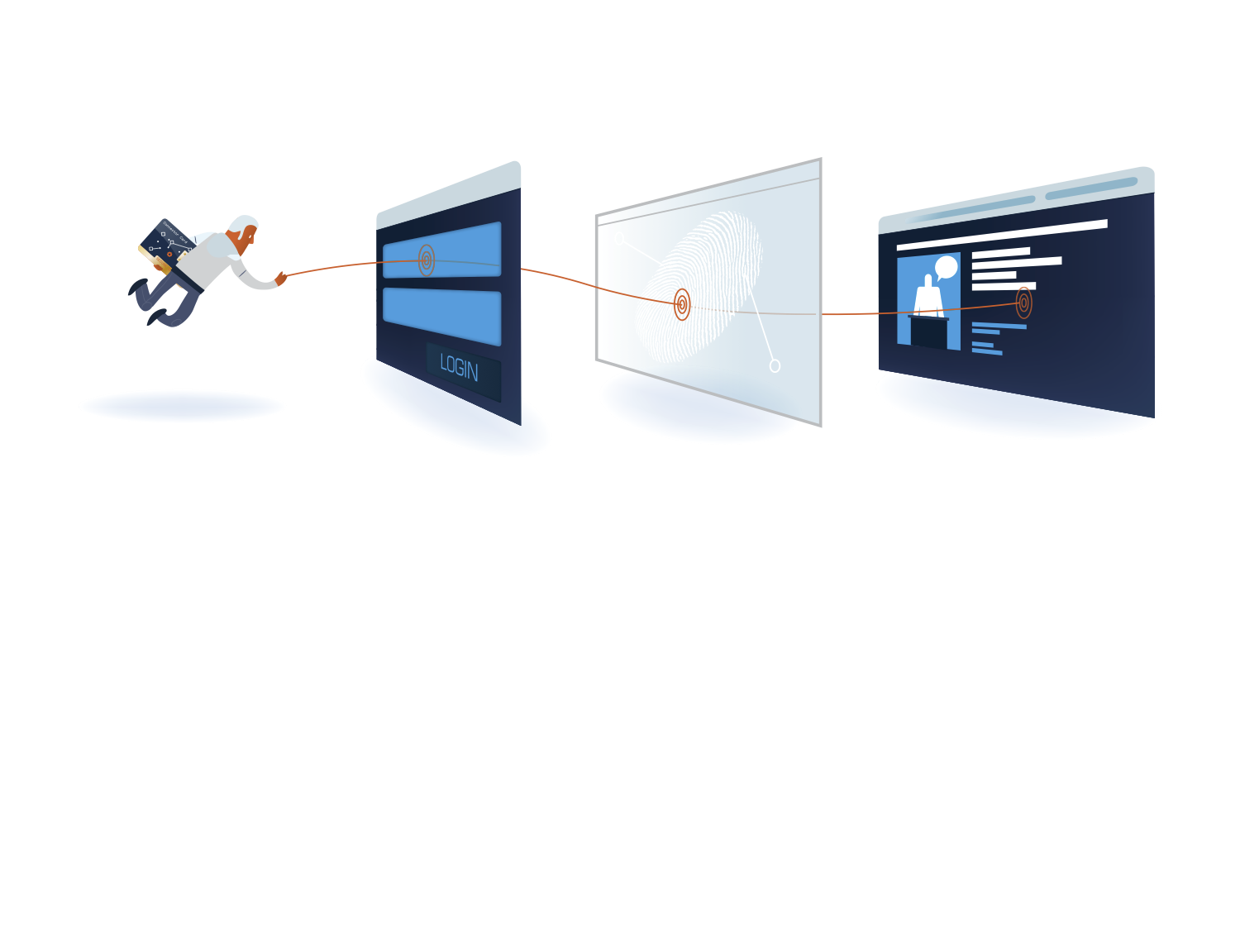
Learning Objectives
How does Federated Identity work in practice?
Components:
  SAML
  Metadata
  Attributes
User Experience
  Discovery Issues
  Current deployments
Notes:
Fix image
Learn the principles behind eduGAIN, FaaS, Enabling Users,
Highlight differences with eduroam and moonshot

Slide 3
Under the Hood Cloak
Identity Management with a little help from Harry Potter
(with apologies for ensuing cheesiness and bad puns)
“What happened down in the dungeons between you and Professor Quirrell is a complete secret, so, naturally the whole school knows.” - Philosopher’s Stone.

Slide 4
Why?
We are ALL irresponsible with usernames and passwords.
Importance of use of an AFFILIATED credential – proven less likely to share.
Protect against the Gilderoy Lockhart’s of this world:
  Steals memory of witches and wizards;
  Claims authority for the exploits in autobiography.
More lasting impact than simply sharing the password to the Gryffindor Common Room.
"Which person, which abysmally foolish person wrote down this week's passwords and left them lying around?" - Prisoner of Azkahban.

Slide 5
What is SAML?
SAML
Assertion
Protocol
Bindings
Profile
Security Assertion Markup Language. A Standard.

Slide 6
Elements of SAML
SAML
Assertion
=
A statement. Something I want to say or ask.
Protocol
=
What assertions will be made.
Bindings
=
HOW these assertions will be made
Profile
=
How this gets deployed in a specific community
“The placing of your name in the goblet constitutes a binding, magical contract. There can be no change of heart once you have become a champion.” – Goblet of Fire.

Slide 7
Elements of SAML Redux
Assertion
“Hello this is Dobby”.
Protocol
“Hi this is Hogwarts with some information. Dobby would like to contact you and he would like to tell you some information. This information is his name.”
Binding
Profile
“Dobby will only be able to talk to you via Owl Service and not via Howler”.
“Hogwarts choses to use Owl Service to talk to the outside world. Hogwarts will not send owls to Dementors or Muggles but will always send them to qualified Wizards.”

Slide 8
So?
“SAML is simply a tool that allows an Identity Provider to talk to a Service and share information safely and securely.”
“Elementary wand safety, nobody bothers about it anymore…” – Goblet of Fire

Slide 9
What is Shibboleth?
Software implementation of SAML
Many parts to the software:
Think of Shibboleth as your wand, and SAML as the spell words.
Shibboleth
IdP
SP
WAYF
Fed Tools
The wand chooses the wizard, Mr. Potter. – Philosopher’s Stone

Slide 10
What do federations do?
PROCESS
TRUST
THAT’S IT.
Register Member
Sign Policy
Register ‘Entities’
Verify Data
Publish ‘Entities’
Sign Metadata
Don't expect me to explain everything, just trust me blindly, trust that I know what I'm doing, trust me even though I don't trust you! – Deathly Hallows.

Slide 11
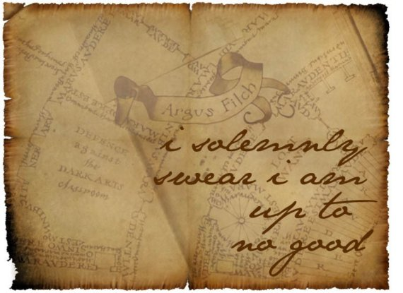
Policy
Simply, a promise by the member to behave in a certain way.
Self-declared, which will be important in the Assurance discussion.
Like the Marauder’s Map:

Slide 12
Entity Information
The information an IdP or SP gives to a federation. Publicly available.
</EntityDescriptor>
<EntityDescriptor ID="uk001516" entityID="https://terena.org/sp">
<!--This is a SimpleSAMLphp Service Provider Proxy for TERENA.-->
<Extensions>
<mdrpi:RegistrationInfo registrationAuthority="http://ukfederation.org.uk"/>
<ukfedlabel:UKFederationMember/></Extensions>
<SPSSODescriptor protocolSupportEnumeration="urn:oasis:names:tc:SAML:2.0:protocol">
<KeyDescriptor use="signing">
<ds:KeyInfo>
<ds:X509Data>
<ds:X509Certificate>
</KeyDescriptor>
<SingleLogoutService Binding="urn:oasis:names:tc:SAML:2.0:bindings:HTTP-Redirect"Location="https://login.terena.org/wayf/module.php/saml/sp/saml2-logout.php/default-sp"/>
<AssertionConsumerService Binding="urn:oasis:names:tc:SAML:2.0:bindings:HTTP-POST" Location="https://login.terena.org/wayf/module.php/saml/sp/saml2-acs.php/default-sp" index="0"/>
<AssertionConsumerService Binding="urn:oasis:names:tc:SAML:2.0:bindings:HTTP-Artifact" Location="https://login.terena.org/wayf/module.php/saml/sp/saml2-acs.php/default-sp" index="2"/>
</SPSSODescriptor>
<Organization>
<OrganizationName xml:lang="en">TERENA</OrganizationName>
<OrganizationDisplayName xml:lang="en">TERENA: Service Provider Proxy</OrganizationDisplayName>
<OrganizationURL xml:lang="en">http://www.terena.org/</OrganizationURL>
</Organization>
<ContactPerson contactType="support">
<GivenName>TERENA AAI Support</GivenName>
<EmailAddress>mailto:aai@terena.org</EmailAddress>
</ContactPerson>
<ContactPerson contactType="technical">
<GivenName>TERENA AAI Support</GivenName>
<EmailAddress>mailto:aai@terena.org</EmailAddress>
</ContactPerson>

Slide 13
Attributes
The information an IdP sends an SP (the federation does not typically see this).
Attributes about ourselves. For Sirius Black this might be:
  Sirius
  Animagus
  “Padfoot”
  Criminal
  Godfather
  member@orderofthephoenix.com
“Which one of you can tell me the difference between an animagus and a werewolf?” – Prisoner of Azkahban.

Slide 14
Attributes (cont.)
We only wish to share certain information with some people.
We want to hide different information from different people (criminal, membership, relation to others).
Can be anything – email, name, address, wand size, wand wood etc.
Mostly commonly expressed via “eduPerson” in educational context.
KEYWORD = SCOPED. Means associated specifically with something. In this case, normally an organisation I belong to.

Slide 15
eduPerson
eduPersonScopedAffilation
who you are in an organisation: student, staff, affiliate, library walk-in, house elf, dark lord.
eduPersonPrincipleName
eduPersonTargetedID
eduPersonEntitlement
“a persistent, globally unique user identifier”. Also scoped, so can look like an email address: harryp@hogwarts.ac.uk
a random number associated with you, that gives no personal information about you.
a bit of a cheat. Place to catch specific requirements that don’t fit elsewhere.

Slide 16
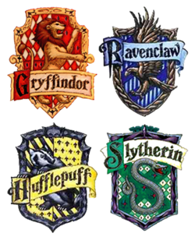
Entity Categories
Bold Gryffindor from wild moor,
Fair Ravlenclaw from glen,
Sweet Hufflepuff from valley broad,
Shrewd Slytherin from fen.
Sorting Hat places students in houses or categories based on their attributes.
Entity Categories place Entities in to categories based on the attributes they need and are allowed.

Slide 17



Entity Category: R&S
SP applies to be in research and scholarship category
Federation checks purpose of SP business and ‘need’ for attributes. Tags SP Entity
IdP has already decided to support R&S with support tag – attributes automagically flow!
More on this tomorrow

Slide 18
Discovery: Where Are You From?
First question asked in the exchanged when a user logs in.
Which IdP should we use, Where Are You From?
Either a list or a type-ahead box.
Often very very very badly implemented. Try logging in as “King’s College London” to:
  www.sciencedirect.com
  onlinelibrary.wiley.com
  historicaltexts.jisc.ac.uk
“Only a person who wanted to find the Stone -- find it, but not use it -- would be able to get it” – Philosopher’s Stone.
Notes:
Plan to demo the bad discovery if possible

Slide 19
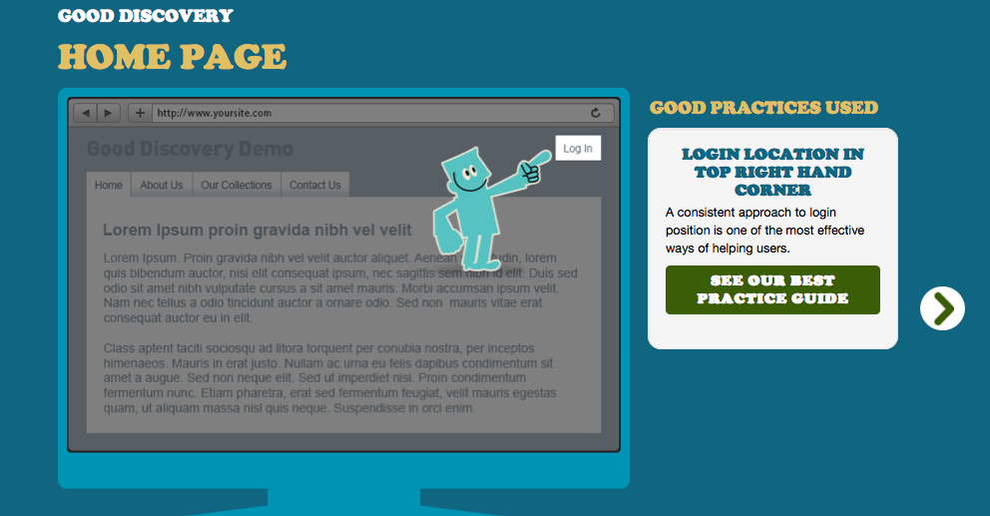
REFED Discovery Guide: discovery.refeds.org
Notes:
Plan to do live demo of these slides if possible

Slide 20
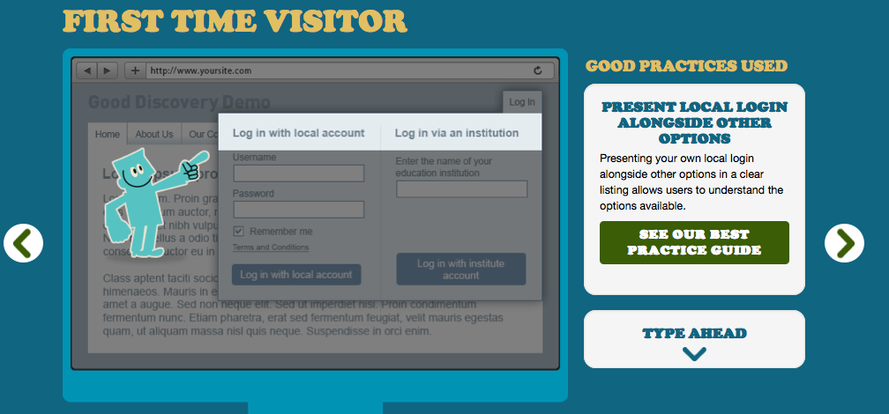
REFED Discovery Guide: discovery.refeds.org

Slide 21
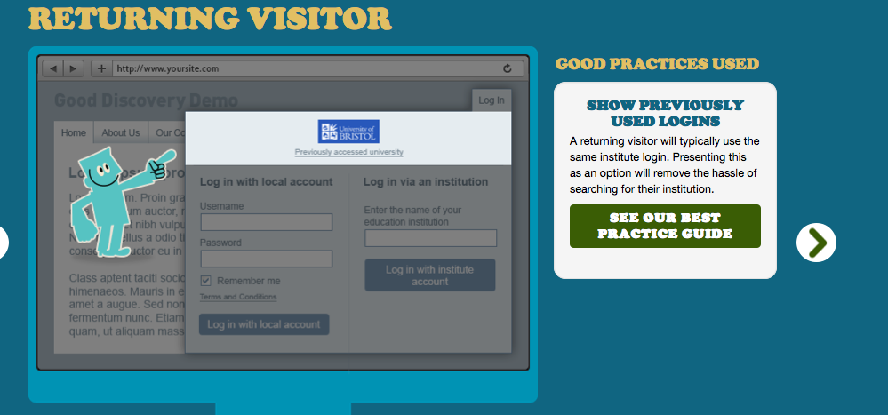
REFED Discovery Guide: discovery.refeds.org

Slide 22
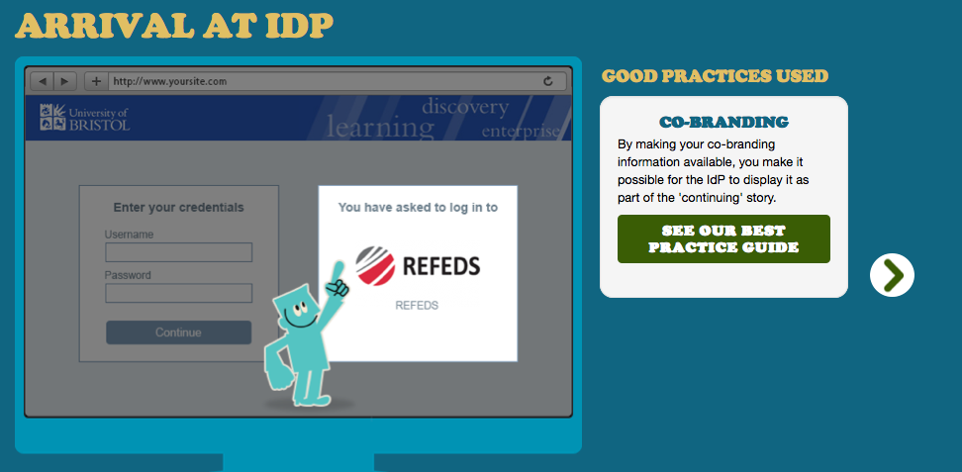
REFED Discovery Guide: discovery.refeds.org

Slide 23

Quiz Time

Slide 24
Quiz Time
Which of the following does NOT describe SAML?
  Assertion
  Protocol
  Software implementation
  Binding
Which of the following is NOT true?
  Federation members must sign a policy when joining a federation.
  Policy statements are self declared.
  A member can only register 1 entity.
  The federation carries out verification checks for registered entities.
Who can see entity information in federation metadata?

Slide 25
Quiz Time
Who can see attribute information passed by the IdP?
What is eduPersonScopedAffiliation?
  A way to describe your role within an organisation.
  Your name.
  A description of what you can access.
  A number assigned to you.
Name one feature of good discovery practice.

Slide 26
Thank you!

