Slide 1


The GÉANT Automation Platform
How to: migrating a backbone link
Karel van Klink
Network Engineer (Network Evolution)
33rd STF – DFN, Berlin
13/11/2024
Public

Slide 2
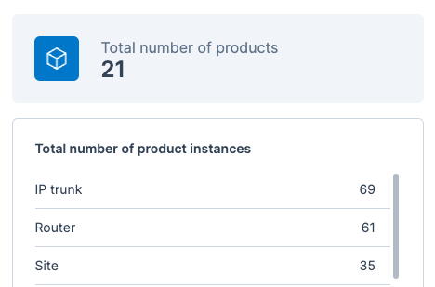
Status quo
21 different products implemented in the orchestrator
  Routers, switches, and other devices
  Layer 2 services
  Layer 3 services
Migrating backbone links
  First external services planned for early 2025

Slide 3





Workflow Orchestrator
Setup under the commons conservancy
All code is licensed under Apache 2.0
All Intellectual Property remains at each member company
Membership levels:
    Partner
    Graduate
    Sandbox
Mainly NREN’s and networking use case but other use-cases as well

Slide 4





Service lifecycle
Out-of-sync
modify
migrate
create
activate
terminate
INITIAL
PROVISIONING
ACTIVE
TERMINATED

Slide 5
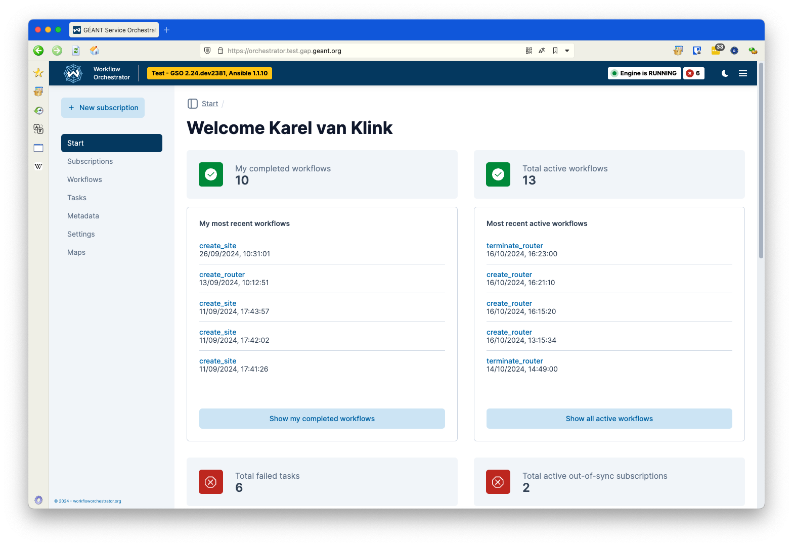
The orchestrator GUI

Slide 6
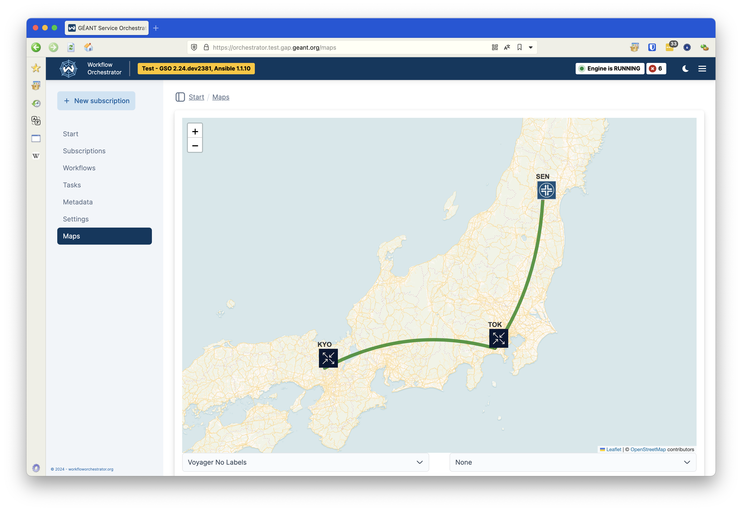
Live interactive map of all subscriptions

Slide 7
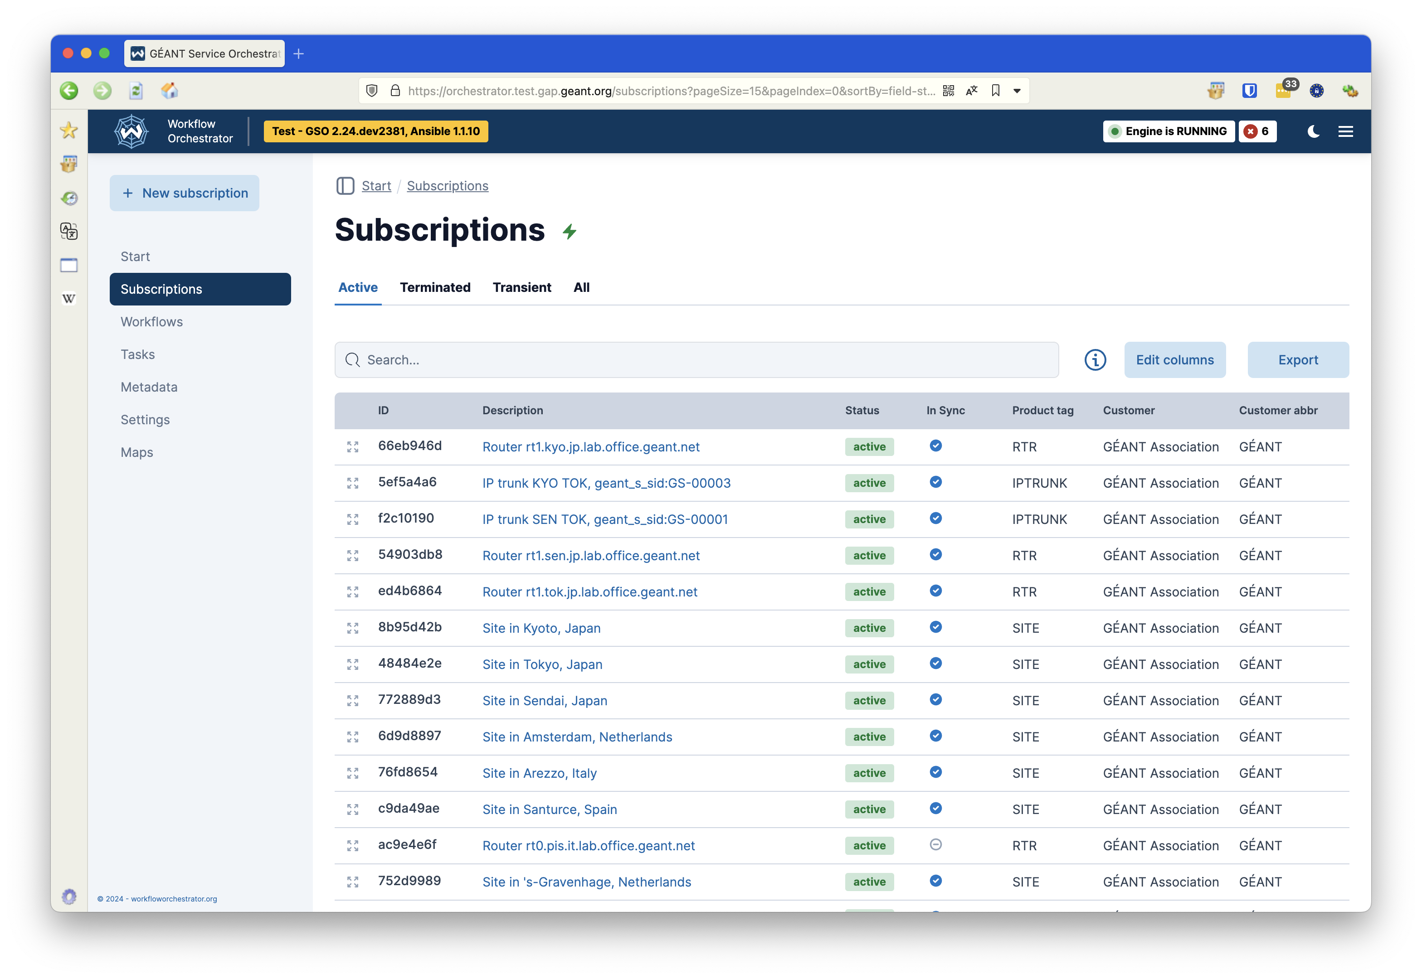
Overview of all services

Slide 8
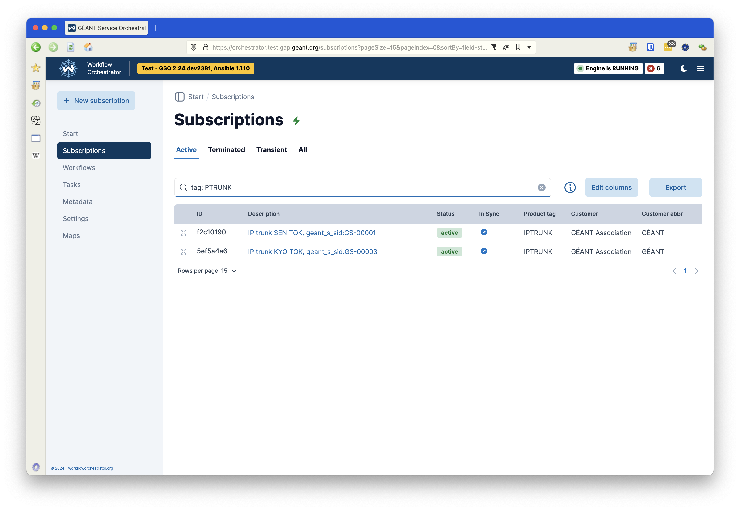
Search for specific service types

Slide 9
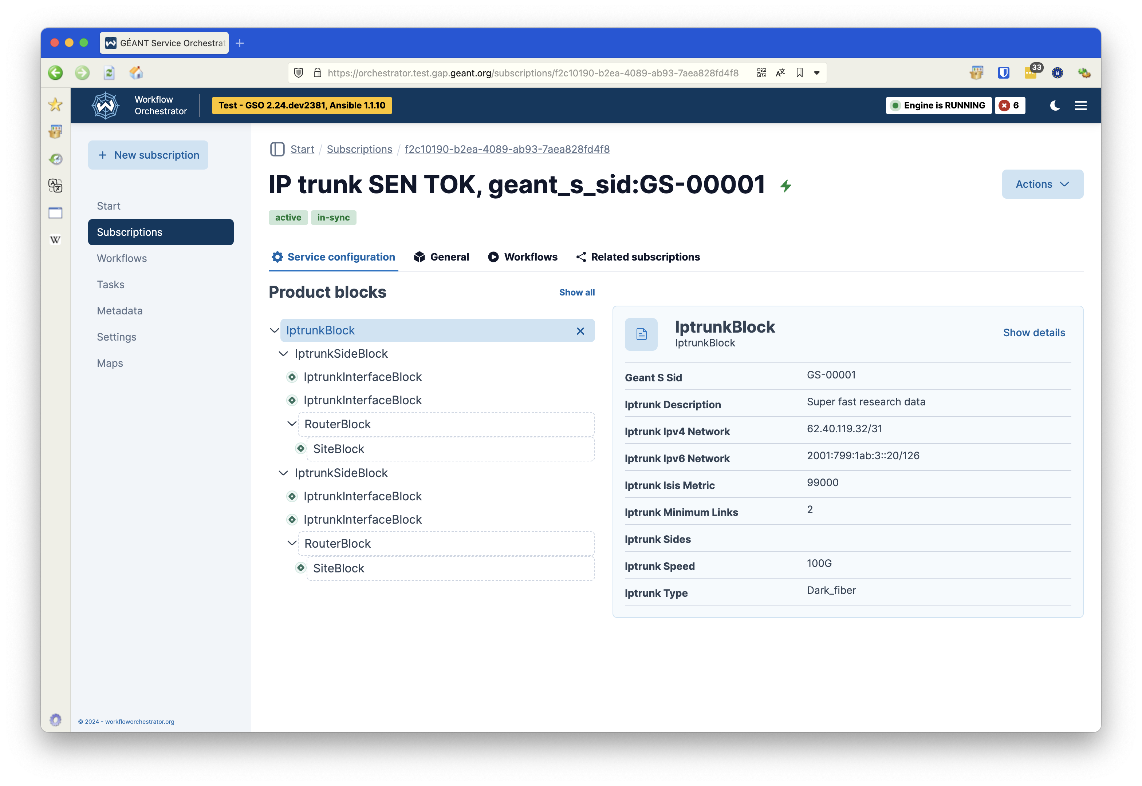
Inspect a service instance

Slide 10
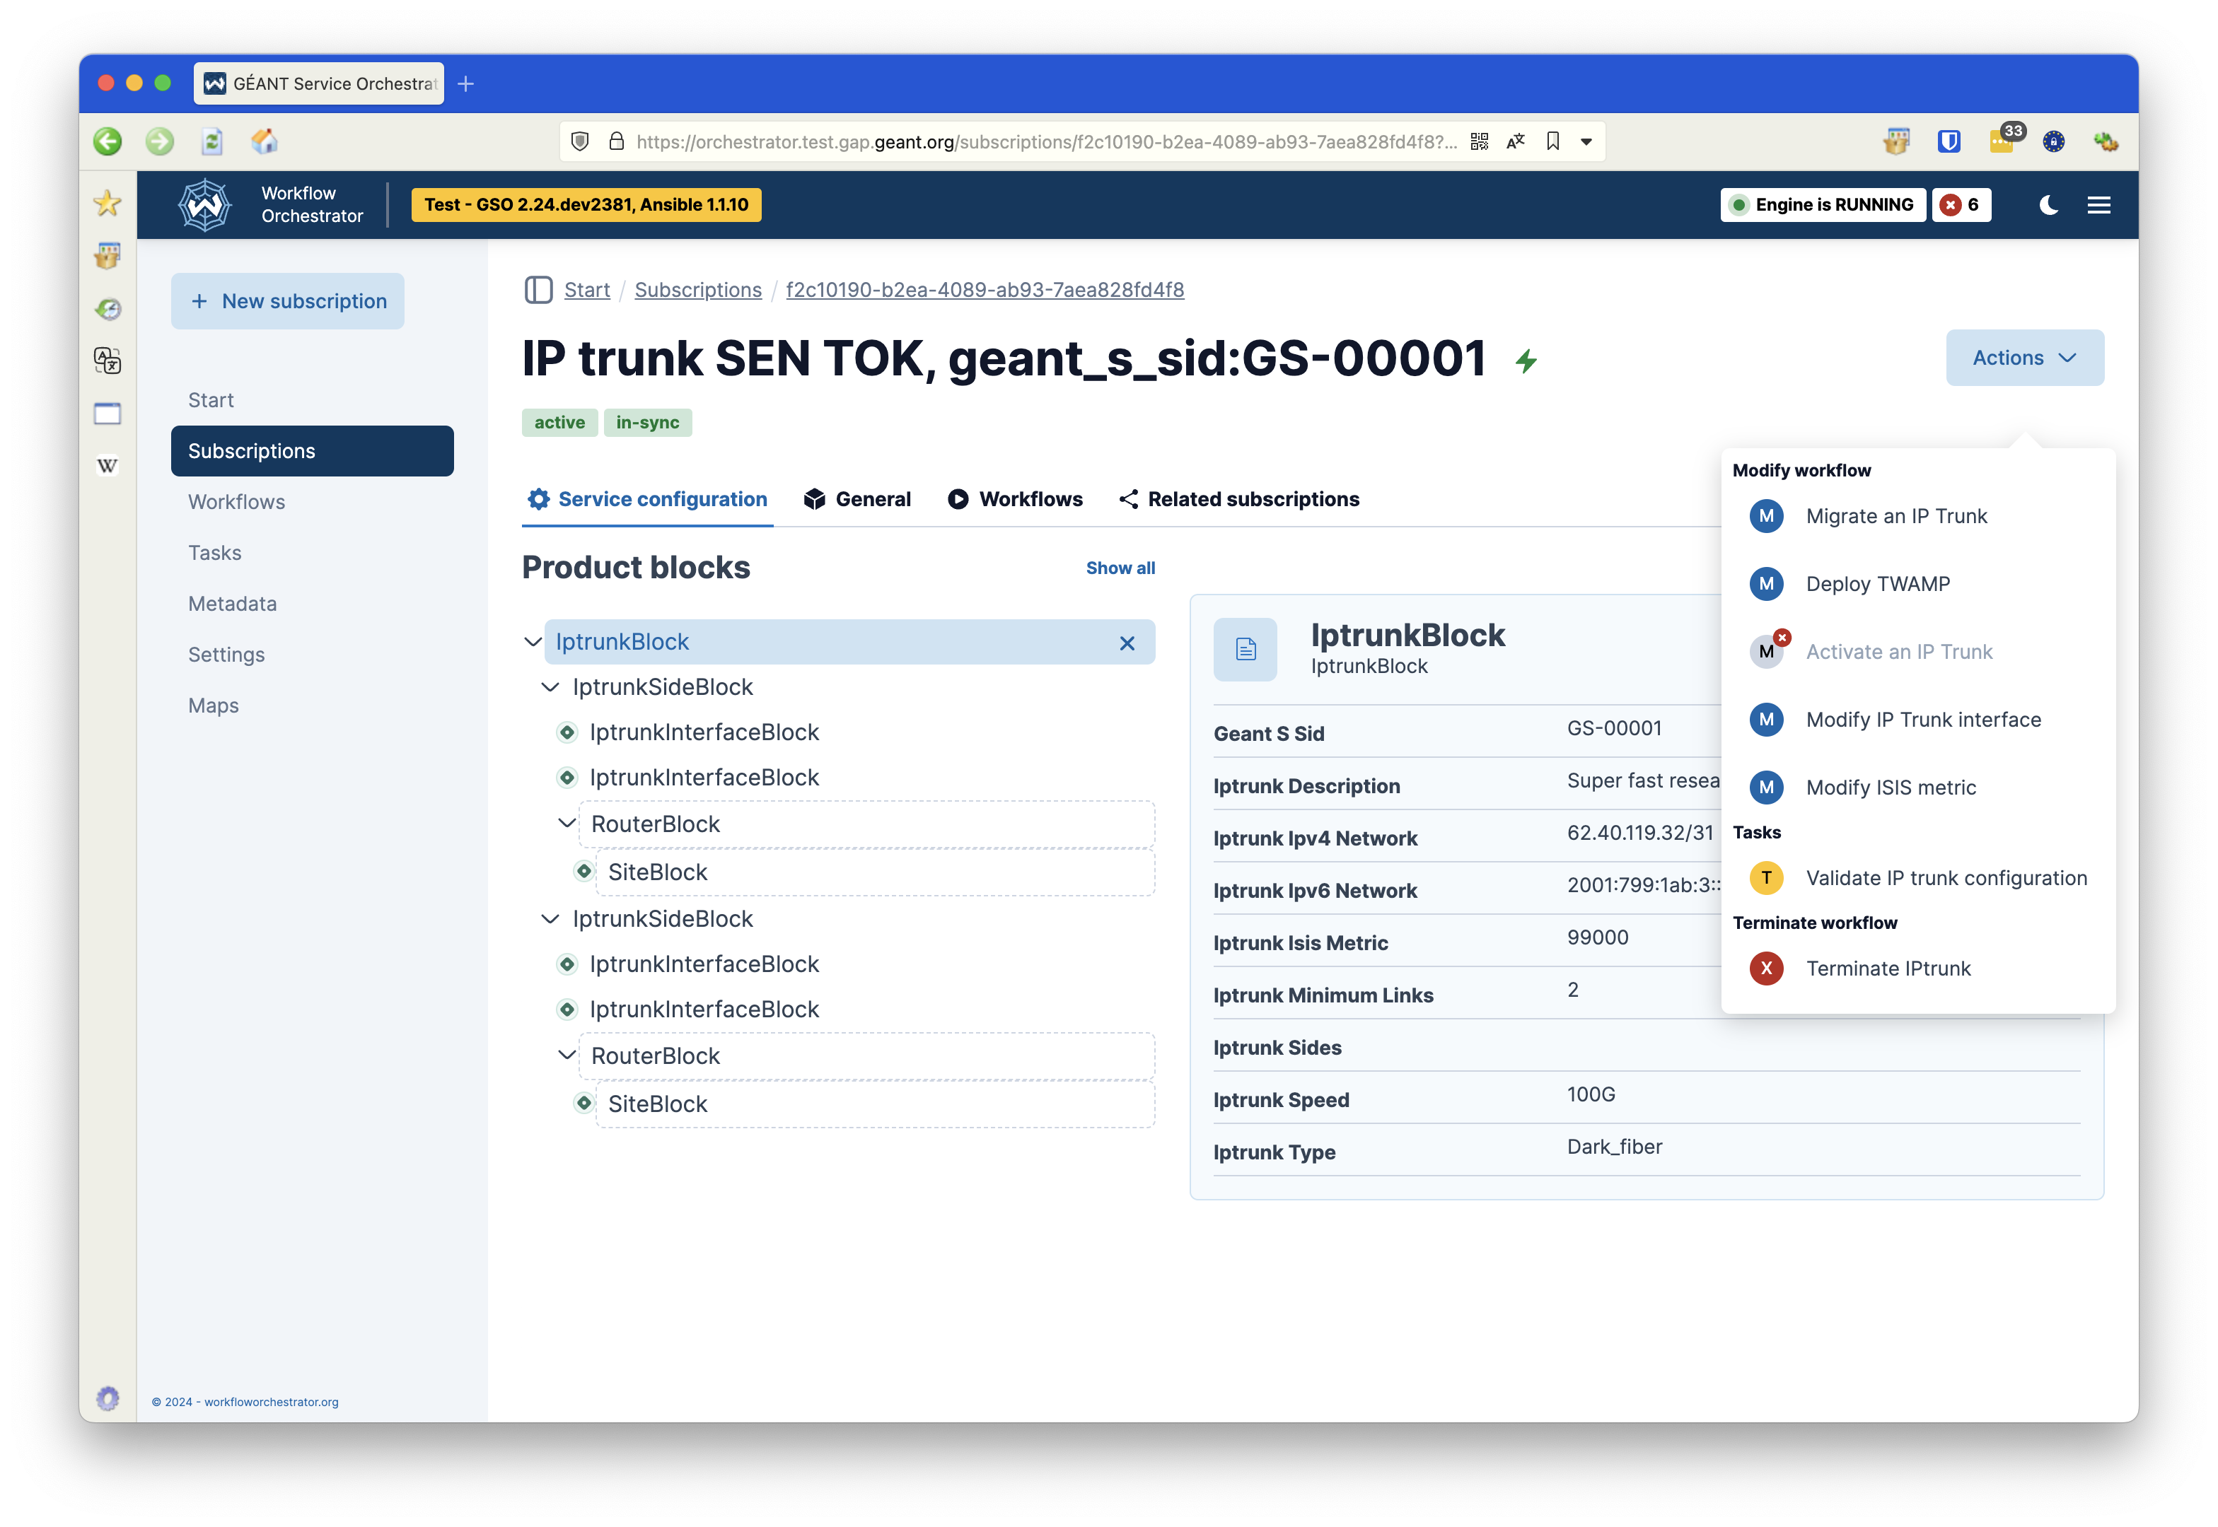
Available workflows for a service

Slide 11
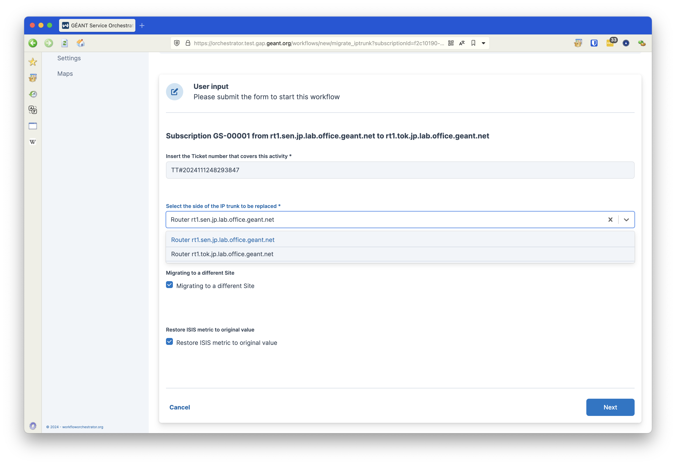
Migrating a link – gathering input

Slide 12
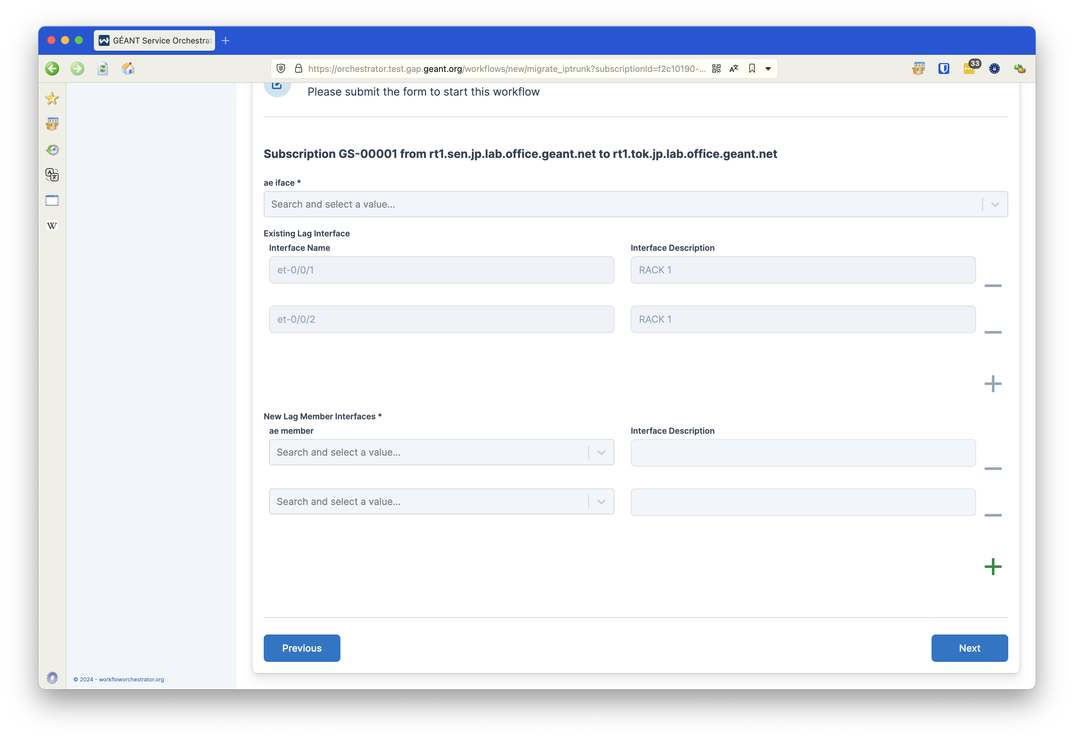
Migrating a link – select new endpoint

Slide 13
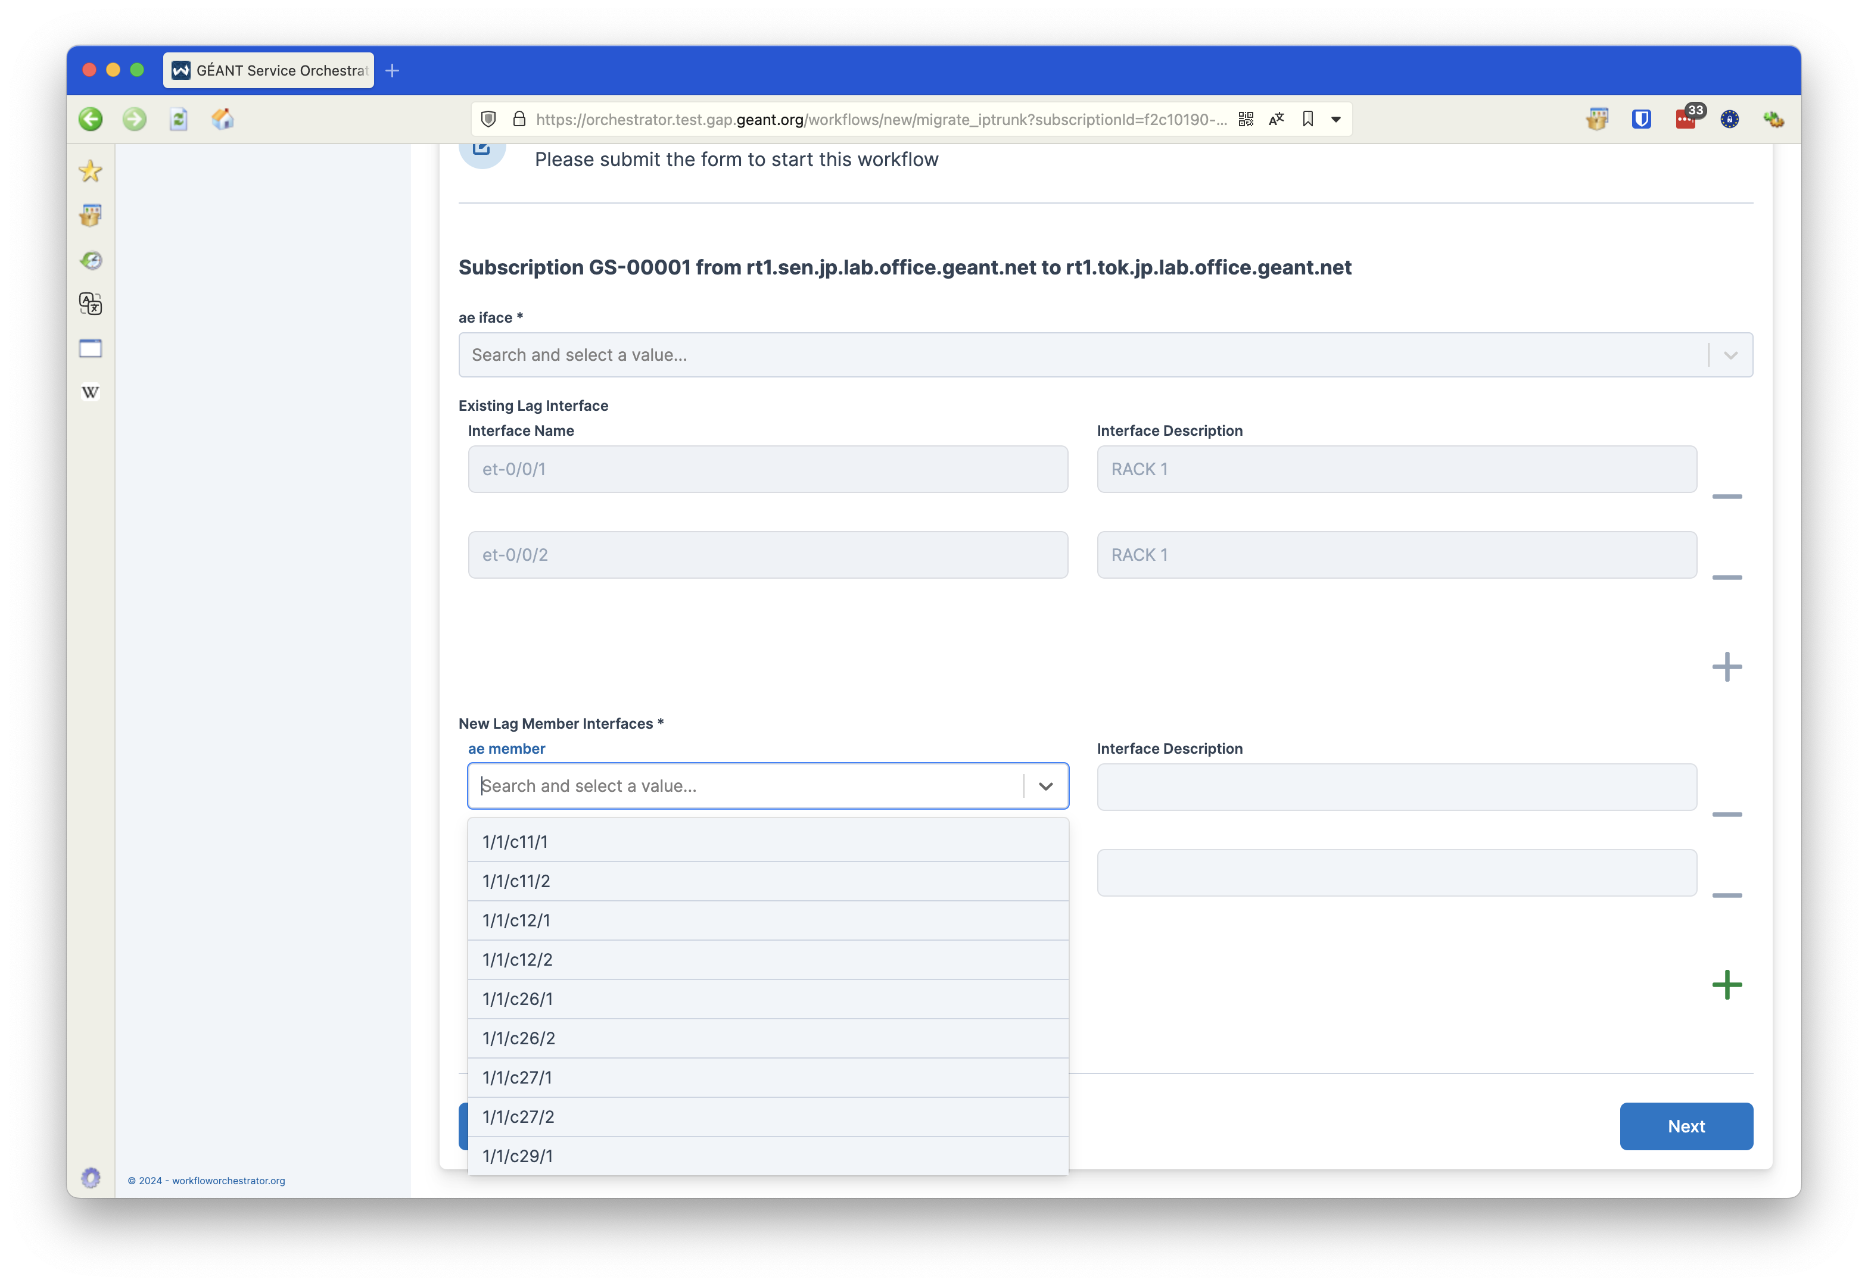
Migrating a link – data from Netbox

Slide 14
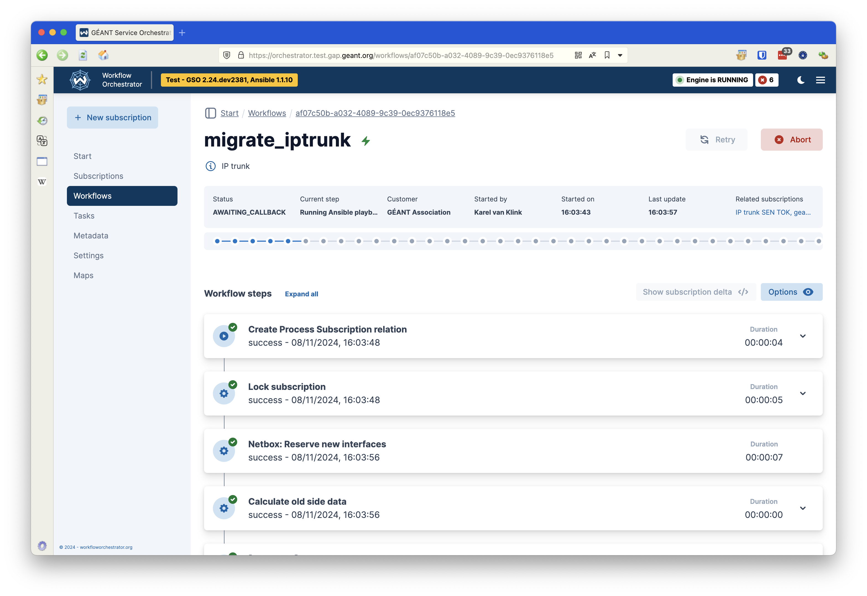
Running the workflow

Slide 15
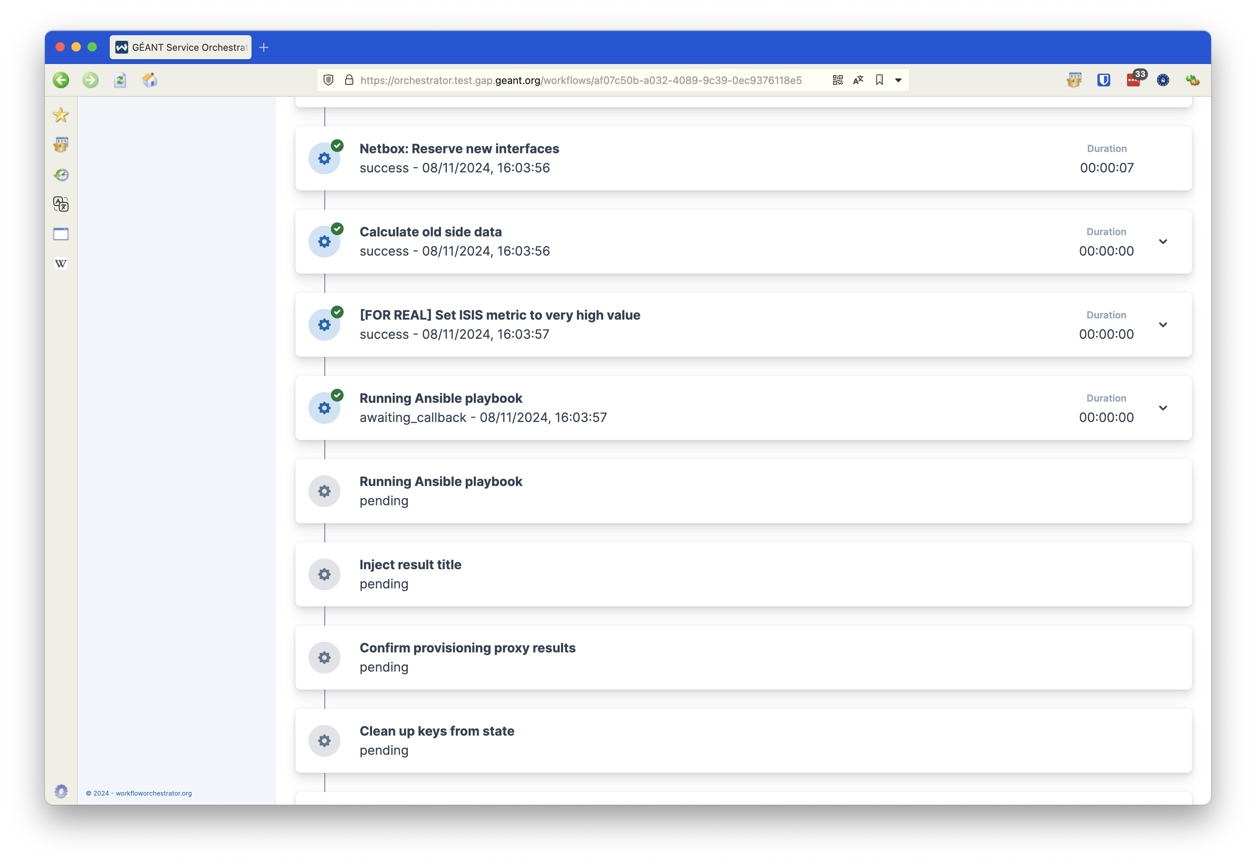
LSO: Running Ansible remotely

Slide 16
LSO: Running Ansible remotely
LSO

Slide 17
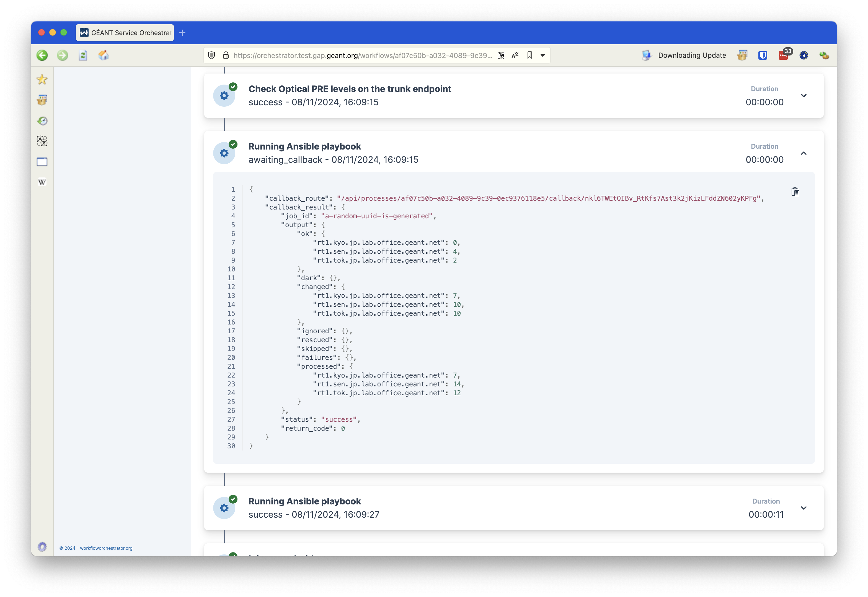
Ansible: Inspecting results

Slide 18
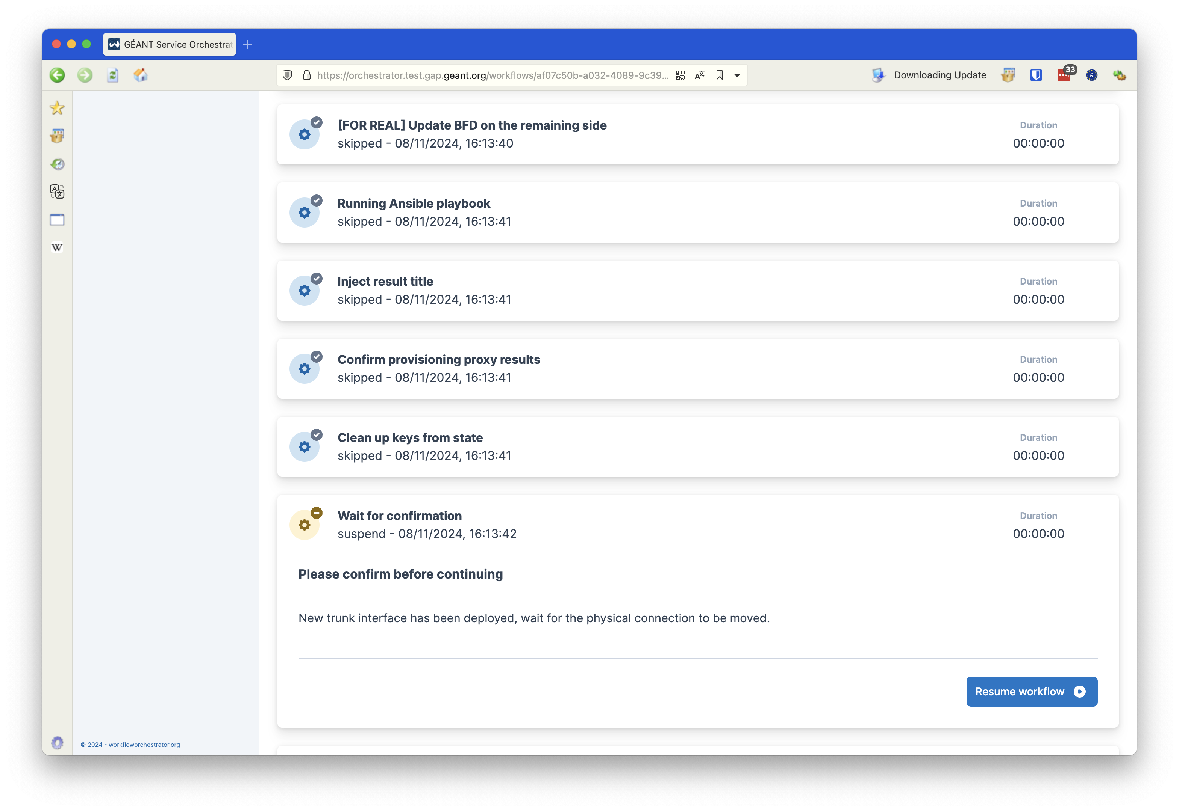
Conditional steps and manual confirmation

Slide 19
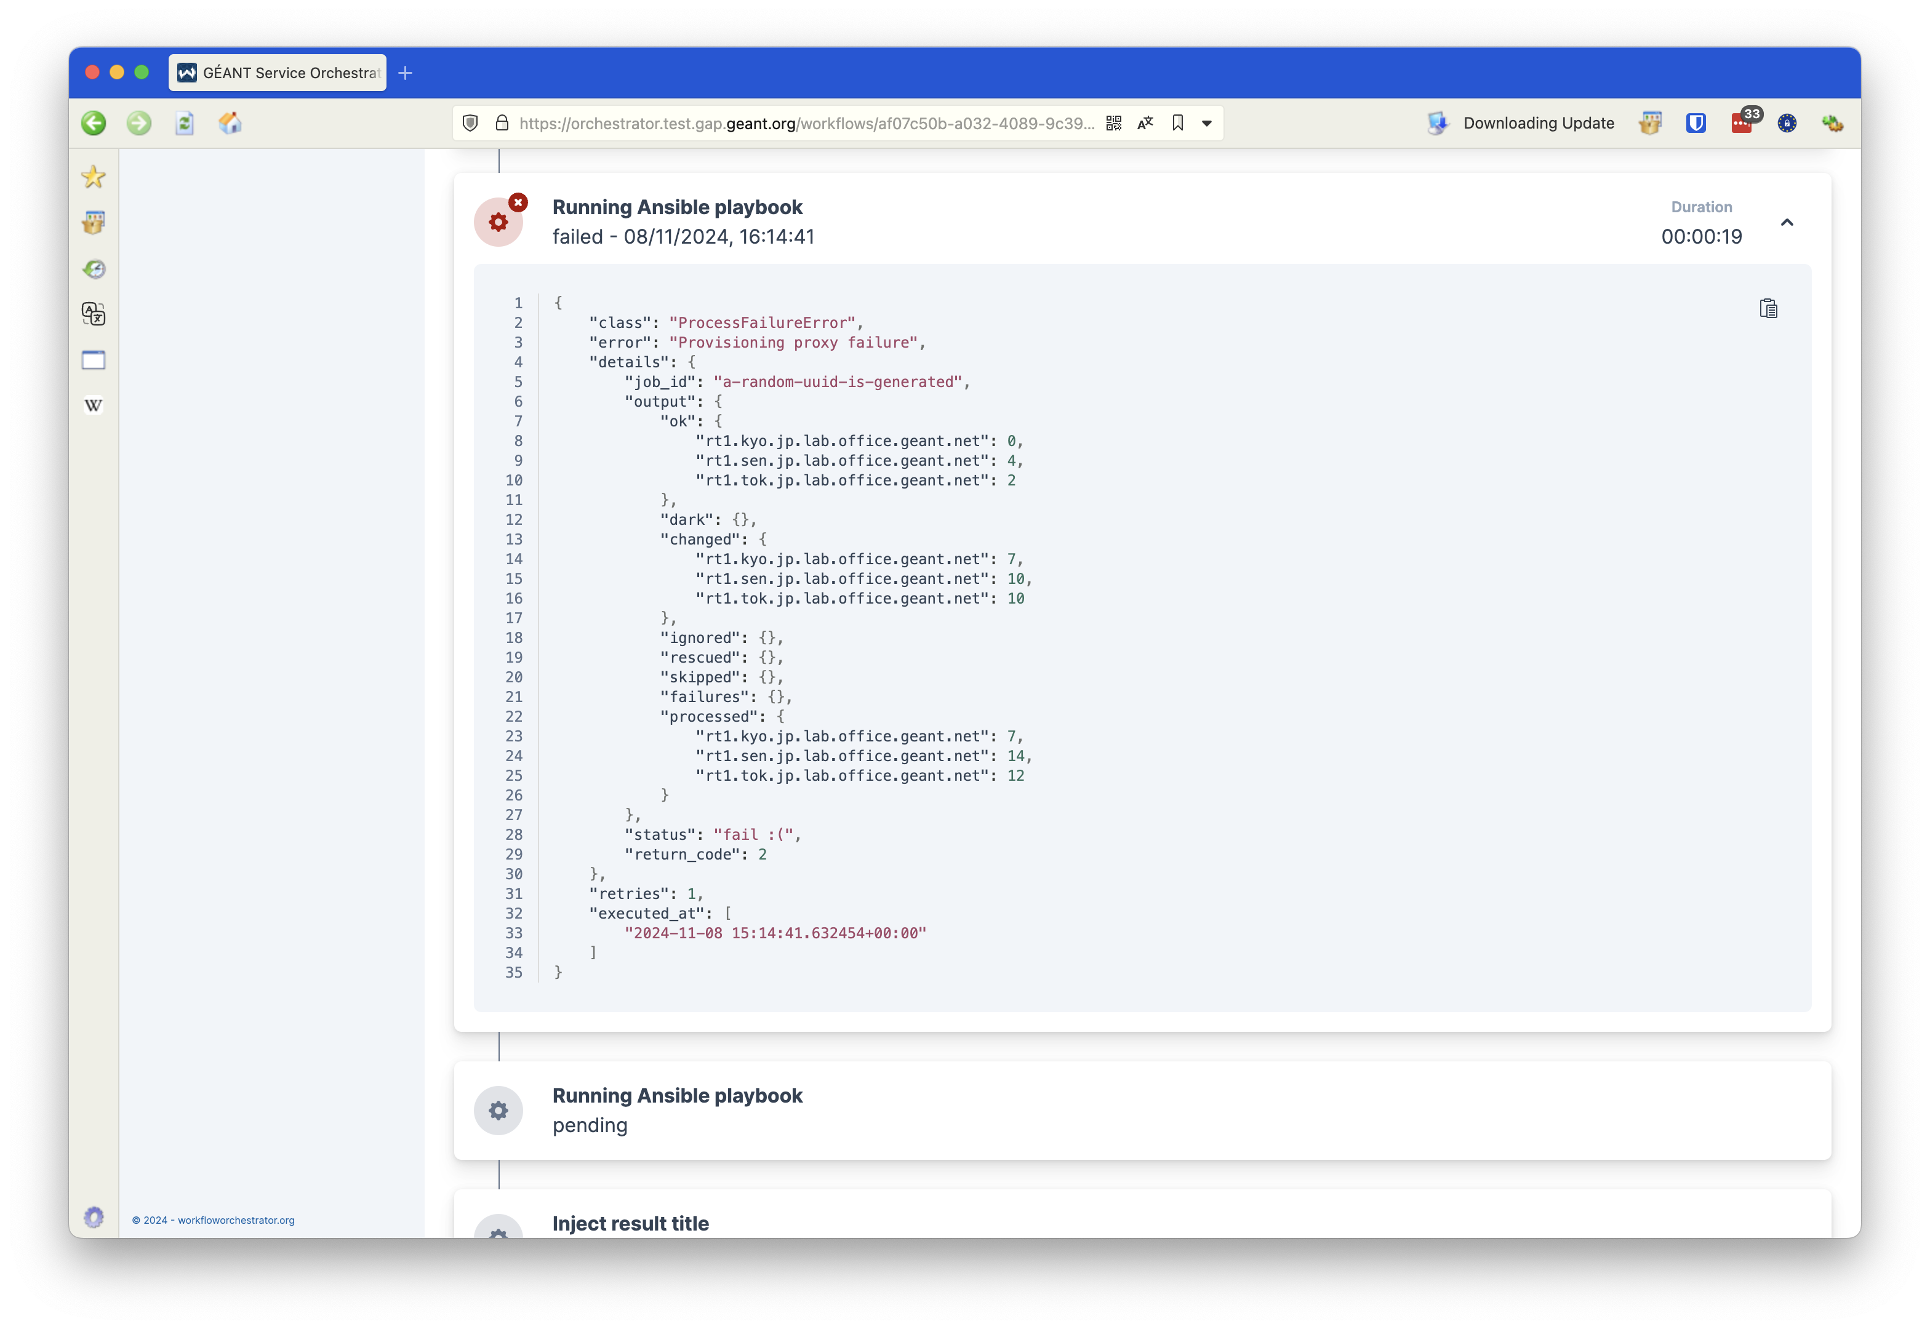
You can’t win them all

Slide 20
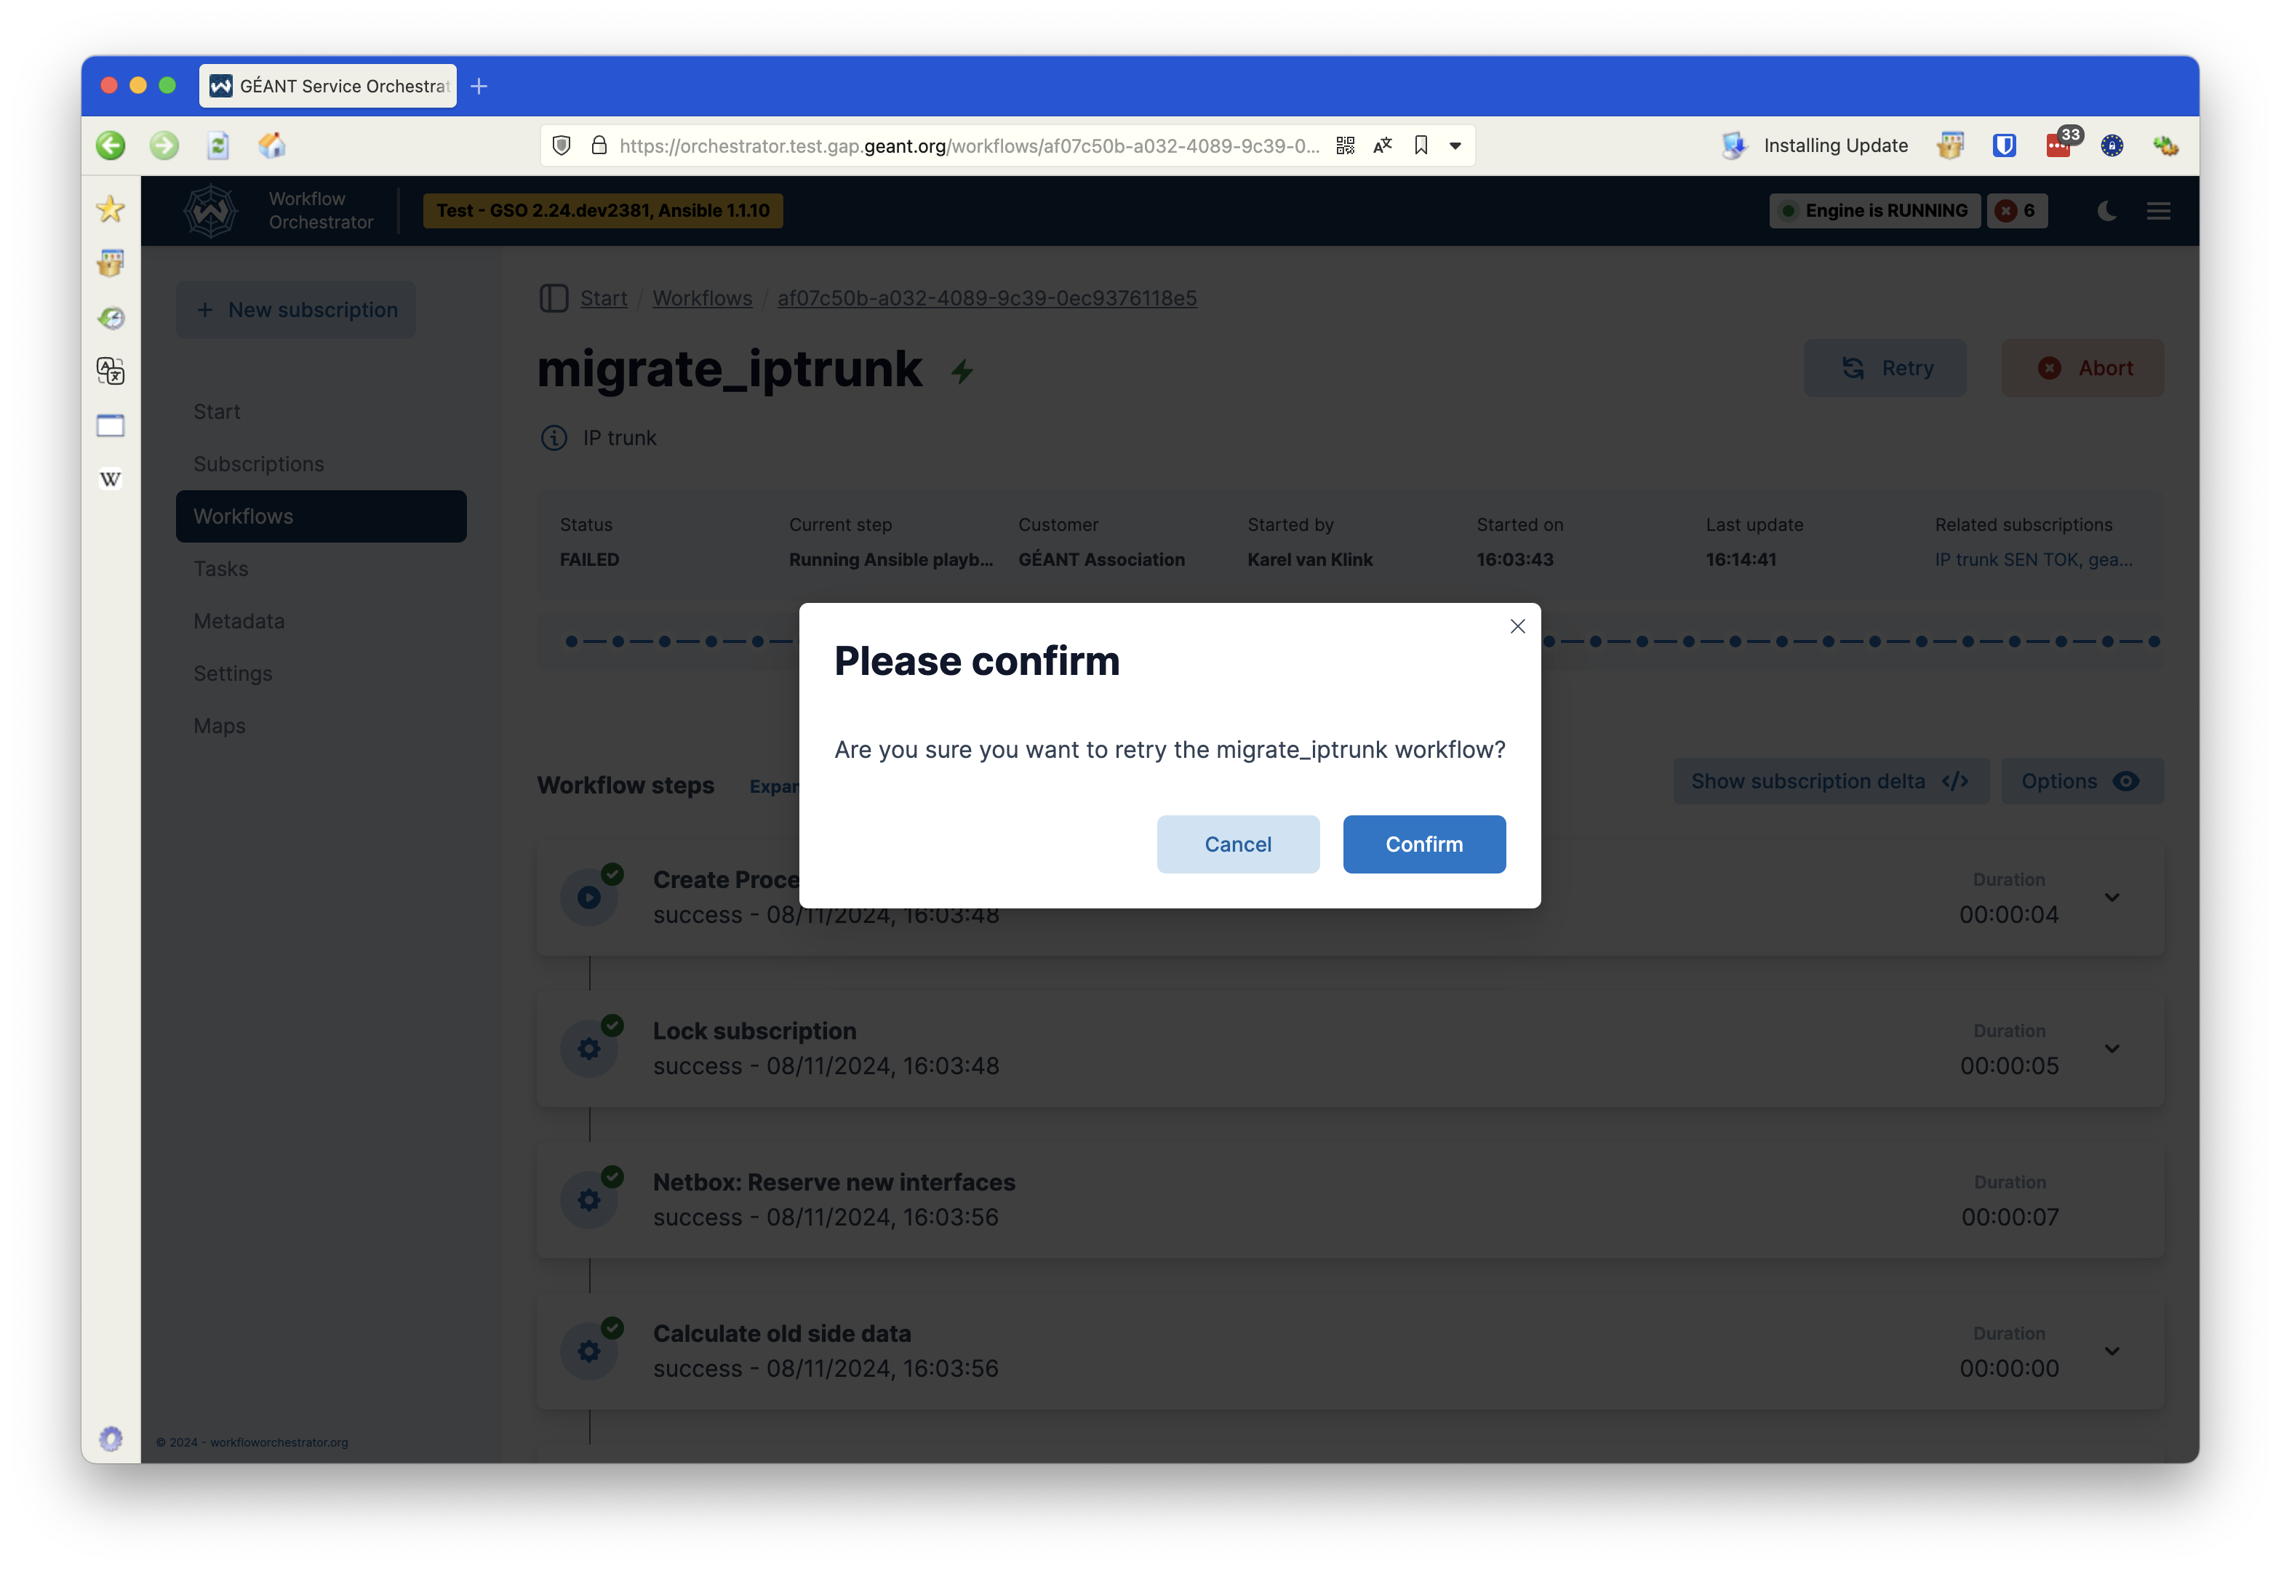
But we can always try again

Slide 21
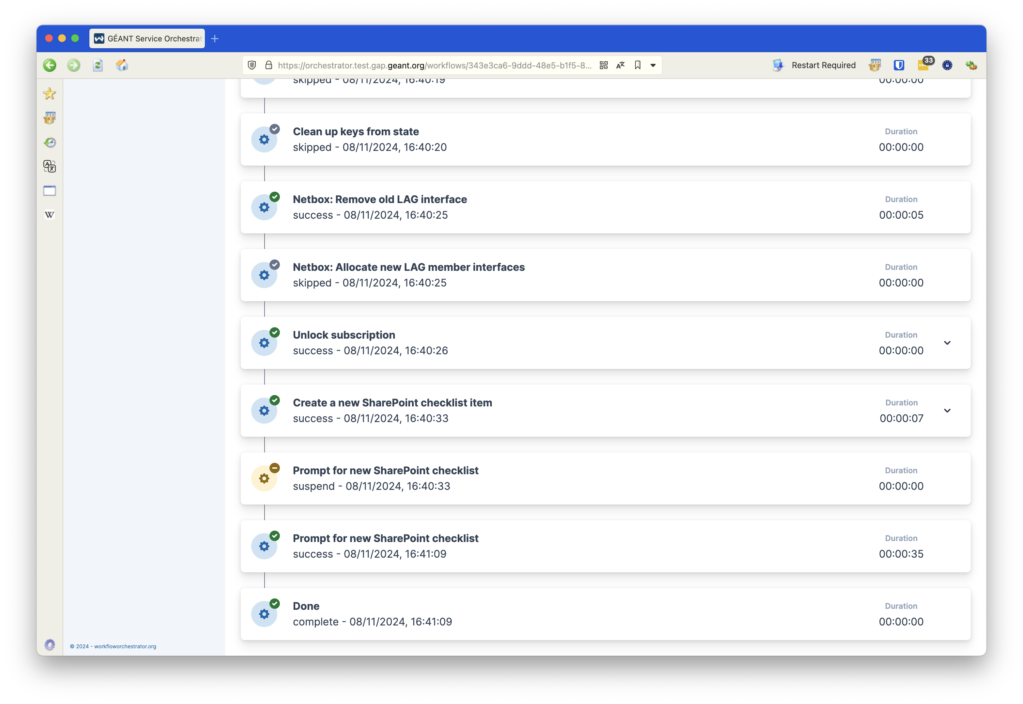
…and done!

Slide 22
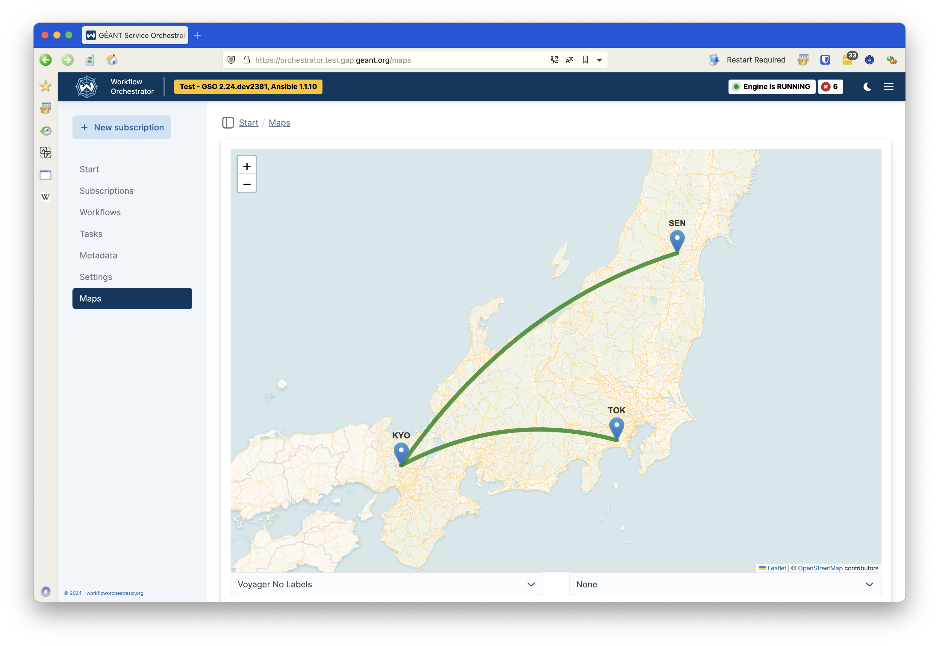
Link migrated – map automatically updated

Slide 23
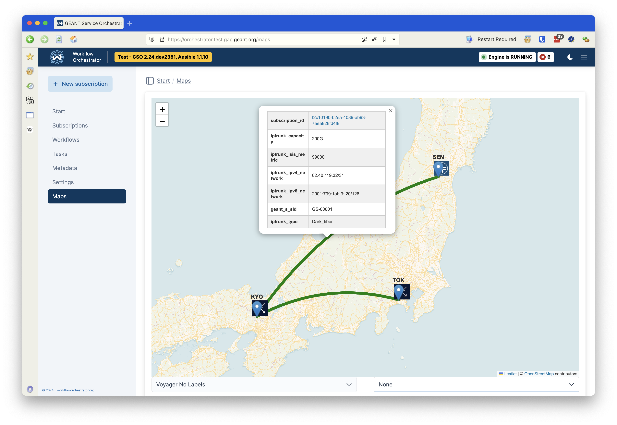
Inspect the new link

Slide 24
Where to find us
https://workfloworchestrator.org
https://docs.gap.geant.org
https://gitlab.software.geant.org/goat/gap
Join us on Discord: https://discord.gg/KNgF6gE8

Slide 25
Thank You
Any questions?
karel.vanklink@geant.org

