Slide 1


The Future
RENAM as an essential digital infrastructure for Moldovan Research and Education in the international landscape
Erik Huizer
CEO
www.geant.org

Slide 2







Climate change
Energy
Scarcity
of materials
Population growth
Food shortages
“If you want to go fast, go alone; if you want to go far go together”
African Proverb
Notes:
We urgently need the creativity, brainpower and research skills of every researcher and student in the world to tackle the problem of climate change. They need to be able to share their data and results, for others to collaborate or enhance. Cooperation needs to be easy, safe and secure.
Research and Education networks like GÉANT are there to facilitate that.
Together we deliver an information ecosystem of infrastructures and services used for communication, collaboration, exchange of data, and access to repositories, services and facilities.

Slide 3
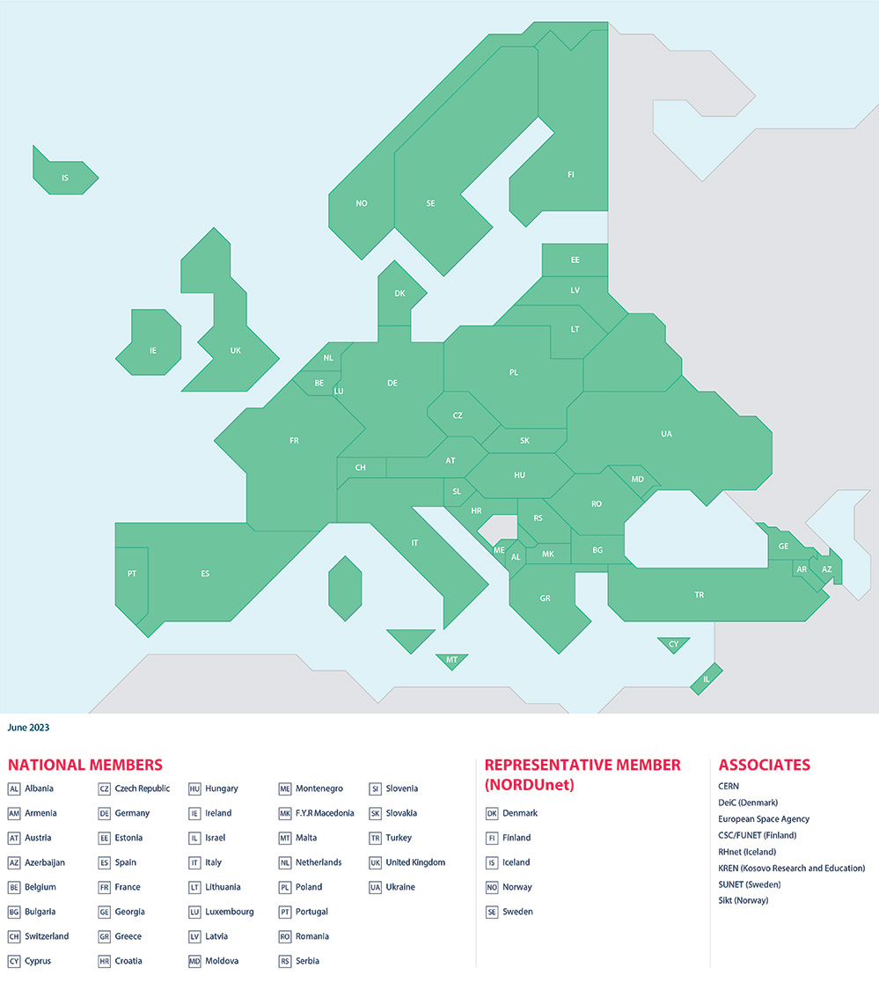
Membership Association
GÉANT Association supports and represents 43 NRENs across Europe.
Together they support over 10,000 institutions and 50 million academic users.
Notes:
Alternative slide using map

Slide 4


IDENTITY FEDERATION
NETWORK
COMMUNITY
Network Services
Cloud
Security
Trust & Identity

Slide 5
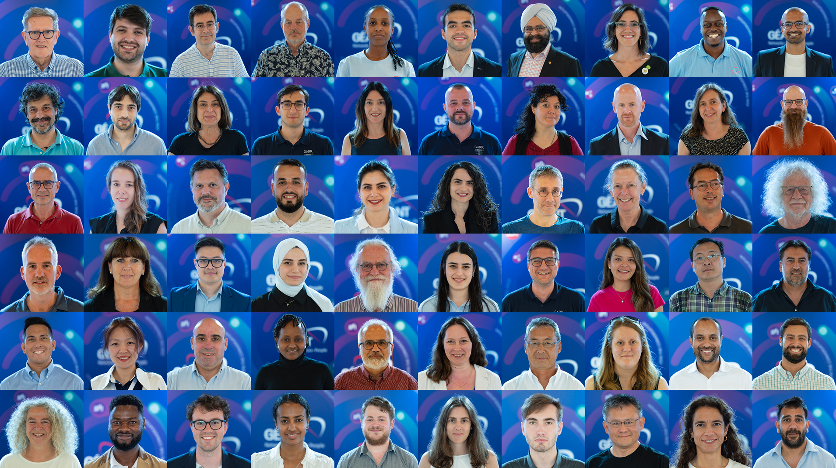
Notes:
RRENs are build upon a community. The GÉANT and Global RREN community invests in the research and development of network architectures, technologies and paradigms to develop into the services, processes, tools and network capabilities of tomorrow.

Slide 6















Trust framework
RRENs
NRENs
R&E Institutions
Universidad Técnica “Luis Vargas Torres” de Esmerelda
Universidad
de Cuenca
Academy of Economic Studies Moldova
Virtual
University
of Uganda
Infectious Diseases
Institute
University of Ghana
Ashesi University College
Université de Ghardaia
Centre de Recherche en Atronomie, Astrophique et Géophysique
University Of Dhaka
Sylhet Agricultural University
Moldova State University
Notes:
NEEDED for a TNC audience?

Slide 7
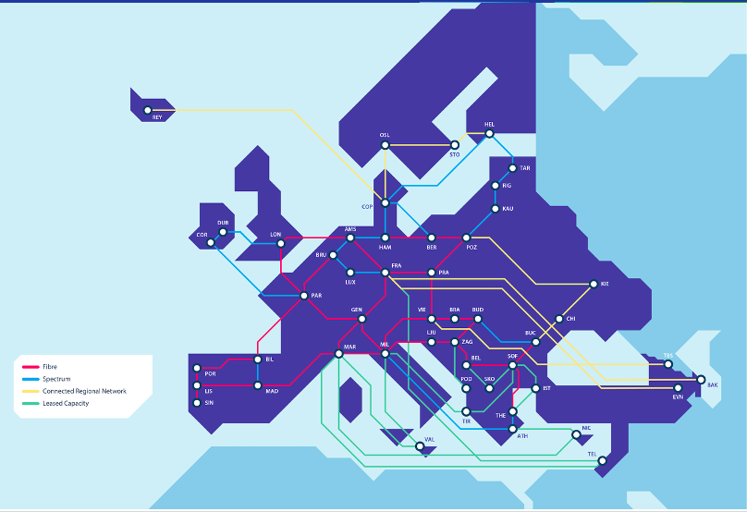

Funded by the EU
Notes:
Use latest map

Slide 8
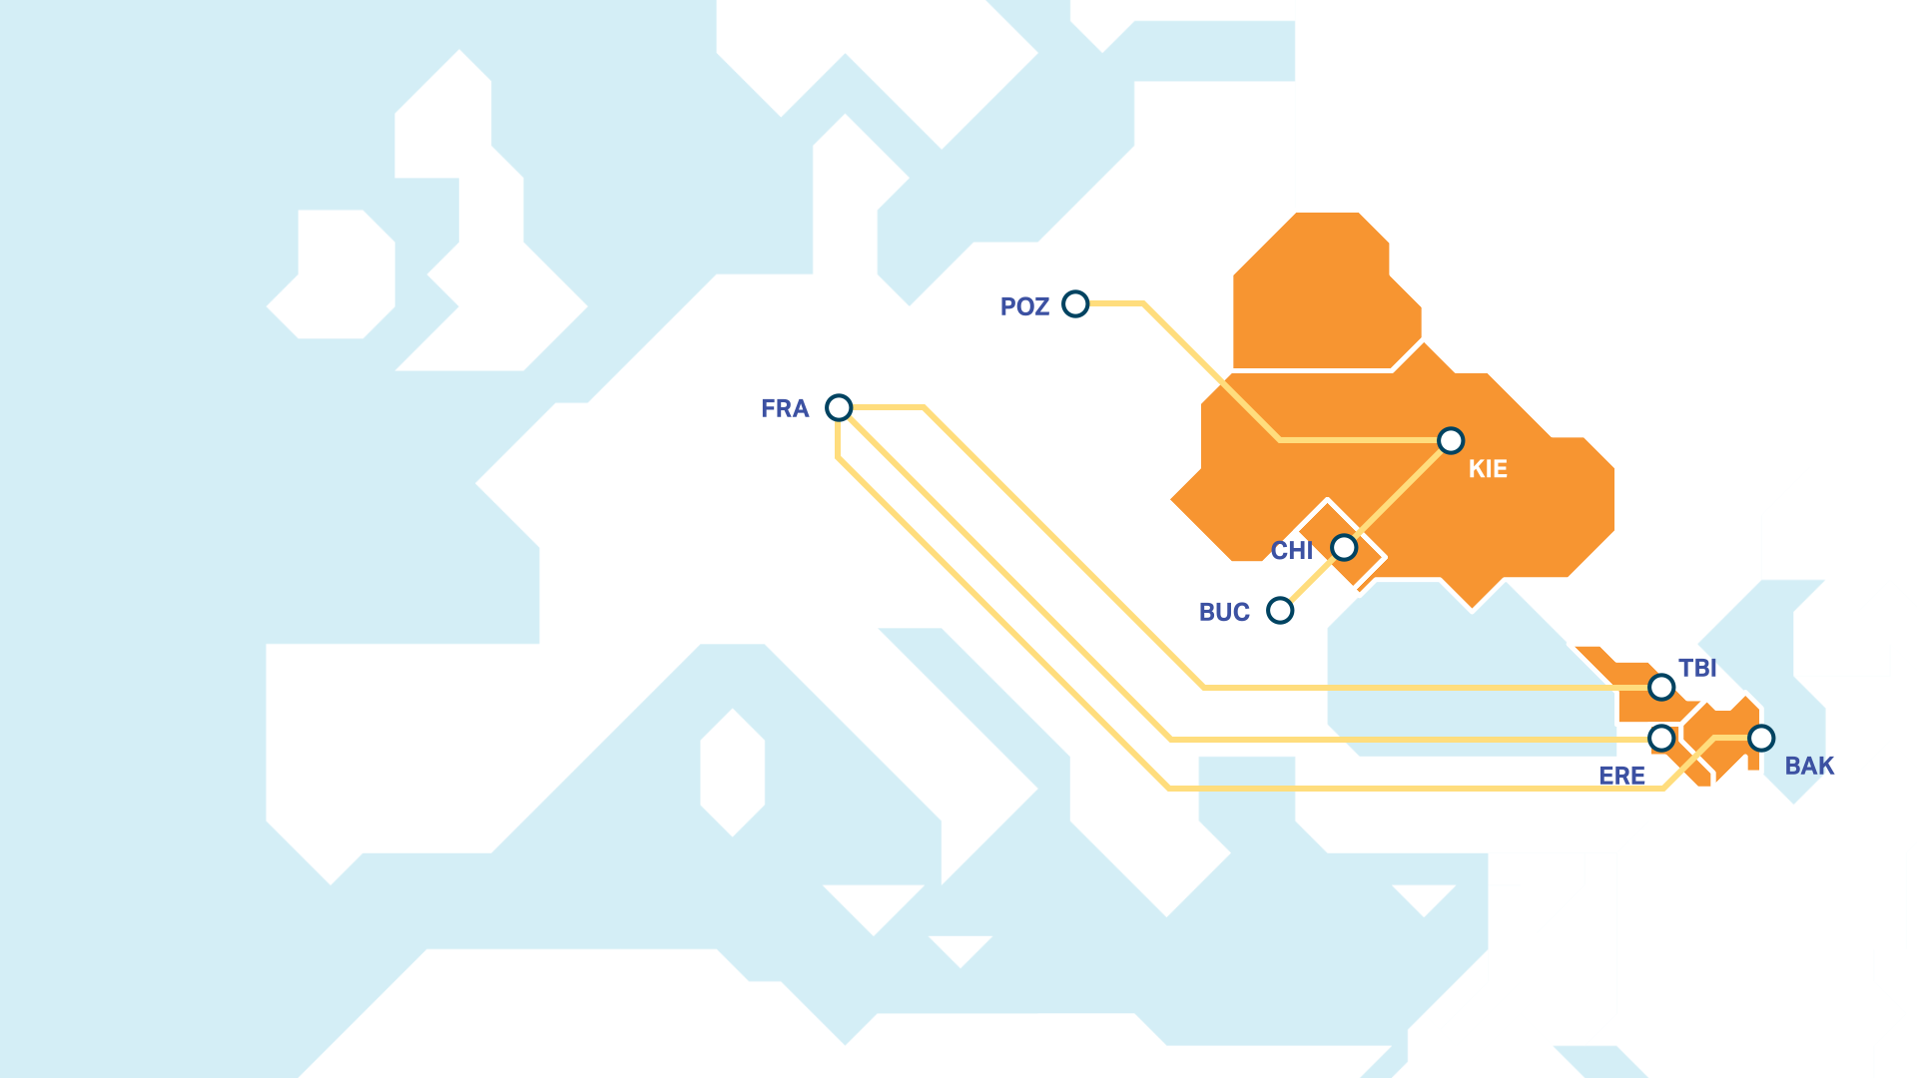
EAPConnect2

Slide 9
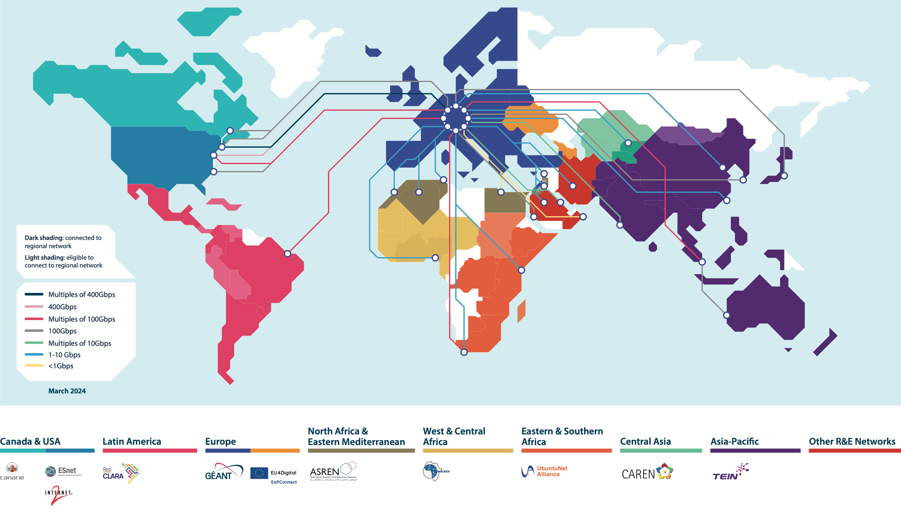

Slide 10

eduGAIN
eduroam

Slide 11

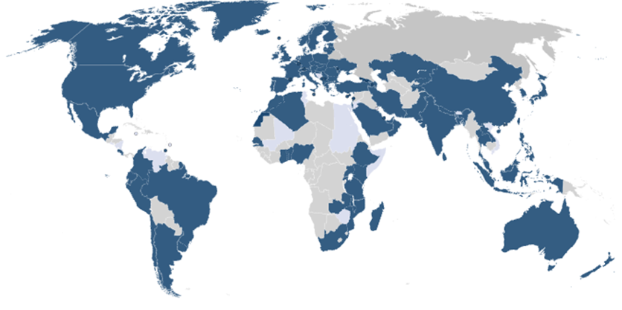
Eduroam Service uptake:
National Roaming Operators (NROs)
>104
Countries
10,000+
Institutions
38,400+
Service
Locations
Member
Pilot
Possible new regions to ‘eduroam-ise’

Slide 12
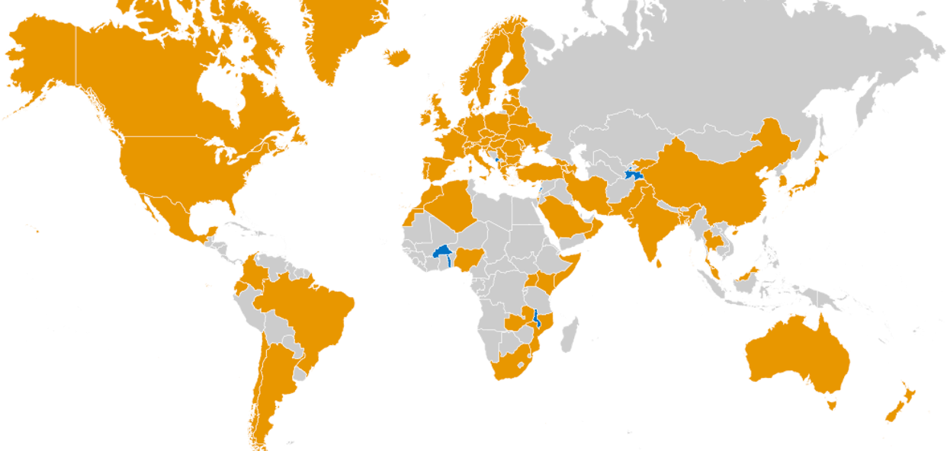

The growth of eduGAIN federations
79
Countries
5,600+
Institutions
3,000+
Service
Locations
edugain.org

Slide 13




Safe and Secure access for Moldova researchers, students and teachers
Universities
Research data
Libraries
Cloud services
Erasmus+
RENAM
Notes:
Seamless access to the resources
Non–limited data transfer speed
Empowering the HPC user
Solving the (currently) unsolvable!

Slide 14

Thank you
www.geant.org
Funded by the EU

