Slide 2

UNIVERSITATEA DE STAT DIN MOLDOVA

Slide 3
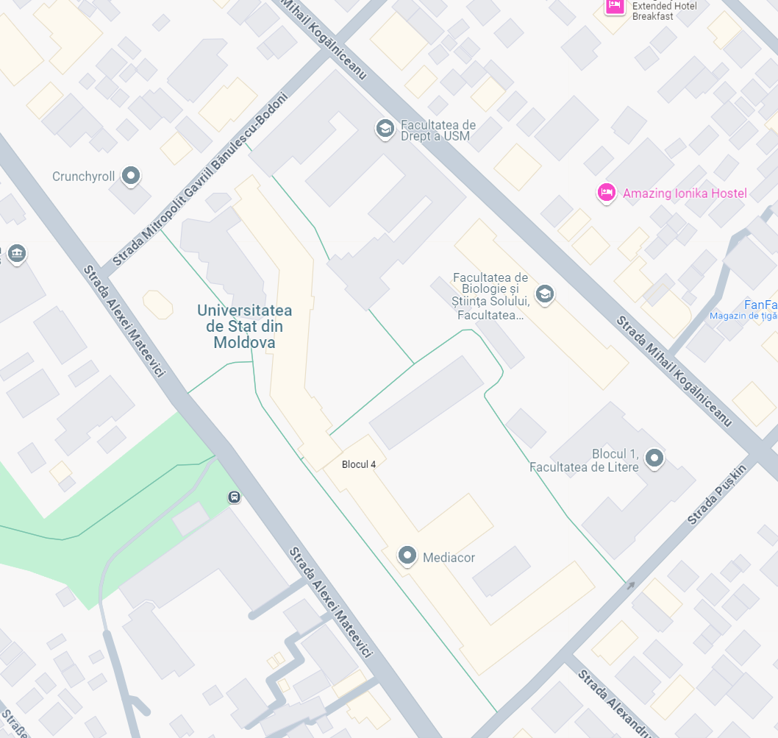
2011 – 2021
Main campus
WiFi
WiFi
WiFi
WiFi
WiFi
IDN
WiFi
WiFi
100 MB /sec
90 % - LAN
WiFi – isolate zones, limited number of connections
WiFi
WiFi

Slide 4
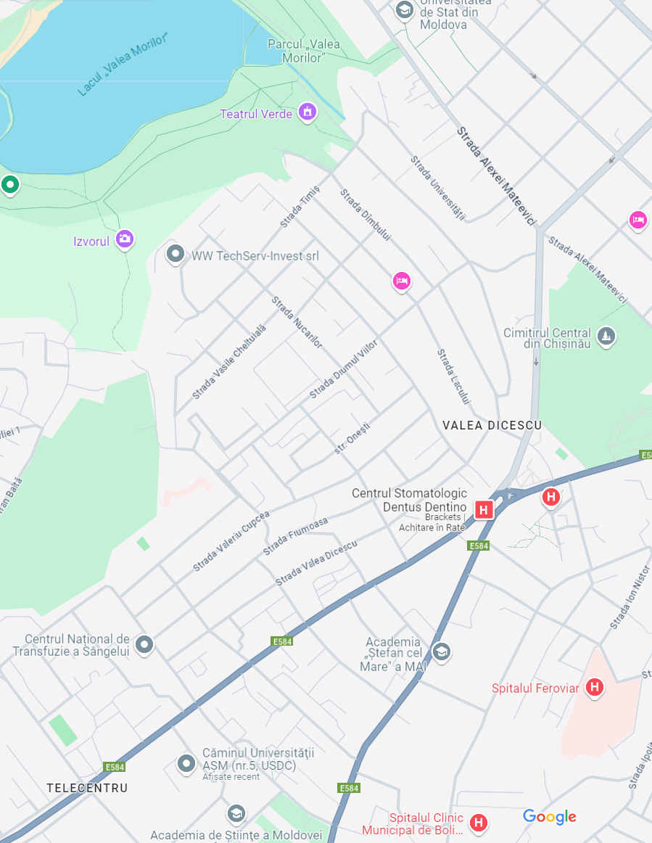
2011 – 2021
Cantemir Campus
USM
100 MB /sec
LAN, WiFi – isolate zones, limited number of connections
Uncertified provider
RENAM
ASM
USM
ASM

Slide 5



STEP 1
New generation network
2022 - 2023
WiFi
WiFi
WiFi
WiFi
WiFi
IDN
Up to 10 GB Internet
80 % - secured WiFi
WiFi – unlimited number of connections, campus coverage
STAGE A:
Campus Optic Fiber Loop
New Internet Distribution Node
+1 BackUp Internet Service Provider
NIDN
WiFi
WiFi

Slide 6
STEP 1
New generation network
2022 - 2023
WiFi
WiFi
WiFi
IDN
Up to 10 GB Internet
80 % - secured WiFi
WiFi – unlimited number of connections, campus coverage
STAGE B:
Main Building: 1Gb Network, Eduroam service, full coverage
NIDN
WiFi
WiFi

Slide 7
STEP 1
New generation network
2022 - 2023
WiFi
WiFi
WiFi
IDN
Up to 10 GB Internet
80 % - secured WiFi
WiFi – unlimited number of connections, campus coverage
STAGE C:
Study block 4:
1Gb Network, full coverage WiFi
NIDN

Slide 8
STEP 1
New generation network
2022 - 2023
USM
Up to 10 GB Internet
80 % - secured WiFi
WiFi – unlimited number of connections, campus coverage
STAGE D:
Connect Research institutes from Cantemir Campus (IFA, IMI, CL)
RENAM
USM
USM
ASM

Slide 9
STEP 2
New generation network – extension
Universitary DataCenter
2024
WiFi
WiFi
WiFi
IDN
Up to 10 GB Internet
80 % - secured WiFi
WiFi – unlimited number of connections, campus coverage
STAGE A:
Study block 3:
1Gb Network, full coverage WiFi
Universitary DataCenter, HCI based.
NIDN

Slide 10
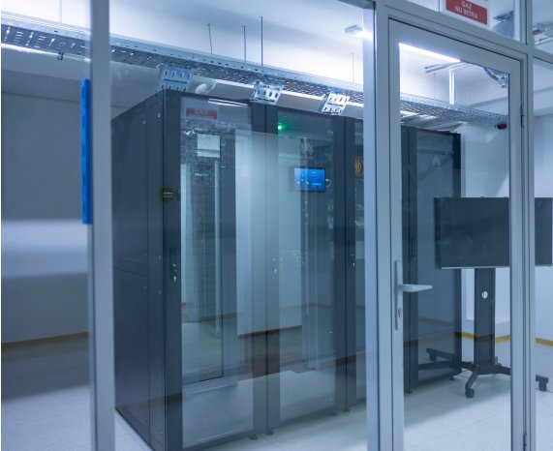
STEP 2
New generation network – extension
Universitary DataCenter
2024
UP to 25000 concurrent active users
Computing cluster, based on HCI
Storage capacities
University information services
STAGE B:
DataCenter

Slide 11
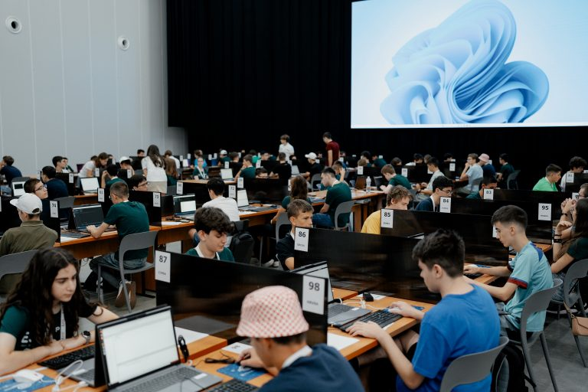
STEP 2
EJOI 2024
26 countries
100 concurents
3 competition sessions
of 4 hours each
secured intranet
0 incidents
max 2 sec delay for evaluation
per submission (on 100 testcases)

Slide 12

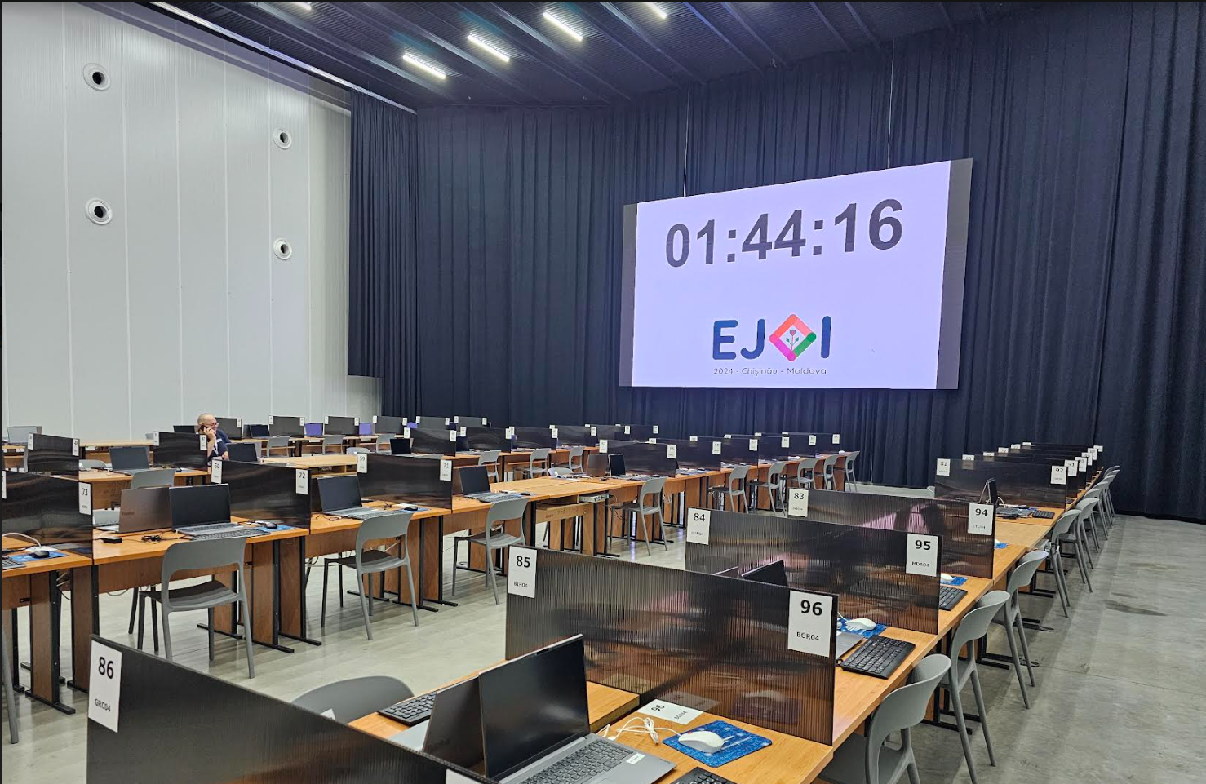
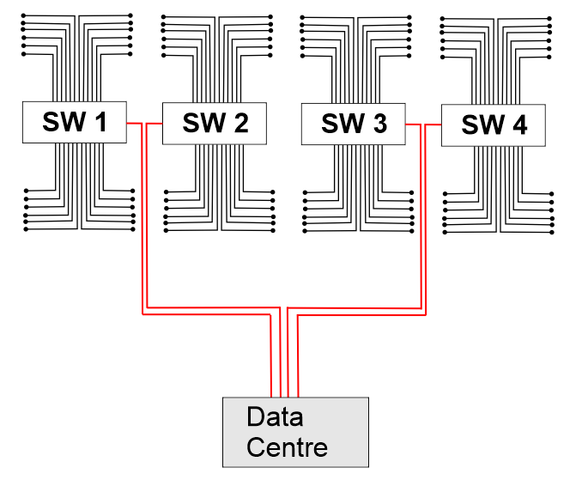
Black Box

Slide 13
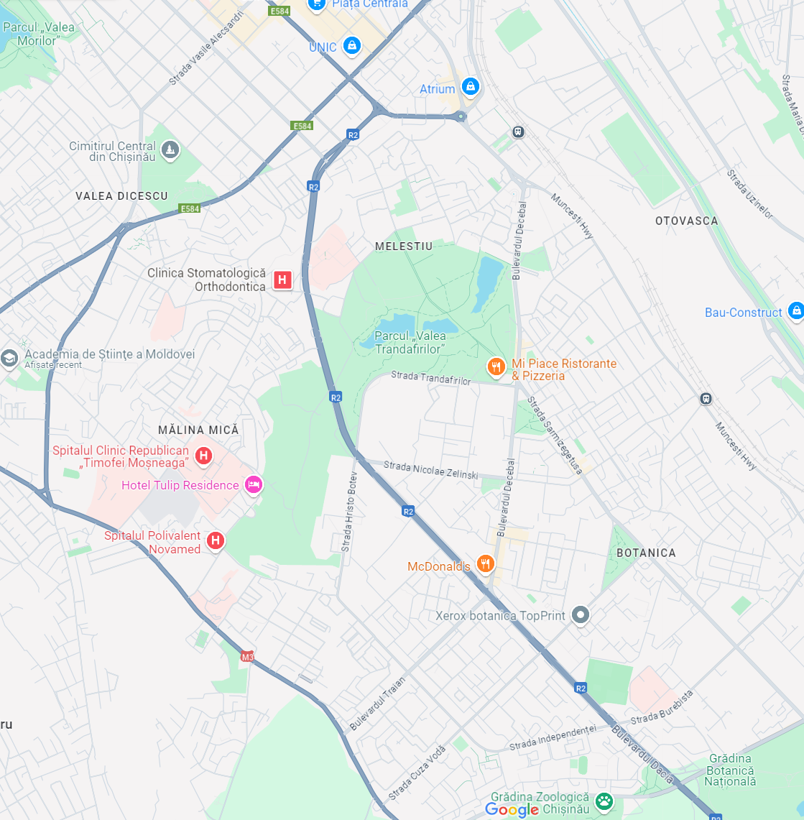
STEP 3
New generation network – extension
Research Institutes connection - 2024
12 new locations
Old or missing local network
Non-autonome network
STAGE A:
Reconnect to adequate provider
Mount own hardware (network equipment)
Reconnect endpoints

Slide 14
What next?
RENAM
GEANT
MSU
EDUCATION
MSU
COMMUNICATION
MSU
SCIENCE

