Slide 1
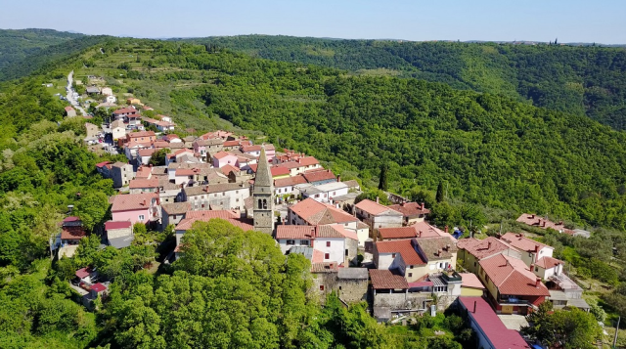
IT4BA - RENAM
COOPERATION
Fostering Sustainable Smart Community Development
in Moldova: The IT4BA and RENAM Partnership

Slide 2
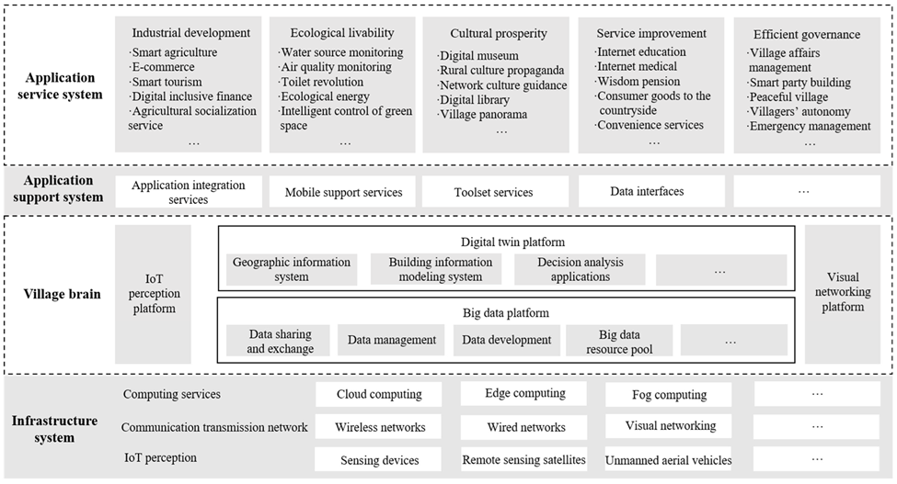
Digital village technology architecture system constructed here is divided into four levels: infrastructure system, village brain, application support system and application service system.

Slide 3
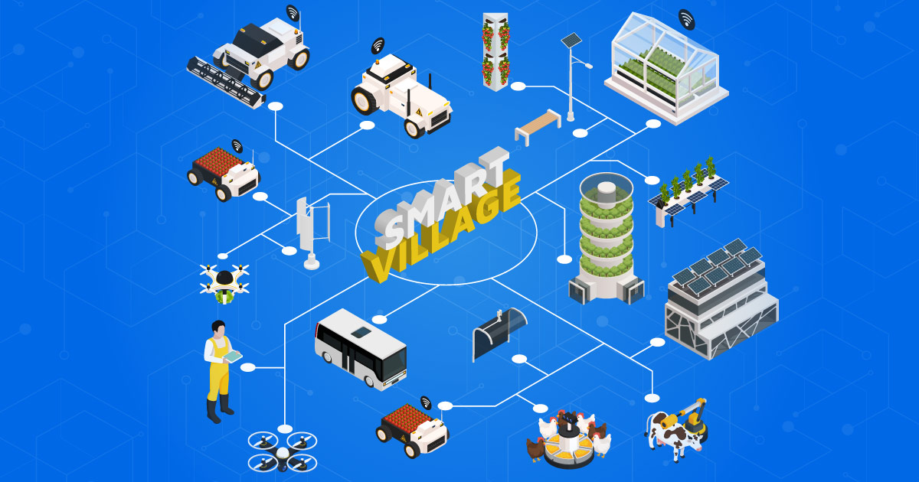
The infrastructure system
consists of three parts: IoT perception, communication transmission network and computing services.
IoT perception is the front-end of the digital village construction, which realizes data collection, intelligent identification and three-dimensional perception through sensing devices, remote sensing satellites, unmanned aerial vehicles (UAVs), intelligent terminals, video monitoring and weather stations. Villages need to set up different types of networks, according to their actual conditions.

Slide 4
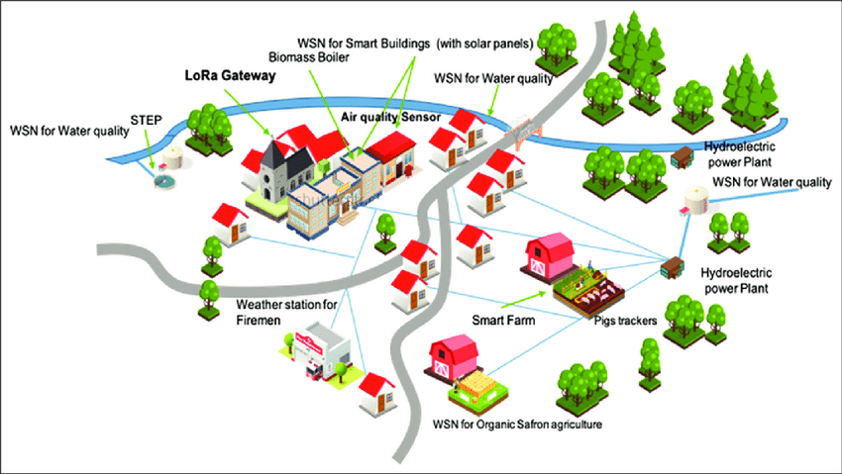

Village Brain
Village Brain builds the digital platforms by adopting digital technologies, such as big data, blockchains and artificial intelligence, to support the digital transformation of rural decision-making and the automation of business processes.
The IoT perception platform mainly manages the data collected by the IoT in a unified manner, and uses visualization technology to display the data intuitively, promoting the formation of rural big data and providing a basic perception data guarantee for the subsequent application development.
.

Slide 5
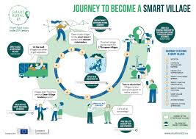
Application Support System
connects the two important structures of the rural brain and the application service system through the application of integration services, mobile support services, toolset services and data interfaces.
The upper application development can enjoy the efficient and friendly development and runtime environment in the application support system, realizing the rapid switch between cooperation and independent operation and providing support for personalized application development.

Slide 6
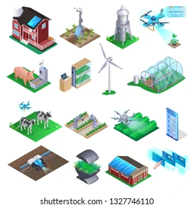
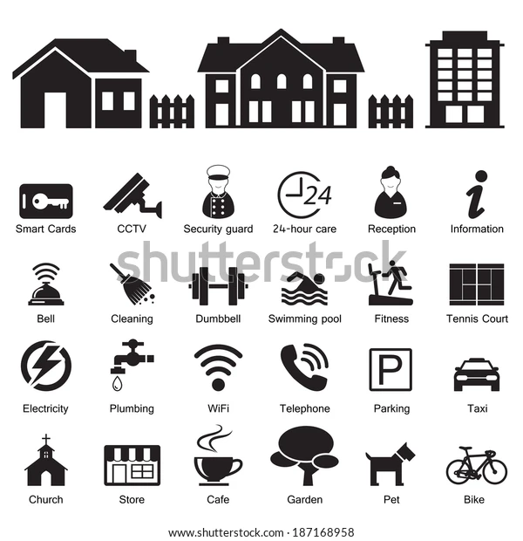
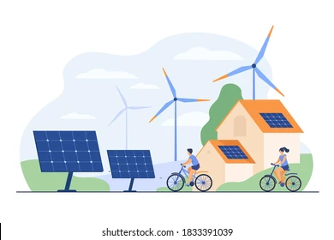
Application Service System
Combined with the digital village’s construction content and the rural sustainable development goal, the application service system can be divided into five aspects: industrial development, ecological livability, cultural prosperity, service improvement and efficient governance.
The founded content mainly includes smart agriculture, rural e-commerce, smart tourism, digital inclusive finance, and agricultural socialization services.

Slide 7
Conclusions
Creating a competency model for administrators of National Research and Education Networks (NRENs) in developing information and communication technology (ICT) architecture for the Smart village requires taking into account multiple factors, including technological, managerial and communication aspects. The structure of such a competency model is presented below:
1. Technical competencies
- Networking technologies
- Information security
- Cloud technologies
- Data management
2. Architectural competencies
- ICT architecture design
- Systems integration
3. Management Competencies
- Project Management
- Strategic planning
- Change Management:
4. Communication competencies
- Stakeholder Engagement
- User training and support
5. Social and ethical competencies
- Social Responsibility
- ICT ethics
6. Innovation competencies
- Analyzing new technologies
- Creativity in problem solving:
7. Interdisciplinary skills
- Understanding the context of the educational environment
- Interdisciplinary Collaboration

