Slide 1
10 years of eduVPN
Tangui Coulouarn, DeiC
RENAM Anniversary Event, Chișinău, Moldova, 8 October 2024
Public (PU)

Slide 2
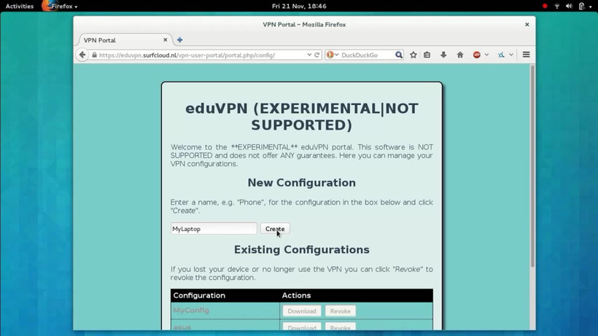
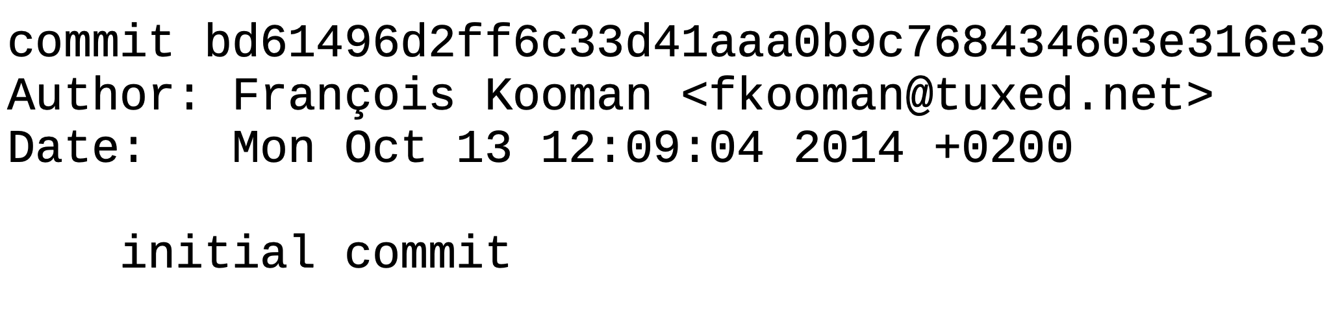
A decade ago…
Started in 2014 within an Innovation Programme at SURF(net), the Dutch NREN
Used in R&E as eduVPN and otherwise as Let’s Connect!
  Collaboration with govroam. Apps can be rebranded
Software governance via The Commons Conservancy
Service governance via GÉANT
Main financial support: GÉANT

Slide 3
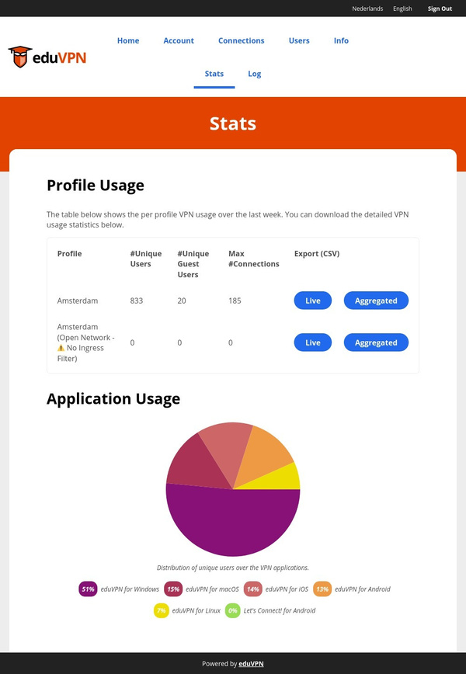
What is eduVPN?
eduVPN is an edu service built by collaboration of several NRENs, supported by GÉANT
Using OpenVPN and WireGuard
Free Open Source Software
Regularly audited

Slide 4
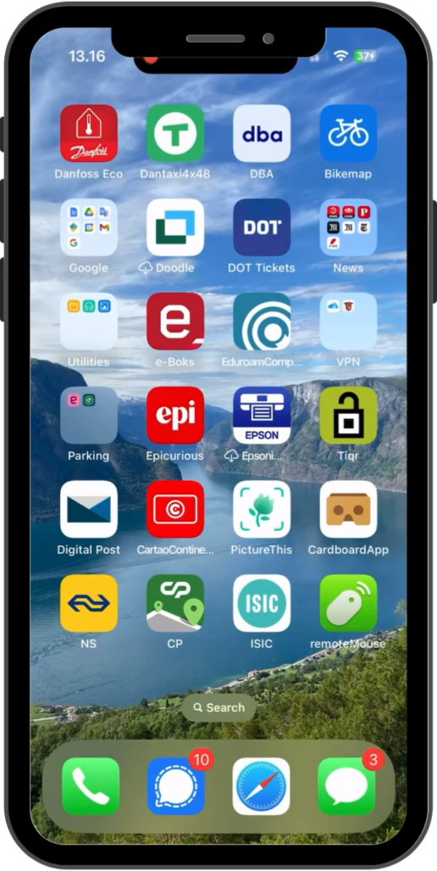
eduVPN today
VPN software package with
  Server side components
  Client apps for Linux, Windows, macOS/iOS, Android
Integrates well with SAML, LDAP, RADIUS, OpenID Connect, Client certificates…
Granular profiles and possibility for managed devices
Scales from raspberry pi to multi-node deployments
See https://docs.eduVPN.org/server/v3/ for full feature list

Slide 5
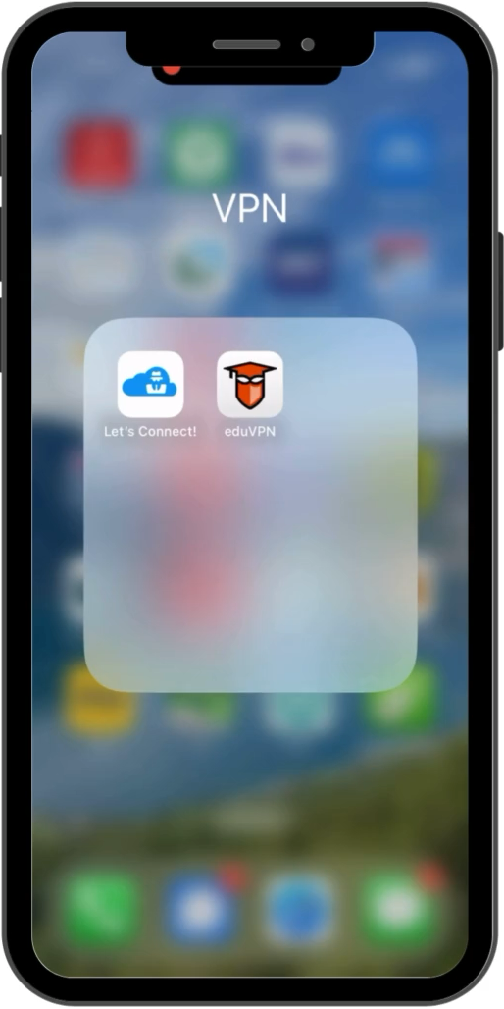
2 (main) use cases
1. Secure Internet
Connection between a client and a server connected to the public Internet
20 secure internet servers currently – with cross usage
For: insecure/broken networks
2. Institute Access
Connection between a client and a server connected to a private network
180+ universities currently
For: granular profiles where a specific user/group of users has access to specific resources; split tunnelling, etc.

Slide 6
Cost as one driver to switch to eduVPN
Example of costs at a Danish university for a commercial solution for 11000 students and 6000 staff with the following requirements:
  1000 concurrent users
  Hardware with 10 Gbps interfaces
  Differentiated access to services according to type of user, equipment used
100000 EUR for hardware + 35000 EUR for licenses for 3 years (without network costs, maintenance, power, etc.).
But these are pre-COVID figures…

Slide 7
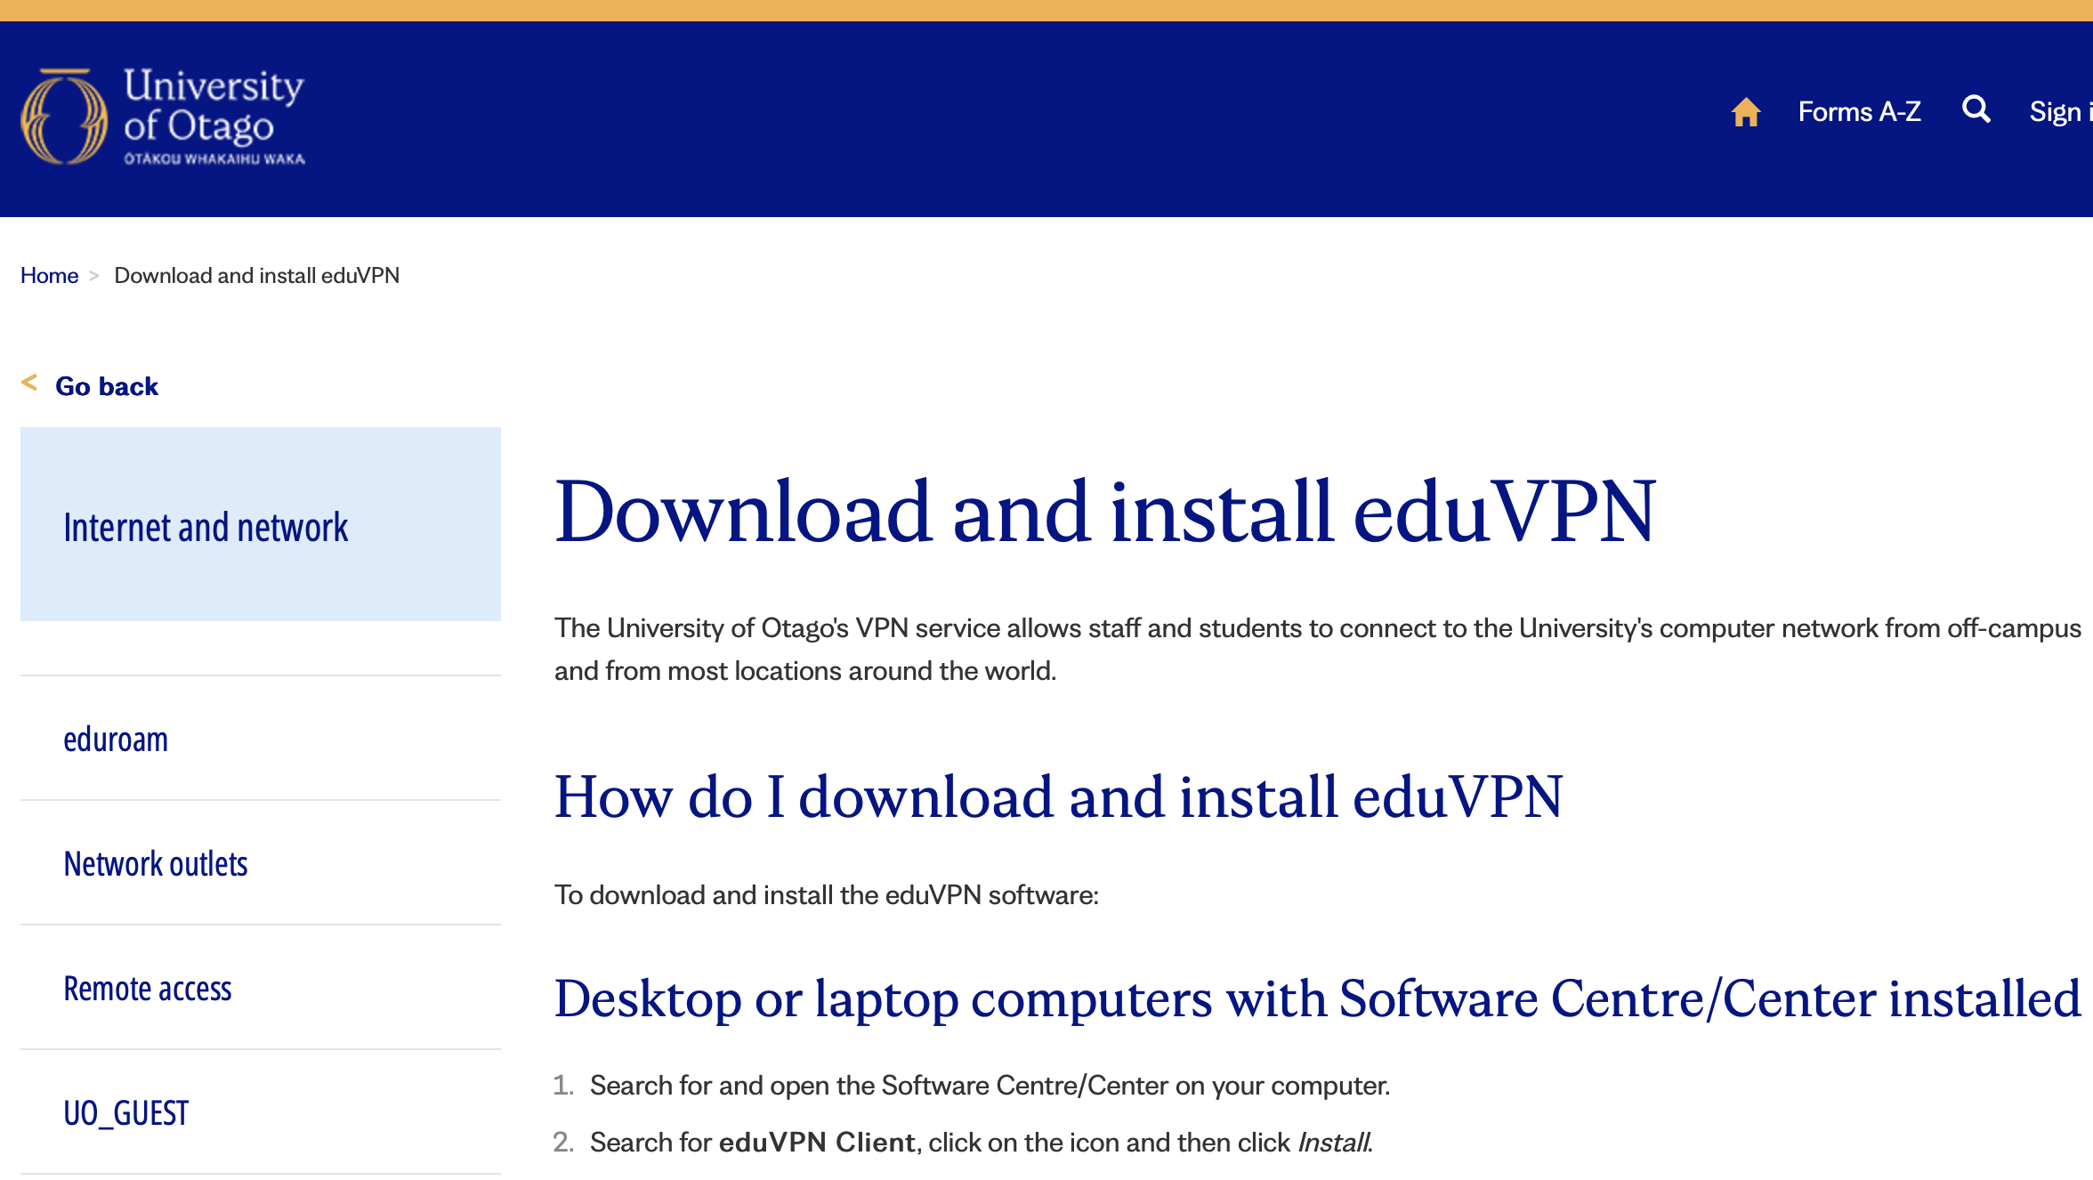
Deployment example 1: Stand-alone instance (Otago University)
Cost + authentication
Need to scale up because of COVID: existing VPN used nearly EOL hardware. Need to buy new concentrators for ca. 275000 EUR or look at alternatives.
Choice for eduVPN because:
possible reuse of existing compute hardware
use of SAML and by extension leverage Azure Active Directory / Microsoft Entra ID with conditional access

Slide 8
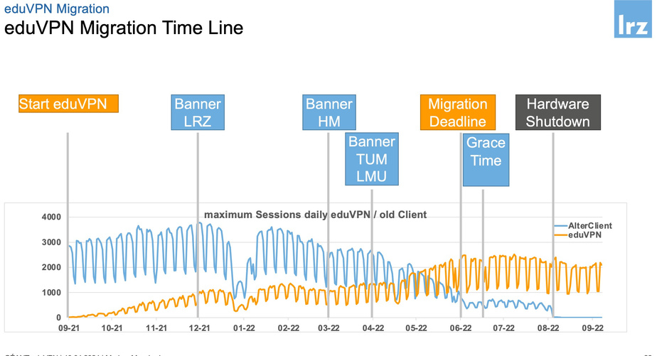
Deployment example 2: eduVPN on shared resources (LRZ)
Scaling and management
Regional computing centre providing network for several higher education institutions in the Munich area
During pandemic, often 6000+ concurrent users
Their solution was EOL
Standard OpenVPN tested but lacked features (incl. Automatic client configuration updates)
Now operates eduVPN for most institutions in the greater Munich area
  Single server for each for the three biggest universities: TUM, LMU and HM;
  One ”catch all” server for the other institutions;
  One dedicated server for LRZ
See https://events.geant.org/event/1515/contributions/1696/attachments/9 54/1472/eduvpn-GSD-2024-04.pdf

Slide 9
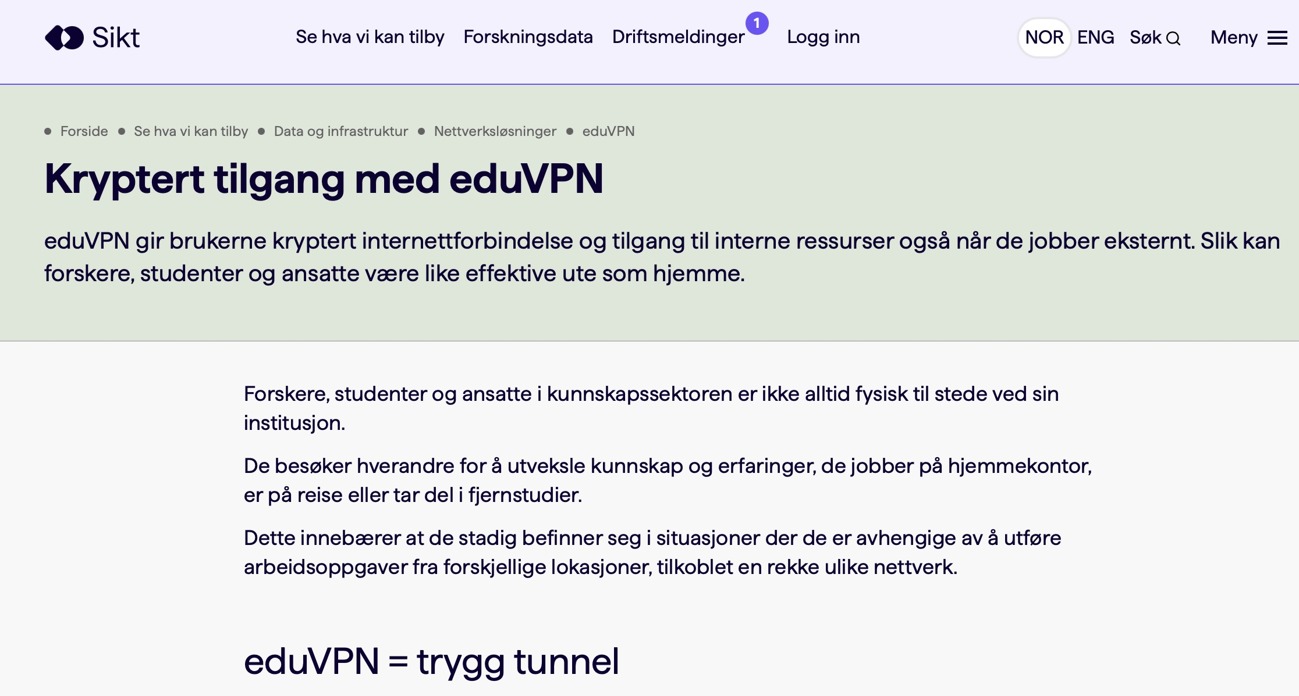
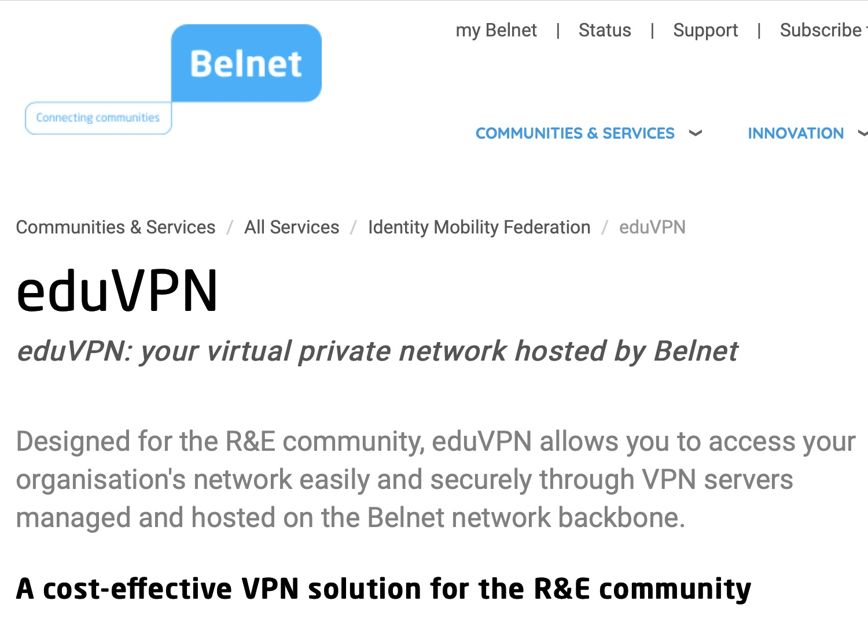
Deployment example 3: Institute Access as a Managed Service for a whole NREN
Model currently implemented in NL, BE and NO
eduVPN instances managed centrally. In NL in a twin data centre near Amsterdam
L2 circuit back to the private resource in the NL
Support by NREN
No need for hardware on campus or licensing limitations
Pricing /Cost recovery model up to the NREN

Slide 10
Roadmap
3.x
  WireGuard + TCP: already works (except on iOS/macOS)
  As some networks block UDP or have MTU issues->send WireGuard traffic over TCP (or over TLS through the Web Server in (Reverse) Proxy Mode(
4.x
  Drop OpenVPN
  User defined networks
  Move server configuration to DB
    Allow server admins to change (some) configuration through Web UI

Slide 11
Set-up eduVPN in 6 steps
Get a VM with one of the supported OSes
Follow the deploy instructions
Configure network (if necessary)
Configure authentication
Test server with eduVPN apps (by specifying hostname in search box)
Request to be registered in eduVPN apps
https://docs.eduvpn.org/server/v3/#installation https://www.youtube.com/watch?v=LbFOueP0tLc

Slide 12
Thank You

Slide 13
Extra-slide: 5 most frequently asked questions
MFA
User defined VPNs
High availability / Redundancy (HA/R)
Real time authorisation
Managed devices

