Slide 1


Géant Cybersecurity month
CSM24 – Your brain is the first line of defence
Leonardo Marino
Product Marketing Manager at Géant
October 2024
Public

Slide 2


What is the European Cyber Security Month (ECSM)?
Annual EU cybersecurity campaign
When: Every year (since 2012), for the entire month of October
What: Hundreds of activities across Europe, including conferences, workshops, trainings, webinars, presentations.
Who: Coordinated by the European Union Agency for Cybersecurity (ENISA) and the European Commission. Supported by EU Member States and hundreds of partners (governments, universities, think tanks, NGOs, professional associations, private sector business).
Target: EU citizens and organisations
#CyberSecMonth
Notes:
It’s the European Union’s annual campaign dedicated to promoting cybersecurity among EU citizens and organisations, and to providing up-to-date online security information through awareness raising and sharing of good practices.

Slide 3

Our approach - How we plan and manage our campaigns in a nutshell
In the context of GÉANT projects (first GN4-3, now GN5-1)
Focus on the Research & Education community
Not only GÉANT: Our cybersecurity campaigns are a community effort
Active involvement of the communication units
Surveying community needs and requirements
Establishing KPIs and continuously evaluating the campaign based on them

Slide 4
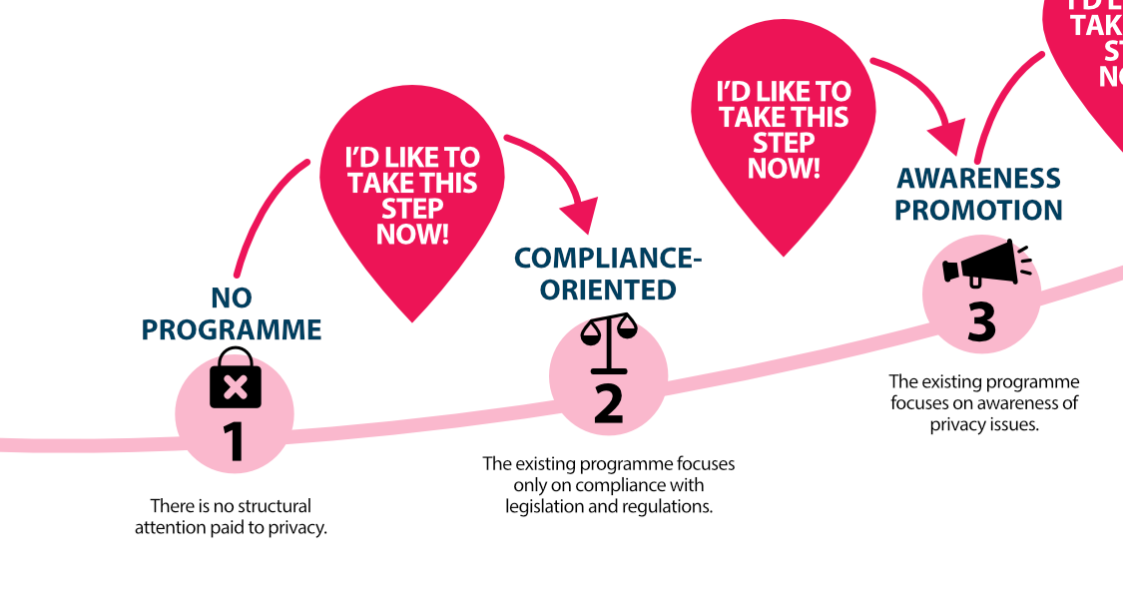
First steps
Part of roadmap developed by

Slide 5
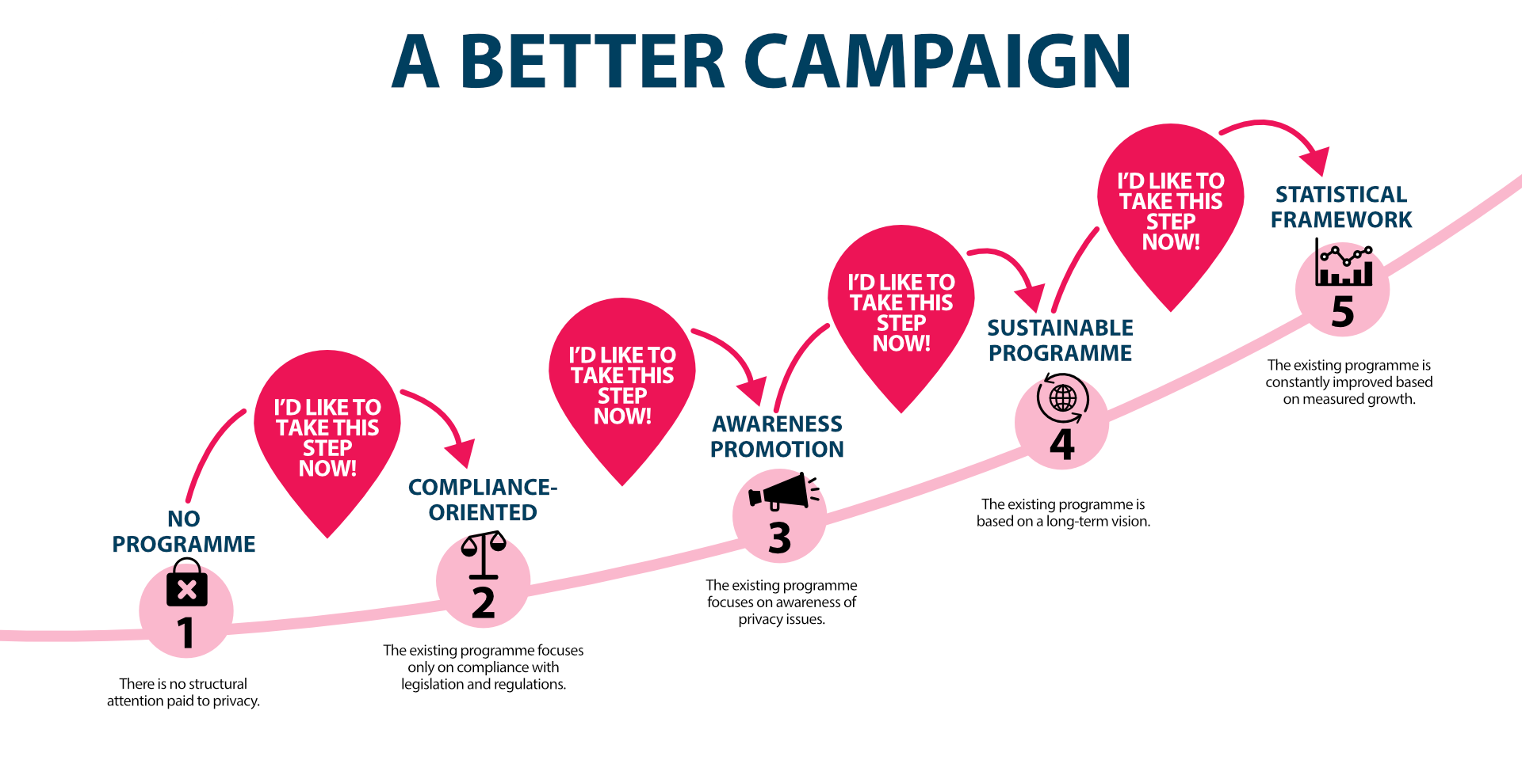
Part of roadmap developed by
Notes:
The Security Awareness Maturity Model allows you to determine the status of an awareness programme, the direction in which the programme can grow and the steps necessary to achieve that goal:
Use the model below to determine where you are now,
Click on the menu item on the left for the desired level,
You will immediately receive information about how your organisation can grow from one level to the next.

Slide 6
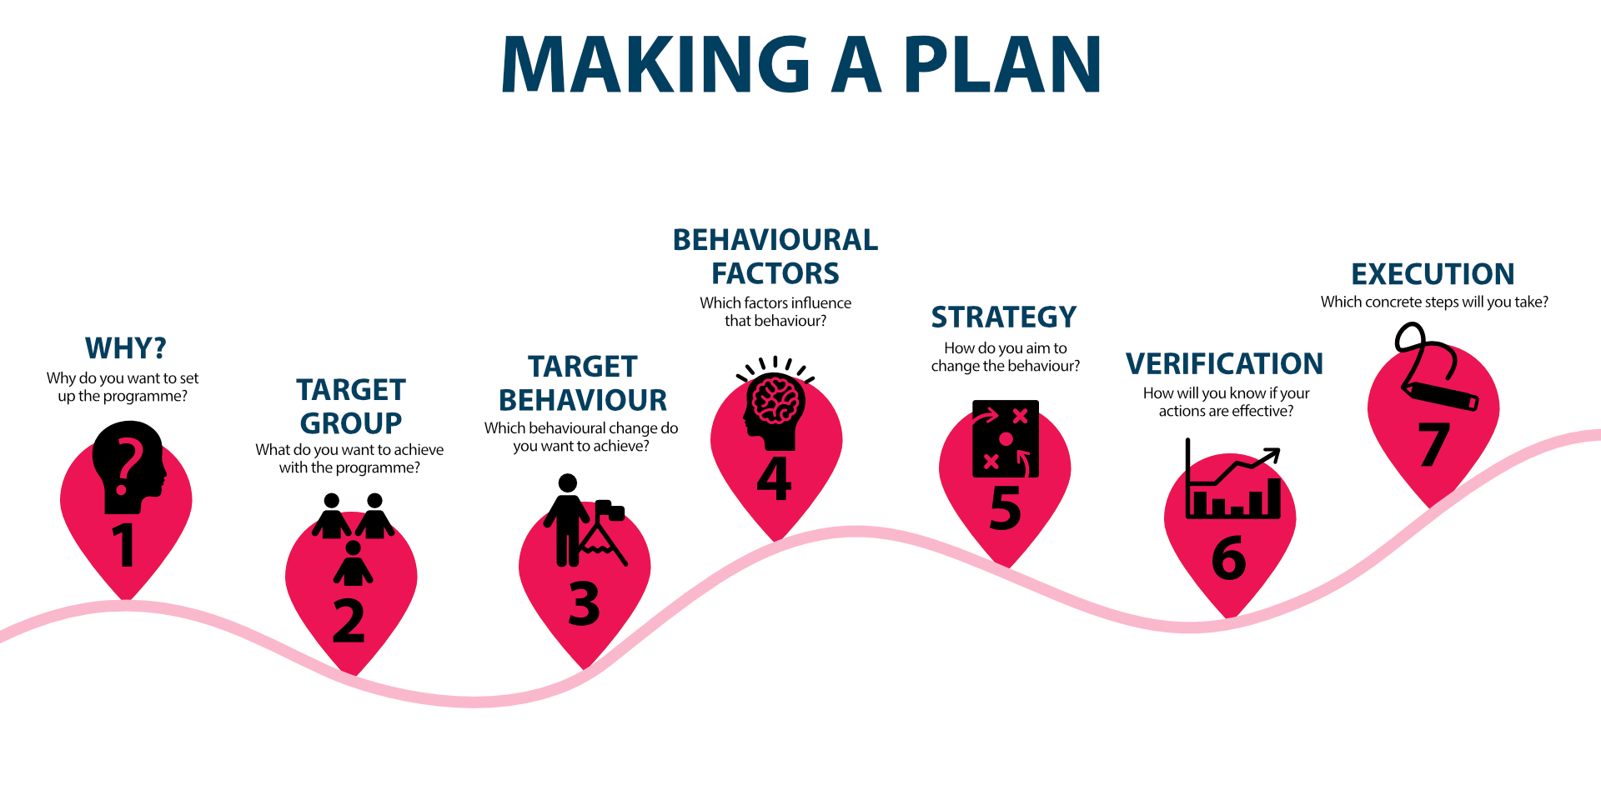
Part of roadmap developed by

Slide 7
Campaign Targets
GÉANT,
NRENs
& RRENs
Universities &
research centres
End users:
students, researchers, teachers
(Secondary target: General pubic / IT & tech outlets / R&E outlets)
1. Decision makers
Security awareness starts at the top. Raising awareness of decision makers on the importance of cybersecurity to lead to the development and enforcement of robust cybersecurity policies.
2. Staff members
– technical
Sharing community expertise and experience
Contributing to the implementation of security practices
3. Staff members
– non-technical/all
Raising awareness on cybercrime and on the behaviour and targets of cybercriminals
Explaining how employees can better protect themselves in a fun and simple way
Focusing on the importance of each one’s behaviour: security is a shared responsibility
4. Comms &
security awareness
Inviting to participate in the campaign and promote it actively within their NREN (intranet, newsletter, internal comms channels, …) and towards their communities (websites, social media, mailings, …)
1. Decision makers
Security awareness starts at the top. Raising awareness of decision makers on the importance of cybersecurity to lead to the development and enforcement of robust cybersecurity policies.
2. Staff members
– technical
Sharing community expertise and experience
Contributing to the implementation of security practices
3. Staff members
– non-technical/all
Raising awareness on cybercrime and on the behaviour and targets of cybercriminals
Explaining how employees can better protect themselves in a fun and simple way
Focusing on the importance of each one’s behaviour: security is a shared responsibility
4. Comms &
security awareness
Inviting to participate in the campaign and promote it actively within their NREN (intranet, newsletter, internal comms channels, …) and towards their communities (websites, social media, mailings, …)
Raising awareness on cybercrime and on the behaviour and targets of cybercriminals
Explaining how employees can better protect themselves in a fun and simple way
Raising awareness on GÉANT and the NRENs, their efforts in cybersecurity, their tools and services, their cybersecurity awareness initiatives

Slide 8
Campaign goals and means
Goal | Message | How?
Educate and empower users to protect their organisations against cyber crime | Your brain is the first line of defence | Social media tips Blogs and articles Webinars
Learn from each other’s incidents and successes | Helping others by sharing and by being transparent | Case studies Interviews with security and awareness experts
Create a sustainable, broad, and replicable awareness concept | Cybersecurity is a shared responsibility. Together, we can protect what matters. | Customisable awareness package

Slide 9








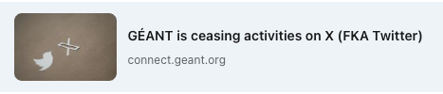
Main GÉANT channels
CONNECT family
GÉANT social media channels
Website
Newsletter
Magazine

Slide 10
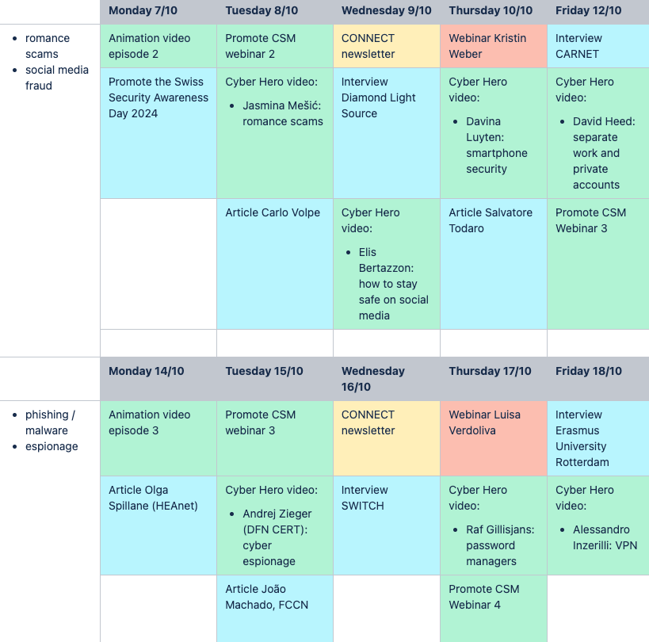
Content Calendar
CyberSecMonth campaigns are a marathon throughout October…
How do we organise all the contributions? And how do we keep the attention high?
Some ingredients for a successful campaign:
Weekly themes
Right mix of content and media types
Right rhythm and frequency

Slide 11
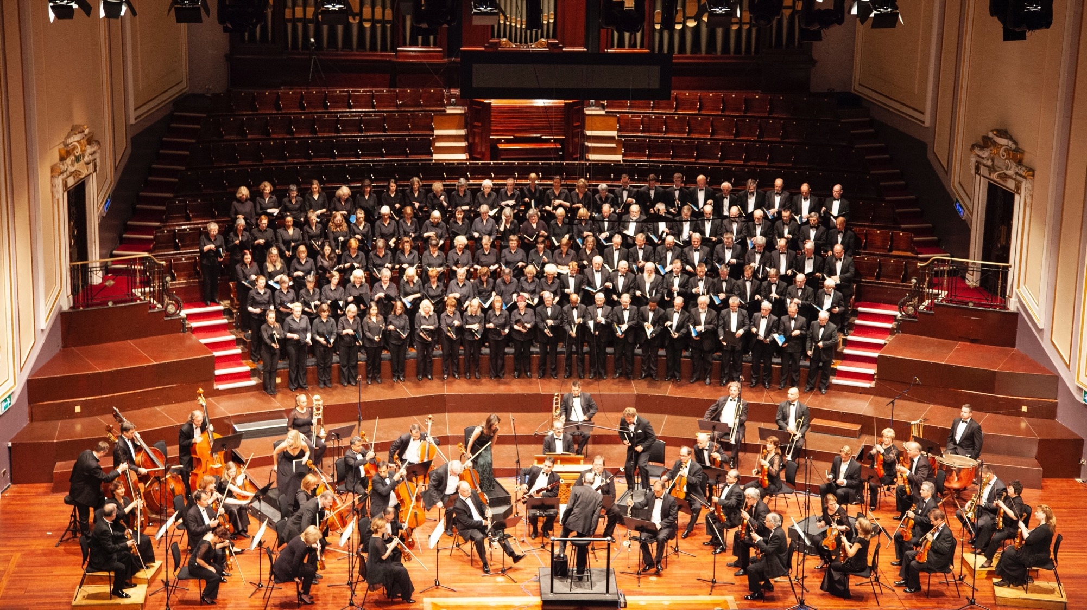
Notes:
How the different element of the campaigns should work together throughout the month (ideally)
And with a group directing
it also feels like having part in directing a complex partition

Slide 12
Highlights of previous GÉANT CSM campaigns
CSM19 | CSM20 | CSM21 | CSM22 | CSM23
6 NRENs involved | 19 NRENs Involved | 27 NRENs Involved | 25 NRENs Involved | 22 NRENs involved
7 articles published | 41 articles published + 1 webinar | 36 articles published + 4 webinars | 45 articles published + 4 webinars | 22 articles published + 4 webinars + 4 Cybercrime for newbies videos + 10 Cyber Hero videos

Slide 13


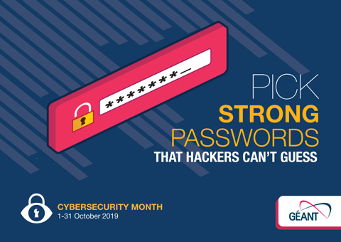
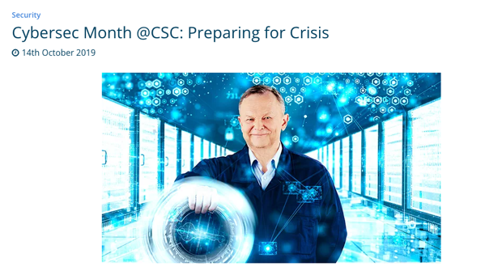
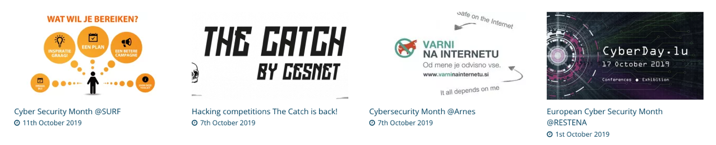
2019: GÉANT launches a pilot CyberSecMonth campaign

Slide 14

2020: Enter the Cyber Heroes
Notes:
Enter the Cyber Heroes

Slide 15




Become a Cyber Hero (2020)
Notes:
consistent visual identity

Slide 16

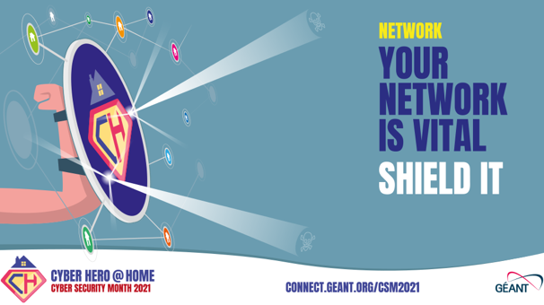



Expanding on the Cyber Hero concept: Cyber Hero at Home (2021)
Notes:
consistent visual identity
Building on the branding elements
Re-using the content
Easily recognisable

Slide 17





Expanding on the Cyber Hero concept: A Community of Cyber Heroes (2022)
Notes:
Targeting specific target groups (with grouping and with some specificities to this campaign: e.g. the Home Workers group is following on from the 2021 campaign and covers the needs of a changing society)

Slide 18


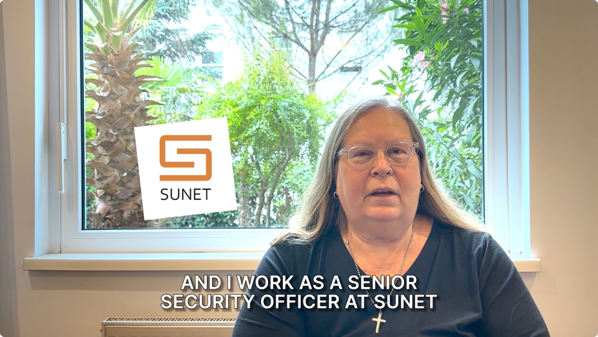
Reprise and synthesis: Become A Cyber Hero (2023)
Refresh in line with new GN5-1 project and new team: Building on successes of previous campaigns
Social media realignment: more spread across socials, more focus on LinkedIn and Instagram, starting to abandon Twitter/X and introducing Mastodon
Introducing animation series: Cybercrime for Newbies (Granny Smith)
Introducing videos with security experts from the community

Slide 19

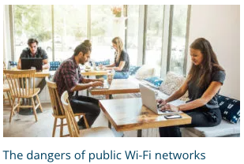

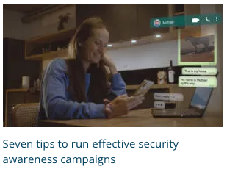
Community blogs, articles, case studies
Currently published (2019-2023)
151 articles!
The CyberSecMonth page is always the most visited page on CONNECT in Oct.
Universities & research centres:
  1. Decision Makers
  2. Staff - Technical
GÉANT, NRENs & RRENs
  3. Staff members – non-technical/all
Universities & research centres
  3. Staff members – non-technical/all
End users: students, researchers, teachers
GÉANT, NRENs & RRENs
  1. Decision Makers
  2. Staff - Technical
Universities & research centres:
  1. Decision Makers
  2. Staff - Technical
GÉANT, NRENs & RRENs
  4. Comms & security awareness
Universities & research centres:
  4. Comms & security awareness

Slide 20
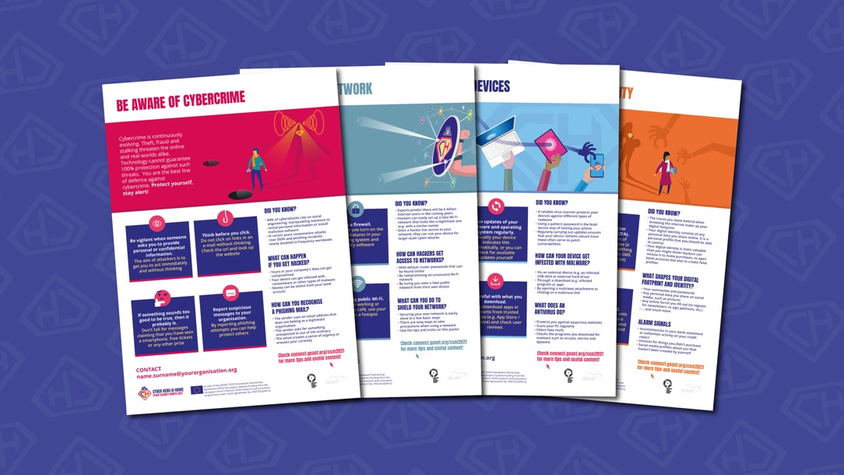
Awareness pack & white-label materials (from 2021)
Re-usable materials:
Logo pack
Posters
Weekly themes visuals
Animations and videos
Email signature banners
Translations
Now available in the Security Awareness Resources Hub
Notes:
Easy to re-use and to customise
Maximising reach and distribution

Slide 21
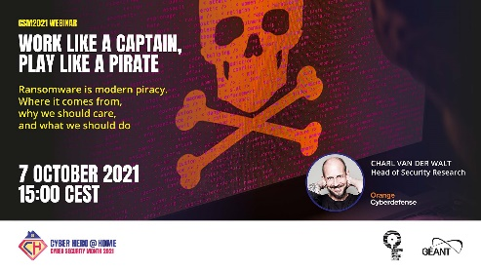

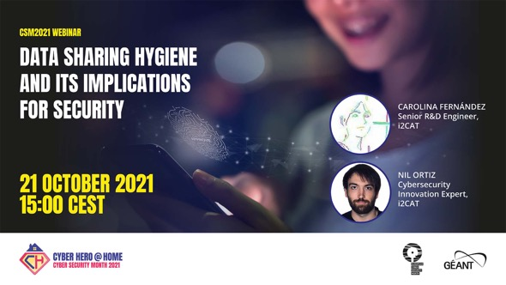

CyberSecMonth Webinars (from 2020-2021)
Opening collaboration with commercial partnership programme

Slide 22
Webinars
2020
2021
2022
2023
Notes:
Introduced single webinar in 2020, then programme in 2021, expanded in 2022 and 2023 also with RedCLARA

Slide 23




CyberSecMonth campaigns across Social Media – 2019-2023
+

Slide 24
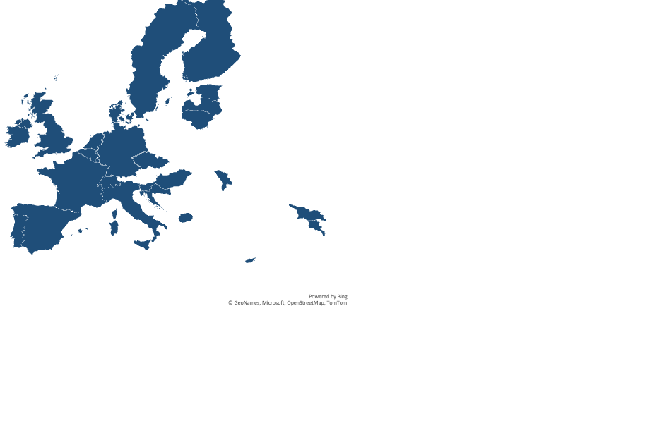
NREN Contributions (2019 – 2023)
31 NRENs and RRENs
actively contributed to the campaigns in different years
+ Brazil
+ South Africa
+ Chile
+ RedCLARA
+ NORDUnet

Slide 25
Success factors
Clear objective and goals
Well defined campaign and targets
Engaging content
Co-creation
Active involvement of communications units
An amazing team
An amazing community

Slide 26

Cybersecurity Month 2024 – Reboot with new concept!
Notes:
Focus: Social engineering
Tagline: Your brain is the first line of defence
Aim: Stay vigilant and think critically to be one step ahead of cyber criminals

Slide 27
Cybersecurity Month 2024 – in a nutshell
4-part animation series following the adventures of Jake Doubt, Head of the Security Team, Guilder University
  Available in 8 languages: English, Croatian, Dutch, French, German, Italian, Portuguese, Spanish
12 videos from community experts
8 interviews with NRENs and connected institutions
6 Planned articles and blogs
4 webinars every Thursday in October 15:00 - 16:00 CEST
2 Technical Security Master Classes with Arista and Nokia

Slide 28
2024 campaign: Weekly themes
Week 1
  Introducing main theme of Social Engineering
  Everyone can be a target
  CEO Fraud
  New threats linked to AI
Week 2
  Romance scams
  Pretexting
  Social media fraud
Week 3
  Phishing
  Malware
  Cyber-espionage
Week 4
  Tailgating
  Information and knowledge sharing with the community
  Cyber crisis management

Slide 29
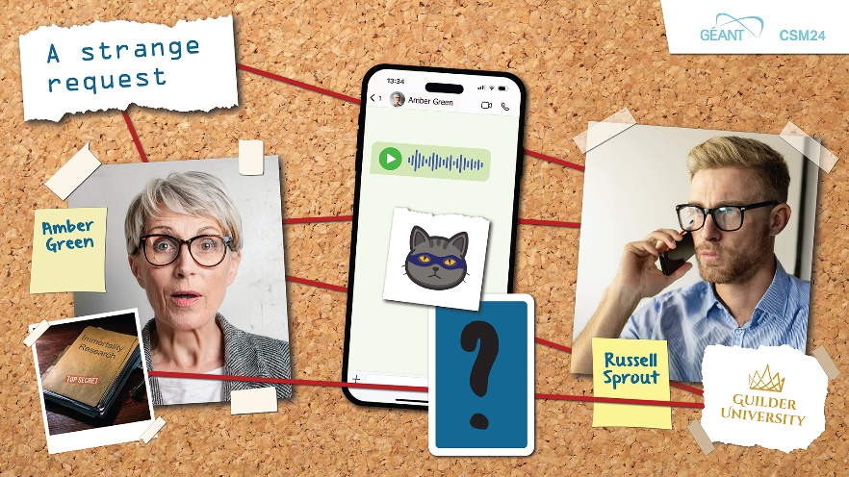
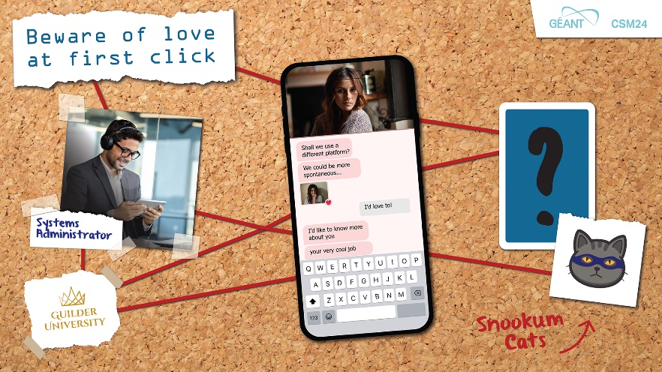
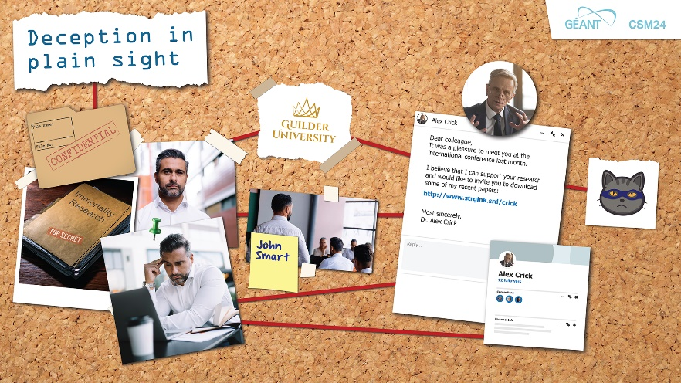
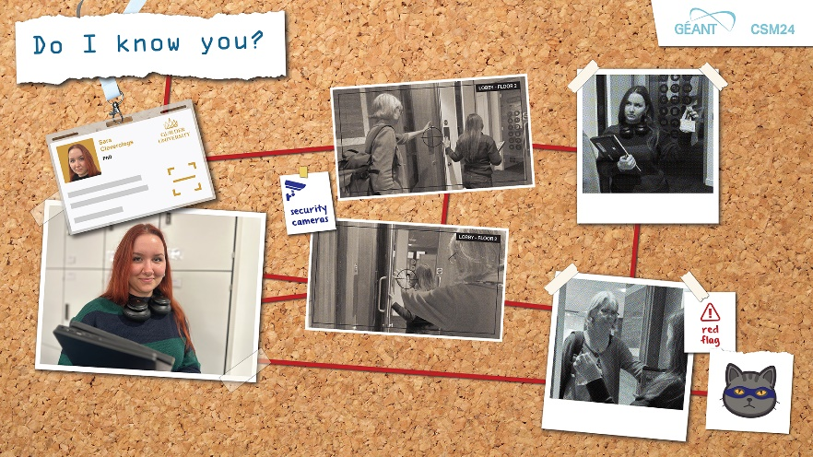
Cybersecurity Month 2024 – video animation series
Following the adventures of Jake Doubt, Head of the Security Team at Guilder University
Notes:
Investigates incidents involving members of staff at the university
Spear phishing, romance scam, tailgating,
The animation are presented in true crime style

Slide 30
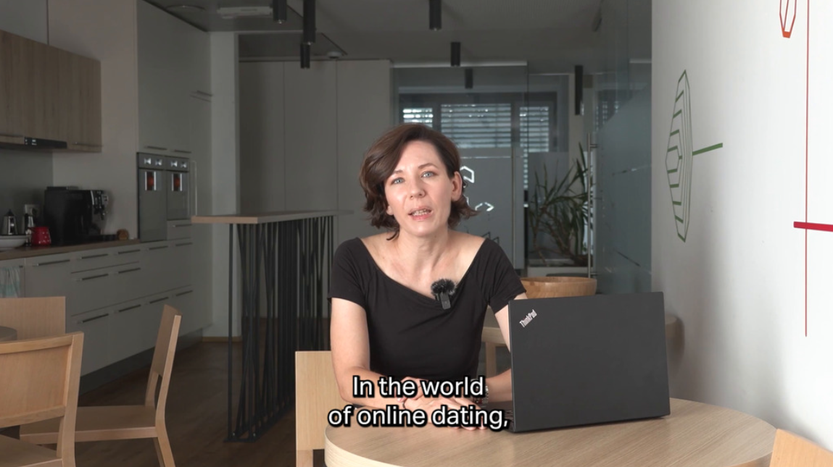
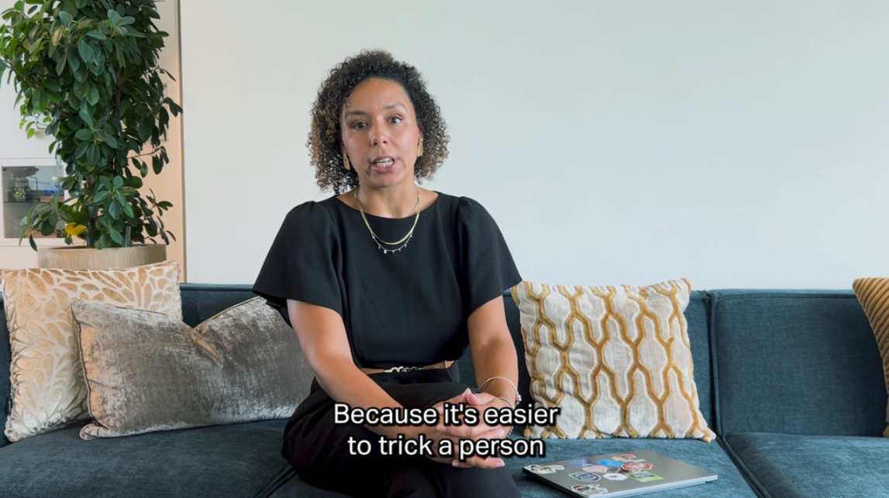
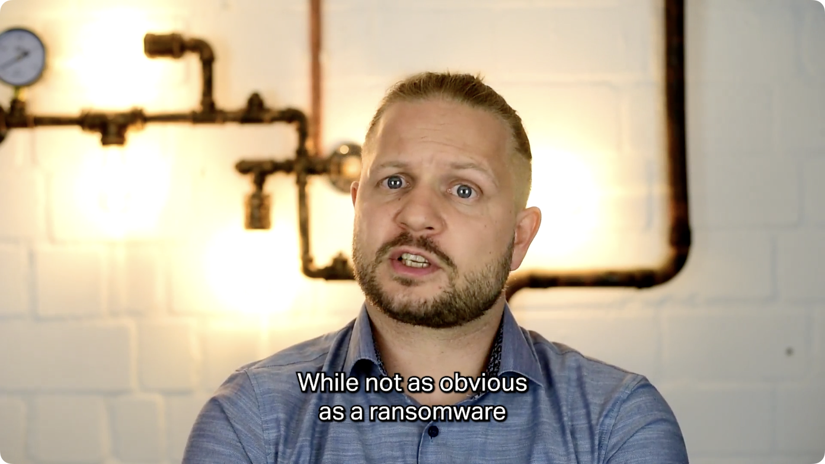
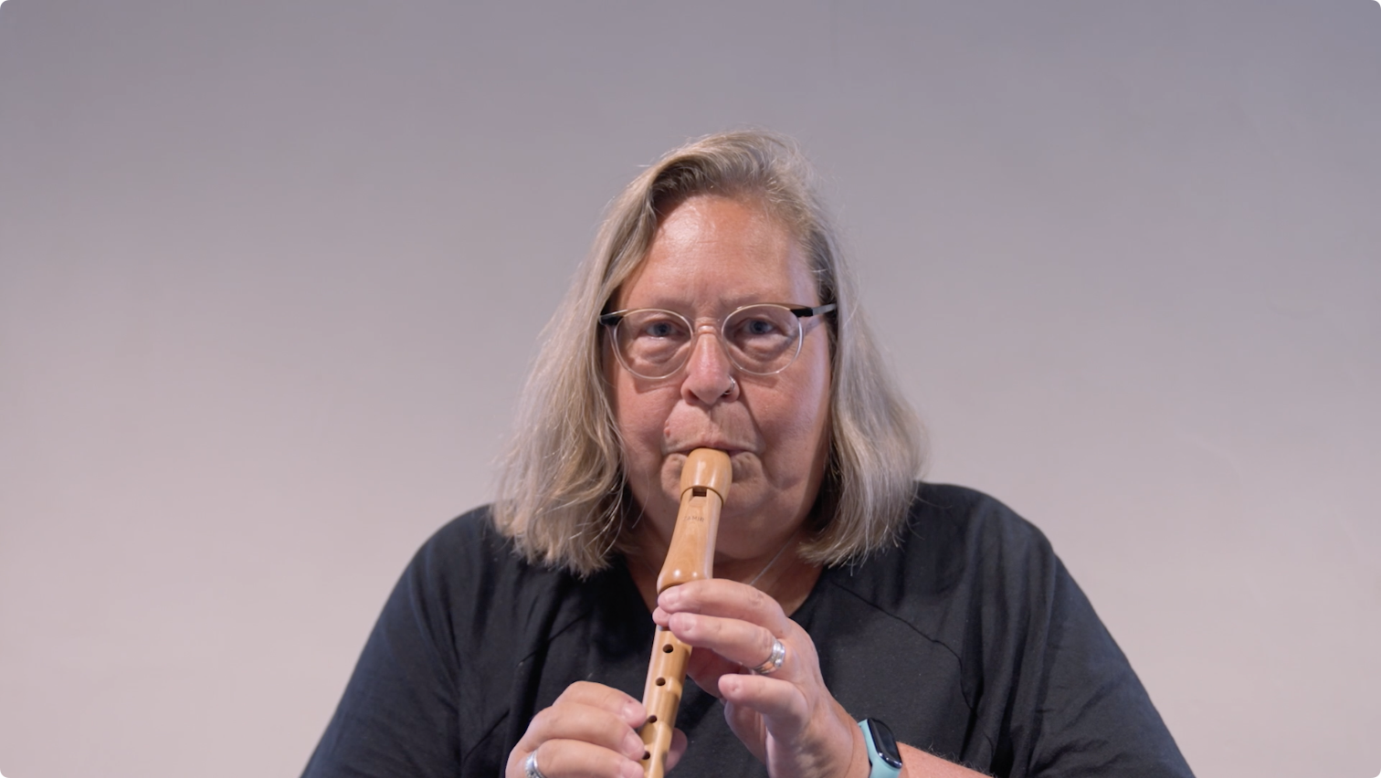
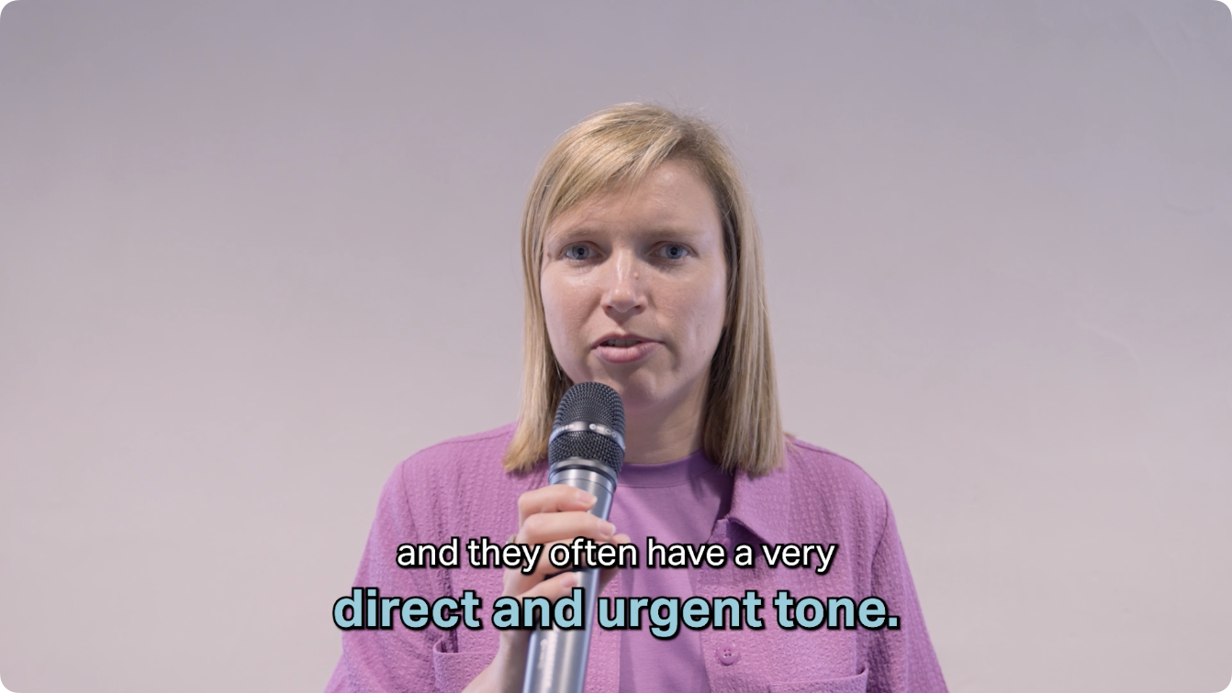
Cybersecurity Month 2024
12 videos from community experts
Notes:
Ana Alves – Social engineering and R&E
Andy Roebuck – Secure use of AI tools
Subjects covered: Online dating and romance scams, sharing data on social media, secure use of smart phones, strong passwords, cyber espionage, password managers, free wi-fi dangers, crisis management

Slide 31
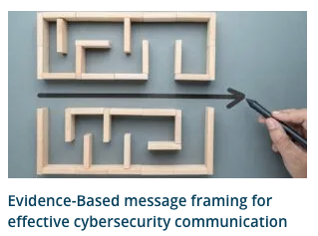
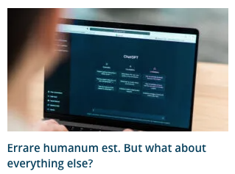
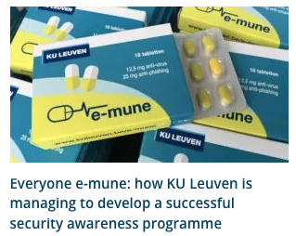
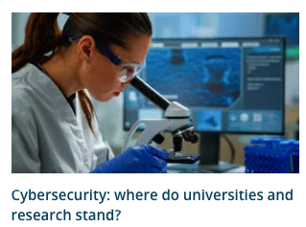
Cybersecurity Month 2024
8 In-depth interviews with NRENs and connected institutions
6 Planned articles from NRENs and connected institutions
GÉANT
NRENs
  GARR
  CARNET
  HEAnet
  FCCN
  Switch
Research Infrastructures
  Diamond Light Source
  ELI Beamlines
Universities
  KU Leuven University
  Erasmus University Rotterdam
  Zurich University
  University of Rijeka

Slide 32
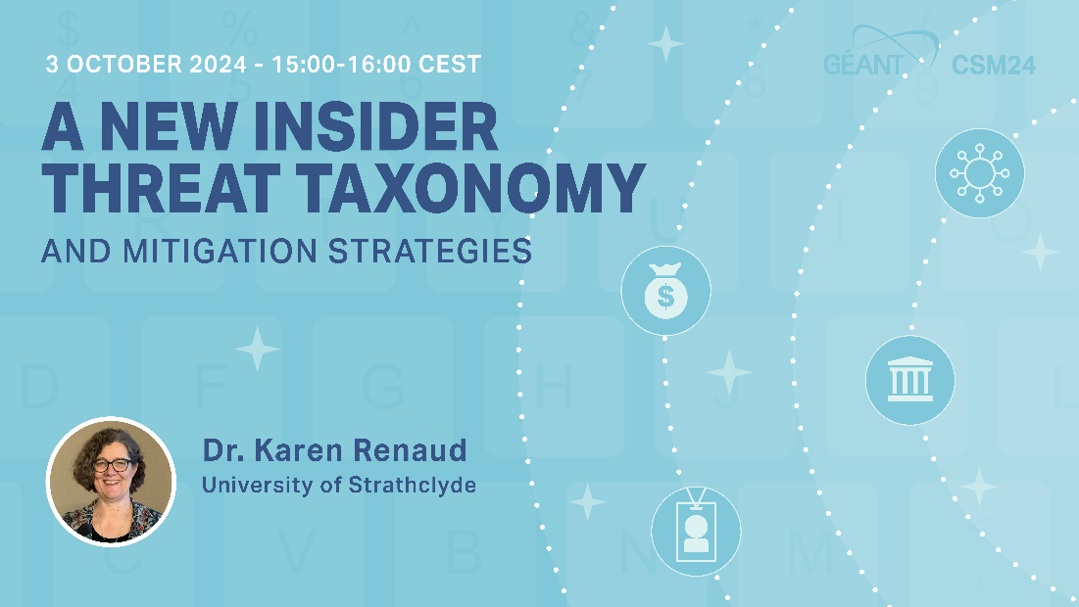
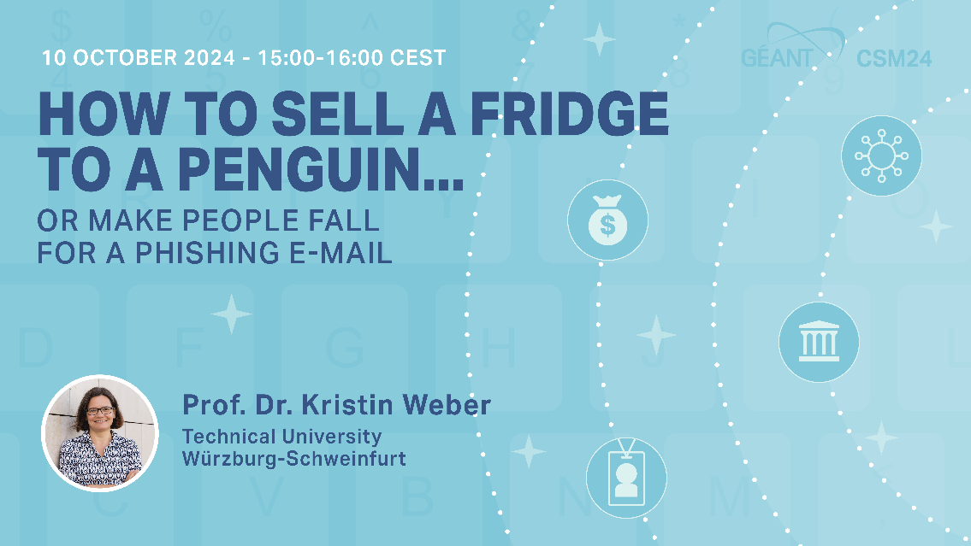

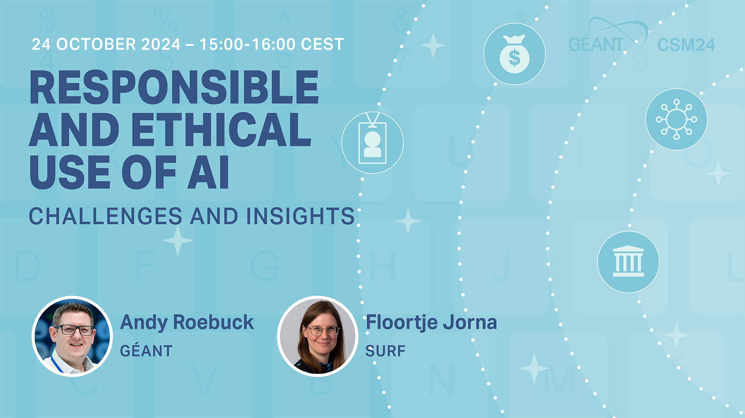
Cybersecurity Month 2024
4 Webinars – Every Thursday at 15:00 CEST!
Recording available
Tomorrow!
Notes:
Insider threat taxonomy
Social engineering
AI and cybersecurity: new threats
Safe use of AI tools : Andy Roebuck and Floortje Jorna

Slide 33
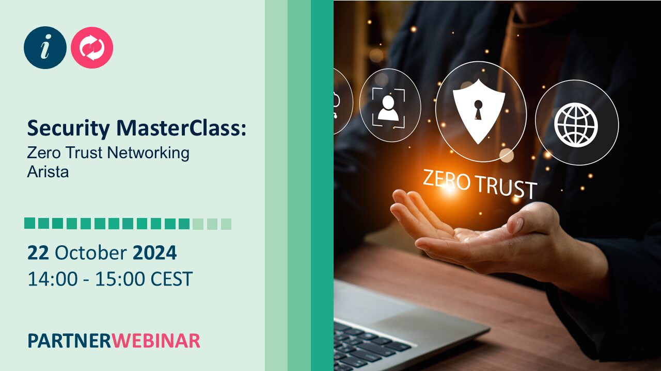
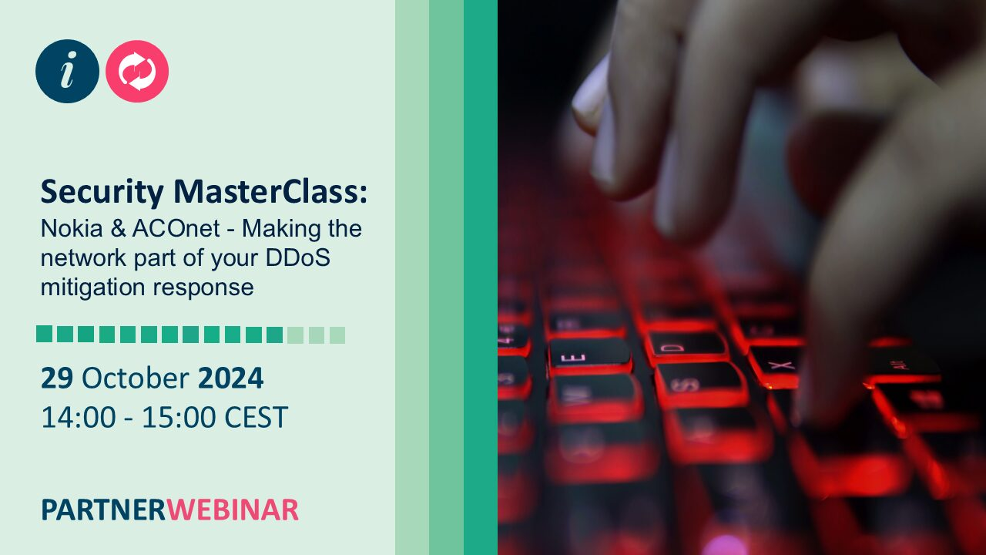
Cybersecurity Month 2024
2 Technical Security Master Classes – with Arista and Nokia

Slide 34
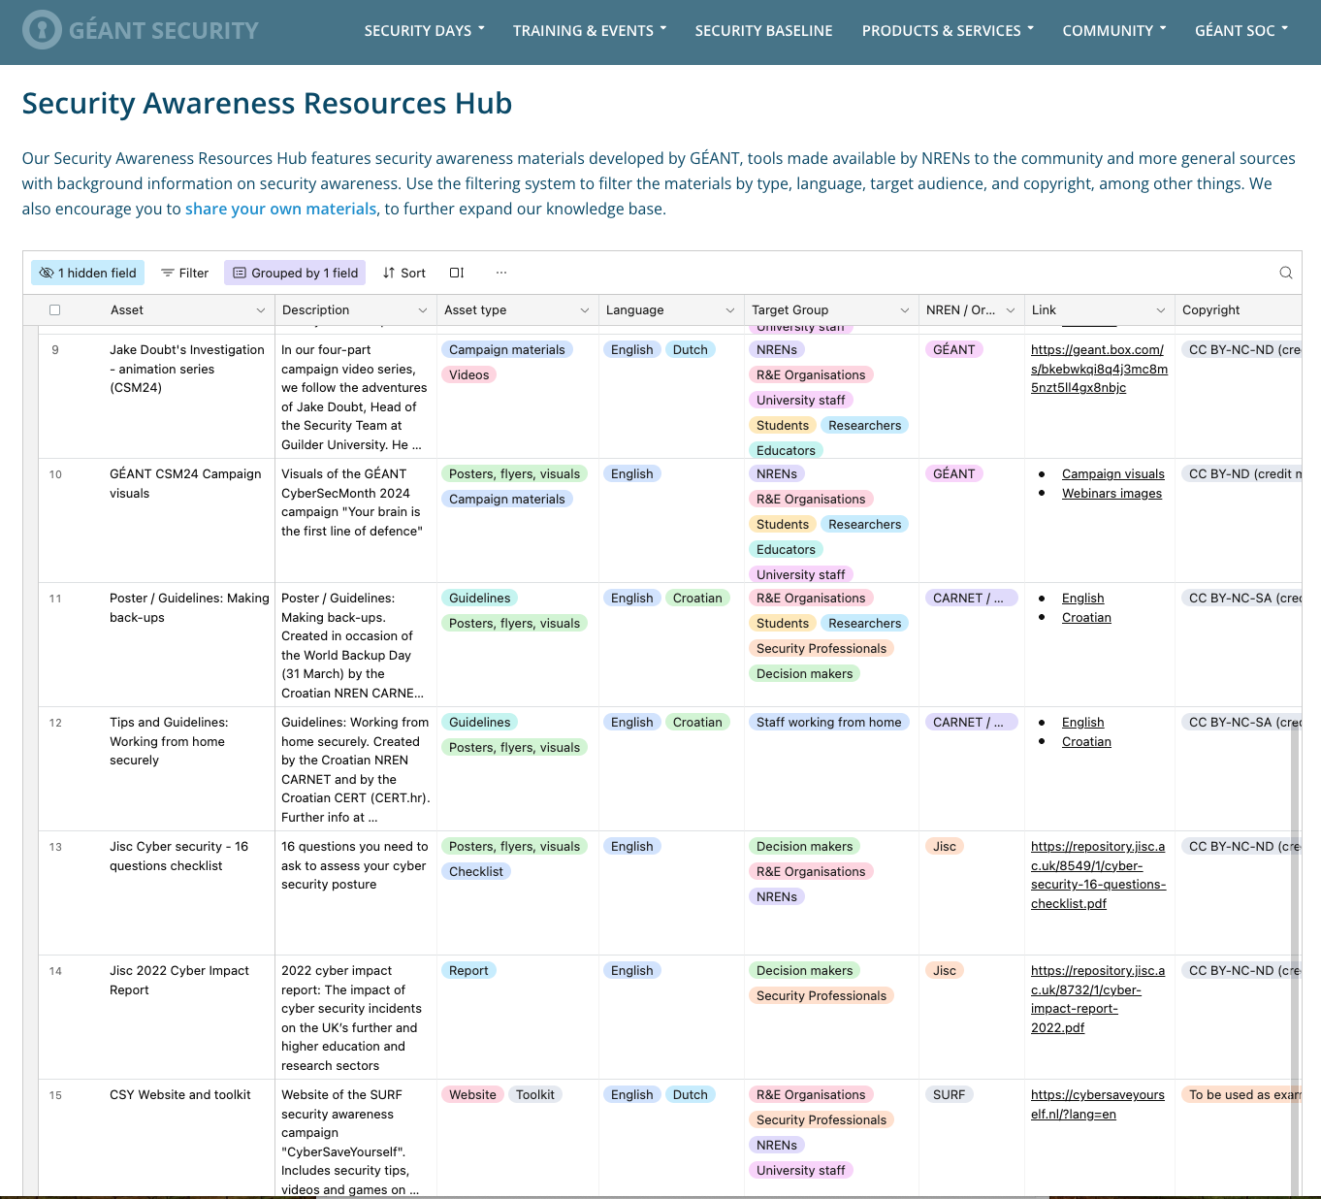
Cybersecurity Month 2024
All campaign resources available in the Security Awareness Resources Hub
https://security.geant.org/security-awareness-resources-hub/
Together with other security awareness materials from NRENs, available for re-use (posters, guidelines, templates, training materials, games, reports, visuals, etc.)

Slide 35

Cybersecurity Month 2024
All materials, articles, blogs, videos, webinars, resources available at connect.geant.org/csm24

Slide 36
Challenges & items for improvement
NEW: Re-starting with a new concept
How do we keep the orchestra playing all year long?
  Spreading campaign throughout the year
The partition is becoming increasingly complex
  Increasingly broad campaign
  Very broad and diverse target audience
  Keeping the attention high
  Changing social media landscape

Slide 37
Challenges & items for improvement
Timely involvement of NRENs - relying on contributions from partners
Involvement of other organisations outside of our bubble
Sustainability of the concept Vs Replicability
  Re-use of materials
  Increasing usage of the Security Awareness Resources Hub
Improving statistical framework and feeding back into campaign

Slide 38
Planting the seeds and fostering security awareness initiatives
Supporting the establishment of other awareness programmes (internal and external)
“Towards a robust cybersecurity awareness programme” series on the roadmap for security awareness programmes developed by SURF – and articles focused on awareness campaigns
Awareness report 2023 on the status of Cybersecurity awareness across NRENs
Launched Security Awareness Resources Hub with ready to use materials and building blocks
Launched Security Awareness community: first meeting on 12 November!

Slide 39

Thank You
Any questions?
What are your thoughts on the campaign?
leonardo.marino@geant.org
www.geant.org

