Slide 1
Introduction to Wallets
Trust and Identity Infoshare for NRENs
Christoph Graf, Switch
Tasklead GN5-1/WP5/T7
GÉANT Infoshare
23 September 2024
Project Participants Sensitive (SEN)

Slide 2


Overview
Our T&I genes – and what came out of them
The bigger picture – and new expectations
Enter “Wallets” – so what?
Next steps – either with, or without us

Slide 3


IDENTITY FEDERATION
NETWORK
COMMUNITY
Network Services
Cloud
Security
Trust & Identity
Source: Erik Huizer @ TNC 2024 and GÉANT Project Management Convention 2023

Slide 4
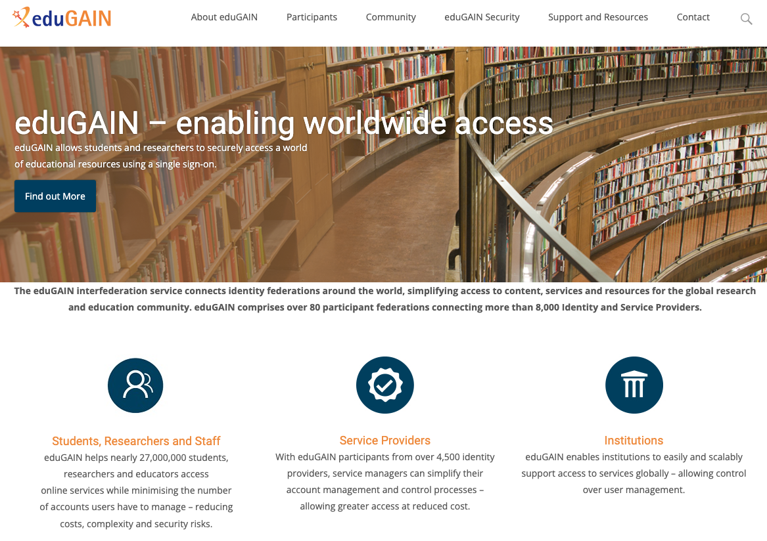

Slide 5



Worldwide access: what is it all about?
I want to use «Cool service»
Me
Reputable University
Cool Service
I know something about you
OK, but only if trustworthy sources tell me enough about you

Slide 6

Our well-established workhorse eduGAIN is solving this problem
Me
1
3
Please let me in
Tell them it’s me!
Who are you?
Reputable University
Identity Provider (members only)
2
Cool Service
Service Provider
(members only)
4
I vouch for him or her
Our technical magic
Our Trust Infrastructure
Our governance
Membership information
Membership information
«centre of the universe»
Approves/denies user-to-service connections
Decides on user data release to services

Slide 7
EU Strategy for Universities: https://education.ec.europa.eu/sites/default/files/2022-01/communication-european-strategy-for-universities.pdf
"Excellent and inclusive universities are a condition and foundation for open, democratic, fair and sustainable societies as well as sustained growth, entrepreneurship and employment."

Slide 8

EU values
EU Policy Measures & Investment
Strategy for universities
Europass, ELM, EDCI, ESCO,…
EOSC, GAIA-X, data spaces
… and much more
eIDAS v2
EUDI wallet
ERASMUS+
Implementing acts
“European universities”
Architecture reference framework
Role of
NRENs?
Role of
GÉANT?
“European degrees”
Large Scale Pilots
European student card
EBSI/
EUROPEUM-EDIC
Universities

Slide 9


Going wallets: how does the picture change? And the terminology?
3
2
4
Me Holder
1
3
Please issue my credentials!
Please let me in
5
Who are you?
Here are your credentials!
It’s me
Reputable university
Issuer
4
2
Our new technical magic
Our new trust infrastructure
Our governance
Cool service
Verifier
Membership information
Membership information
«centre of the universe»
Establishes user-to-service connections
Decides on user data released to service

Slide 10
Scale-out with wallets: how does the picture change?
Me Holder
Reputable university
Issuer
Shared technical magic
Cool service
Verifier
Our governance
Governance
framework
Our sector governance
Other sector’s governance
Our governance

Slide 11
Opportunities and Risks
GAFAM
The role, power and unpredictability of the GAFAMs - changes in the ecosystem we don’t control affects us faster then we can react
EU seed money only lasts as wallets are still novel enough
Money available NOW
Ivory tower
We isolate ourselves from the transformative changes happening because we believe we are not affected
Cross sector use cases
Benefit of being part of a larger ecosystem
Global community
How do EU policies scale beyond EU borders
Synergies by using cross-sectorial solutions
We’re no longer alone
Usability and compliance
New solutions need to meet user expectations to pass the adoption Chasm
User-centrism challenges: organisation to service relationship, protection offered by IdPs, organisational control, data leaks
Notes:
-

Slide 12
Community activities
Monitoring
Keep up with developments: update risk assessment, identify and assess relevant activities
→ GN5-2
Builds and trials for new technologies
“Get your hands dirty”: Engage in activities relevant to our stakeholders
→ DC4EU (Stefan will talk)
→ GN5-2 (T&I Incubator)
Contribution to the standards, collaboration with global R&E
→ OID (Davide will talk), IETF etc.
→ GN5-2
→ AARC tree
Interoperability
Dissemination and consensus building
Periodic infoshares or SIG, community consultations:
→ GN5-2
→ AEGIS / AARC Tree
→ EOSC-A taskforces
Leverage existing federation infrastructure
Evolution and revolution – the right mix of it: bridging the worlds
→ MyAcademicID for education credentials (Christos will talk)
→ OID Federation for eduGAIN (Davide will talk)
Notes:
Represent the interests of our community: leverage 20+ years of experience in IAM in our community
AEGIS: https://aarc-community.org/about/aegis/ “AARC Engagement Group for Infrastructures”
AARC TREE: https://aarc-community.org/aarc-tree-project/ “AARC Technical Revision to Enhance Effectiveness”

Slide 13

NREN activities
NRENs can have different roles in national activities depending on the mandate given
NRENs should plan effort for:
Treat their federation as critical infrastructure, incl. supporting OpenID adoption
Contribute to monitoring, dissemination and consensus building in their national context
Liaise with GÉANT GN5-2 to carry the discussion to the GÉANT community level

Slide 14
Thank You

