Slide 1
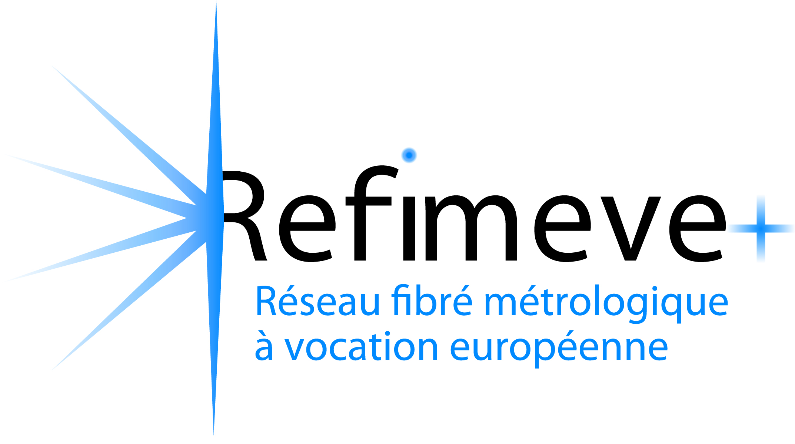



ESFRI Roadmap 2026
From a National Time & Frequency Network, REFIMEVE,
to a European Research Infrastructure
Fibre-based Optical netwoRk for European Science and Technology
Christian Chardonnet, CNRS
head of REFIMEVE

Slide 2
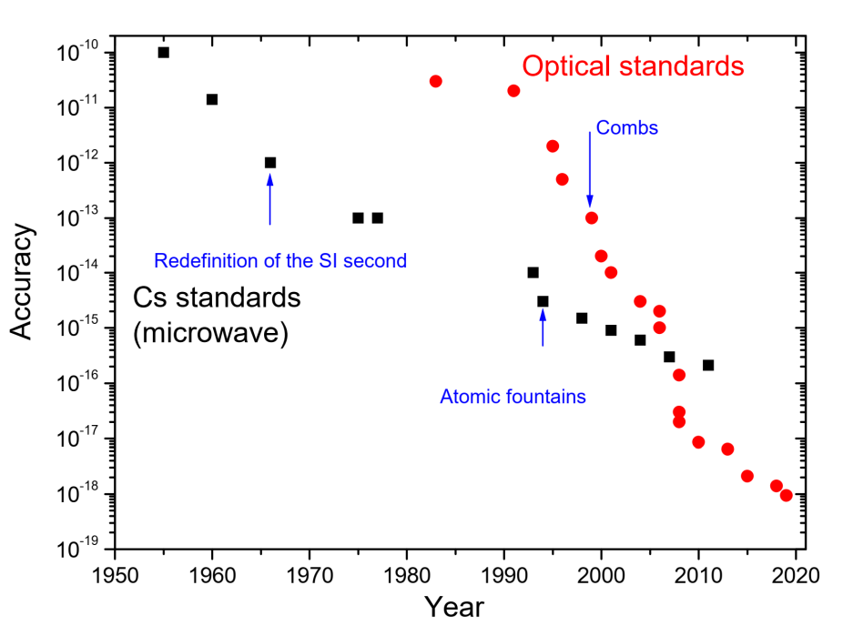
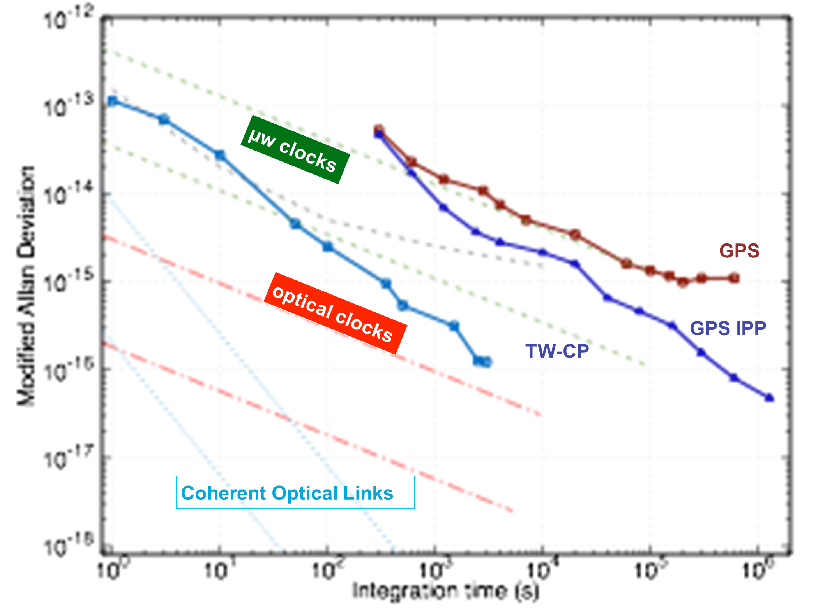
The revolutions in the time and frequency domain
Performances of frequency comparison
Progress of frequency standards with time
Coherent optical links
Coherent optical links
3 revolutions of frequency standards :
1/ laser cooling of atoms 2/ frequency combs 3/ advent of optical clocks: 10⁻¹⁷ – 10⁻¹⁸
Revolution in frequency comparisons:
Colerent optical link surpass GPS and TW methods by more than 4 orders of magnitude: 10⁻¹⁹ – 10⁻²⁰

Slide 3
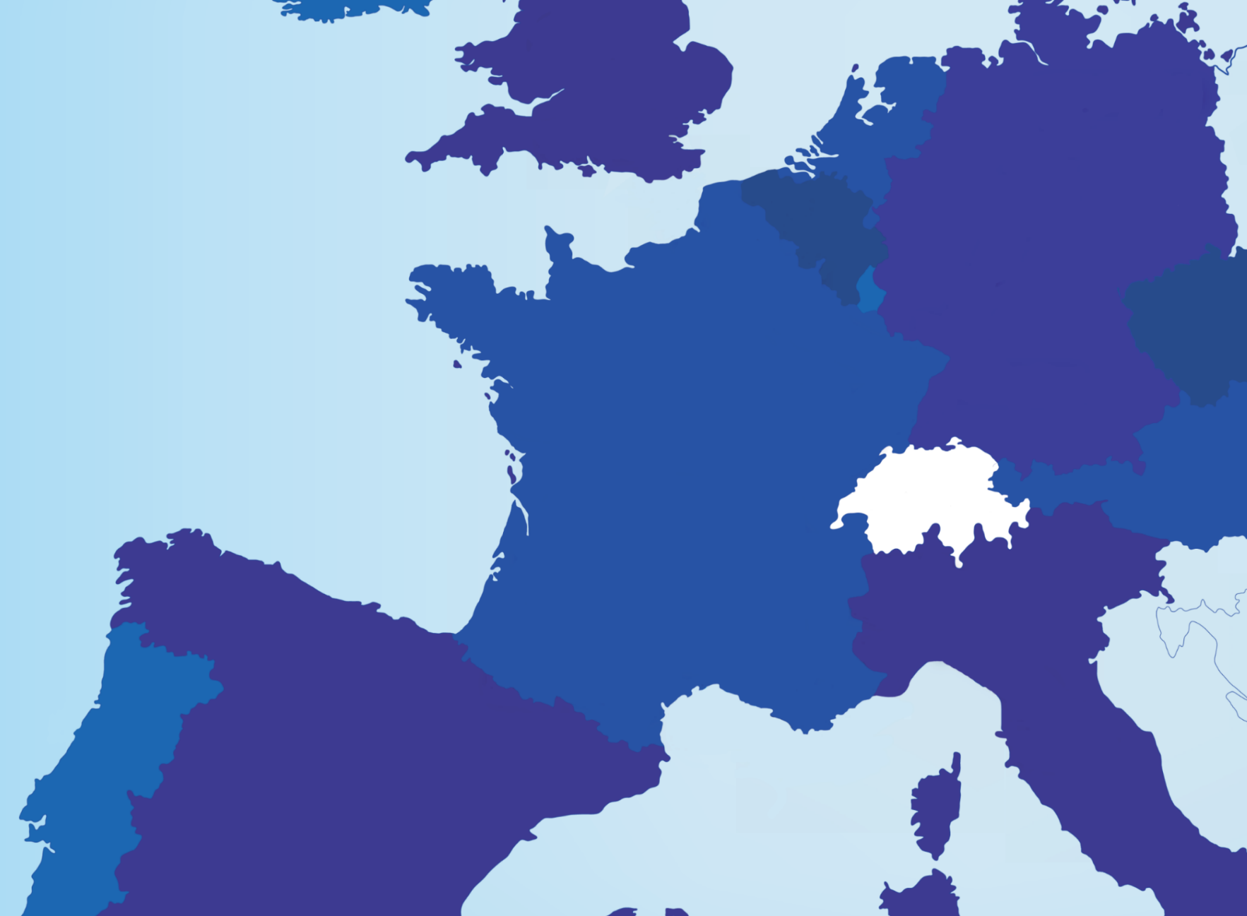
TEDDINGTON
NPL
BRAUNSCHWEIG
PTB
BRUSSELS
N
FOTON
LPL
LILLE
PHLAM - IRCICA
SHOM
PARIS
14 LABS
REFIMEVE today
network of 5000 km of optical fibre pairs mainly shared with the data traffic of RENATER
30 French labs + CERN connected
connections to the DE, UK, IT NMIs
100 km
Operational links
FOTON
BESANCON
Future extensions
FEMTO-ST
UTINAM
STRASBOURG
MUNCHEN
International links
NANCAY
USN
VIENNA
CERN
TO SWITZERLAND
AUSTRIA
POLAND
City - Lab
Crossborder
BORDEAUX
LP2N
TURIN
INRIM
GRENOBLE-MODANE
ESRF – LIPHY – IRAM -LSM
TOULOUSE
CNES – LCAR - LAAS
MARSEILLE
PIIM
NICE
OCA - GEOAZUR

Slide 4
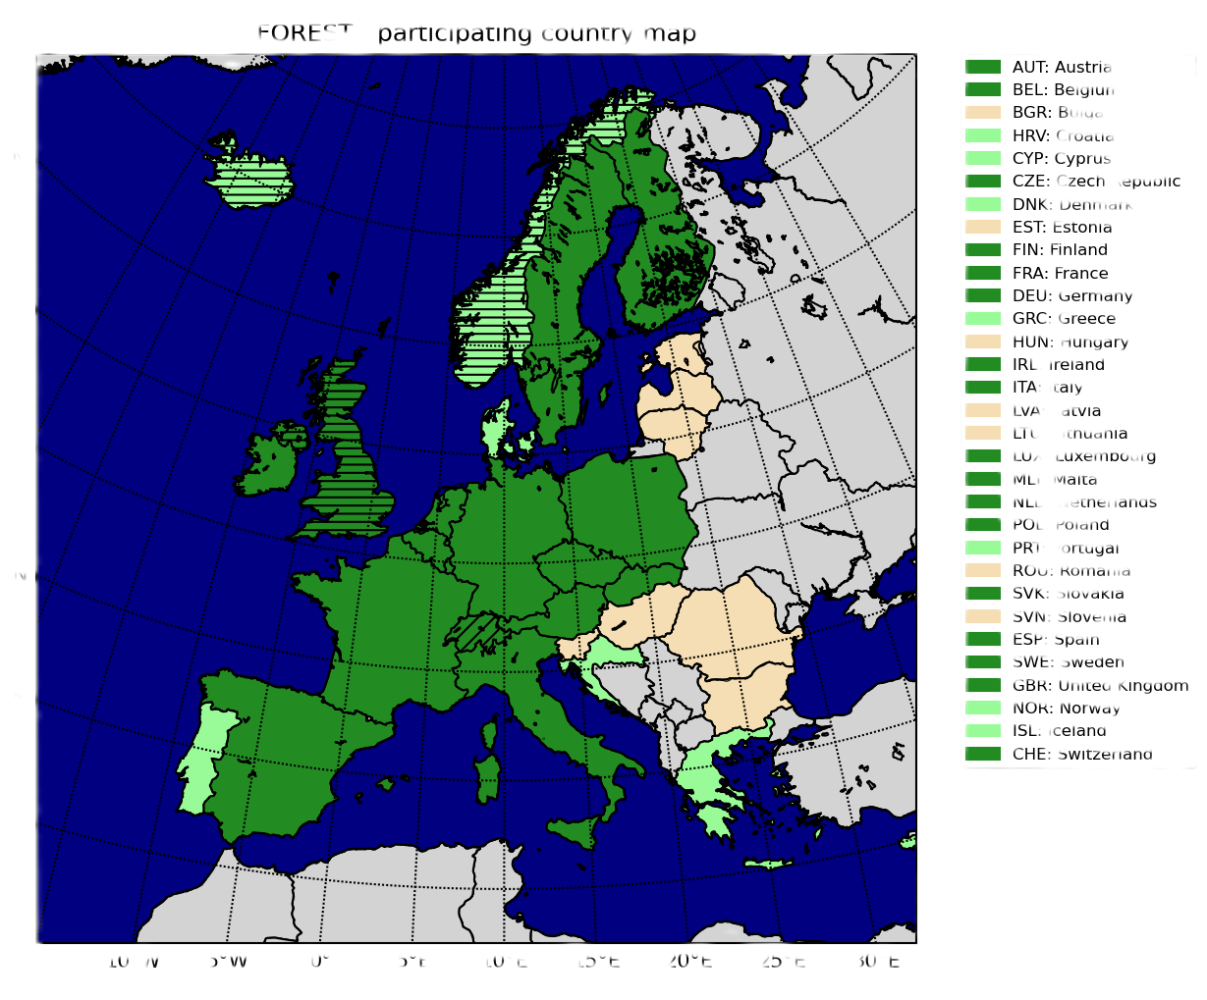
FOREST Partners from 15 countries
AT, BE, CZ, DE, ES, FR, IE, IT, LT, LU, MT, NL, PL, SK, UK.
+ CERN + GEANT
+ Specific role of EURAMET

Slide 5
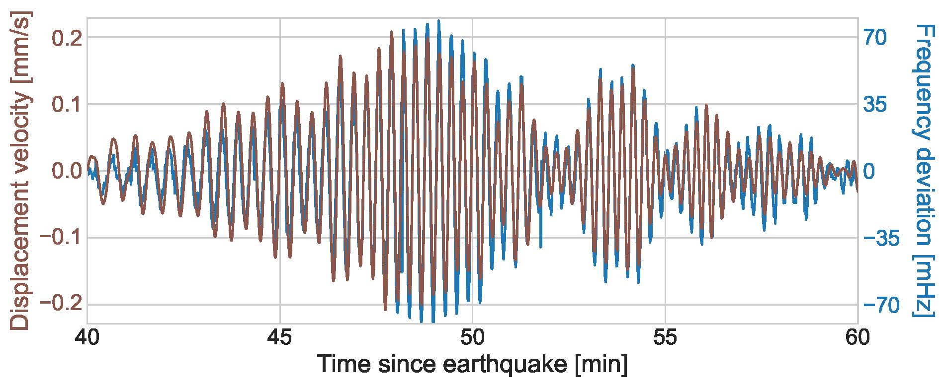
Earthquake detection with an optical fibre
September 2022
Earthquake in Mexico
Comparison between « noise » on an optical link SYRTE-LPL and signal from a seismometer of EPOS-FR.
Signal correlation : 0,94.

Slide 6
Length of the national T&F networks
and cross-border connections
STRUCTURE OF THE FOREST NETWORK
 | Length (km) | DF | DC
TOTAL | 29 369 | 18 767 | 10 602
National networks | 23 672 | 14540 | 9132
NMI cross-border connections | 2 404 | 934 | 1 470
GEANT cross-border connections | 3 293 | 3 293 | 0
DF: Dark fibre
DC: Dark channel

Slide 7
Length of the national T&F networks
and cross-border connections
Network | Length (km) | DF | DC
TOTAL | 29 369 | 18 767 | 10 602
AUSTRIA | 746 | 730 | 16
BELGIUM | 1 000 | 0 | 1 000
CZECH REPUBLIC | 2 148 | 1 090 | 1 058
GERMANY | 1 137 | 1 137 | 0
FRANCE | 5 214 | 29 | 5 185
IRELAND | 1 749 | 892 | 857
ITALY | 2 843 | 2 587 | 256
THE NETHERLANDS | 760 | 0 | 760
POLAND | 7 035 | 7 035 | 0
SLOVAKIA | 5 | 5 | 0
UNITED KINGDOM | 1 035 | 1 035 | 0
Cross-border | 5 697 | 4 227 | 1 470
DF: Dark fibre
DC: Dark channel

Slide 8
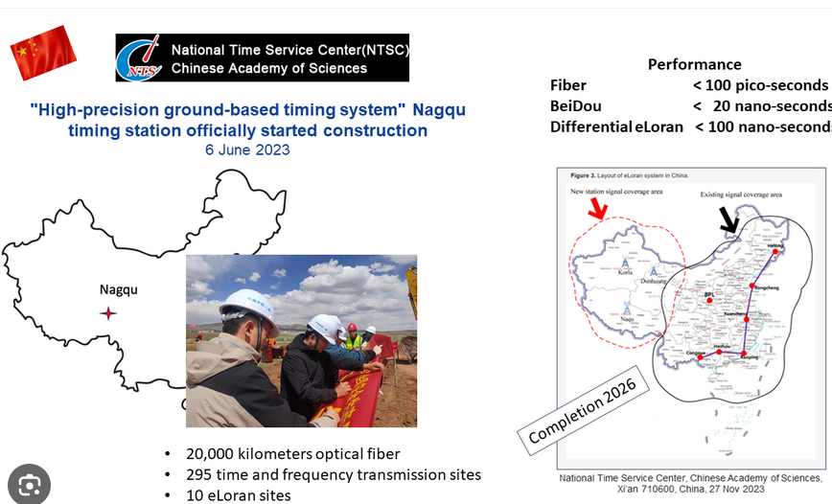
FOREST network: already larger than the highly competitive Chinese project

Slide 9
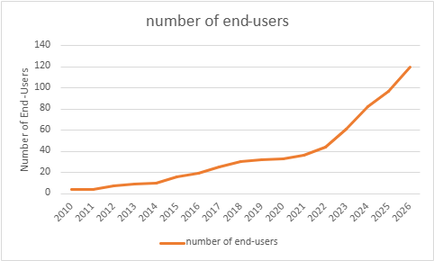
Evolution with time of the number of end-users connected to national T&F networks

Slide 10
Structure of the partners expected to sign the FOREST MOU
14 NRENs, National Research and Education Networks
12 NMIs, National Metrological Institutes
+ GEANT, consortium of the European NRENs
35-40 other institutions which play a significant role in Science using high performance time & frequency, quantum communication, fibre sensing

Slide 11
Other expected letters of support of FOREST
CERN which will participate to the governance of FOREST (WR collaboration)
BIPM, Bureau International des Poids et Mesures
EURAMET, consortium of the NMIs
ESA, European Space Agency
Several European Research Infrastructures:
  ESRF, LOFAR, JIVE, IRAM, VIRGO, Einstein Telescope
  EPOS, EMSO

Slide 12
Sustainability
Globally, FOREST is already sustainable.
Most of the national Time-Frequency networks are operational for years. Half of the cross-border connections are financed nationally for years.
The second-half of the cross-border connections is covered by the C-TFN GEANT project financed by EC.
Extension of these cross-border connections and long-term financial commitments will be sought under the FP10 programme
Joint Research Center (EC) is helping finding long-term solutions.

Slide 13
Thank you for your attention !

