Slide 1


GCP Workshop
Prague, 14-15 May 2025
Public

Slide 2
Why are we here?
Get to know your community (in person!)
Understand the GÉANT Community Programme framework and the new GCC
Share ideas on how to broaden our community reach and impact
Contribute to the GÉANT strategy
Open forum to bring coordinators, steering committee and GCC together to honestly evaluate GCP and propose areas of improvement
Active participation encouraged to ensure diverse input

Slide 3
Agenda
Time | What
13:00 – 13:15 | Welcome
13:15 – 13:30 | GCP framework and GCC updates
13:30 – 15:00 | SIG-What?
15:00 – 15:30 | Break (find SIGs to co-locate with)
15:30 – 17:00 | Mapping our ecosystem
17:30 – 19:00 | Sightseeing tour of Prague Castle
19:00 | Working Dinner at Restaurant Pod Věží

Slide 4
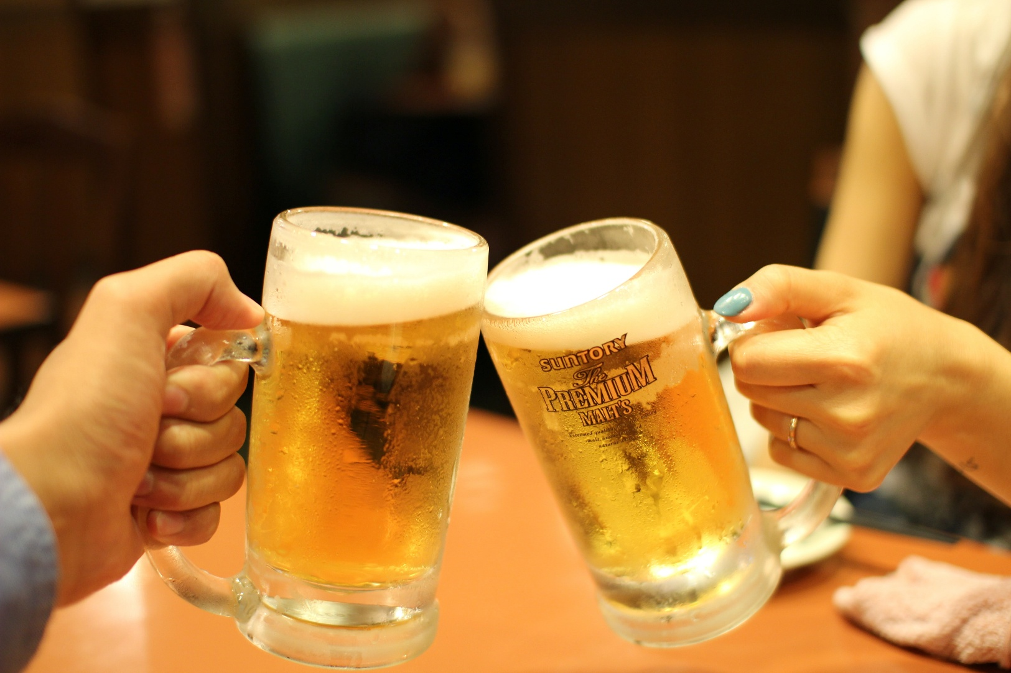
Introductions
Notes:
Name, SIG, NREN -> really really quickly!

Slide 5
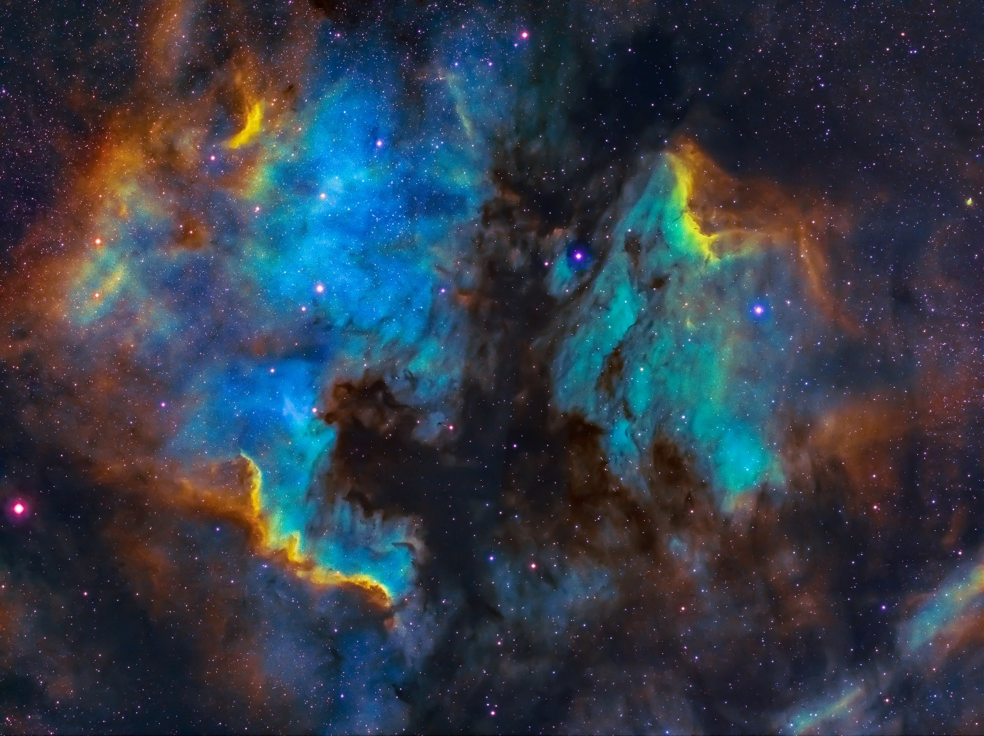
Code of conduct

Slide 6
Code of conduct – aim and definitions
Everyone in the GÉANT Community is entitled to work in an environment free from harassment.
Within this Code, harassment is defined as any unwanted
  physical,
  verbal,
  or non-verbal conduct
that has the purpose or effect of violating a person’s dignity or creating an intimidating, hostile, degrading, humiliating or offensive environment for another

Slide 7
Code of conduct – process
If you are being harassed, notice that someone else is being harassed, or have any other concerns, contact:
For a virtual/online event, contact the person who is listed as the “Host”
For an in-person meeting or event, contact anyone listed as “Event Staff” in the meeting or event invitation directly
Where you are unsure of the contact person, or if they are involved in the behaviour or issue you are reporting, please contact Partner Relations.

Slide 8
Code of conduct – steps taken when harassment is reported
The contact person and any other relevant persons will undertake any necessary investigation and, may arrange for any or all of the following steps:
Ask the individual or individuals to stop the harassing behaviour.
Arrange for the individual or individuals to be ejected from the meeting or event or refused entry.
Contact the event or hotel security, or the local police.
Arrange for anyone who feels threatened by someone else’s behaviour to be accompanied during the course of the event or meeting.
Other reasonable actions, as are deemed appropriate for the circumstances.

Slide 9
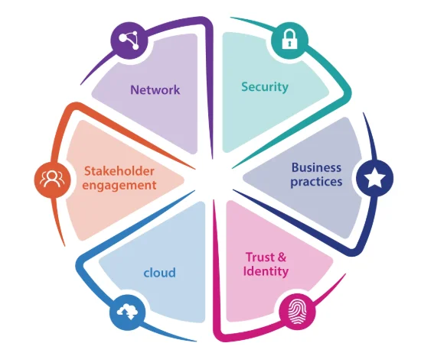
GCP framework and GCC ToR

Slide 10
GCP Framework
Vision: A connected, collaborative and harmonised research and education networking community.
Mission: Provide optimal conditions for the R&E networking community to collaborate both face-to-face and virtually.
Objectives
Identify and share areas and trends benefiting NRENs and the wider R&E community.
Connect people to the right human network and facilitate knowledge transfer across Europe and globally.
Support methods of eliminating gaps within the R&E community and foster an inclusive community that represents the diversity of the entire community.
Facilitate group collaborations and strategic links to relevant initiatives within GÉANT and the broader community to maximize impact.
Notes:
Comes from discussions last GCP workshop
Former GCP strategy

Slide 11
GCC ToR
Objectives of the GCC:
  Build community identity
  Link strategically
  Steer and advise
  Unite in diversity
  Bridge gaps
  Evaluate and improve
Processes:
  GCC members found through application process and endorsed by Board
  GCC chair from standing GCC and endorsed by GA

Slide 12
New GCC members
Ivana Golub, PSNC
Maria Isabel Gandia, CSUC
Ariela Hercek, Arnes
Michel Wets, SURF

Slide 13

Strategy

Slide 14
Break time tasks
SME spreadsheet
Innovation Programme presentations at SIG meetings
TNC Roster assignments
Indico/wiki 101 with Nadelina

Slide 15

SIG-What?!
1. SIG-ISM | 10. TF-EDU
2. SIG-MSP | 11. SIG-Procurement
3. SIG-NOC | 12. SIG-CISS
4. SIG-NGN | 13. SIG-DHD
5. SIG-AI | 14. SIG-Marcomms
6. SIG-RED | 15. Innovation Programme
7. SIG-TFN | 16. Gender Equality Principles
8. SIG-Quantum | 17. Community of Practice for Software Solutions
9. SIG-Sustainability | 18. NPAPW
SHORT BREAK
4 min LT’s
-who you are
-your focus
-challenges
-opportunities to…
COFFEE BREAK DATE

Slide 16

Break

Slide 17
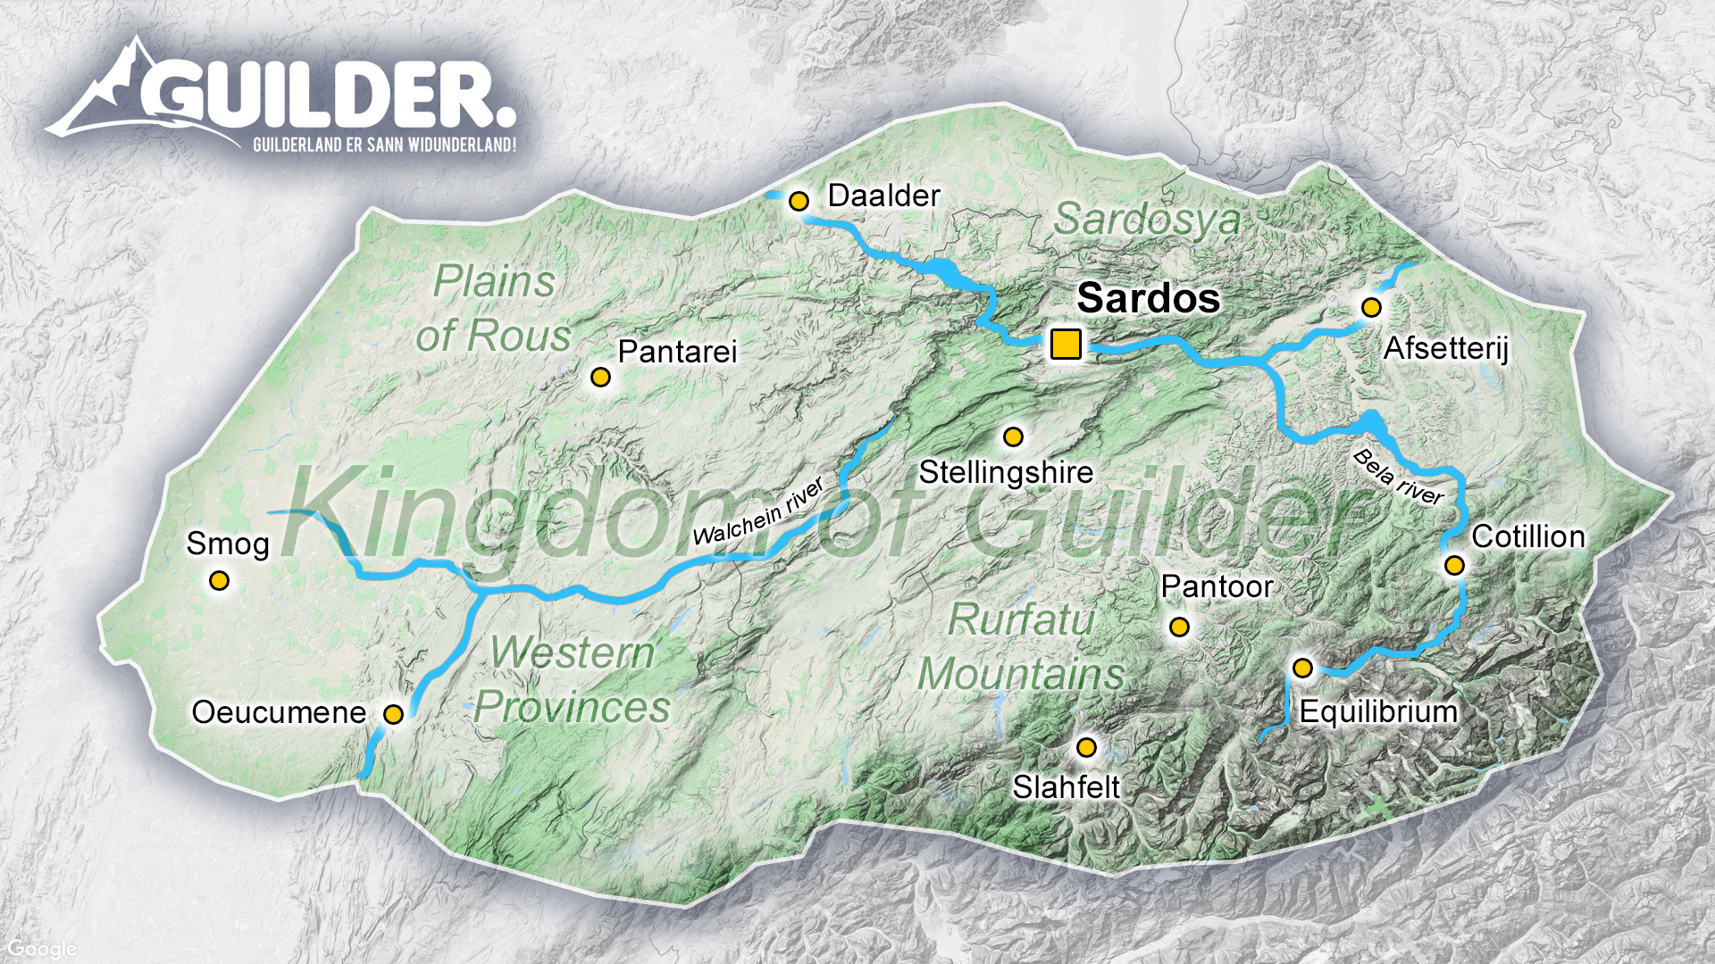
Mapping session

Slide 18
Overview
Time | What
5 minutes | Intro and goals
5 minutes | The world that we are in and that surrounds us
30 minutes | Discussing overlap and differences
15 minutes | Draw our ecosystem
35 minutes | Show, tell and discussion

Slide 19
Goal
Find out what our ecosystem as a community is
Find out where we overlap
Help each other to find links to activities that are relevant
Find out what we are already doing well and what we might be missing

Slide 20
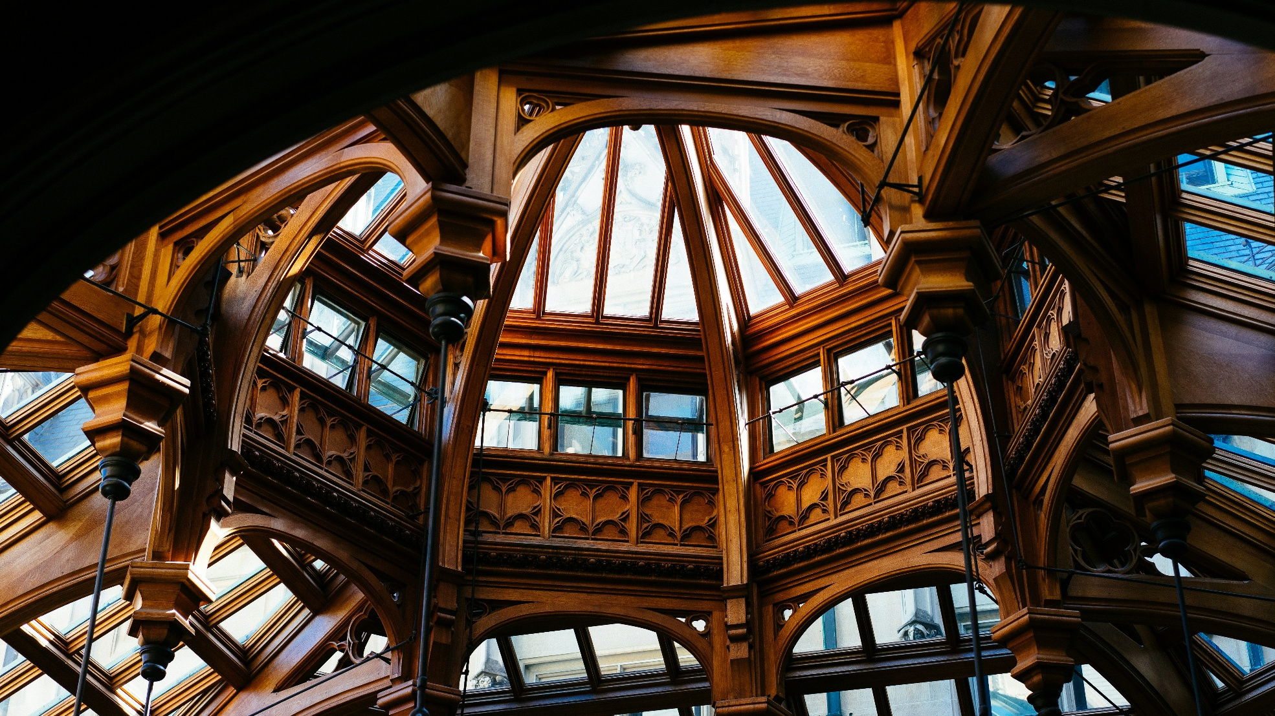
Write down all the different activities in and around our community that you think are relevant
Notes:
For instance:
GN5-2
EOSC
Eunis
CTO workshops
RIPE
FIRST
Etc.
5 mins, post its, put them on the table/wall

Slide 21

Stand on a line from true to not true
Notes:
Second: Charlie reads out different activities, every time stand on a line -> my SIG/TF is active in/has ties to ___ activity. Find someone from the other end of the spectrum and talk to them about this activity and find out if it is something your SIG should also be active in.
Also the statement: the theme of my SIG is relevant for all different SIGs
This will take approx 30 mins
Short break?

Slide 22
Drawing our ecosystem
Groups of 7
Draw the ecosystem of our whole community
Present them to each other
Discussion
Notes:
Make groups of about 7. In 15 mins, draw the ecosystem of our whole community as you have just discovered it
Then: show them to each other in the big room -> present your ecosystem – 3 mins per group + discussion time = 35 mins

Slide 23
Discussion
What are we doing right?
And are we missing anything as a community? (Thematically, tie ins to certain global communities, getting discussions in SIGs to other groups etc.)
Notes:
15 mins

Slide 24
Social Event & Dinner
17:30 Sightseeing tour of Prague Castle and its surroundings
Meet in front of the Restaurant Lví dvůr (20-min walk from CESNET)
U Prašného mostu 51/6, 118 00 Praha 1-Hradčany, Czechia
End Point Charles Bridge
19:00 Group dinner
Restaurant Pod Věží
Mostecká 58/2, 118 00 Malá Strana, Czechia

Slide 25
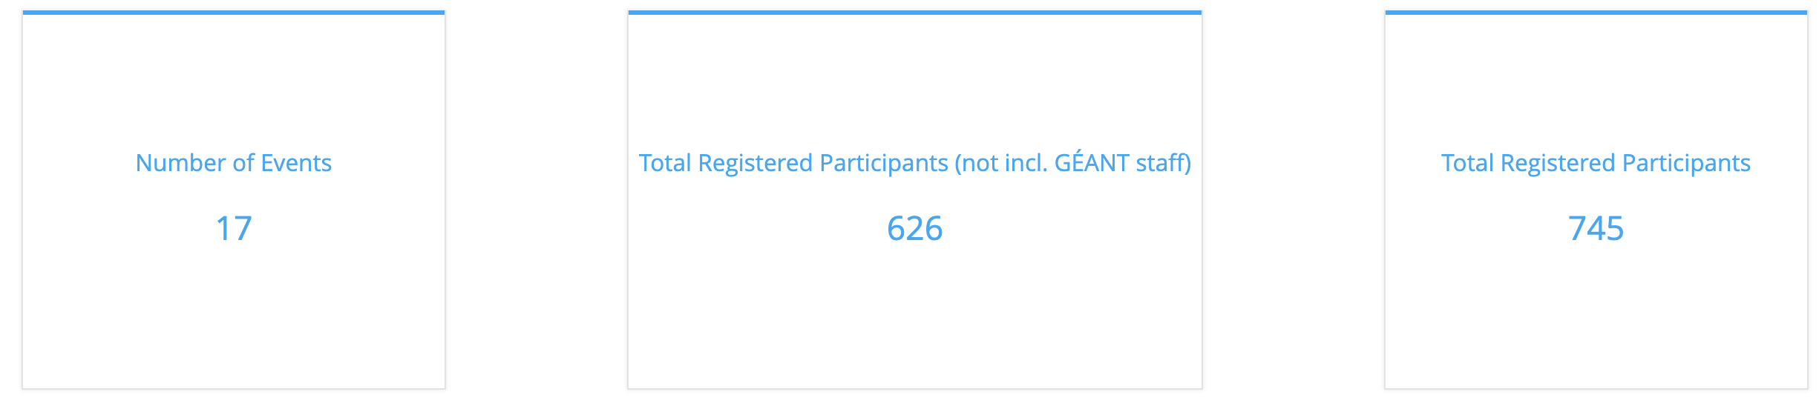
Our Framework, Our Future: Where are we now? The Numbers...
General SIG meetings statistics for 2024:

Slide 26
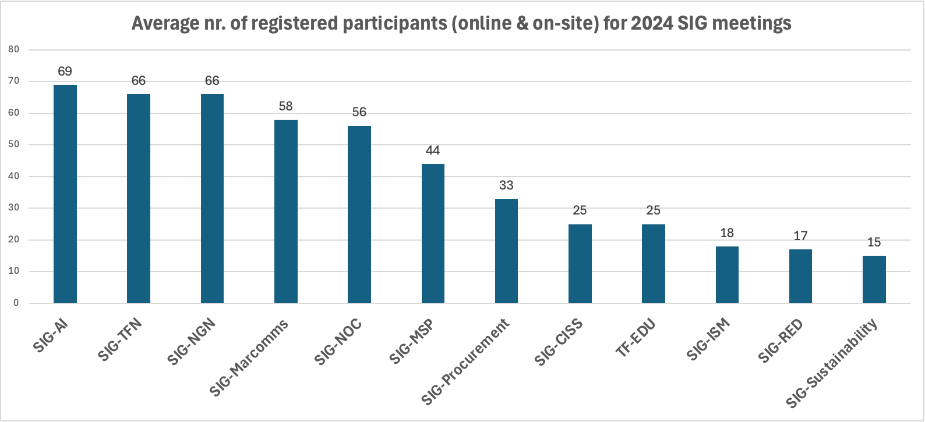
Registered Participants per SIG meeting - 2024

Slide 27
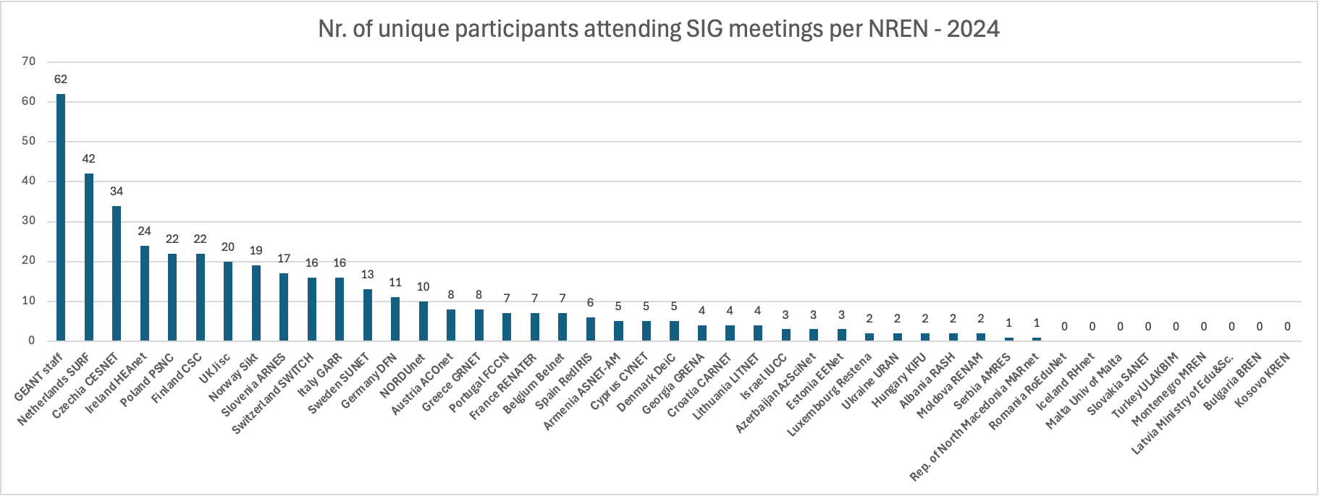
Unique Participants per Organisation - 2024

Slide 28
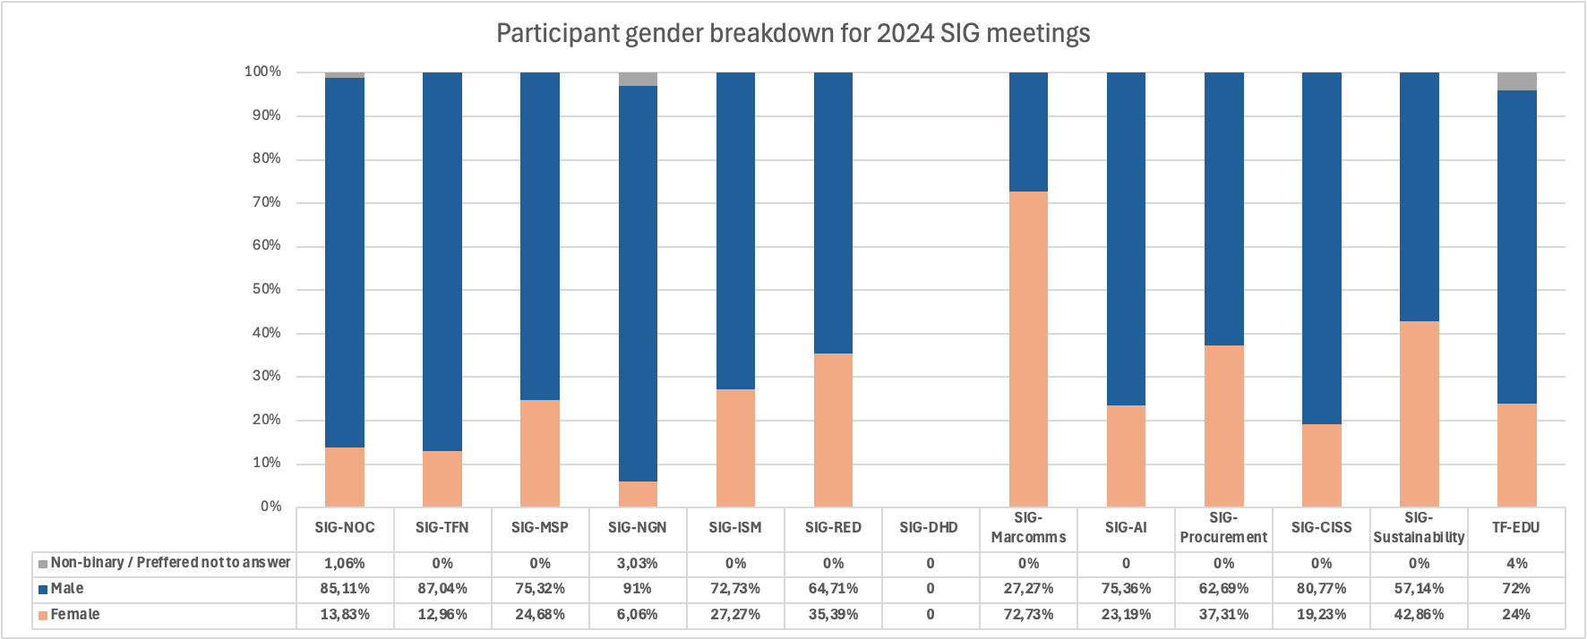
Participant Gender Breakdown - 2024

Slide 29
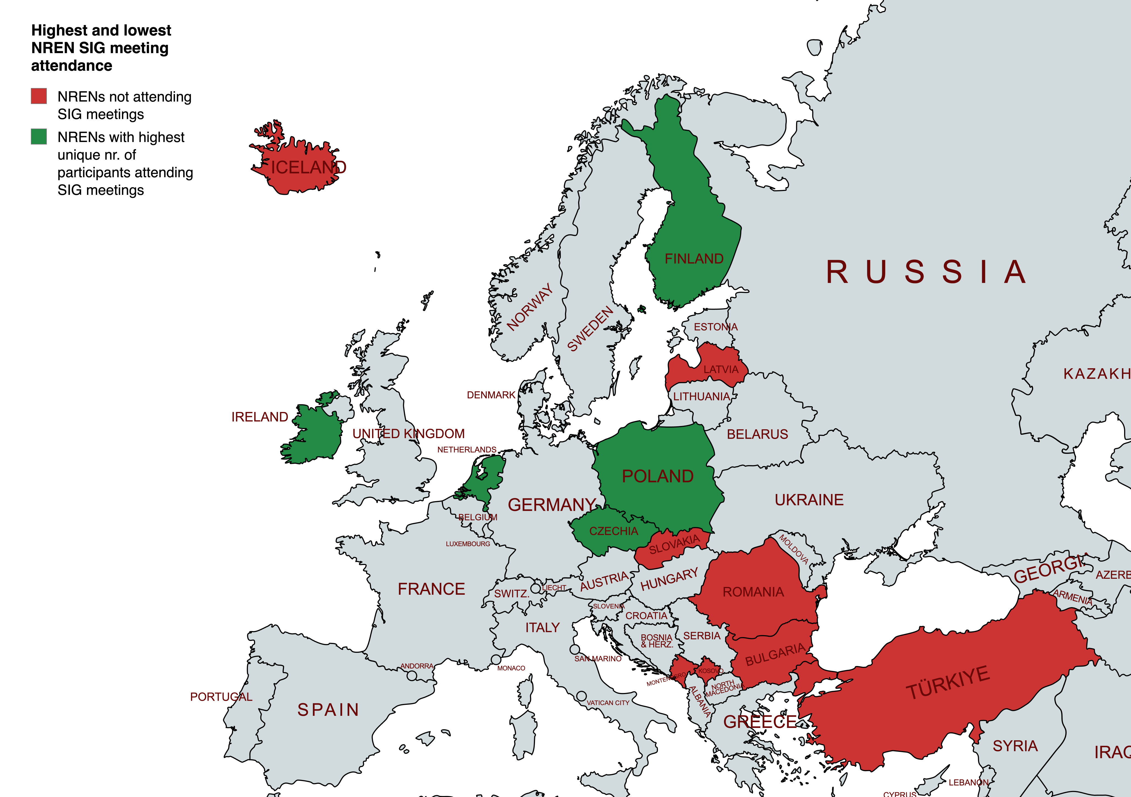
Unique Participants per NREN - 2024
NRENs not attending SIG meetings
Bulgaria
Iceland
Kosovo
Latvia
Malta
Montenegro
Romania
Slovakia
Turkey
Top 5 NRENs with highest nr. Of unique participants attending SIG meetings - 2024
SURF
CESNET
HEAnet
PSNC
CSC/Funet

Slide 30
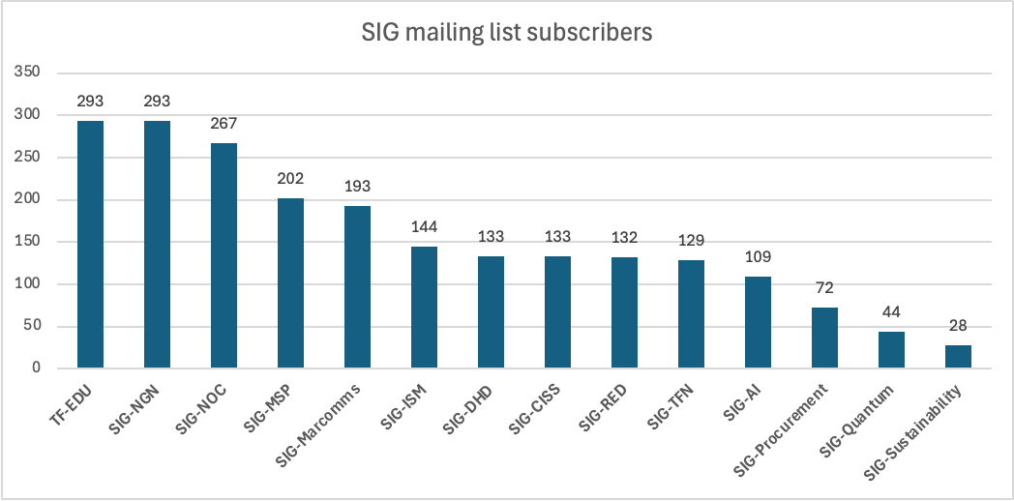
SIG Mailing Lists

Slide 31
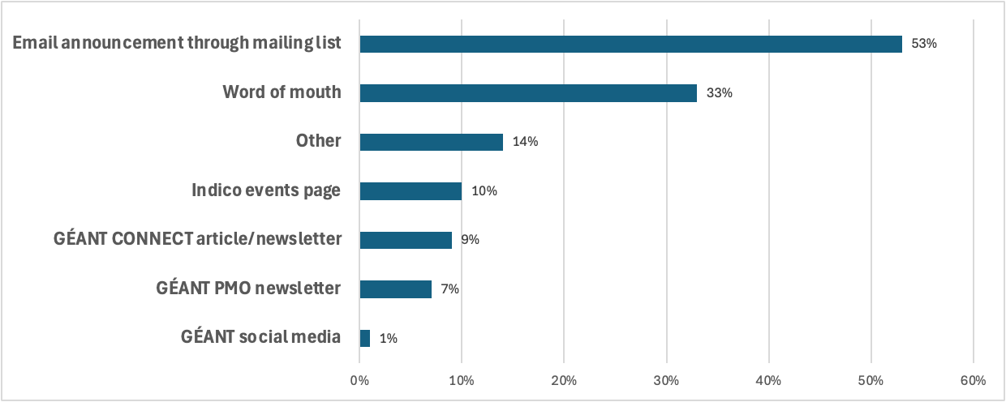
SIG Promotion Channels
Average (multiple-choice) responses of 8 end-of-meeting surveys (2024/25) on how participants found out about the respective SIG meeting they were attending:

Slide 32
TNC Community Hub – Proposals Submitted per Organisation
2024 2025
Organisation/NREN
Sunet x2
CANARIE
RNP
CESNET
Karlsbad Univ
Afnic
NTUA/GRNET
Spherical Cow
RIPE
Research Space
CESNET
CSUC
DFN x4
e-Science Data Factory / SURF
GÉANT x14
Huawei
Institute for Informatics (Armenia)
Jisc
PSNC
Sikt
OMREN
Belnet
DFN x2
CEDIA
ESnet
Qinghua Univ GÉANT x14
Internet2
Jisc
Peking University
RNP
SUNET x2
SURF
The Vietsch Foundation

Slide 33
GÉANT Community Programme Budget
GN5-2 WP3T4: 863,193 Eur (30 months)
  83 PMs (2 FTE GÉANT, GCP Manager and Events and Project Specialist + 1PM/yr, Coordinators)
  87,500 Eur Travel and subsistence
Member contribution: 310,000 Eur (per year, contingent on AOPB approval)
  300,000 Eur Innovation Programme
  15,000 Eur GCC
  The rest is pure TLC on a voluntary basis... With less than 1 Mill Eur, we reached 3821 participants from 67 different countries in GN5-1.

Slide 34
Our Framework, Our Future: Working session
Happy with the status quo? Let's Get to Work!
Group 1- Lars, Michel G., Dom, Mario, Barbara, Judith (Blue Room)
Group 2- Annabel, Arjan, Monique, Rudolf, Ariela (Blue Room)
Group 3- Eli, Piotr, Nadelina, Silvia, Erik, Ivana (Blue Room)
Group 4- Mian, Leonie, Grace, Charlie, Michel W. (Green Room)
Group 5- Gyongyi, Daniela, Josef, Dawn, Martin (Purple Room)
Group 6- Nicole, Paul, Badre, Clare, Jan (Purple Room)
Assign a Facilitator and Note taker in each group.

Slide 35
Guiding Questions – Future
Reflect on gaps/inefficiencies from the mapping and our status quo to answer the following:
Priorities
What should they be for the coming year?
What is essential to include in the GÉANT strategy? What do we need to STOP/CONTINUE/DO MORE of for the community?
What are common themes across the community that we can collaborate on?
Process
How do we realise our priorities?
Should we be less SIG-centric? What are other channels/platforms/ways of working to consider?
Growth
How do we reach new audiences to diversify participation and ensure the next generation?
All notes to be recorded here: https://docs.google.com/document/d/1ED1TQgd667QSyCShc78NuKRzzFUiuIKo9JaBmXuBRJI/edit?usp=sharing

Slide 36
Things you should know
Events 101 from Nadelina
Communications - best practice overview + practical examples from Grace

Slide 37
Reflection and Next Steps

Slide 38
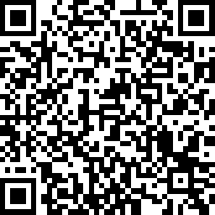
Survey and see you next time!
https://www.surveymonkey.com/r/GCP2025

Slide 39

Thank You
Any questions?
www.geant.org

