Slide 1
Business Models and Value Propositions in an NREN context
Dr Leonie Schäfer (DFN)
SIG-MSP Meeting – 13 March 2024 – Copenhagen, Denmark

Slide 2
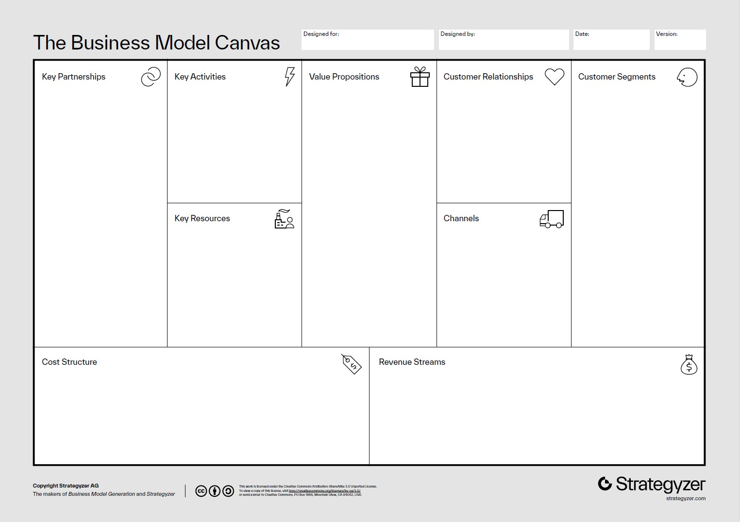
Business Model Canvas
Strategic Management Template
Proposed by Alexander Osterwalder in 2005
Freely available for download via Strategyzer
Use primarily for the corporate sector
but with adaptations also useful for Non-Profits and R&D

Slide 3
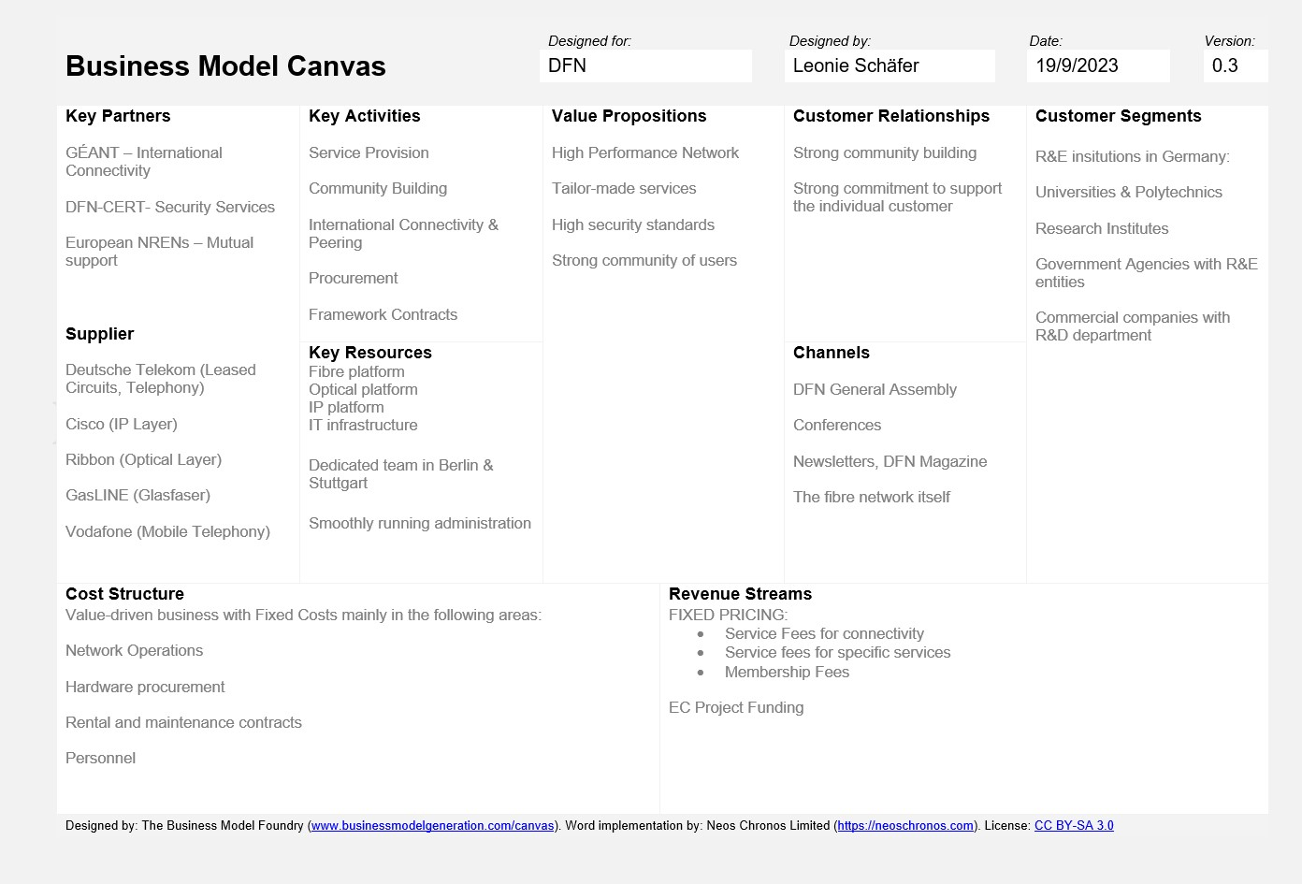
Business Model Canvas - DFN

Slide 4
Business Model Canvas
Business Model Canvas for your NREN / for GÉANT ?
Compendium has a section on Business Models
Action: Please fill in the templates
  for yourself
  to share it with your peers
  As knowledge base for future versions of the NREN Compendium

Slide 5
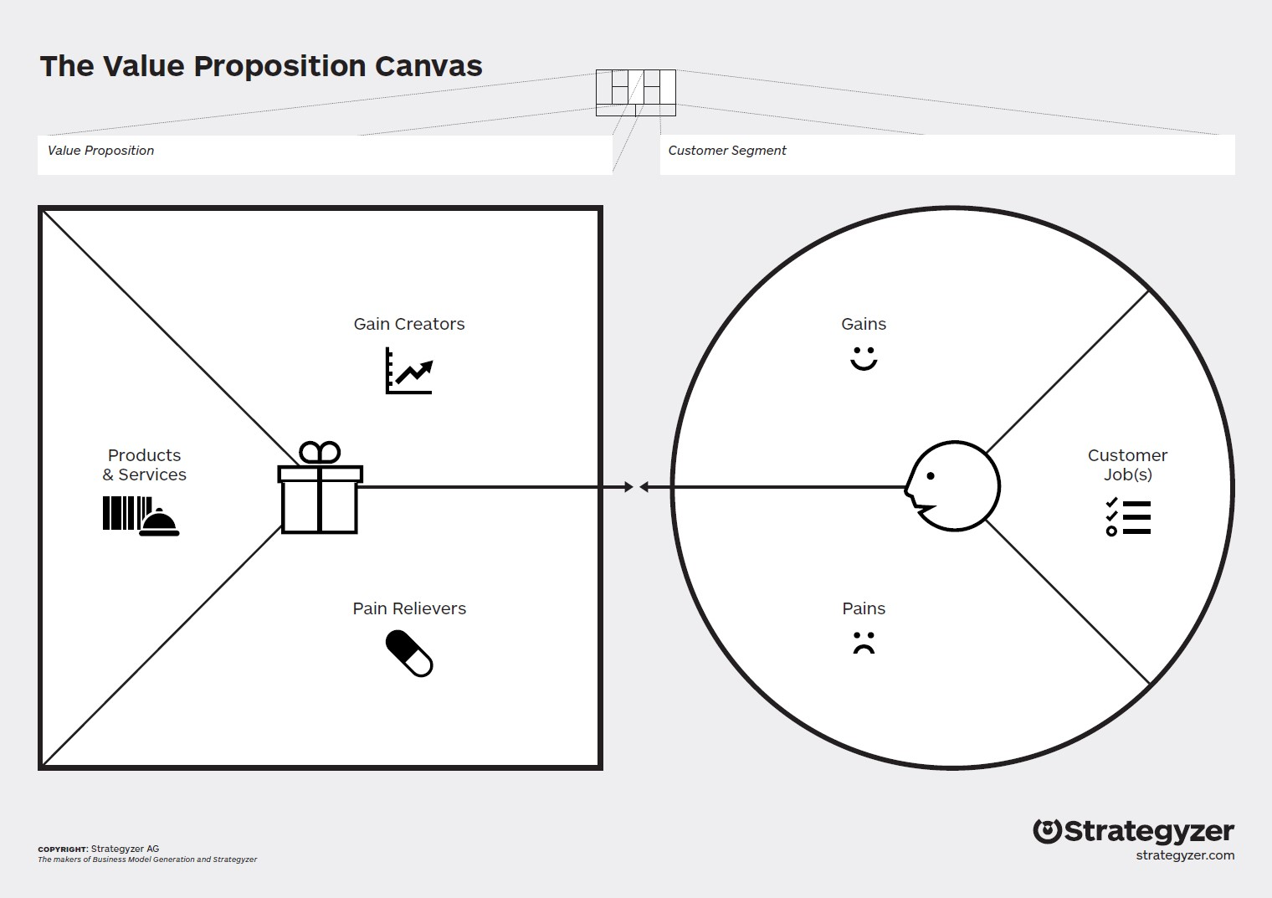
Value Proposition Canvas
A value proposition is a statement which identifies clear, measurable and demonstrable benefits consumers get when buying a particular product or service
The value proposition provides value through various elements such as newness, performance, customization, "getting the job done", design, brand/status, price, cost reduction, risk reduction, accessibility, and convenience/usability.
Notes:
If you are going to sell into a new market or market segment, a value proposition canvas will help you to understand whether the market truly needs the product or service or not.
Avoid a common mistake of completing both sides of the canvas simultaneously. Instead, start from the customer’s side of the template.
Value proposition canvas encourages you to ask questions and perceive the world through your customers’ eyes, which is the keystone of success for any business.

Slide 6
Value Proposition Canvas for NRENs
ValueProp.Dev
Company description:
Internet service provider that exclusively serves universities and research institutes. In addition to the network, it offers a wide range of services for the benefit of individual researchers and students. The company has international links with similar organisations in other countries. The company is a non-profit organisation.

Slide 7
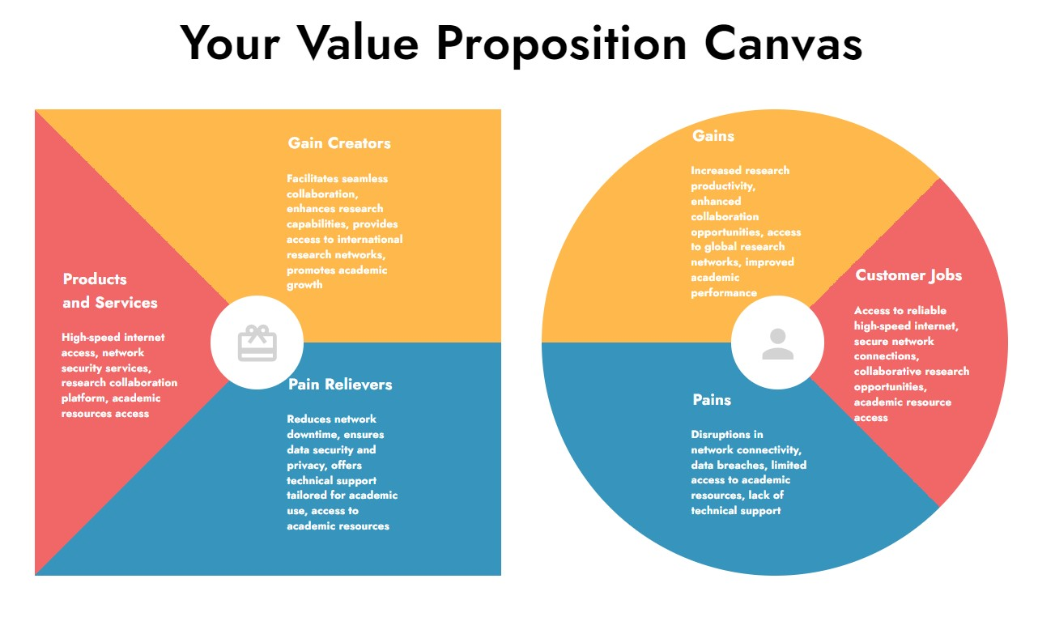
Value Proposition Canvas for NRENs
Source: ValueProp.Dev

Slide 8
Value Proposition Canvas for NRENs
Source: ValueProp.Dev

Slide 9
Discussion Round Table - Preparation
What are the main service sharing challenges?
What elements need to be looked at further and how could this be done?
Definition of ‘Service Sharing’ ?
Who is the target group for ‘Service Sharing’ ? Who is the ‘Customer’?
What is the main goal your customer wants to accomplish?
What are the Pains? What are the Gains? – of that customer.
Action: Define the value proposition in the context of ‘Service Sharing’

Slide 10
Thank you!
Any questions?

