Slide 1


WP3 GÉANT Foresight study
SIG-MSP
Beatrix Weber
Charles Hutchings
Daniel Wustenberg
Raimundas Tuminauskas
13 03 2024
www.geant.org

Slide 2
Who we are
GN5-1 WP3 Task 1 Foresight Study Team:
Beatrix Weber (Task 1 leader)
Annabel Grant (WP3 leader)
Daniel Wustenberg (GÉANT)
Charles Hutchings (Jisc)
Raimundas Tuminauskas (PSNC)
NREN Focus Group Members:
George Konnis (CYNET)
Martin Bech (DeiC)
Mauro Campanella (GARR)
Veronika Di Luna (GÉANT)
Licia Florio (NORDUNET)
Simona Holstein (IUCC)
Leif Johanson (SUNET)
Krzysztof Kurowski (PSNC)
Victoria Moody (Jisc)
Anastas Mishev (MARNET)
Olga Popcova (RENAM)
Karen Thornton (HEANET)
Alexander van den Hil (SURF)
Liaison and Coordination w/ GCC
Claudio Allocchio (GCC Chair)

Slide 3
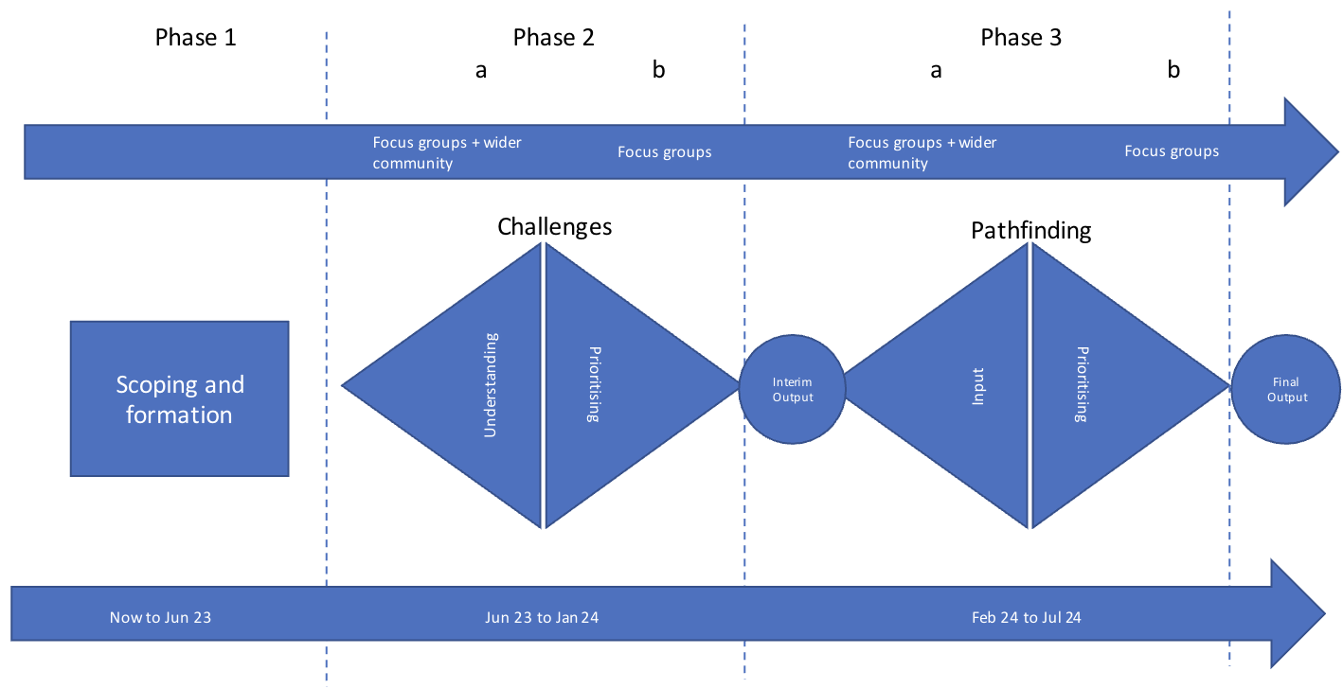
Methodology – generating content
3 major phases of work:
Phase 1 Scoping
Phase 2 Challenges
Phase 3 Pathfinding

Slide 4
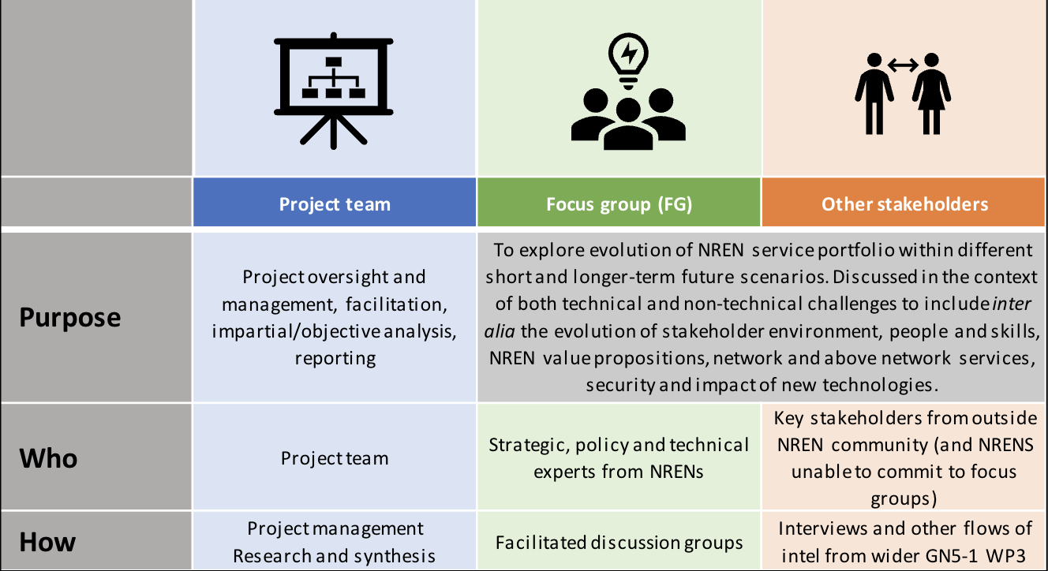
Methodology – stakeholder interaction
Parallel working tracks:

Slide 5
Part 1 - Challenges

Slide 6
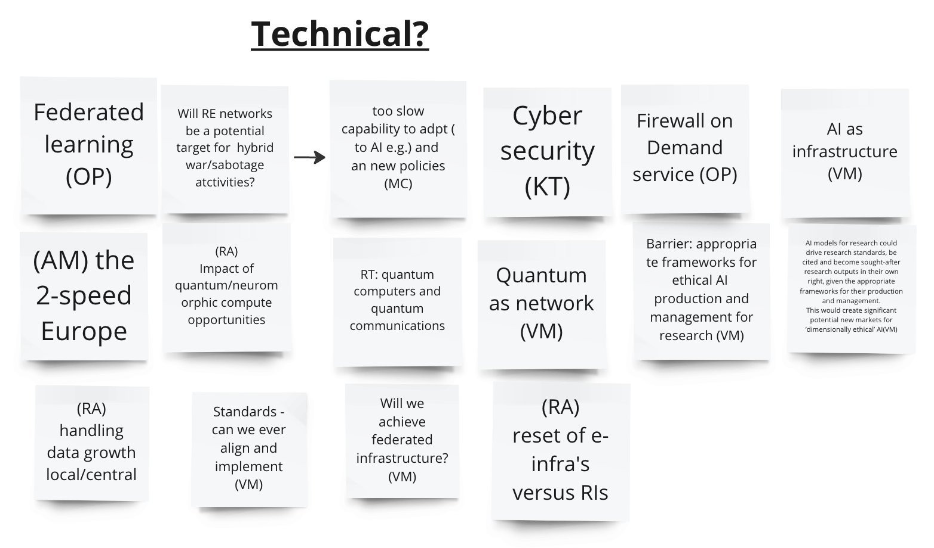
Challenges identification
Over 50 challenges were posted initially.
Several groups were identified:
Geo-political challenges mainly stemming from the perception of an increasingly unstable situation in the world.
Sustainability challenges concerning the energy and financial sustainability.
Funding, commercialization, and competition challenges concern the evolution paths of the NREN ecosystem especially with regard to interaction with the commercial world.
Cultural, behavioural, and societal challenges area group mainly arising from interactions with the world outside the NREN ecosystem.
NREN governance challenges concern internal processes within the NREN ecosystem.
Employment, skills, and “human factor” challenge group
Technical challenge group, concerning the evolution of technology.

Slide 7
Challenges prioritization
Highest priority challenges were selected to be analysed deeper:
Interaction with commercial actors
Climate change
Employment and skills
Technical challenges, where four most prominent technical areas were selected for further analysis:
    Data life cycle,
    Quantum technology,
    Cyber security,
    Artificial intelligence (AI).
NRENs' governance
Virtualization of research and education processes

Slide 8
Further analysis
More extensive description of a challenge:
What it entails, evidence, flavours of the challenge if any.
Gartner trend classification:
Transformative – impact can only be speculated and imagined;
Unpredictable – path of growth is heavily influenced by external accelerators or inhibitors that quickly alter the course;
Predictable – develop in a predictable way over the time;
Reality today – strong evidence that the trend is embraced by organizations today.
Three “lenses” to consider implications/impacts:
Environment: partners, stakeholders, users (constituencies),
Value proposition: value, delivery channels, resources,
Finances: income, expenses, financial flows.

Slide 9
Interaction with commercial actors
Description
Challenge has three flavours: competition, collaboration, commercialization.
Competition: Gartner category – Unpredictable. NRENs have limited experience in competition.
Collaboration: Gartner category – Reality today. Collaborative services with commercial entities will be an opportunity to add value.
Partnership, stakeholders, and users
NRENs partnerships will be challenged by the requirement to provide joint solutions with the commercial actors as partners.
Value, chains of delivery, resources
The current trusted environment will be challenged by collaboration with commercial actors.
Service portfolio will be challenged to address the pain-points by NREN users.
A balance will have to be found between over-the-top services and institutions as constituents of NRENs.
This aspect of operational model will likely to undergo significant change.
Financial (income and expenditure)
Current situation is likely to evolve into more OPEX-oriented expenditure.

Slide 10
Part 2 – Pathfinding
Scenarios

Slide 11
Scenarios
A scenario is understood as a possible future (this is different from a prediction, as it is explicitly conceived as one future among others)
Scenarios will be built by combining possible developments in the different challenge areas
This clearly opens up a huge space of possibilities which we cannot explore comprehensively therefore
  When considering the various possible developments, keep in mind
    Are there alternative trajectories for a given factor
    Plausibility
    Impact – will this have an impact on NRENs/GEANT either way

Slide 12
Overview of process
Identify key factors within challenge areas
Generate and prioritise factor axes
Create situation matrices
Develop the scenarios (3-5)
Explore the objective/purpose in the context of the scenarios to identify implications and response
e.g. For Technical: Cybersecurity; factors might be NREN and GÉANT involvement and responsibility, success rate, frequency, or motivation of attacks
e.g. For motivation of attacks, axis could be political vs financial, frequency could be high volume low impact ('nuisance') vs low volume high impact ('malevolent') etc
High
Combining factor axis (first within challenge areas, later between to identify plausible and interesting/relevant situations):
Skill surplus
Skill deficit
Low
Combining interesting situations identified using the matrices (workshop work)
e.g.
e.g. In an environment of widespread daily cyber attacks where cyber technical skills are fiercely competed for and commercial product alternatives saturate the market, what role should NRENs play to best support their constituents in this scenario?

Slide 13
Questions to ask yourself:
What are the factors or drivers that will influence the future of the challenge area?
What are the major uncertainties?
Have we considered both positive and negative (desirable/undesirable) factors, as negative are often easier to think of than positive?
Identify key factors within challenge areas
Brainstorming exercise:
The process would start by taking each challenge area and identifying key factors within the area.
Categorizing
Grouping the identified items into larger themes or categories
Examples:
Cybersecurity
Motivation of attacks (e.g. criminals, state actors, political activists, …)
Responsibilities (who is in charge of cyber security)
Regulation (legal obligations for companies, legal landscape)
Commercial players:
Competition and cooperation (e.g. Procurement, services offerings)
Structure of the commercial spaces (how many commercial players are there, how powerful are they?)
Some factors are unlikely to change within the time frame – they are important as background but would be identical for all scenarios
Some trends are known already – again such trends are important as background but would be identical for all scenarios
Will a change have meaningful consequences for GEANT and the NRENs?

Slide 14
2. Generate and prioritise factor axes
The aim is to come up with axis for each factor that present plausible and meaningful alternatives that are mutually exclusive (ideally polar opposites). This is so any resulting scenarios have clear points of difference
Importantly, this is not about good or bad outcomes
An axis doesn't have to be polar opposites, a scale eg 'none to a lot' would suffice
NRENs and GÉANT are strongly involved in delivery of cybersecurity to R&E
NRENs take responsibility and deploy necessary services to ensure protection of R&E institutions
NRENs and GÉANT are only lightly involved in cybersecurity effort
R&E institutions are responsible for protection themselves.
GÉANT and NRENs only facilitate knowledge sharing, community coordination
Unitary legal framework in Europe apply to all actors within (at least) the EU
Fragmented legal spaces due to renationalizing tendencies within Europe
Security threats by state actors remain a rare hazard for R&E networks
Hybrid warfare means digital infrastructure becomes a common target

Slide 15
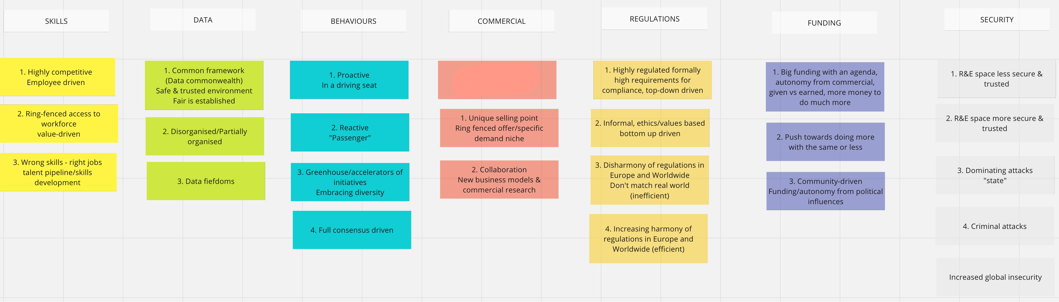
3. Refining and prioritising factors
The previous two steps have generated a high number of factors (88), some of which may be the same or overlapping.
Grouping factors into few areas of the potential future:
Identifying highest priority potential futures in each area based on analysis of identified individual factors
SKILLS
DATA
BEHAVIOURS
COMMERCIAL
REGULATIONS
FUNDING
SECURITY
Highly competitive, employee driven
Ring-fenced access to workforce, value-driven
Wrong skills – right jobs, talent pipeline and skills development

Slide 16
4. Ideating skeleton scenarios
Identify invariances:
  Energy prices will go up
  Increased global insecurity: energy, geopolitics, cyber attacks becoming more frequent, more sophisticated and more aggressive
Identify most interesting combinations of individual futures to create skeleton scenarios
E.g. the “ring-fenced” scenario where NRENs retain or increase their role as an exceptional entities.
Scenarios still have to be checked against plausibility and common sense criteria

Slide 17
5. Next steps
Develop narrative for each identified scenario
Prioritize (leave 3 scenarios for further development)
Incorporate factors and challenge areas in top priority scenarios
Derive potential vectors of change – recommend areas of effort for most desired outcome

Slide 18

Thank you
www.geant.org
© GÉANT Association
As part of the GÉANT 2020 Framework Partnership Agreement (FPA), the project receives funding from the European Union's Horizon 2020 research and innovation programme under Grant Agreement No. 856726 (GN4-3).

Slide 19
APPENDIX - Challenges

Slide 20
Climate change
Description
Climate change and the efforts to mitigate its effects will affect As a consequence of the change in average temperatures, data storage and processing might move geographically to more northern areas which has the potential to challenge the network capacity and topology as well as policies, especially those concerning transit of commercial traffic and data preservation inside countries.
The consequences of climate change will echo throughout society and therefore affect both NRENs themselves and the wider communities they support. This challenge has many different aspects, ranging from physical risks (e.g. floods) to rising energy costs, compliance requirements to intangibles like reputational risks (and opportunities).
Partnership, stakeholders, and users
Compliance to climate-change-related regulations might force a change of business partners in some cases when procurement policies need to be updated.
Value, chains of delivery, resources
Global data sharing for climate research will increase which will to a large degree make use of NRENs' networks and their role in enabling research cooperations will likely increase – while at the same time offering the chance to use existing resources more efficiently, lowering the carbon footprint of research.
Ecological sustainability could also be furthered through procurement activities where the bundled demand of NREN user could be used to enforce criteria supporting sustainability.
Perception of the value of IT services is likely to change, which will present an opportunity for NRENs presenting themselves as a responsible organizations to improve value of the services as well as a motivational package for the "Case for NRENs"
Financial (income and expenditure)
Energy prices will likely remain elevated or even increase until 2030, driving up the costs of any energy-dependent activity – therefore energy-efficient operation will be a potent driver. Potentially affects many areas – travel, network equipment, office heating ...
Costs will arise also from the business continuity needs in case of externally driven events like floodings, cooling problems or fuel and energy shortages.

Slide 21
Employment and Skills
Description
This challenge in most cases is already evident in NRENs.
The potential implications range from the partnership-wide effects due to e.g. change of leadership, to effects within each NREN due to the potential mismatch of expectations of new employees and current operational model of NRENs.
Partnership, stakeholders, and users
Changing backgrounds of leaders in the ecosystem will impose challenges to find the appropriate leadership for NRENs and GÉANT that is capable to convincingly represent the operational models
Increasing mobility of the workforce, virtualization of offices, and disparity between countries imposes challenge on the coherence of the community when specialists are not bound to their "home" NREN any longer.
Value, chains of delivery, resources
Value for employees is directly linked to the value for constituencies and partnership, people are the key asset of NRENs
Expectations of the new workforce will make current onboarding approach more difficult.
Recognition of the international efforts within organizations will become a challenge for implementation of joint projects.
NRENs will have to make a significant move towards becoming people-centered organizations.
Financial (income and expenditure)
NRENs will face a strategic challenge to change the recruitment strategies and invest significant amounts of effort in order to acquire a workforce with the right mindset.

Slide 22
Technical challenges: Data life cycle
Description
The data space is fragmenting in terms of storage places and access conditions (FAIR vs. Restricted and sensitive data)
Partnership, stakeholders, and users
Increasing diversity of data storage will require more partners (e.g. peering agreements)
A solution that allows reliably share sensitive data could open new constituencies for NRENs (e.g. medical data from hospitals)
Value, chains of delivery, resources
Currently, access to data is the lifeblood of R&E networks, so finding solutions to challenges in this area is essential.
Financial (income and expenditure)
Investments and research will be required – however, this is unlikely to produce any surprise expense

Slide 23
Technical challenges: Cyber security
Description
The importance of Cyber security will increase, driven by technical, societal and legal developments. Security requirements could fragment the internet.
Partnership, stakeholders, and users
Due to regulations, more organizations will have to consider cyber security in their interactions with others
Security tools will become increasingly sophisticated, likely increasing the need to rely on specialized partners
Value, chains of delivery, resources
Cyber security expertise will be ever more in demand, which NRENs as organizations are well placed to satisfy.
A fragmentation of the internet would endanger the collaborative space NRENs have created – e.g. the easy access to data for research
Financial (income and expenditure)
Cyber security requirements means expenses – compliance, suitable procedures and a qualified workforce

Slide 24
Technical challenges: Quantum technology
Description
Quantum computing and encryption will profoundly impact internet communication security – but probably only after 2030
Partnership, stakeholders, and users
To develop, use and deploy this new technology, partner with expertise in this area will be needed – this already explored in joint research projects.
Strong push towards involvement of industry from funding bodies.
Value, chains of delivery, resources
To maintain their core value proposition, NRENs will have to update their network processes. NRENs will need to help users to keep up with new requirements in the security/cryptography area.
Financial (income and expenditure)
For the foreseeable future costs will be mostly research costs.

Slide 25
Technical challenges: Artificial Intelligence (AI)
Description
AI will potentially touch all activities of NRENs, but predictions of actual impacts are very difficult, making this a known unknown. Very likely there will be productivity gains through automation equally security threats and trust issues.
External expertise, e.g. by interviewing experts, could help to explore this challenge.
Partnership, stakeholders, and users
AI Automation might make technically capable users less dependent on NRENs.
Value, chains of delivery, resources
AI-enabled automation might make NREN services cheaper and better. AI might create the need for new or improved services, e.g. for data validation and security
Financial (income and expenditure)
Productivity gains would release funds for other purposes but increased cost could come from increased energy consumption and from the need to develop new expertise.

Slide 26
Virtualization of research and education processes
Description
The digitalization of information at large, coupled with a significant improvement in mobile and home connectivity, is facilitating an environment in which physical participation can be replaced in many and maybe most cases by virtual or remote presence.
If this trend persists, much traffic from the R&E sector will be re-routed, changing the requirements and maybe the importance of NREN networks.
Partnership, stakeholders, and users
Stakeholders and constituencies of the NREN community may shift their connectivity to other providers and contribute less to NRENs.
NRENs will come closer to the single end-users where before an NREN’s main user was the user’s institution.
Analysis: Value, chains of delivery, service portfolio
NRENs must strengthen the service value and focus even more on service offering which are not available through commercial providers.
Analysis: Financial (income and expenditure)
The topology and service change may imply additional cost for topology modification and a reduction of income due to lower capacity needs from universities and small sites.
Offering end-user support for NREN services would require substantial changes in the way NRENs operate such changes to the network and the services may imply an increase in costs towards connectivity providers.

Slide 27
NREN governance
Description
It is expected that, due to evolving regulations, technologies, funding streams and new use-cases that will arise, the NRENs governance will change over the next ten years so that NRENs can continue to fulfil their pivotal role. Main challenges:
National laws and compliance with European frameworks will drive changes in the NRENs governance
Expansion of the NRENs constituency and NRENs mandate: K12, hospitals, libraries etc
NRENs Membership model is still mostly connectivity-centric: other services are available if the members get the connectivity first
NRENs become bigger players in supporting the digitalisation of universities and to support digital skills
Participation in European procurement will require compliance and agility
Partnership, stakeholders, and users
More interaction with other sectors and participation in new initiatives will make the stakeholders base larger
Value, chains of delivery, service portfolio
With more stakeholders on board, NRENs will need to fine tune how they communicate their values.
Diverse delivery models will be needed to support emerging use-cases (for instance education, data and skills, etc)
Financial (income and expenditure)
If more compliance and skills are needed this will results in more expenditure; however new possibility to recover costs may emerge.

