Slide 1


GÉANT Compendium of NRENs
New Website
Annabel Grant
Partner Relations
SIG-MSP, Copenhagen, Denmark
13th March 2024
Public

Slide 2
What’s the point of a Compendium Website?
The place you go to fill in the questionnaire each year.
The database storing historical responses to the questionnaire.
The place to see NREN responses.
The Report gives a view of the state of the NREN landscape.
The Website allows you to drill down to look at the responses to a single question, looking at as many or as few NRENs as desired.

Slide 3
What was wrong with the old one?
Poorly maintained, based on and old, obscure software.
Underlying database was broken, with incorrect data, and correct data stored in different places.
Lacking a “trustworthy” feel, with malfunctioning graphs and formatting.
Only a sub-set of questions were visible.
Contained out of date information drawn from sources other than the Compendium questionnaire, ie. NREN logos.
Not integrated properly into the GÉANT website family.

Slide 4
What to do about it?
Build a new site from scratch.
Unify the survey site, data presentation, and report repository.
Clean up the database so only corrected, confirmed, clean data is there, with a structure in place for future additions.
Integrate all sections of the Compendium – Organisation, Network, Connected Users, Standards & Policies, and Service Matrix – into one website.
Only show information gathered from the survey (to keep upkeep simple)
Focus on the questions.
Rebuild the questionnaire site to ensure only valid answers are given.
Make downloads easy and convenient.

Slide 5
Who is the new site for?
GÉANT NRENs
International NRENs and RENs
Your funding bodies/government ministries etc.
The EC
Researchers
………………. And more! We’d welcome your suggestions!

Slide 6
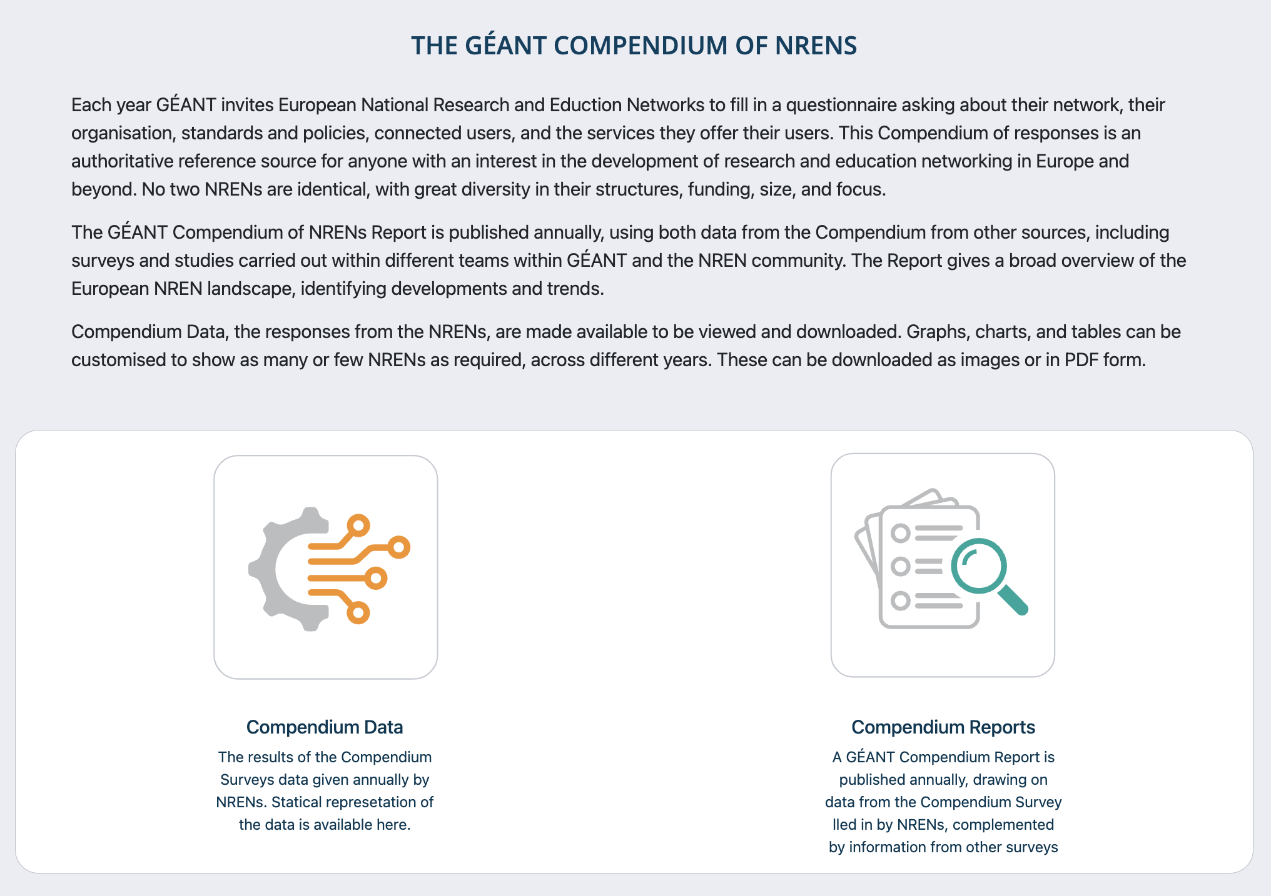
So where should I go?
Compendium.geant.org
Notes:
Follow the Data path to explore the quesitons and responses. The Reports path will, for now, move you to the repository of exisiting reports that people will be familiar with already.

Slide 7
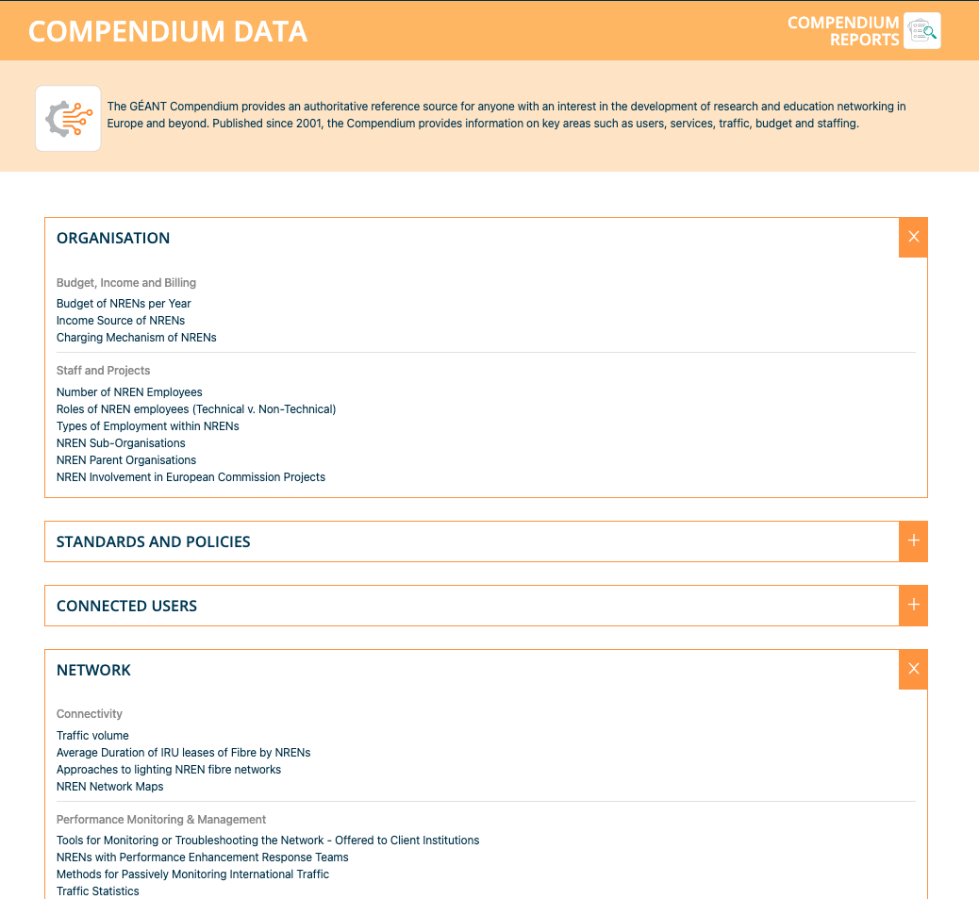
Focused on questions and NREN responses.
Some more still to be added, but mostly complete.
2023 data included

Slide 8
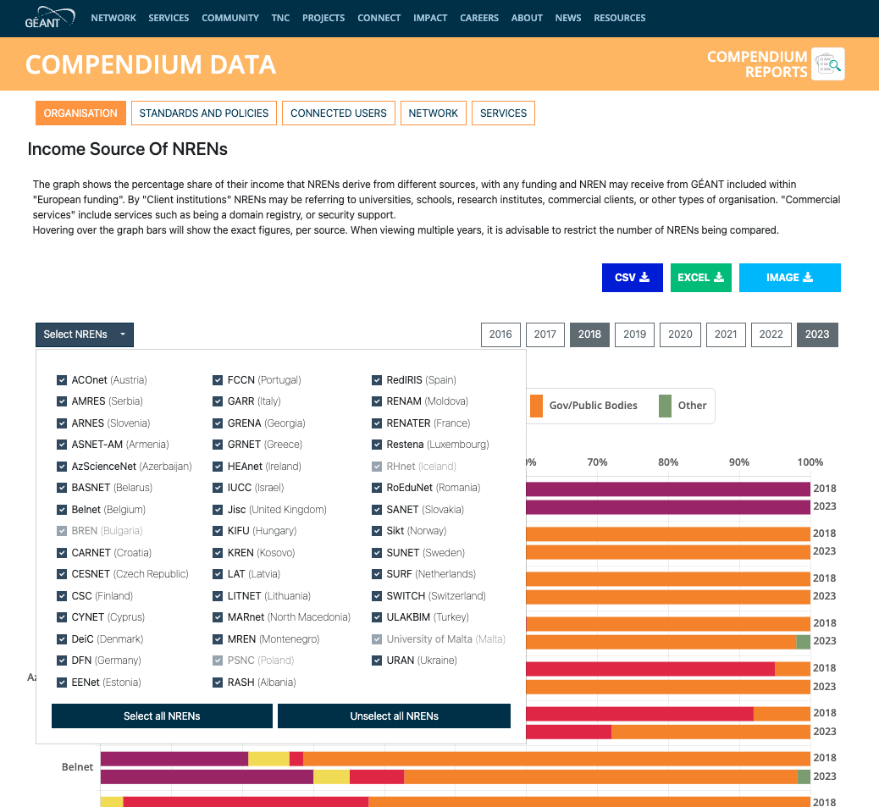
Choose which NRENs you want to see, and which years.
The website will remember your choices when you navigate between graphs.
Download all the relevant data in CSV or Excel form, or the graph you’ve made as an image (PNG, JPEG, SVG)

Slide 9
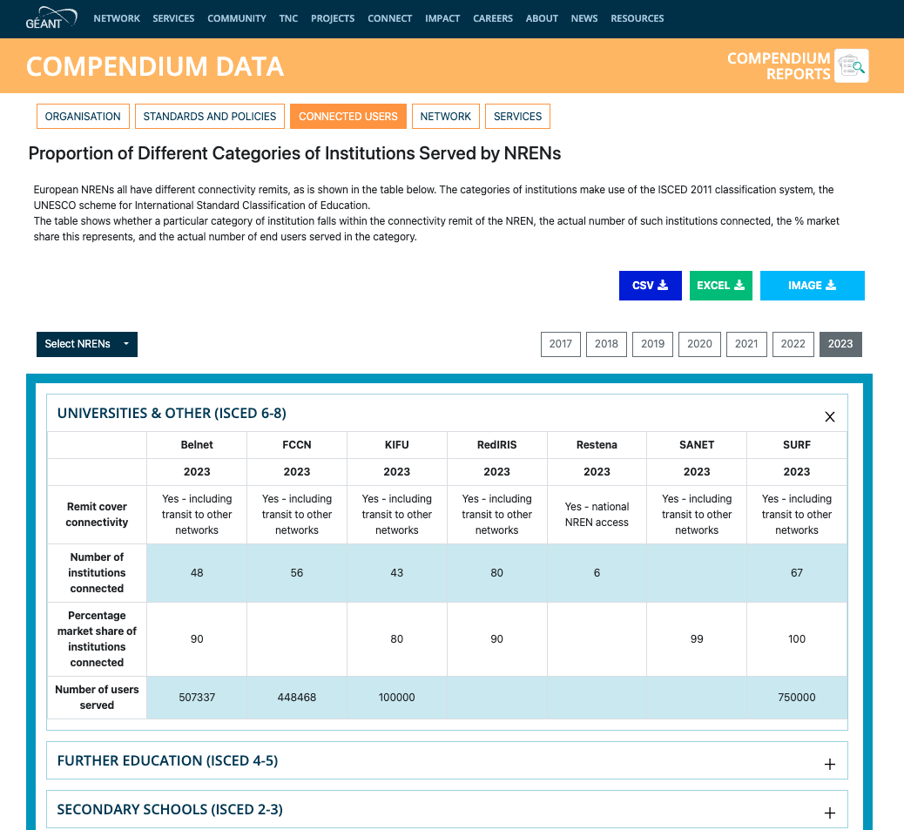
Understand which users are served by different NRENs, levels of connectivity, expected growth, and more

Slide 10
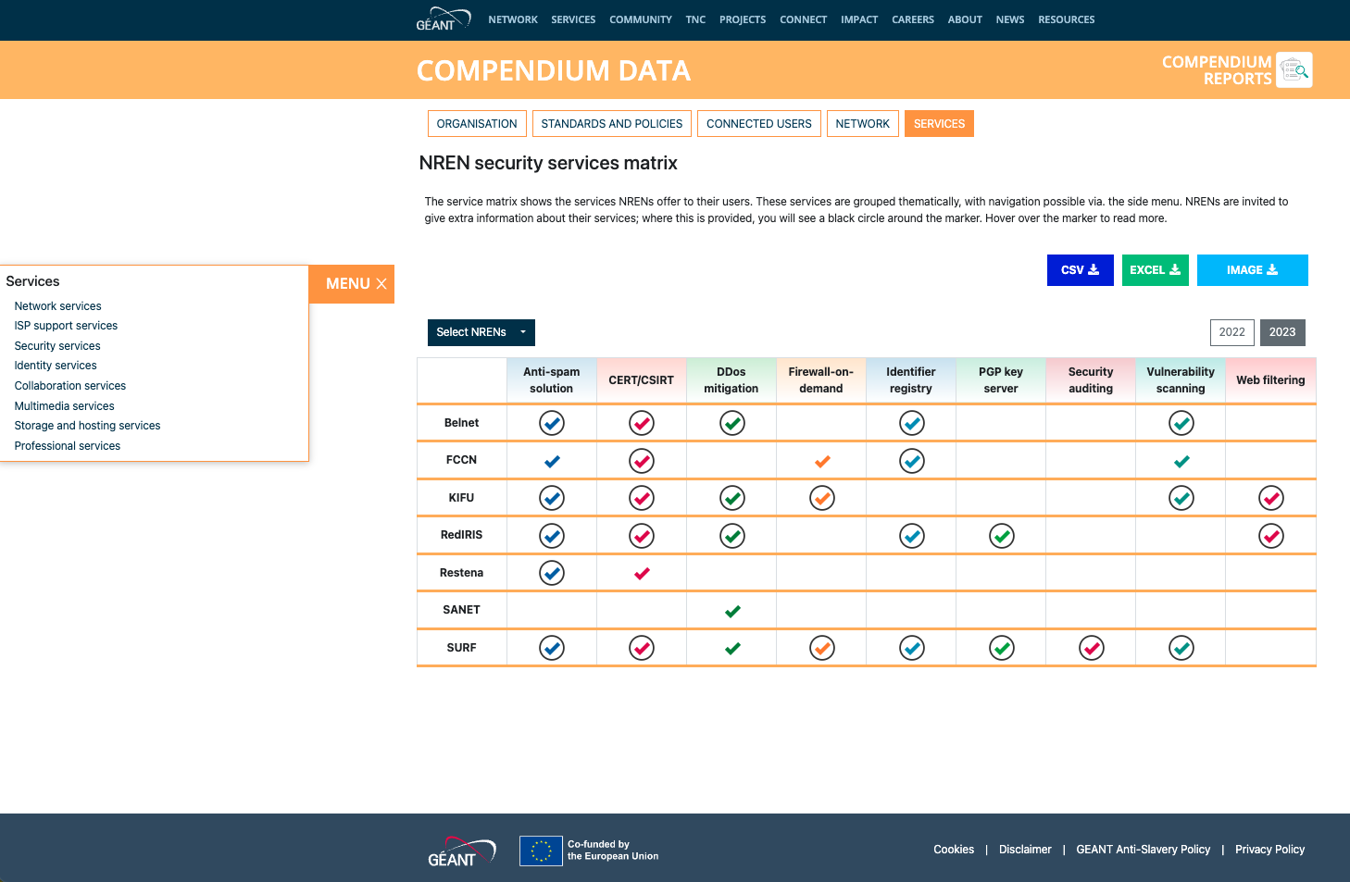
The new Service Matrix
Learn which services NRENs offer their users.
Hover over markers with circles around them for further info.
Separated by thematic area for ease of use.
See as many or few NRENs as you want.
Notes:
If anyone asks why there is only 2 years of data here, you’ll need to explain that the old service matrix was built in such a way that it did not record when data had been added, so we had no way of knowing what had been kept up to date, and what was hoplessly innacurate. We felt the only trustworthy data would be that collected via Daniel’s desk research, and the NREN’s own responses to the 2023 questionniare.

Slide 11
What’s next?
More data to come! Continuous additions until all questions/answers are available.
Suggestions welcome! Are there data you’d like to see differently? Do the graph/chart types best show the information you’re looking for?
Publicity campaign:
  Project newsletter
  Social media posts
  Presentations at STFs, SIGs etc.
  CONNECT 45
  Lightning Talk (fingers crossed!)

Slide 12

Thank You and Enjoy!
Any questions, comments, suggestions….
Jennifer.Ross@geant.org
www.geant.org

