Slide 1
SURFspot
Exploring collaboration possibilities on purchase & delivery of software & hardware in Europe

Slide 2
Introduction
Patrik Zorica
Teamlead SURFspot & Product Manager
Patrik.zorica@surf.nl
+31622106566
https://www.linkedin.com/in/patrik-zorica/
Maurice Bolier
Purchase & Contract Advisor
maurice.bolier@surf.nl
+31628504644
https://www.linkedin.com/in/maurice-b-1214a369/

Slide 3
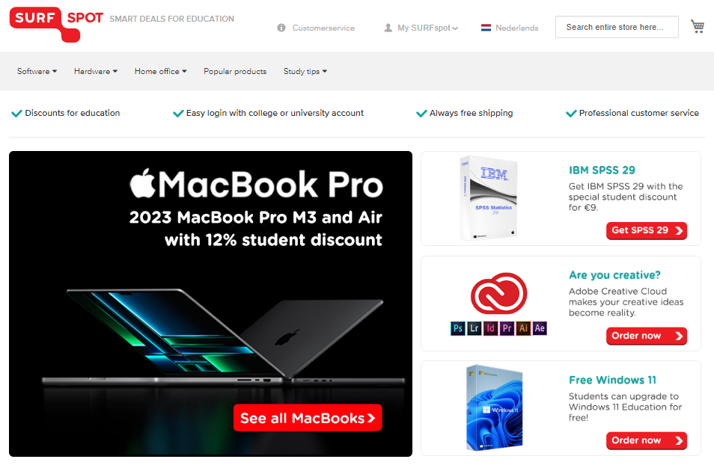
About SURFspot (B2C)
Part of SURF
Webshop
Hardware & software
180.000 orders in 2023
10 FTE
160 connected institutions

Slide 4
SURFspot: What we do
We purchase hard- & software (reseller, no stock)
API connection with suppliers
Make it available for institutions (educational discount)
Provide delivery
Give support
Promote
Give access to employees and students

Slide 5
SURF DLM (Device Lifecycle Management) B2B
We purchase hardware (high volume)
Make it available for institutions
Provide delivery
Give support
Promote

Slide 6
Advantages
We provide support to the SURF cooperation so the institutions can focus on core activities.
The new trend in the Netherlands is that institutions don't want to waste time on the operational process but want to have a directive role.
We save costs and time because we do all the tenders.
We provide the tech and support.
Employees and students have access to affordable hard & software.

Slide 7
What we ask
Are there any Nren's who have similar ideas?
Is there interest to explore the possibilities of exchanging knowledge about any of the services that we are trying to provide in the Netherlands?
Who wants to exchange contact information and discuss these topics more frequently?

Slide 8
Questions?

