Slide 1
Above-the-Net Services
2023 Roadmap Update Proposal
Maria Ristkok, EENet of HTM
Jakob Tendel, DFN
Work Package Co-Leader
GPPC subgroup, GN5-2 strawman session
04 December 2023
Project Participants Sensitive (SEN)

Slide 2


Agenda
Quick review of current roadmap
Outcomes of 2023 CTO workshop
Known continuing activities
Proposed potential future topics

Slide 3
Current roadmap Above-the-Net Services (baseline 2021, re-confirmed 2022)
Do once what must otherwise be done many times.
Do together what is hard to do alone.
Maintain and support portfolio of services
Ensure timely
re-procurement
of IaaS Cloud Framework
Cloud Strategy Development
to include
community cloud
WebRTC videoconferencing, support for sustainable future for eduMEET

Slide 4
Proposed Potential Future Topics for Above-Net Collective Action
Research data-set mobility service on-top of network
Common PaaS cloud middleware for integrated Trusted Research
Pan-European Sovereign research data object-storage
Heavy lift,
long-term payoff|
In GN5-2:
concept development
eduMEET
federation
AI expertise and NREN support
Education interoperability
Research Data and EOSC coordination
Joint commercial activities
(EOSC)
Medium-term
Valuable, but unclear if best fit in WP4
Notes:
Long-term “heavy-lift” topics (in GN5-2, first concept development):
A higher-level research data mobility service for the middle-ground data transfers (0.5TB < X < 1PB), e.g. Research Infrastructures, Research Data Repositories, interfacing with HPC. Abstract away many of the challenges around point-to-point data transfers, allow users to move on from Bits and files to managing datasets. Optimises exploitation of the network infrastructure and apparent value to those users.
A common baseline suite for Platform-as-a-Service cloud research data environments, integrating NREN services such as T&I and security by design, deployable to any Infrastructure Cloud (commercial or community), offering Virtual/Trusted Research Environment functionality to end-users.
A Pan-European infrastructure for sovereign research data storage, built on a unified hardware platform collectively procured, offering simple object-storage interfaces. Delivers a sovereign solution for storage, capitalises on scale efficiencies and collective procurement capability of GÉANT community, enables temporary and flexible use of non-sovereign platforms for data processing and generating value while knowing a copy of the data is safe.
Medium-term “doable” topics
Coordinate a community-wide federation of NREN-based eduMEET
for mutual benefit and resilience in the face of changing commercial services market
ongoing support also for development in scaling to support wider operational deployments.
Artificial Intelligence – AI
Establish a forum in the community program (SIG?) for experience sharing and mutual support
Establish a support function in the project, to bundle expertise and facilitate:
Researcher use of AI and access to appropriate infrastructures
Assist smaller NRENs
NREN-applications of AI
Technical pitfalls and risks
Ethics surrounding use of public data
Supporting Education
cross-institution interoperability around exchange of student credentials and courseware
Location independent consistent service provision
Research data sharing
Coordinating NRENs’ experience with the role of national or thematic EOSC node
Data Spaces / -Lakes
Joint actions towards commercial Suppliers of diverse commercial services
Leverage the influence that demand aggregation at GÉANT level offers gives us for beneficial concessions.

Slide 5
Long-term “heavy-lift” topics (in GN5-2, first concept development):
A higher-level research data mobility service for the middle-ground data transfers (0.5TB < X < 1PB), e.g. Research Infrastructures, Research Data Repositories, interfacing with HPC. Abstract away many of the challenges around point-to-point data transfers, allow users to move on from Bits and files to managing datasets. Optimises exploitation of the network infrastructure and apparent value to those users.
A common baseline suite for Platform-as-a-Service cloud research data environments, integrating NREN services such as T&I and security by design, deployable to any Infrastructure Cloud (commercial or community), offering Virtual/Trusted Research Environment functionality to end-users.
A Pan-European infrastructure for sovereign research data storage, built on a unified hardware platform collectively procured, offering simple object-storage interfaces. Delivers a sovereign solution for storage, capitalises on scale efficiencies and collective procurement capability of GÉANT community, enables temporary and flexible use of non-sovereign platforms for data processing and generating value while knowing a copy of the data is safe.

Slide 6
Long-term Heavy-lift Topics in GN5-1 (First Concept Development) 1/3
Enhanced data mobility service for mid-range transfers
Supporting Research Infrastructures &
Data Repositories, interfacing with HPC
Enabling seamless dataset management
(moving on from bits and files)
Overcoming challenges in point-to-point data transfers
Maximising the network performance perceived by users
Optimising exploitation of network infrastructure

Slide 7
Long-term Heavy-lift Topics in GN5-1 (First Concept Development) 2/3
Unified Platform-as-a-Service layer for cloud research data environments
Integrates NREN services (T&I, security)
Deployable on any infrastructure cloud (commercial and community)
Provides Virtual/Trusted Research Environment functionality to end-users

Slide 8
Long-term Heavy-lift Topics in GN5-1 (First Concept Development) 3/3
Pan-European sovereign research data storage infrastructure
Unified hardware platform, collectively procured
Simple object-storage interfaces
Enables temporary and flexible use
of non-sovereign platforms
Ensures data safety with a copy in a sovereign solution
Capitalises on scale efficiencies and
collective procurement capability

Slide 9
Proposed Potential Future Topics for Collective Action
Research data-set mobility service on-top of network
Common PaaS cloud middleware for integrated Trusted Research
Pan-European Sovereign research data object-storage
Heavy lift,
long-term payoff|
In GN5-2:
concept development
eduMEET
federation
AI expertise and NREN support
Education interoperability
Research Data and EOSC coordination
Joint commercial activities
(EOSC)
Medium-term
Valuable, but unclear if best fit in WP4
Notes:
Long-term “heavy-lift” topics (in GN5-2, first concept development):
A higher-level research data mobility service for the middle-ground data transfers (0.5TB < X < 1PB), e.g. Research Infrastructures, Research Data Repositories, interfacing with HPC. Abstract away many of the challenges around point-to-point data transfers, allow users to move on from Bits and files to managing datasets. Optimises exploitation of the network infrastructure and apparent value to those users.
A common baseline suite for Platform-as-a-Service cloud research data environments, integrating NREN services such as T&I and security by design, deployable to any Infrastructure Cloud (commercial or community), offering Virtual/Trusted Research Environment functionality to end-users.
A Pan-European infrastructure for sovereign research data storage, built on a unified hardware platform collectively procured, offering simple object-storage interfaces. Delivers a sovereign solution for storage, capitalises on scale efficiencies and collective procurement capability of GÉANT community, enables temporary and flexible use of non-sovereign platforms for data processing and generating value while knowing a copy of the data is safe.
Medium-term “doable” topics
Coordinate a community-wide federation of NREN-based eduMEET
for mutual benefit and resilience in the face of changing commercial services market
ongoing support also for development in scaling to support wider operational deployments.
Artificial Intelligence – AI
Establish a forum in the community program (SIG?) for experience sharing and mutual support
Establish a support function in the project, to bundle expertise and facilitate:
Researcher use of AI and access to appropriate infrastructures
Assist smaller NRENs
NREN-applications of AI
Technical pitfalls and risks
Ethics surrounding use of public data
Supporting Education
cross-institution interoperability around exchange of student credentials and courseware
Location independent consistent service provision
Research data sharing
Coordinating NRENs’ experience with the role of national or thematic EOSC node
Data Spaces / -Lakes
Joint actions towards commercial Suppliers of diverse commercial services
Leverage the influence that demand aggregation at GÉANT level offers gives us for beneficial concessions.

Slide 10
Thank You

Slide 11
VRE reproducible on different locations
Catalogus Item X
Catalogus Item X
Catalogus Item X
GIT repo
Component A
GIT repo
GIT Repo Y
Component B
DEV
BETA
PROD
Component C
SURF Research Cloud deployment framework
SURF HPC Cloud
On-Prem Cloud
Azure
AWS
Oracle
Google
Notes:
The component owner can upgrade the Beta component version to the product version of the component. All catalogue items that use this component will start using the new production version of the component.

Slide 12
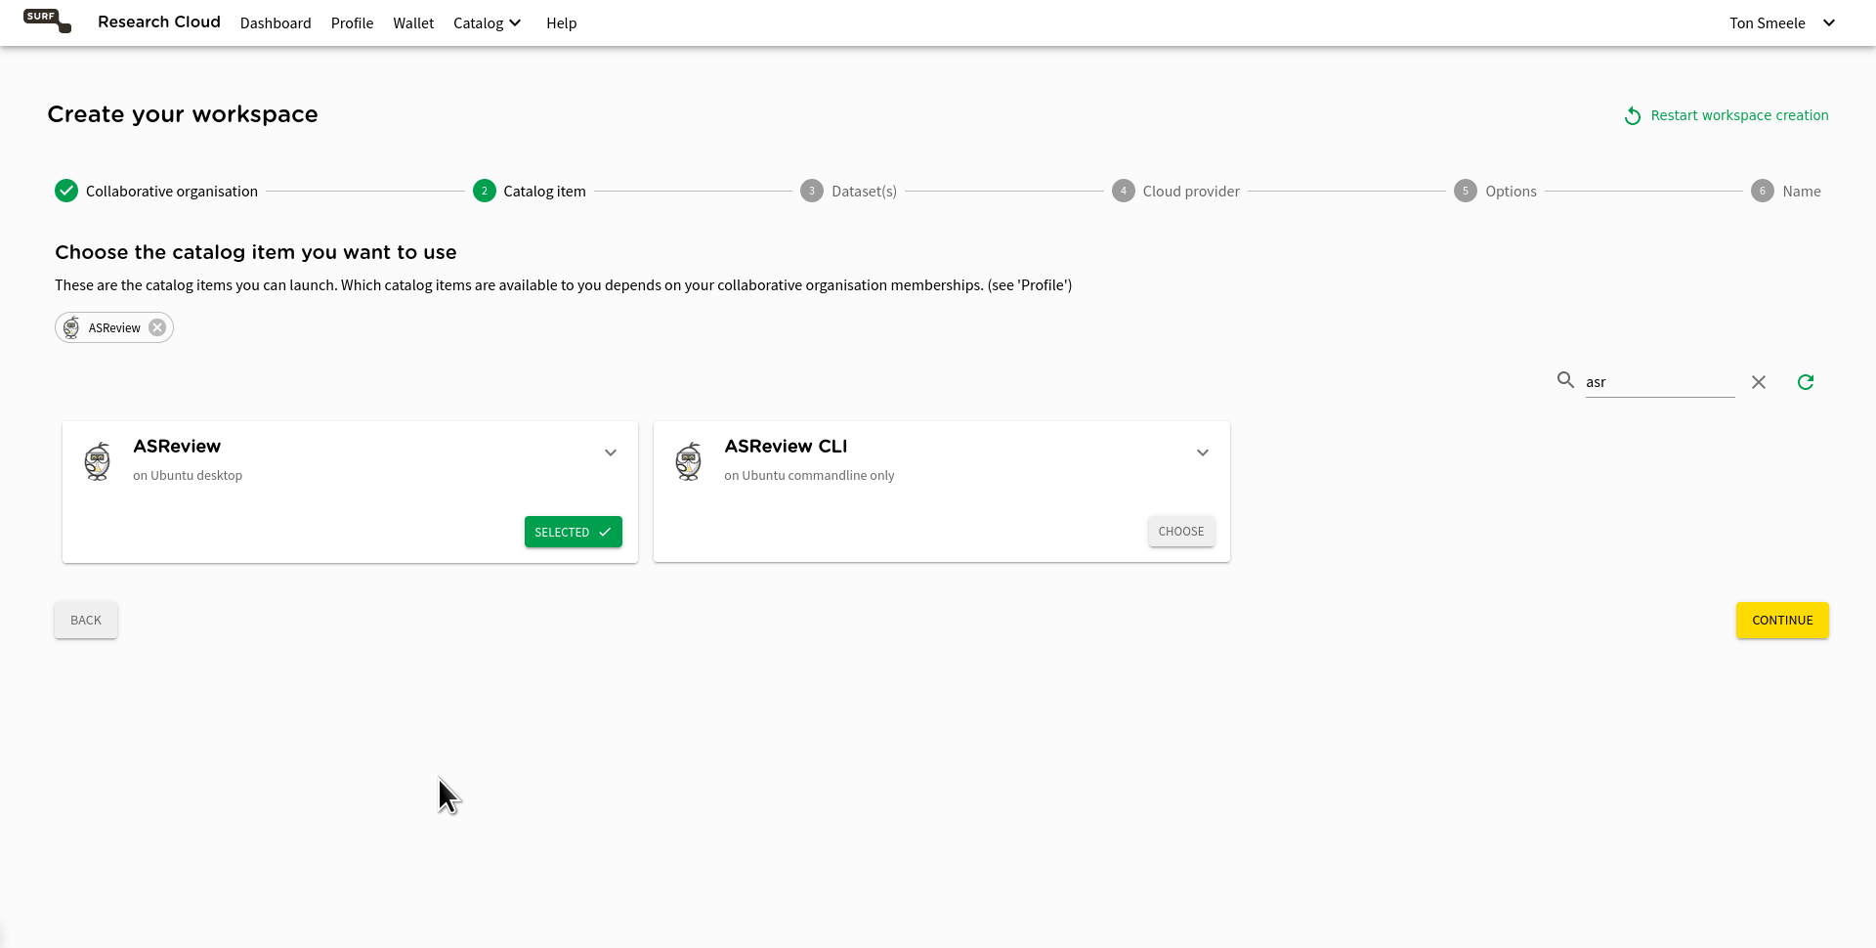
Notes:
Then select the application you want to use. There are over 400 applications available. In this case only the ASReview application is shown since “asr” is typed in the search bar.

Slide 13
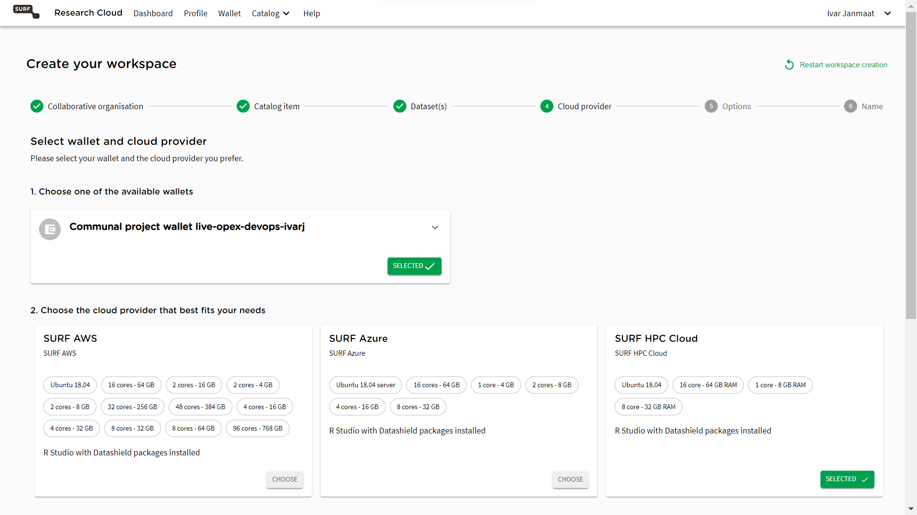
Notes:
Then select the wallet from which you want to pay the resource. A user can have multiple wallets provided by the Dutch Research Council, research institution, EOSC Future, etc. Then choose the cloud provider where you want to deploy the workspace.

Slide 14
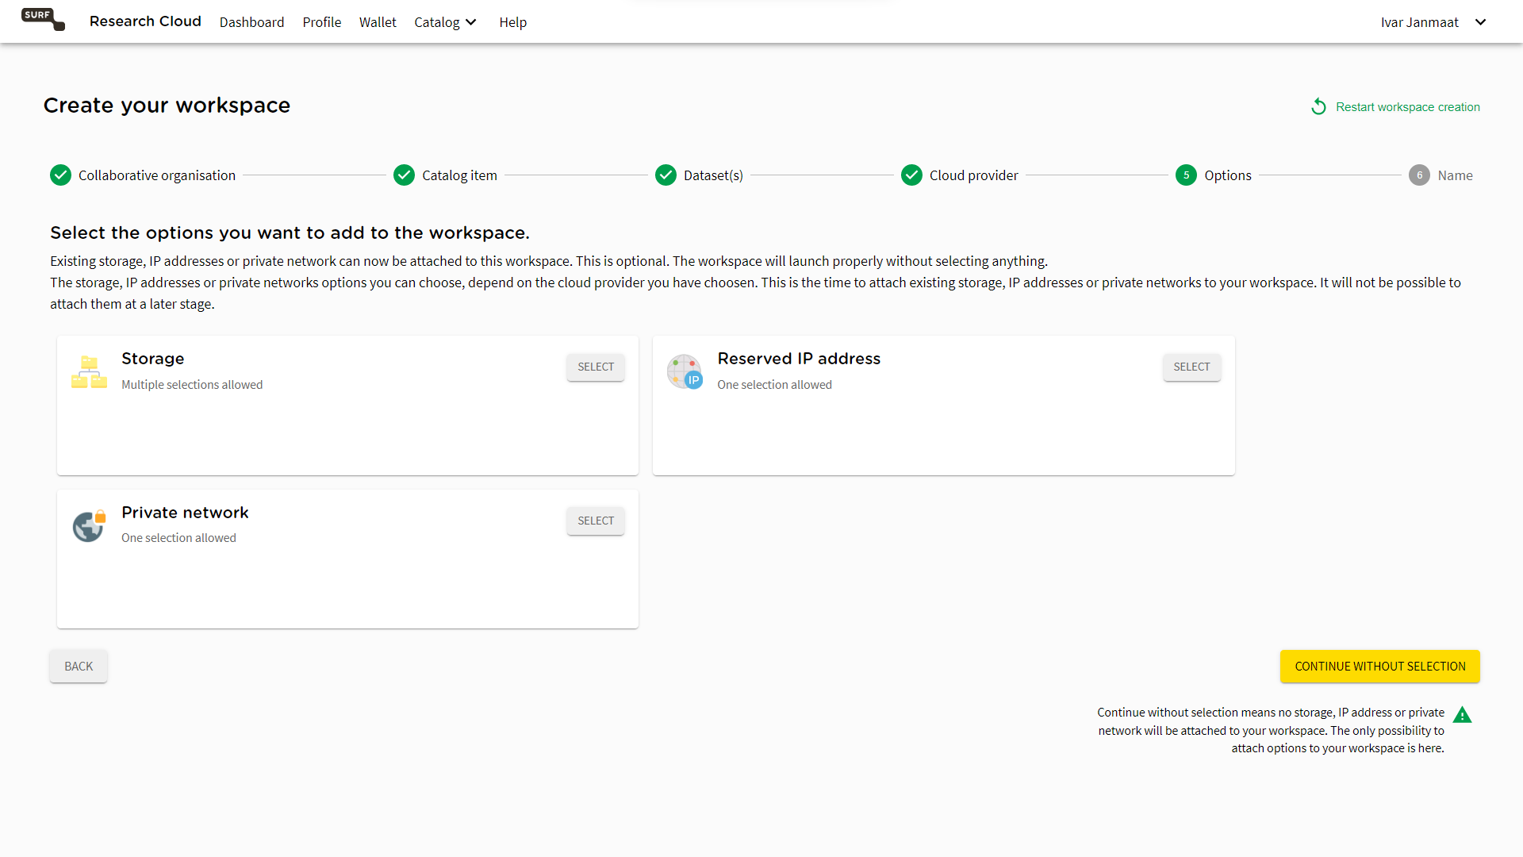
Notes:
Choose additional items you want to have available on your workspace. You can continue without selecting things.

