Slide 1





How is the weather
Jonas Hagström @ SUNET

Slide 2
Background
Increase collaboration
Improved transparency between NOCs
Seek common ground for statistics and monitoring
Notes:
Collaboration between the nordic NRENS SUNET,FUNET,SIKT,DEIC,NORDUnet, (RHNET)

Slide 3

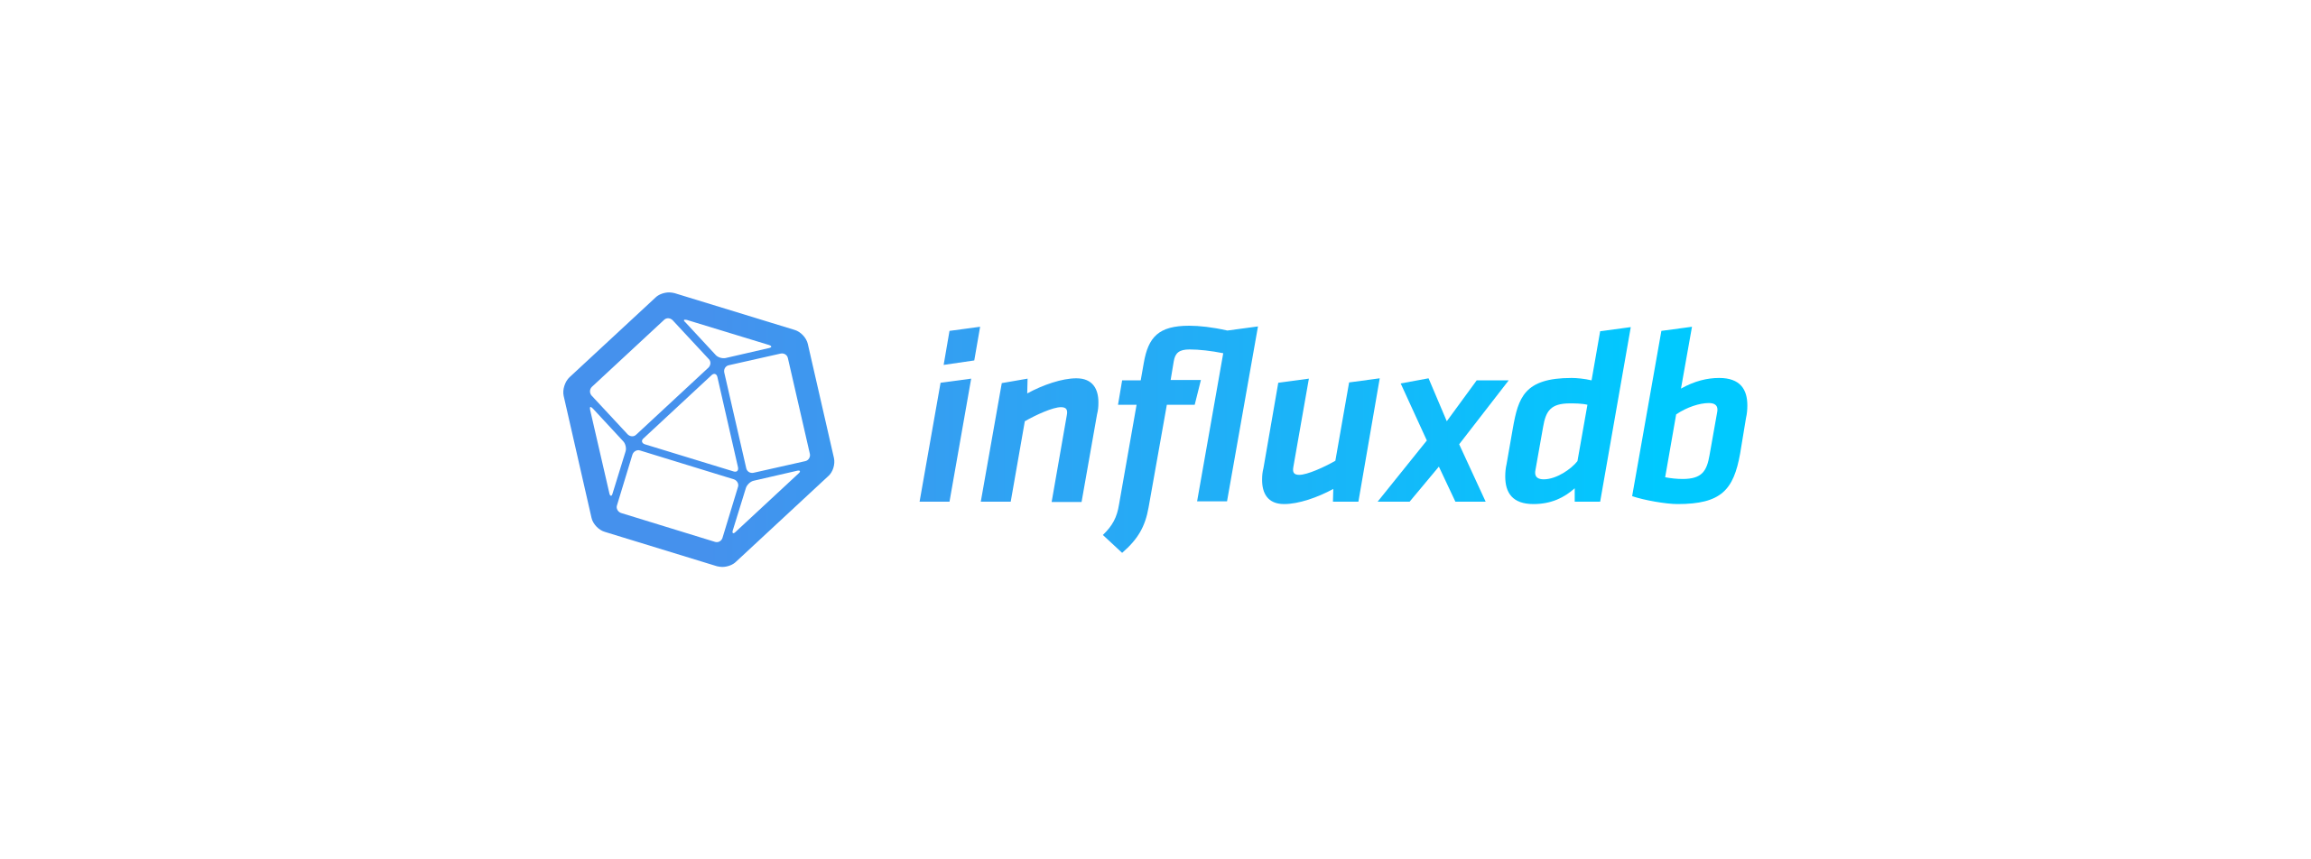

Collection of data
Streaming
NREN DB
SSH
Notes:
LibreNMS - SNMP
Telegraf – SNMP/GNMI
Script – SSH
Vendor agnostic
RFC 2863 - The Interfaces Group MIB
IfAdminStatus and IfOperStatus
https://datatracker.ietf.org/doc/html/rfc2863#section-3.1.13
GNMI
gRPC Network Management Interface - https://github.com/openconfig/gnmi
https://docs.influxdata.com/influxdb/v2/reference/syntax/line-protocol/
Line protocol
// Syntax <measurement>[,<tag_key>=<tag_value>[,<tag_key>=<tag_value>]] <field_key>=<field_value>[,<field_key>=<field_value>] [<timestamp>]
// Example myMeasurement,tag1=value1,tag2=value2 fieldKey="fieldValue" 1556813561098000000

Slide 4
Database & Data replication
SIKT
SUNET
FUNET
DEIC
Influx v2
1.Influx remote create
2.Influx replication create
3.Influx remote list
NORDUnet
influx replication create --name REPLICATION_STREAM_NAME --remote-id REPLICATION_REMOTE_ID --local-bucket-id INFLUX_BUCKET_ID --remote-bucket REMOTE_INFLUX_BUCKET_NAME
InfluxDB version 2 with bucket replication
Notes:
Each NREN collects data and stores it in influxDB
Each responsible for the own filtering and selection of data to be pushed
The Pushing data from each NREN to shared platform at NORDUnet
Each nren has write (and read) to their own bucket and read to others data
InfluxDB is setup with remote and then replication on bucket level (duplicates all writes to a certain bucket to a remote)

Slide 5
Design
Poller
Poller
Poller
Poller
Poller
DB
FUNET
DB
SUNET
DB
DEIC
DB
SIKT
DB
NORDUnet
DB – NORDUnet (shared instance)
Presentation
Notes:
To be able to swap out different pieces if necessary.
Change polling methods over time perhaps go from SNMP to API-calls to Streaming
Possibility to change DB in the future to something else
Change graphical layer without having to change the complete system.

Slide 6
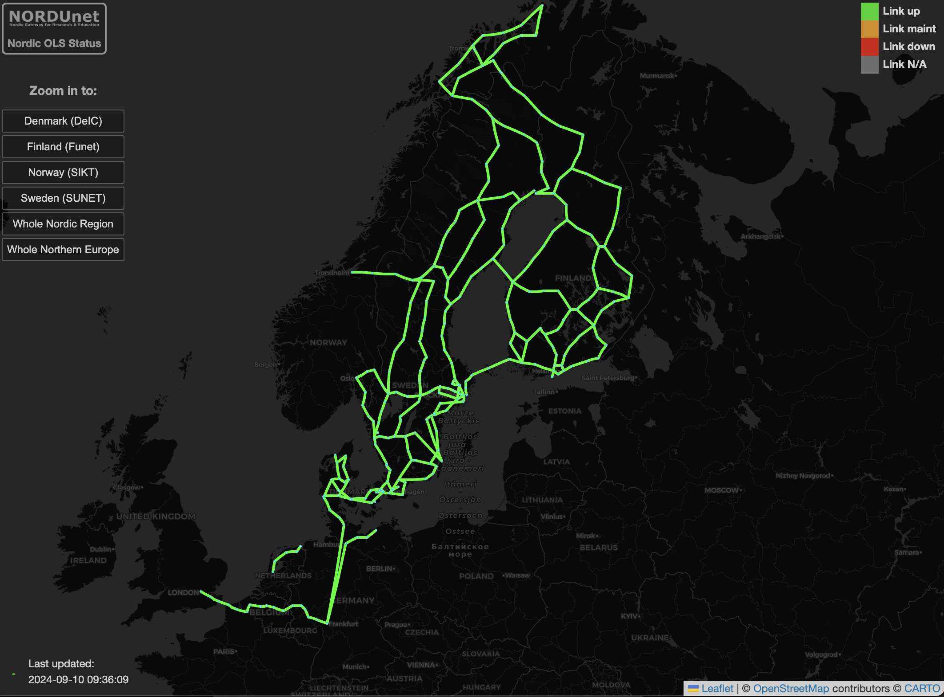
Links from:
SIKT
SUNET
FUNET
DEIC
NORDUnet
Vendors
Ciena
Adva
ECI (Ribbon)
Nokia
~280 Nodes
>300 Links
Notes:
LeaftletJS
PearlCGI
Continued development of the map from FUNET
Originally developed for network traffic https://netmap.funet.fi/
Nordic optical weathermap
Data for configuring the map has been provided from each NREN Sites and Links put inside yaml

Slide 7
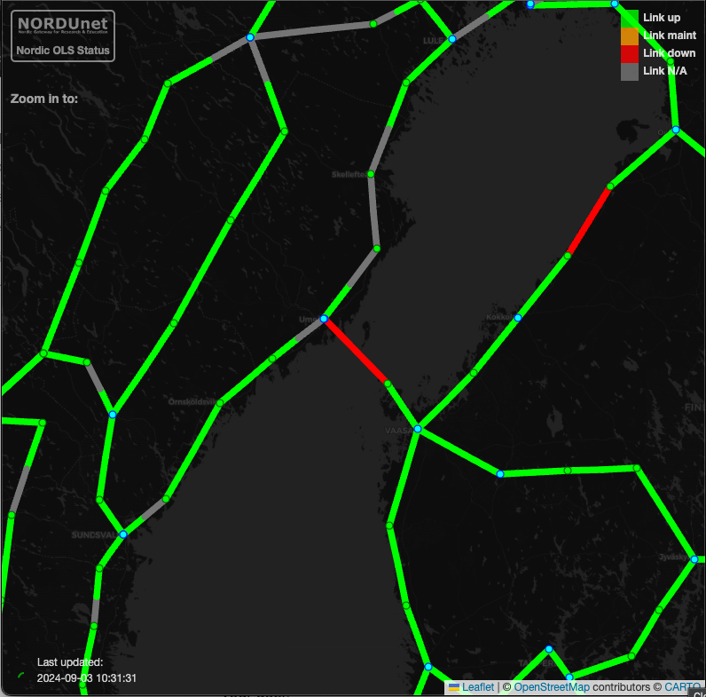
Example
Notes:
Outage between SUNET and FUNET
“Before would be we are experiencing outage on the link x and X starting 07:00”
After we have noticed and outage on the link between x and x started at 07:00 and we can se that there is a ongoing outage in your network.
Do you have a reference for it .
We have noticed that the light levels have restored and that there is no current outage in your network.

Slide 8
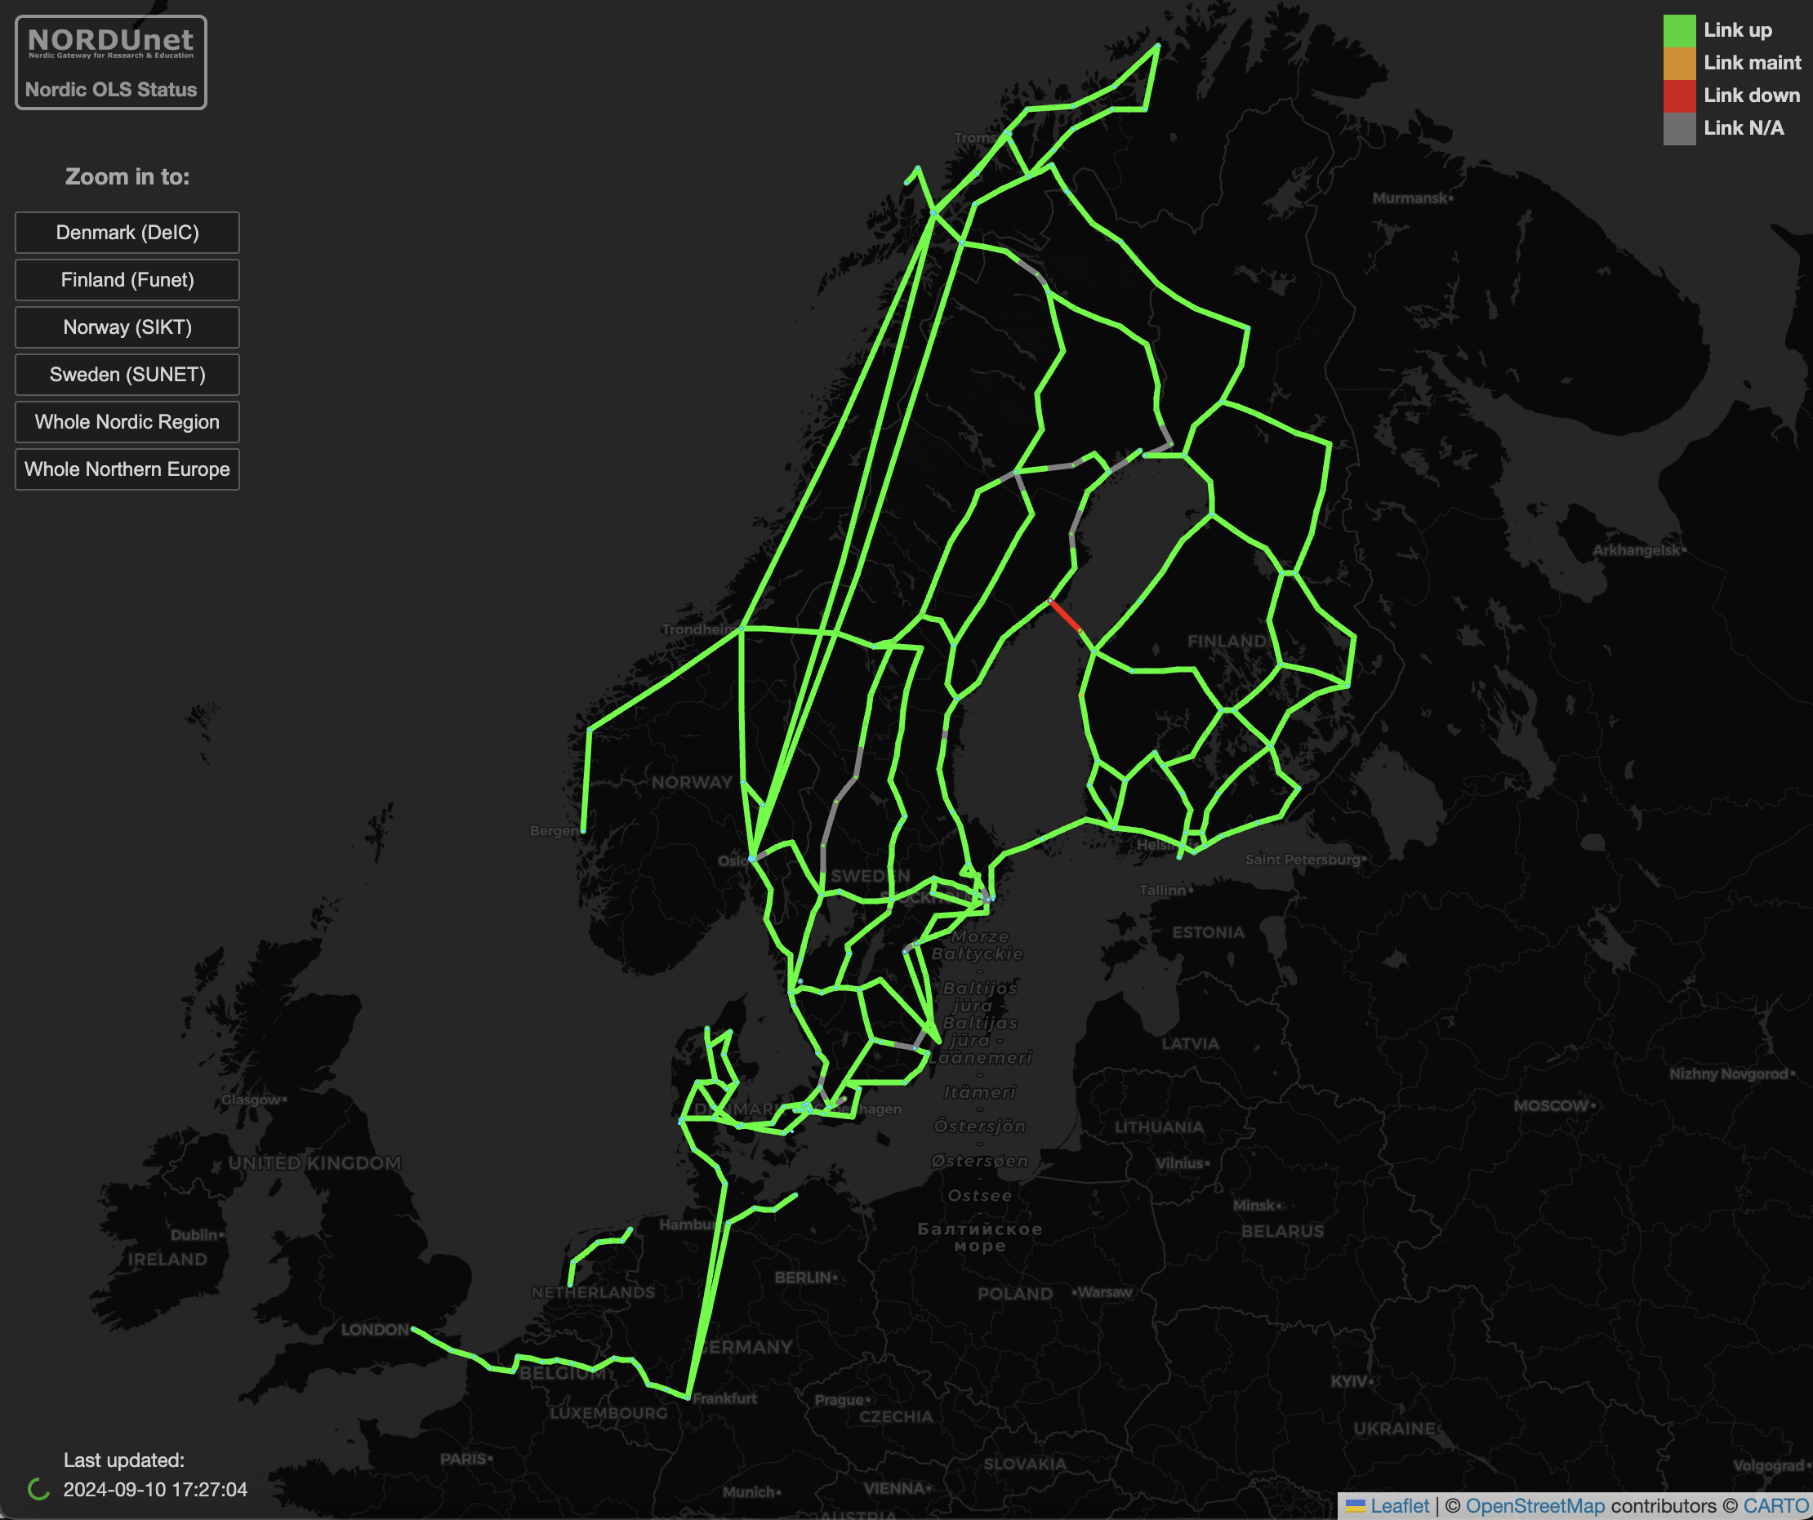
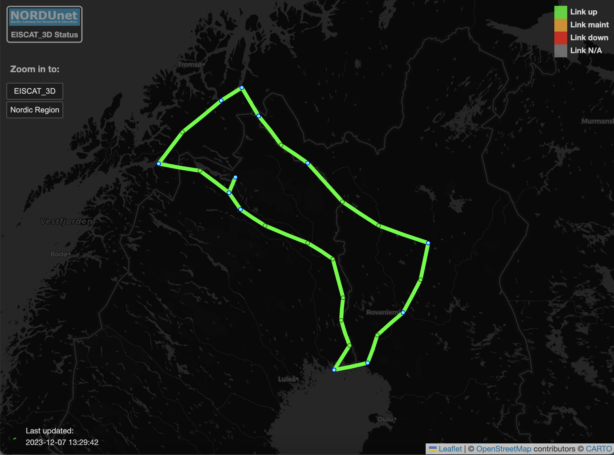
Layers

Slide 9
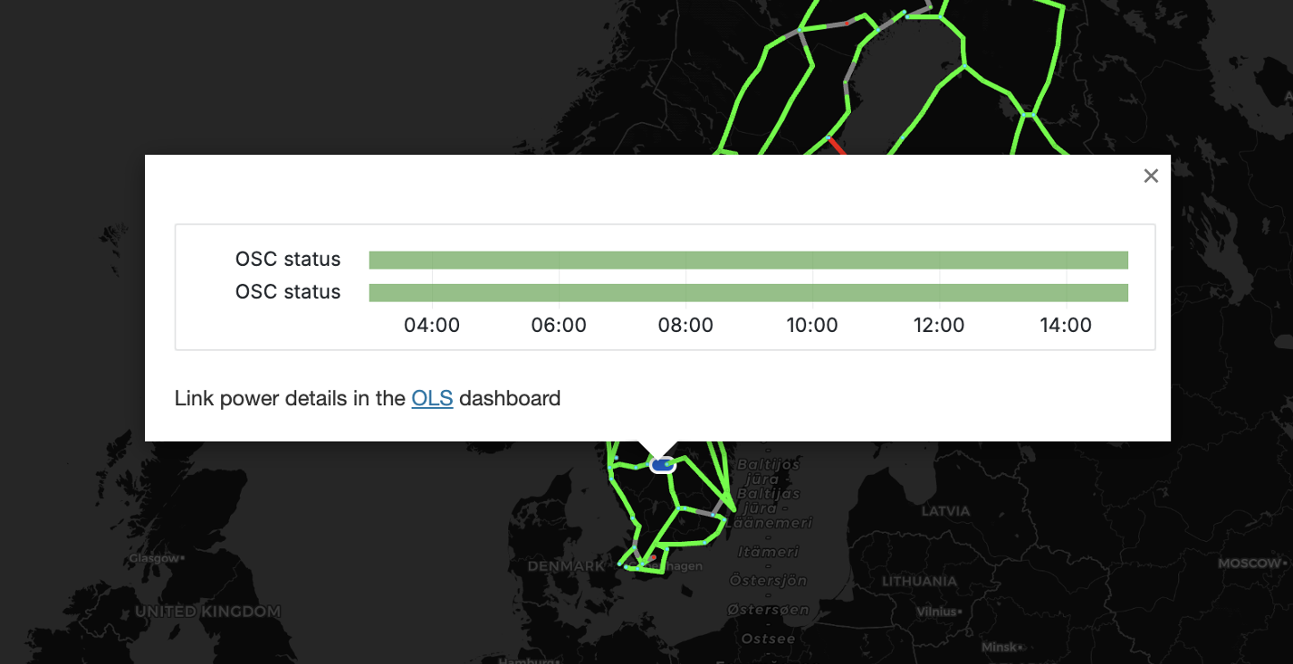
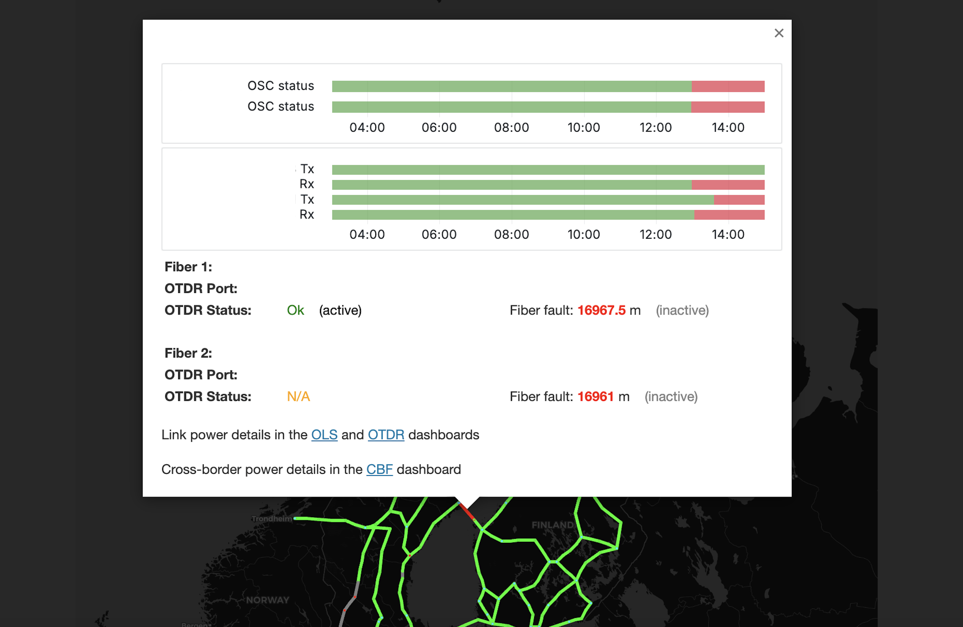
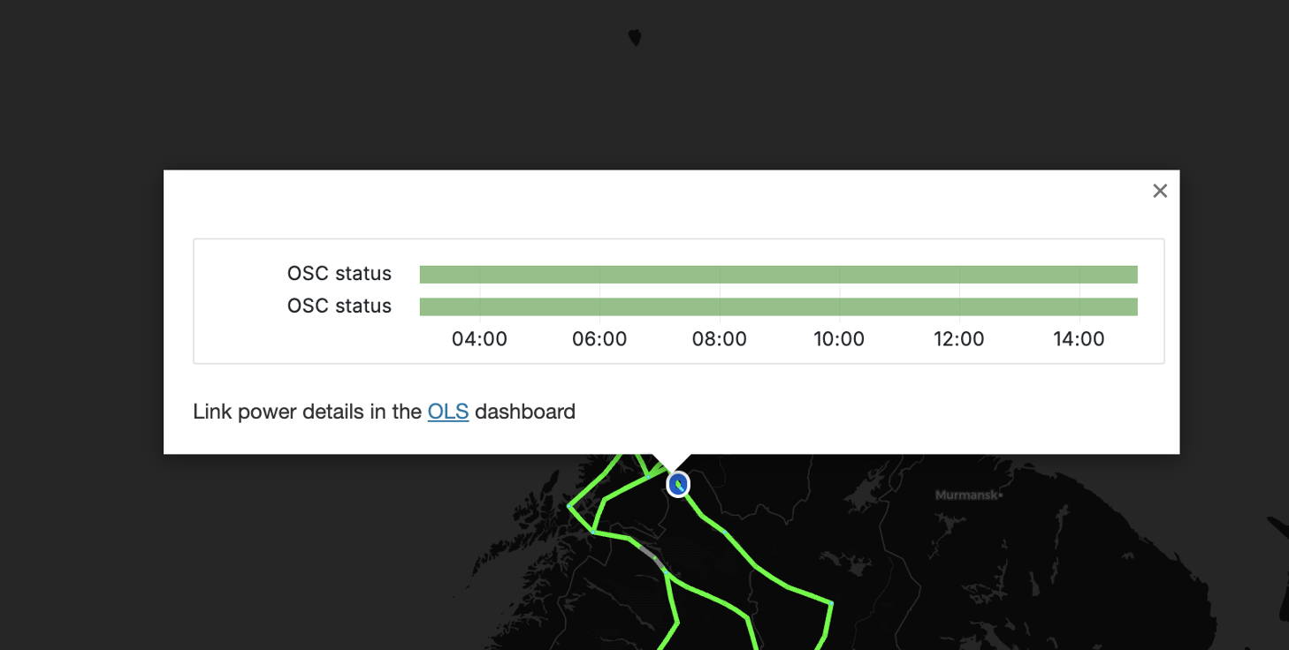

Slide 10
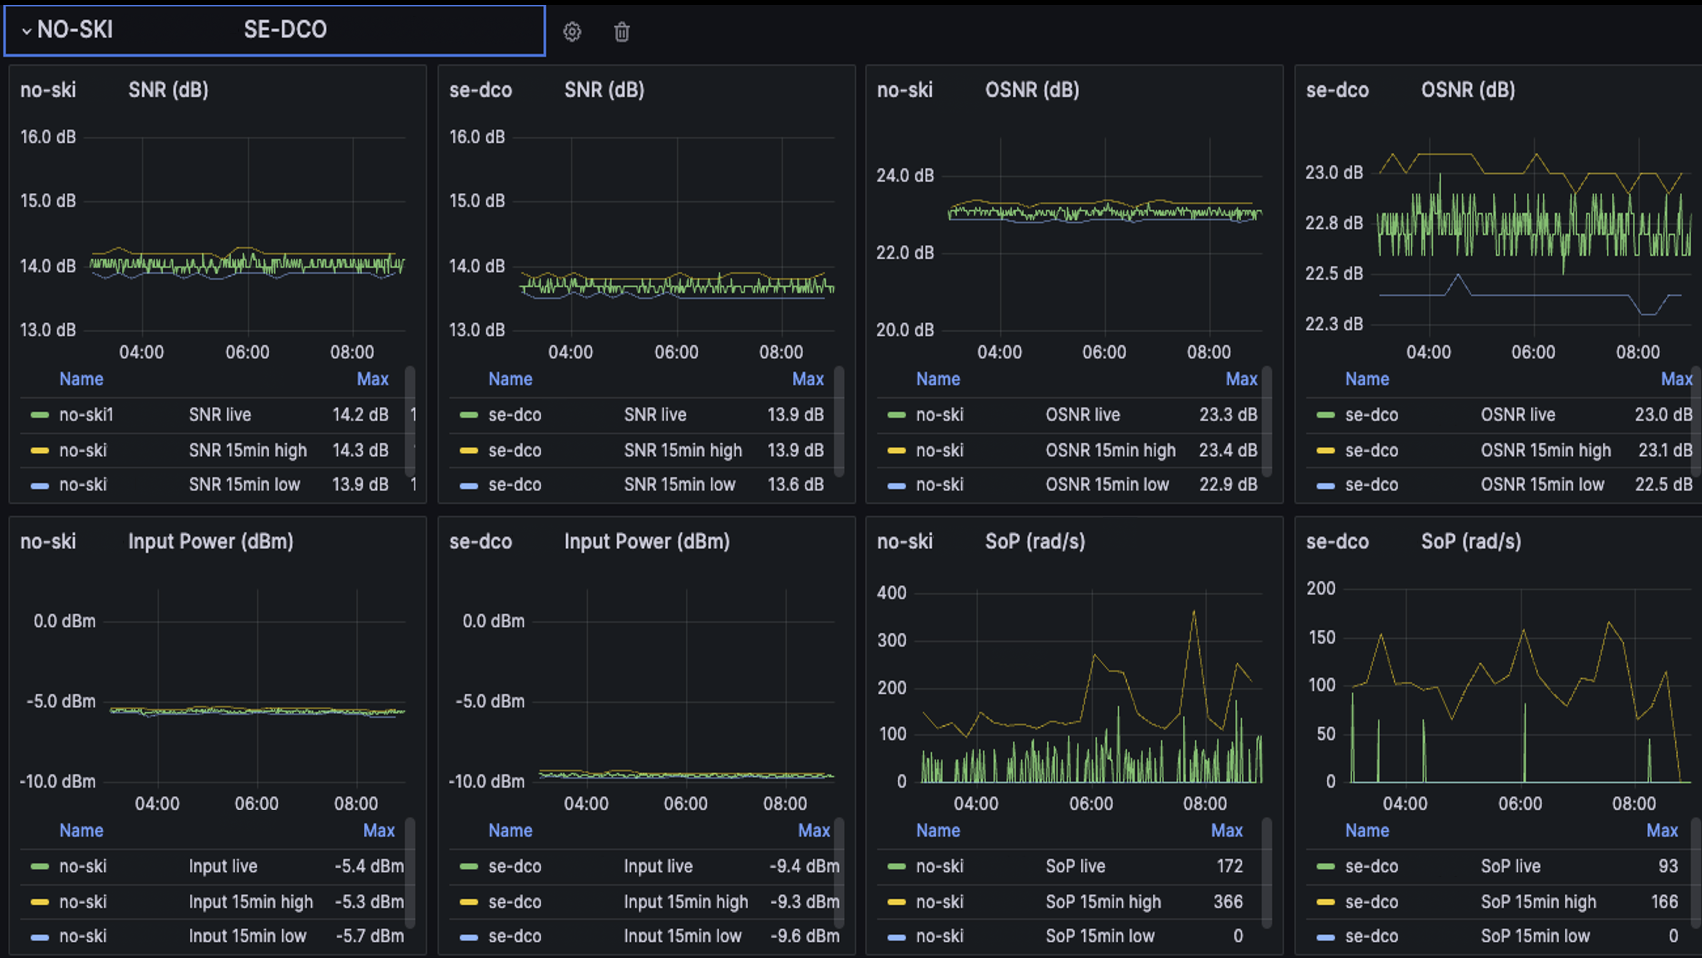
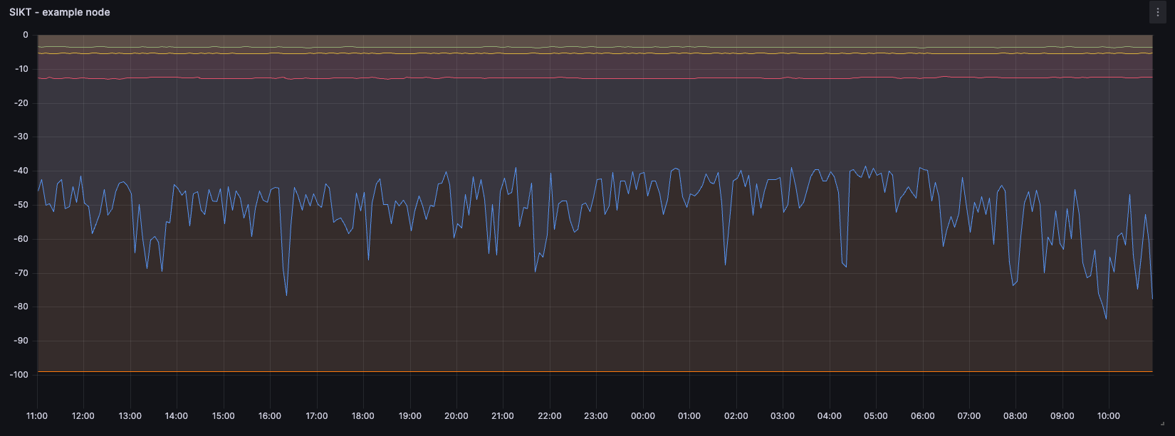

Slide 11
Lessons learned
Colaboration
Capacity
Notes:
SSO
Sharing more data points

Slide 12
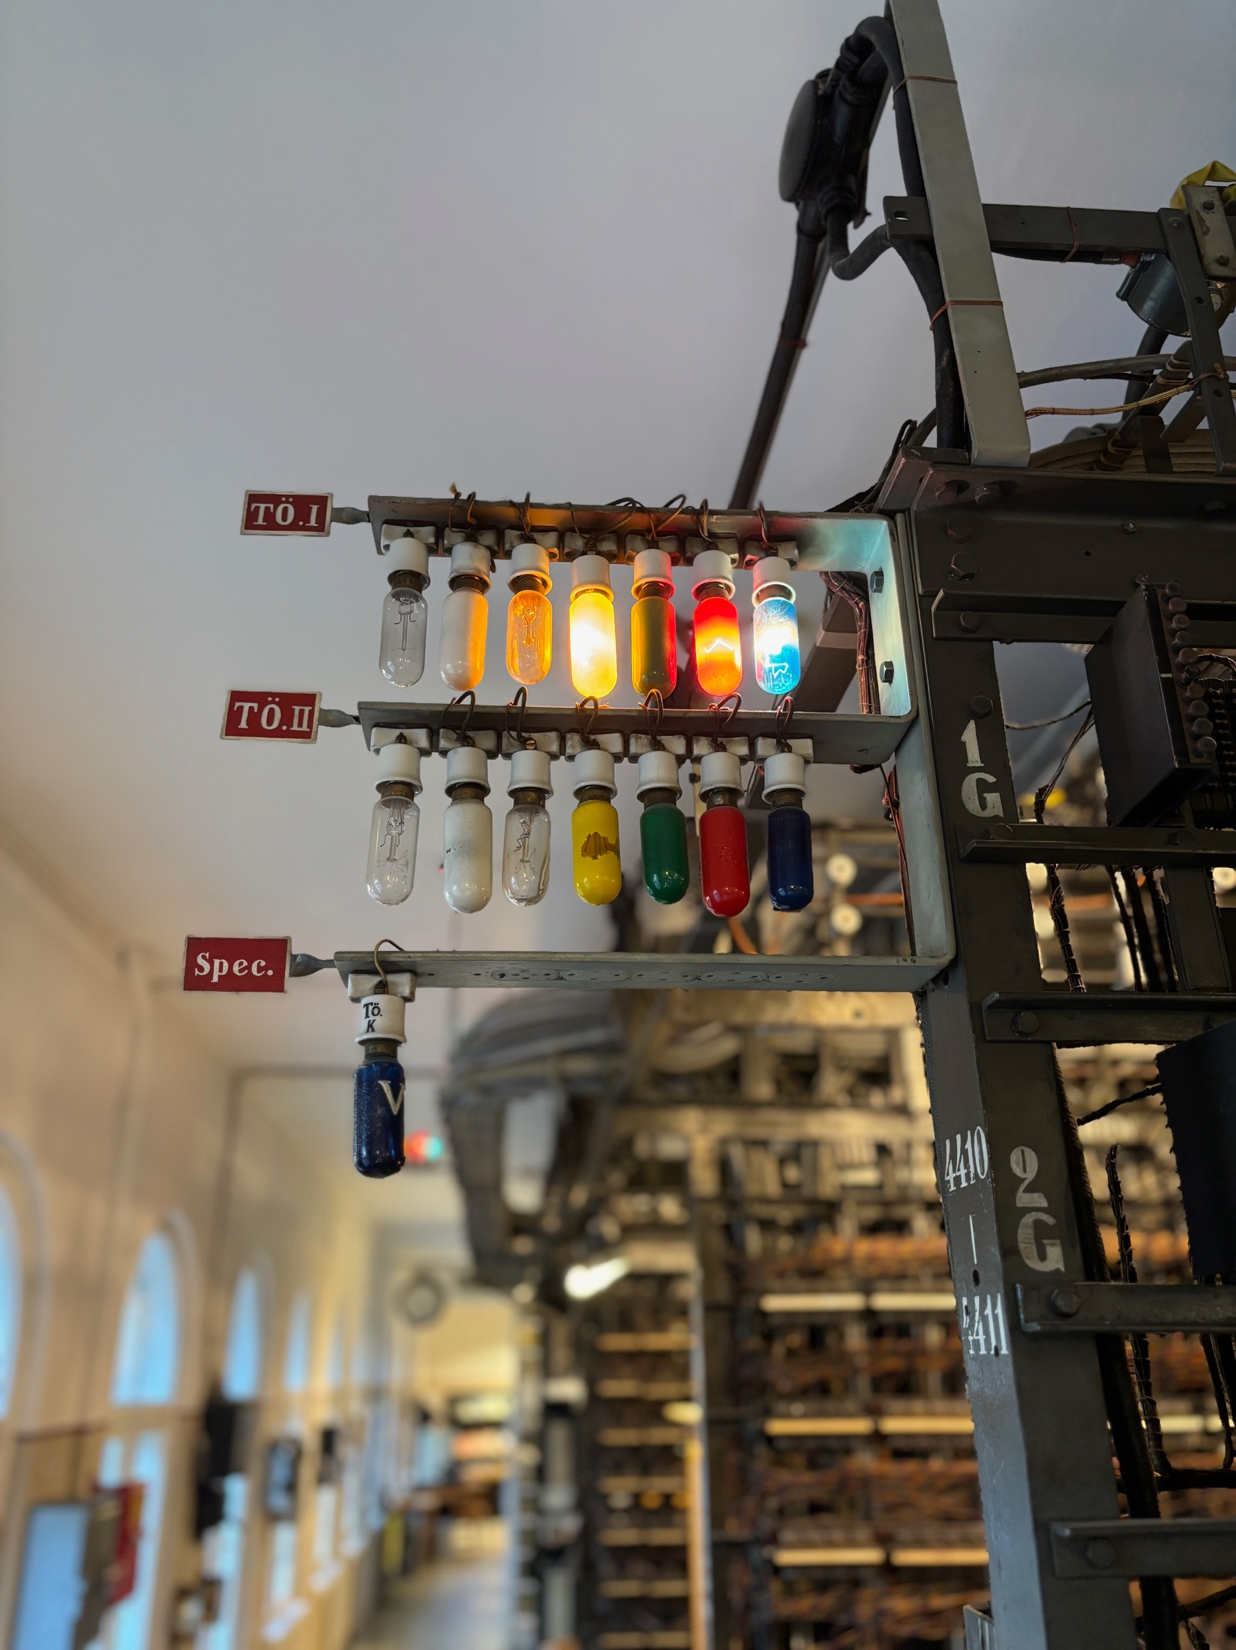
Notes:
You could say we built another lightbulb system
This image from Telephone Museum in Finland

Slide 13
Questions

