Slide 1


Challenges to implementing an ISMS at Jisc
Dr John Chapman
Director information security, policy and governance
Notes:
Jisc – one of the largest NRENs with more than 1400 staff, delivering more than just connectivity and security – more than 130 different services. Massive range of skills and information security awareness
Image generated by Adobe Firefly AI

Slide 2
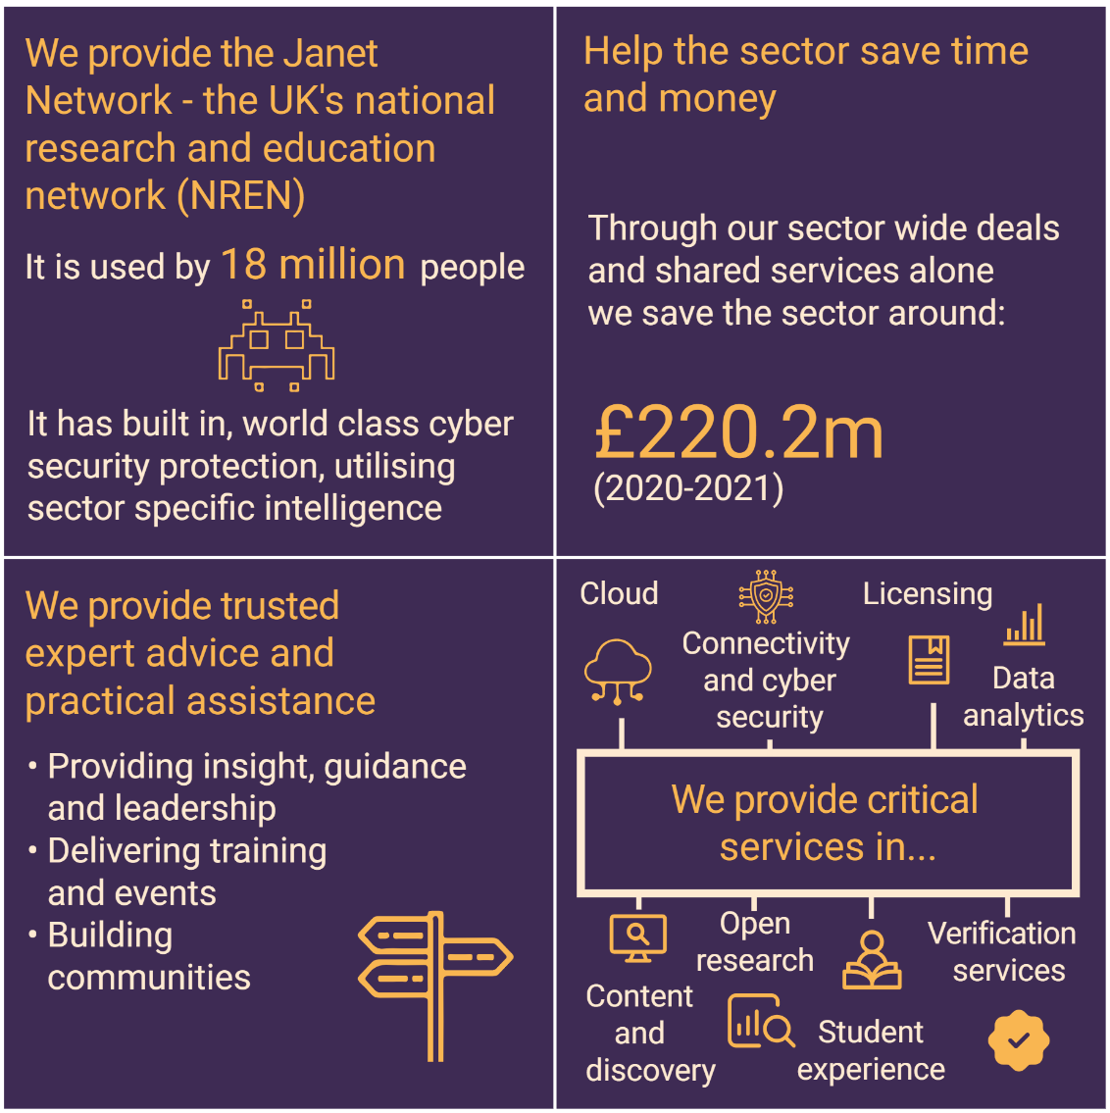

About Jisc
Notes:
Jisc – one of the largest NRENs with more than 1400 staff, delivering more than just connectivity and security – more than 130 different services. Massive range of skills and information security awareness
Image generated by Adobe Firefly AI

Slide 3

Standards & certifications
ISO 9001 - Quality Management
  Providing products/services that meet customer requirements and delivery satisfaction.
ISO 27001 - Information Security
  Protecting the confidentiality, integrity and availability of information.
Cyber Essentials – protection against a wide variety of the most common cyber attacks.
(ISO 14001 – environmental management)
(ISO 22301 – Business continuity management)
…
Cyber Assessment Framework - high level framework developed by NCSC. Used by operators of essential services under the Network and Information Systems regulations as well as more widely across the private sector, including Critical National Infrastructure (CNI) sectors.
Telecoms Security Act security requirements - places strengthened telecoms security duties on public telecoms providers, providing new powers for the government to set out specific security requirements and issue codes of practice, and giving Ofcom new tools and responsibilities to ensure industry compliance.
Notes:
Where we started: Quality – good foundation for introducing information security
Image generated by Adobe Firefly AI

Slide 4
Why achieve Jisc-wide ISO certification?
Follow policies, processes and procedures
Activities conducted in a consistent manner
Desired outcome achieved
Products/services delivered as expected
ISO 9001
Quality management
Improved information security
Consistency and increased efficiency
Competitiveness
Increased staff awareness
Risk mitigation & identification
Meeting statutory & regulatory requirements
Continual improvement
Streamlining of external audit activities
Satisfaction
ISO 27001
Information security management
Information protected
“It gets everyone thinking about information security, how we implement and maintain it - especially people managers.”
“ISO is a good lens through which to examine existing processes and procedures, to identify where action may be required”
”Identifying and addressing areas of improvement as a result of ISO expansion activities”

Slide 5

Processes
Introduction & expectation setting with stakeholders
Scoping
Required process documentation identified and created
Information security activities completed (e.g. risk treatment)
Gap analysis and verification activities
Additional work and awareness activities
Internal audit
Completion of internal audit actions
Ready for external audit
Services & activities
Working parties agreed
External audit
Maintain and continually improve - BAU
Certification

Slide 6

Challenges
Scope
Multiple standards & certifications
Lots of documentation
Organisational changes and mergers
Internal audits
External audits
Not just box ticking
Changing standards
People
Legislation
14 days of external audit starting on Monday 😬
Notes:
Cyber Essentials / ISO27001 / Cyber Assessment Framework (GovAssure) / Telecoms Security Act.
2 projects = align our ISO9001 and 27001 scopes – to then share audits. Easier, less time and money. ISO expansion – get a whole Jisc certification (or at least compliance).
Image generated by Adobe Firefly AI

Slide 7

Benefits
Company-wide mechanism to pick up areas of concern or system failures
Systematically identify risks
Mitigate against potential regulatory breaches and incidents
Increased adherence to key internal policies and processes
Reduces poor practice, duplication and inefficiencies
Increases engagement and awareness of information security and quality
External audit findings help deliver change
Ability to bid for work requiring ISO9001/27001/CE
On the front foot for legislative changes
Notes:
Started from a desire to improve. Now moving towards desire to do things methodically and not be surprised by external intervention
Image generated by Microsoft Copilot’s AI

