Slide 1
eduroam CAT new features update
Tomasz Wolniewicz
Poznańskie Centrum Superkomputerowo-Sieciowe (PCSS)
Poznan Supercomputing and Networking Center
Mobility Day – TNC25, Brighton, 9.06.2025
Public (PU)

Slide 2
Selected new features in CAT since the last Mobility presentation
new version 2.2 to be released during summer (new translations in the admin area) – it is now available for testing at cat-test
removed dependency on eduroam DB v1 – it is fully v2 now
new hints in the admin area – partially on production
new function of self registration of institution admins (in two variants) – not on production yet
new function of creation of new CAT institutions by eduroam DB institution admins – not on production yet
improved RADIUS/TLS certificate management for NRO – partially on production
added IdP realms, institution acronyms and alternative names to DiscoJuice keywords, so now you can select IdP by typing them in – partially on production
new profile sorting feature
new profile duplication feature
new monthly download statistics – partially on production
added support for ARM processors in Windows installers
multiple additions to the linux Python installer (mainly additions provided in GitHub by users):
  new tinker part of the linux installer (extends the current list of zenity and kdialog)
  added --gui flag to the linux installer (mainly for testing)
  catching more exceptions on module import
  improving behaviour on missing python module
multiple improvements in Managed SP are (separate presentation by Maja) – not on production yet

Slide 3
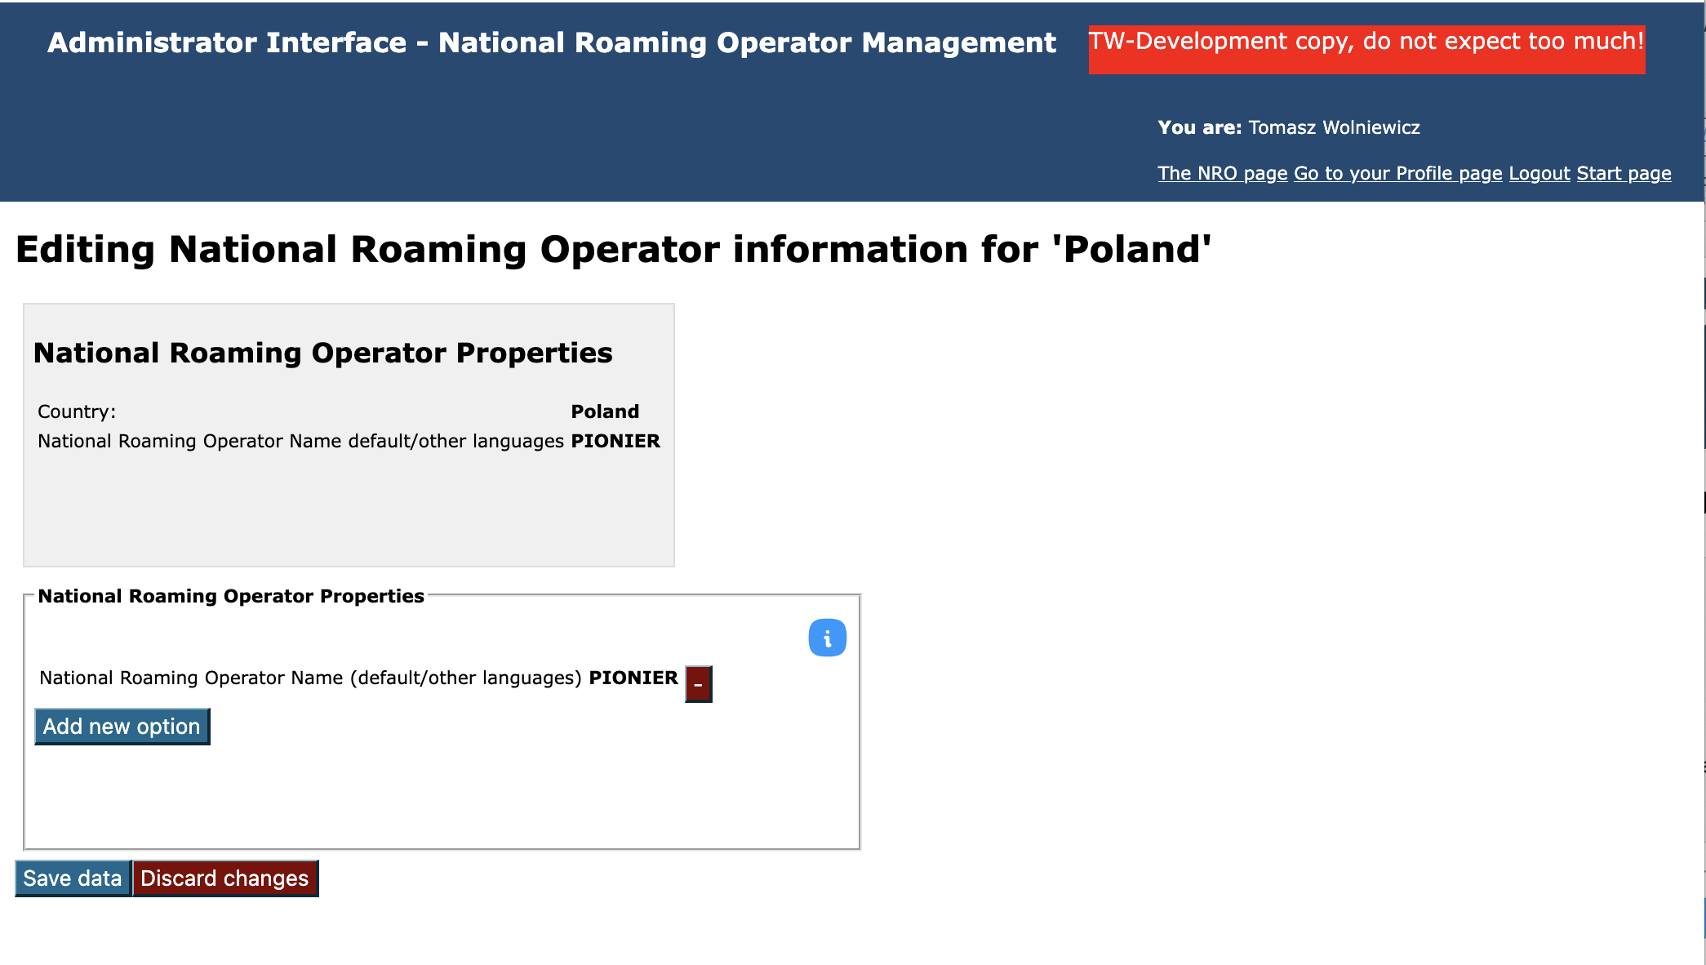
Hints in the admin area

Slide 4
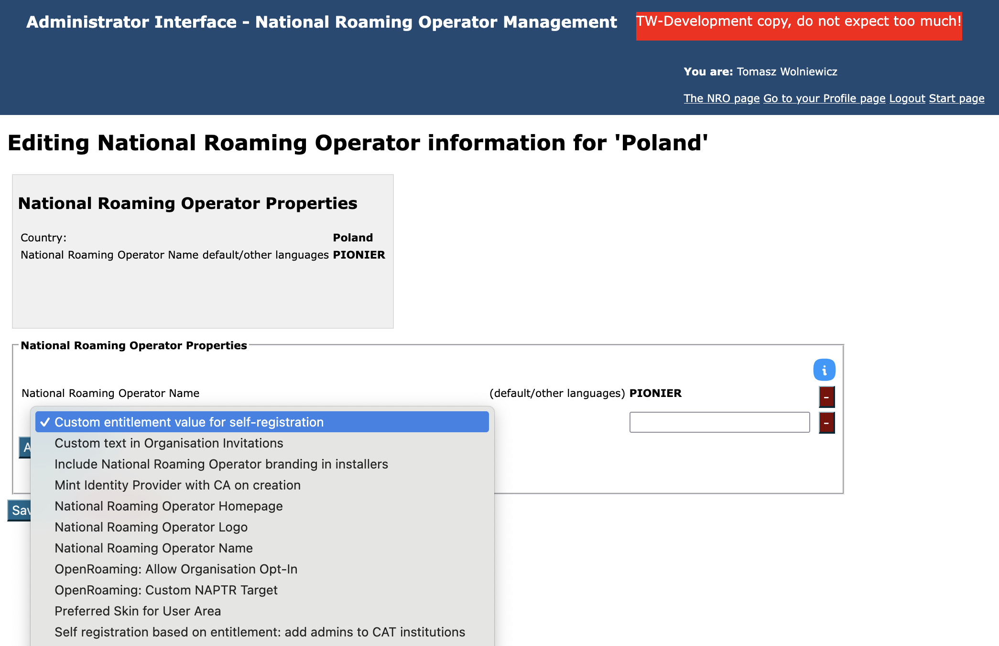
Hints in the admin area

Slide 5

Hints in the admin area
If you feel lost what the options are for
then just click the icon

Slide 6
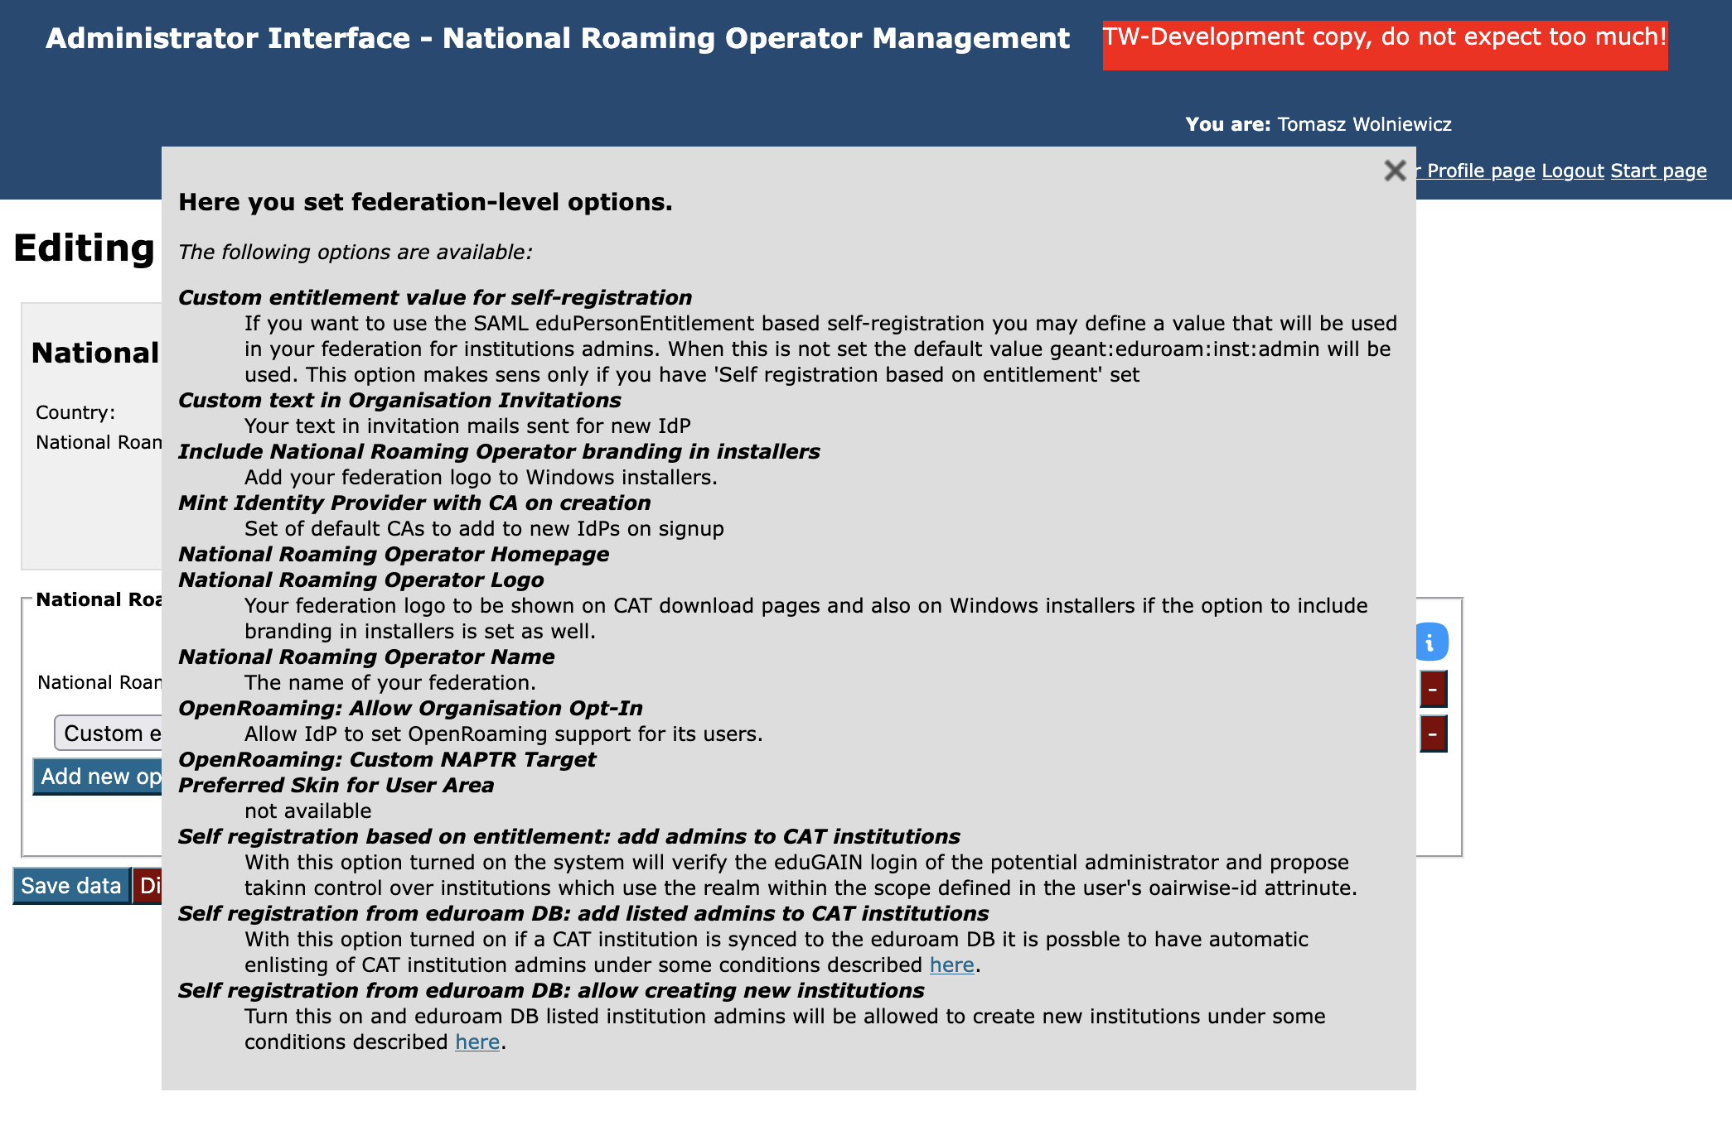
Hints in the admin area

Slide 7
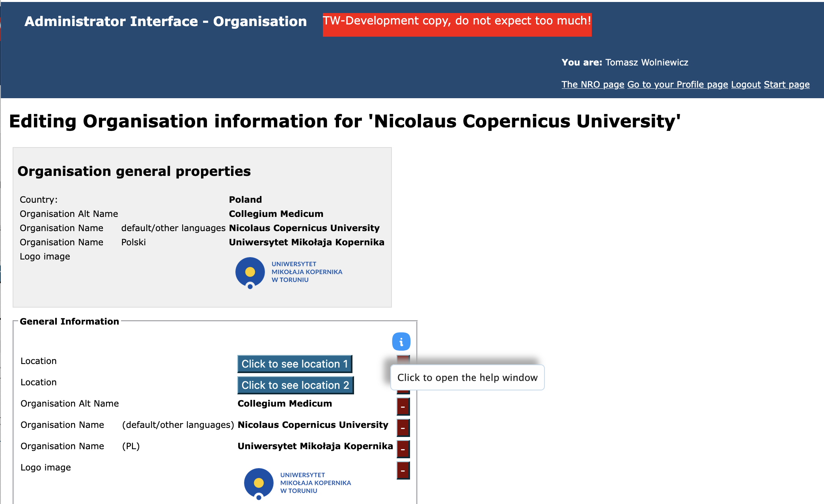

Hints in the admin area

Slide 8
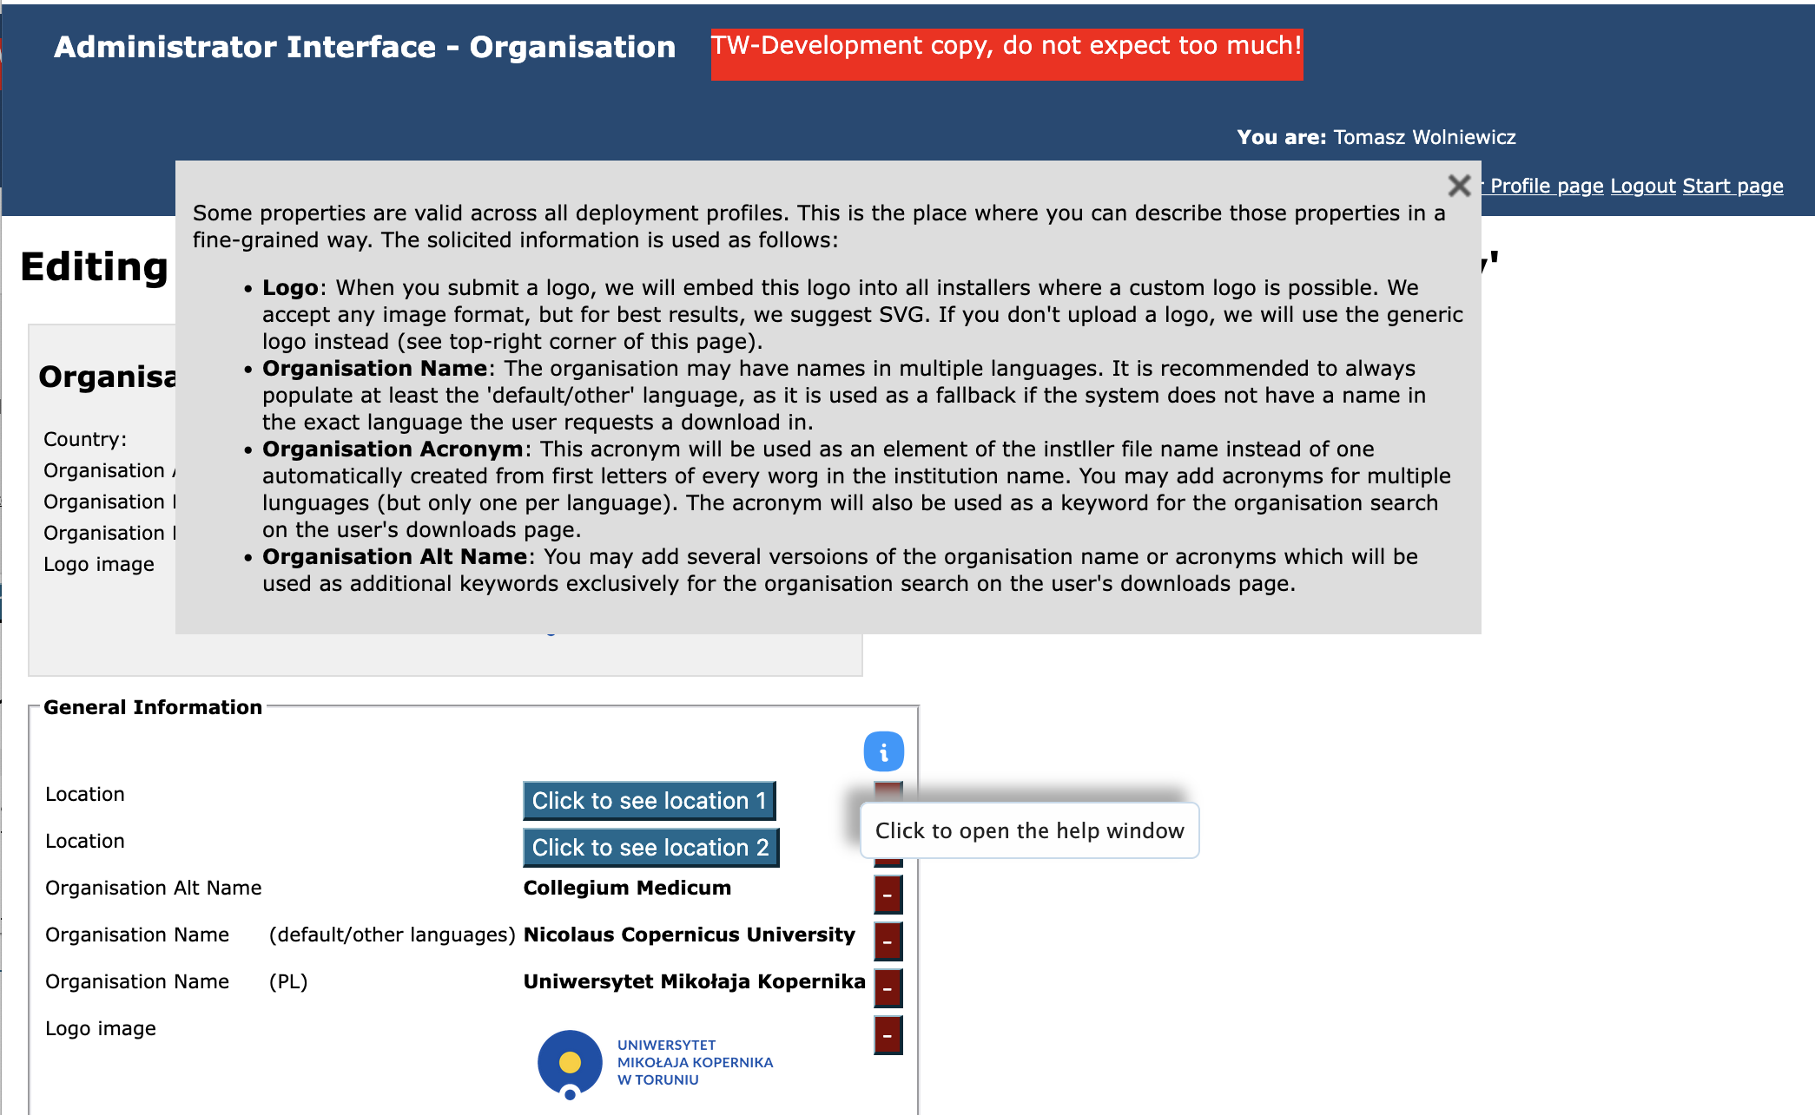
Hints in the admin area

Slide 9
Self registration of admins and creation of new institutions in eduroam CAT based on data from eduroam DB
It really makes a lot of sense to keep the eduroam DB up to date and complete including realms and administrator emails and synced with CAT
The prerequisite for this type of self registration - the potential admin must log in with an eduGAIN registered IdP
There are two NRO options that can be set independently
  Self registration from eduroam DB: add listed admins to CAT institutions
  Self registration from eduroam DB: allow creating new institutions
With any of the options above set, when a user meeting the prerequisite logs in:
  the user’s email address is retrieved from the SAML login
  a list of all eduroam DB institutions which have this email listed as the admin email is created

Slide 10
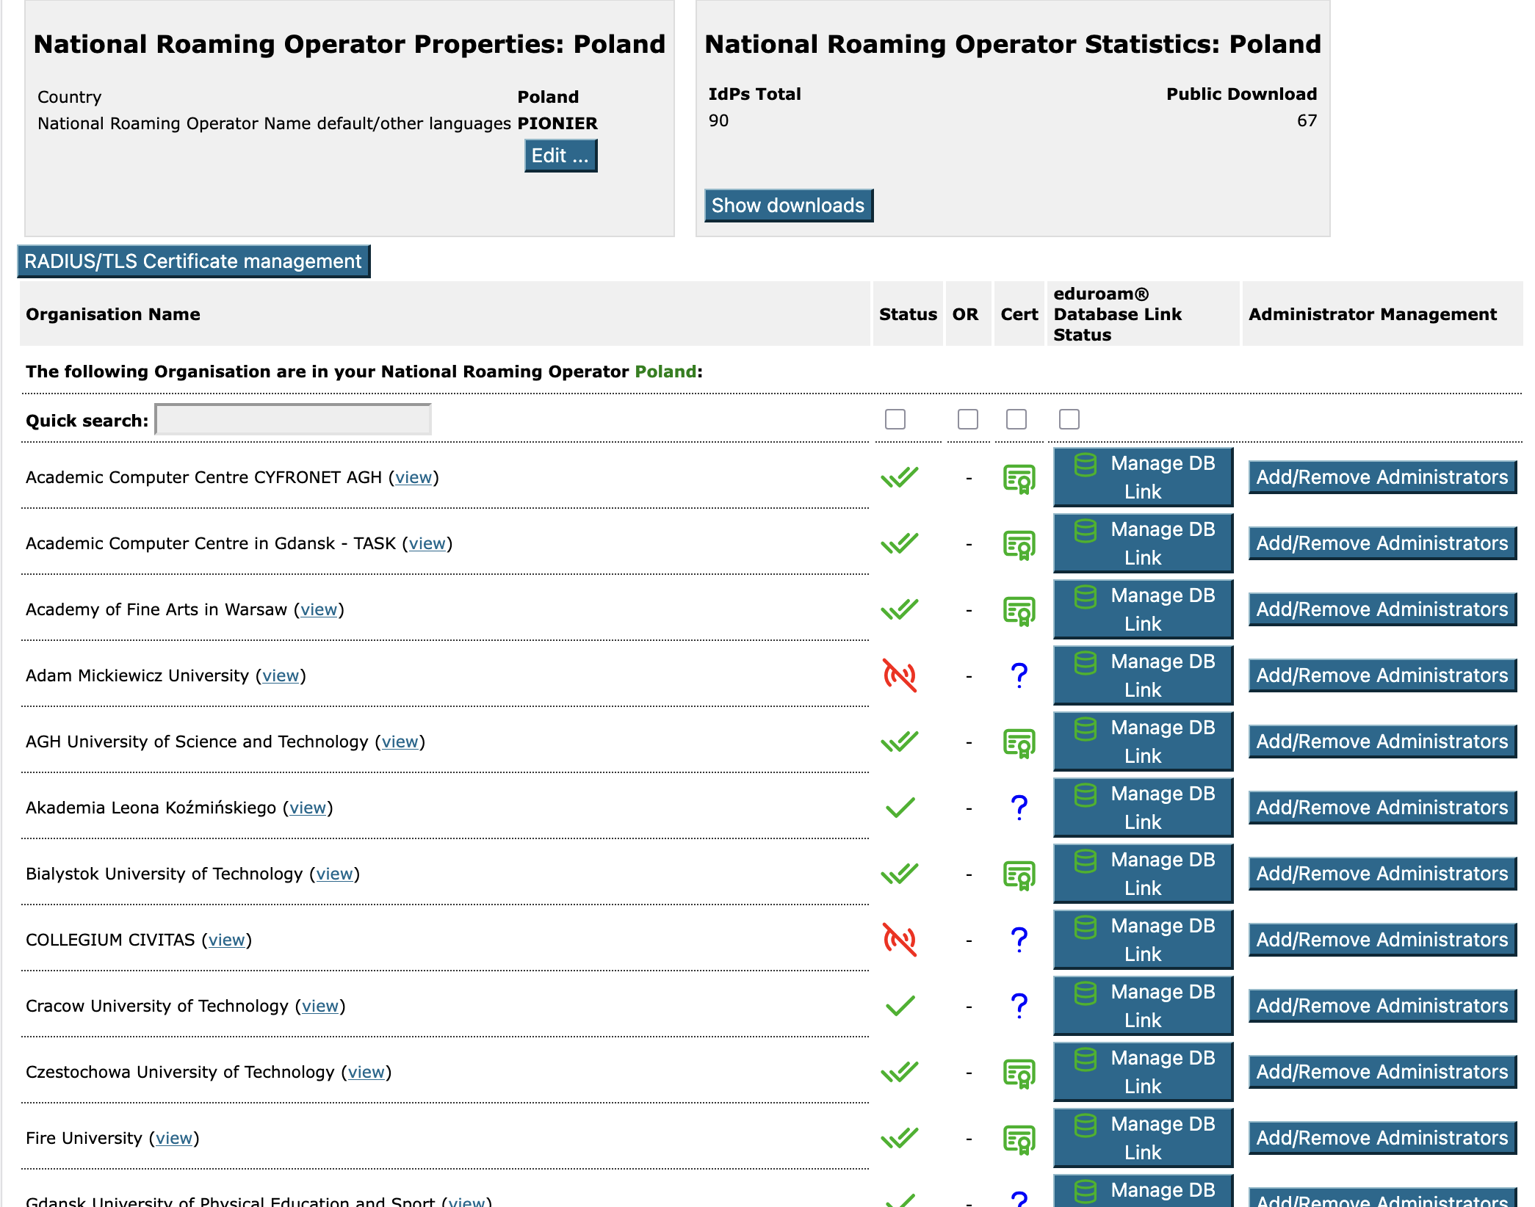

Slide 11
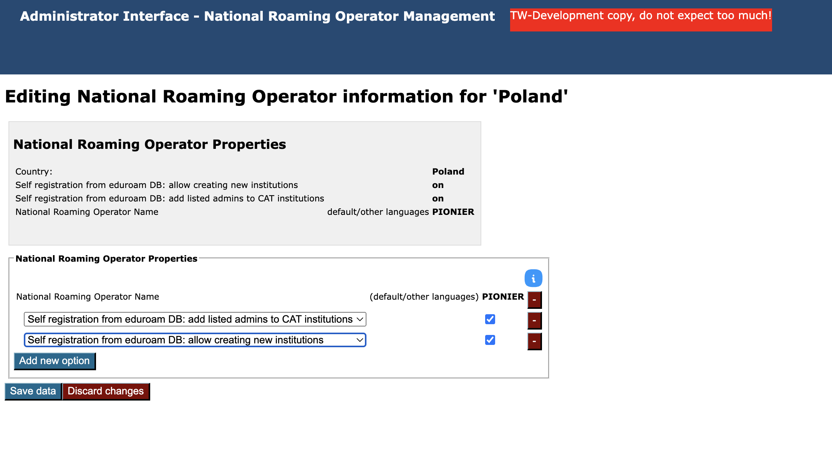
We start by adding both relevant NRO options

Slide 12
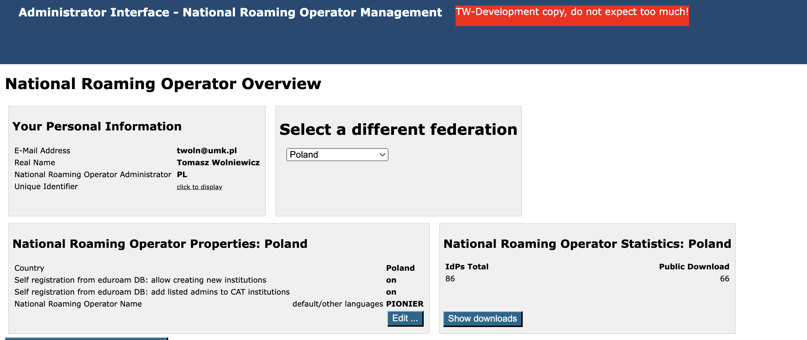

Slide 13
Add eduroam DB listed admins to existing CAT institutions
The CAT institution MUST be synced to its eduroam DB equivalent
Example use cases:
  new institution admin has been hired and is now listed in the eduroam DB
  situations where the admin’s SAML IdP details have changed (like the entityId) or the IdP changed the policy about sending eduPersonTargetedId
  the admin switched from using a last-resort central SAML IdP or Google /Facebook to the local IdP run by the institution
How it works
  From eduroam DB we retrieve a list of institutions for this admin (based on admin’s email)
  We check the list for any entries where there exists a synced CAT institution, but this admin’s SAML Id is not listed in the „owners” list for this CAT institution
  The admin’s SAML Id is automatically added to such institutions
  The information that this has been done will appear at the bottom of the admin’s profile page
NOTE. It could, in principle, happen that the admin’s email is listed in institutions in several national federations. In such a case multiple lists will be created and the NRO options will be checked separately for every of the federations in question.

Slide 14
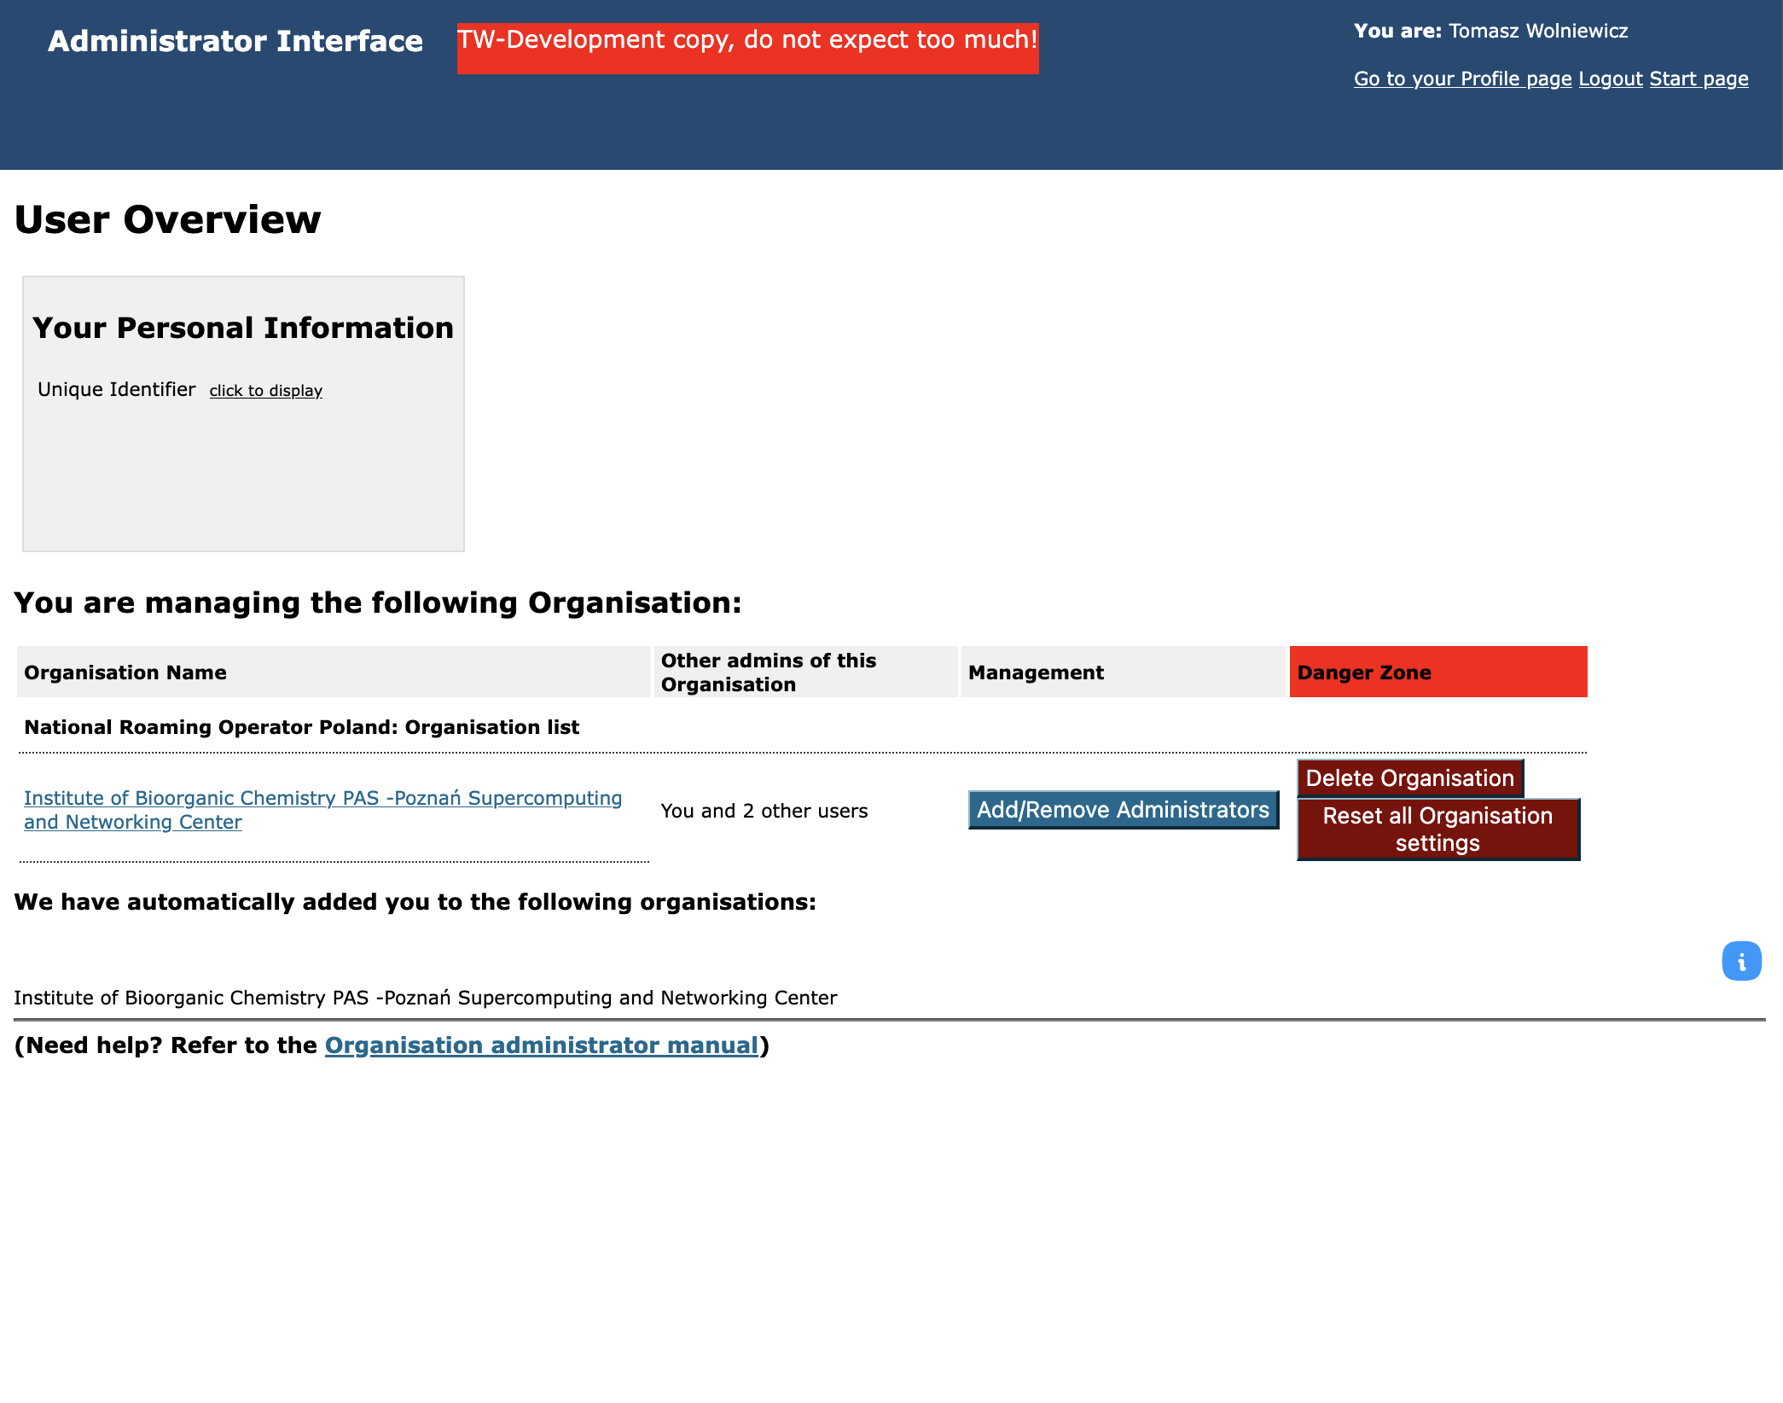

Slide 15


Slide 16
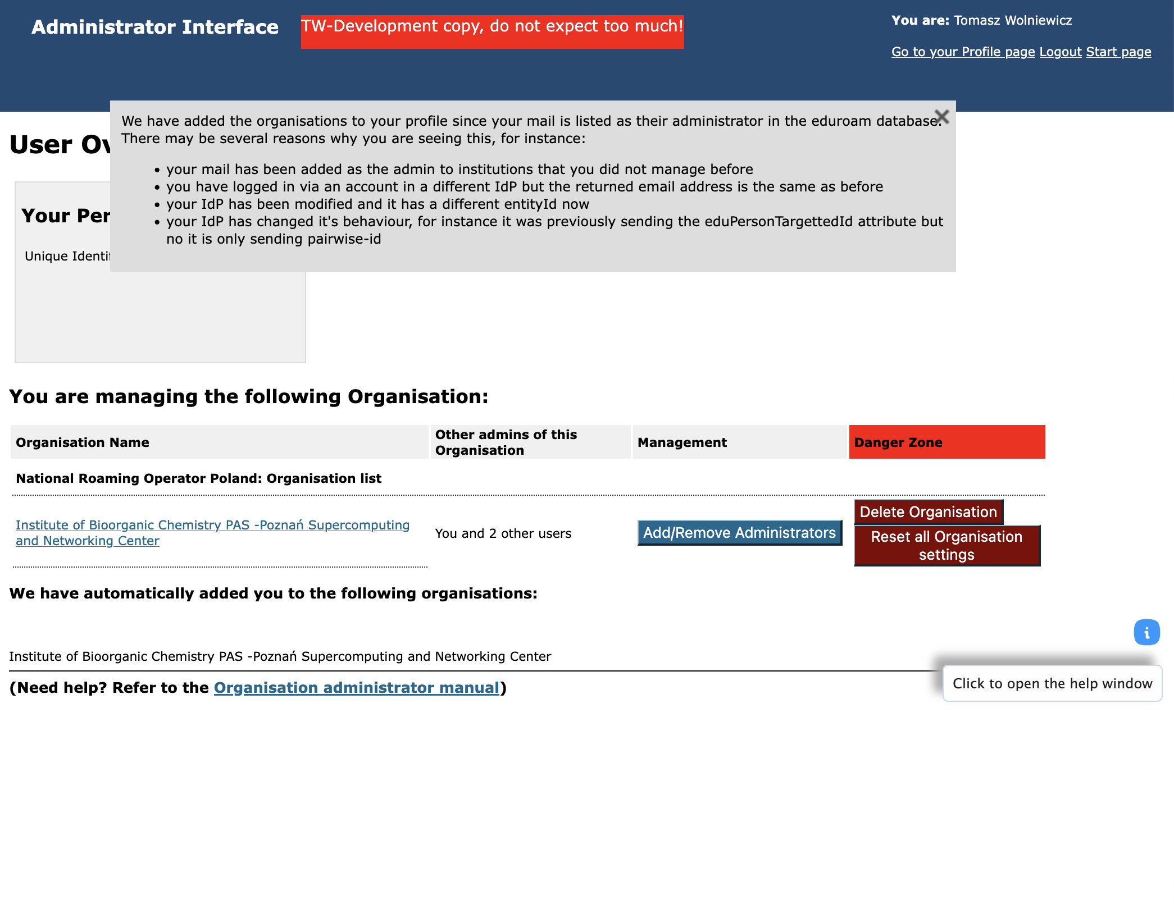

Slide 17
Create a new CAT institution
From eduroam DB we retrieve a list of IdPs for this admin
We check the list for for possible matches to existing CAT institutions
  First we ellimitnate cases where there already is a link between the eduroam and CAT institutions (this case should have been handled by the previous feature)
  The institution names from both databases in all languages are lower-cased and compared, also the realms listed in the eduroam DB are compared to those found in CAT profiles. If any match is found, then the entry is removed from the list of potential candidates.
The remaining entries are presented to the admin to decide if new CAT institutions should be created. If the answer is positive, then the skeleton CAT IdPs will be created and added to the admin’s list.

Slide 18
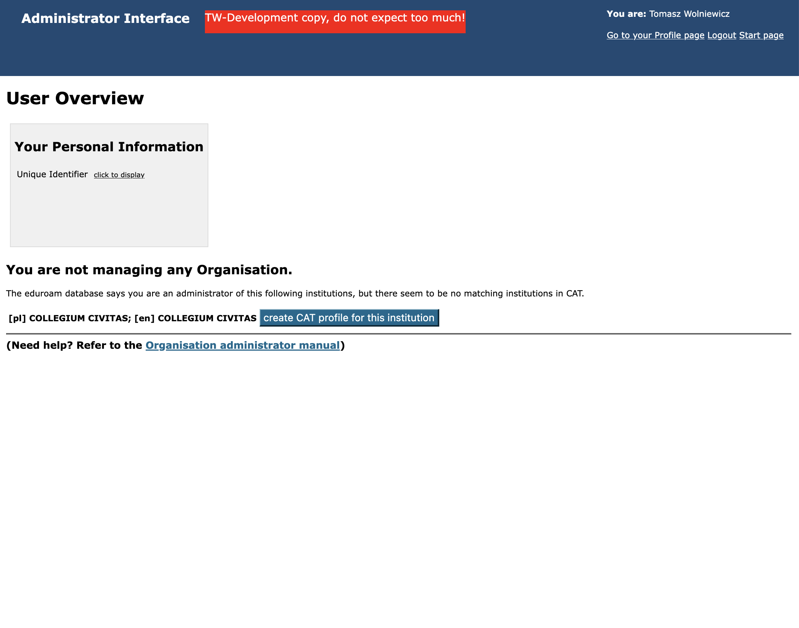

Slide 19
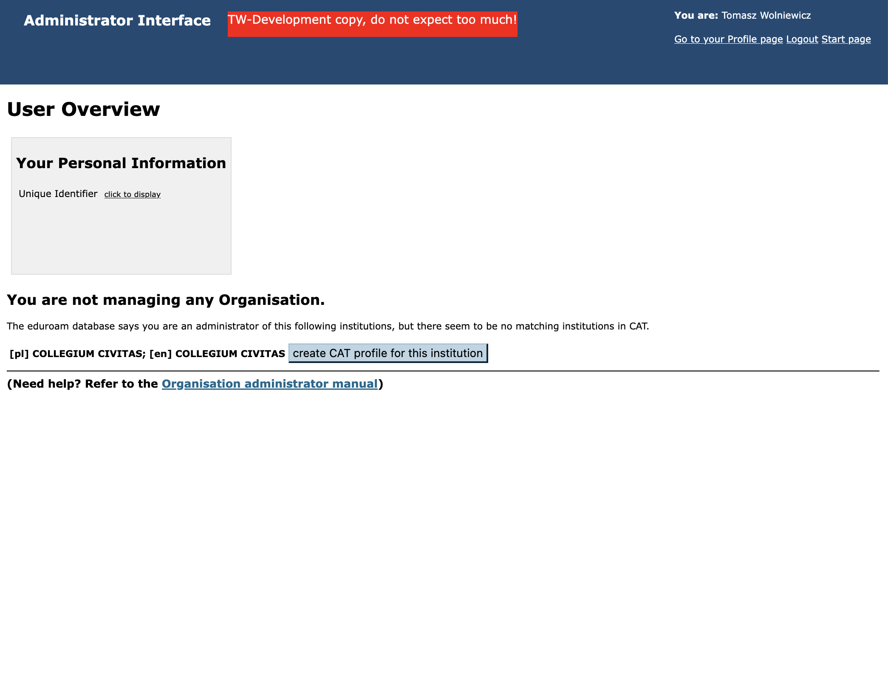

Slide 20
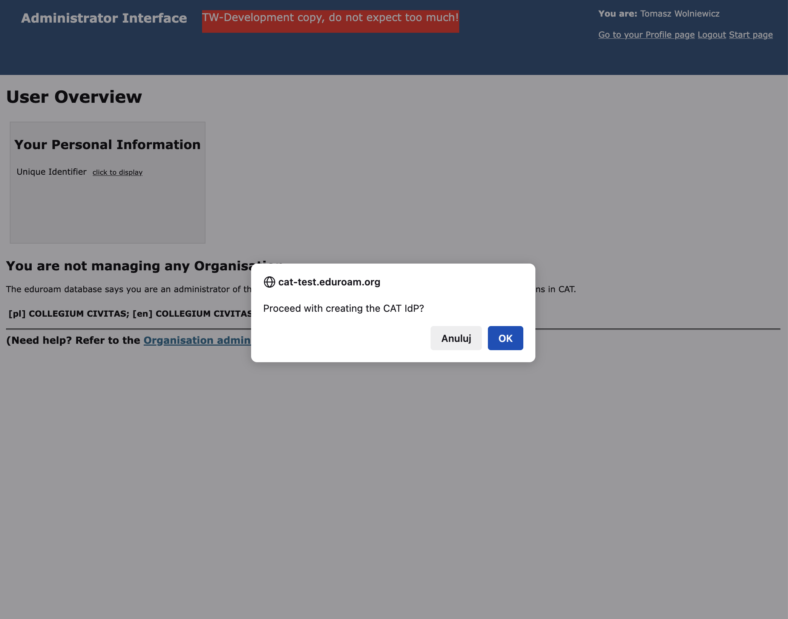

Slide 21
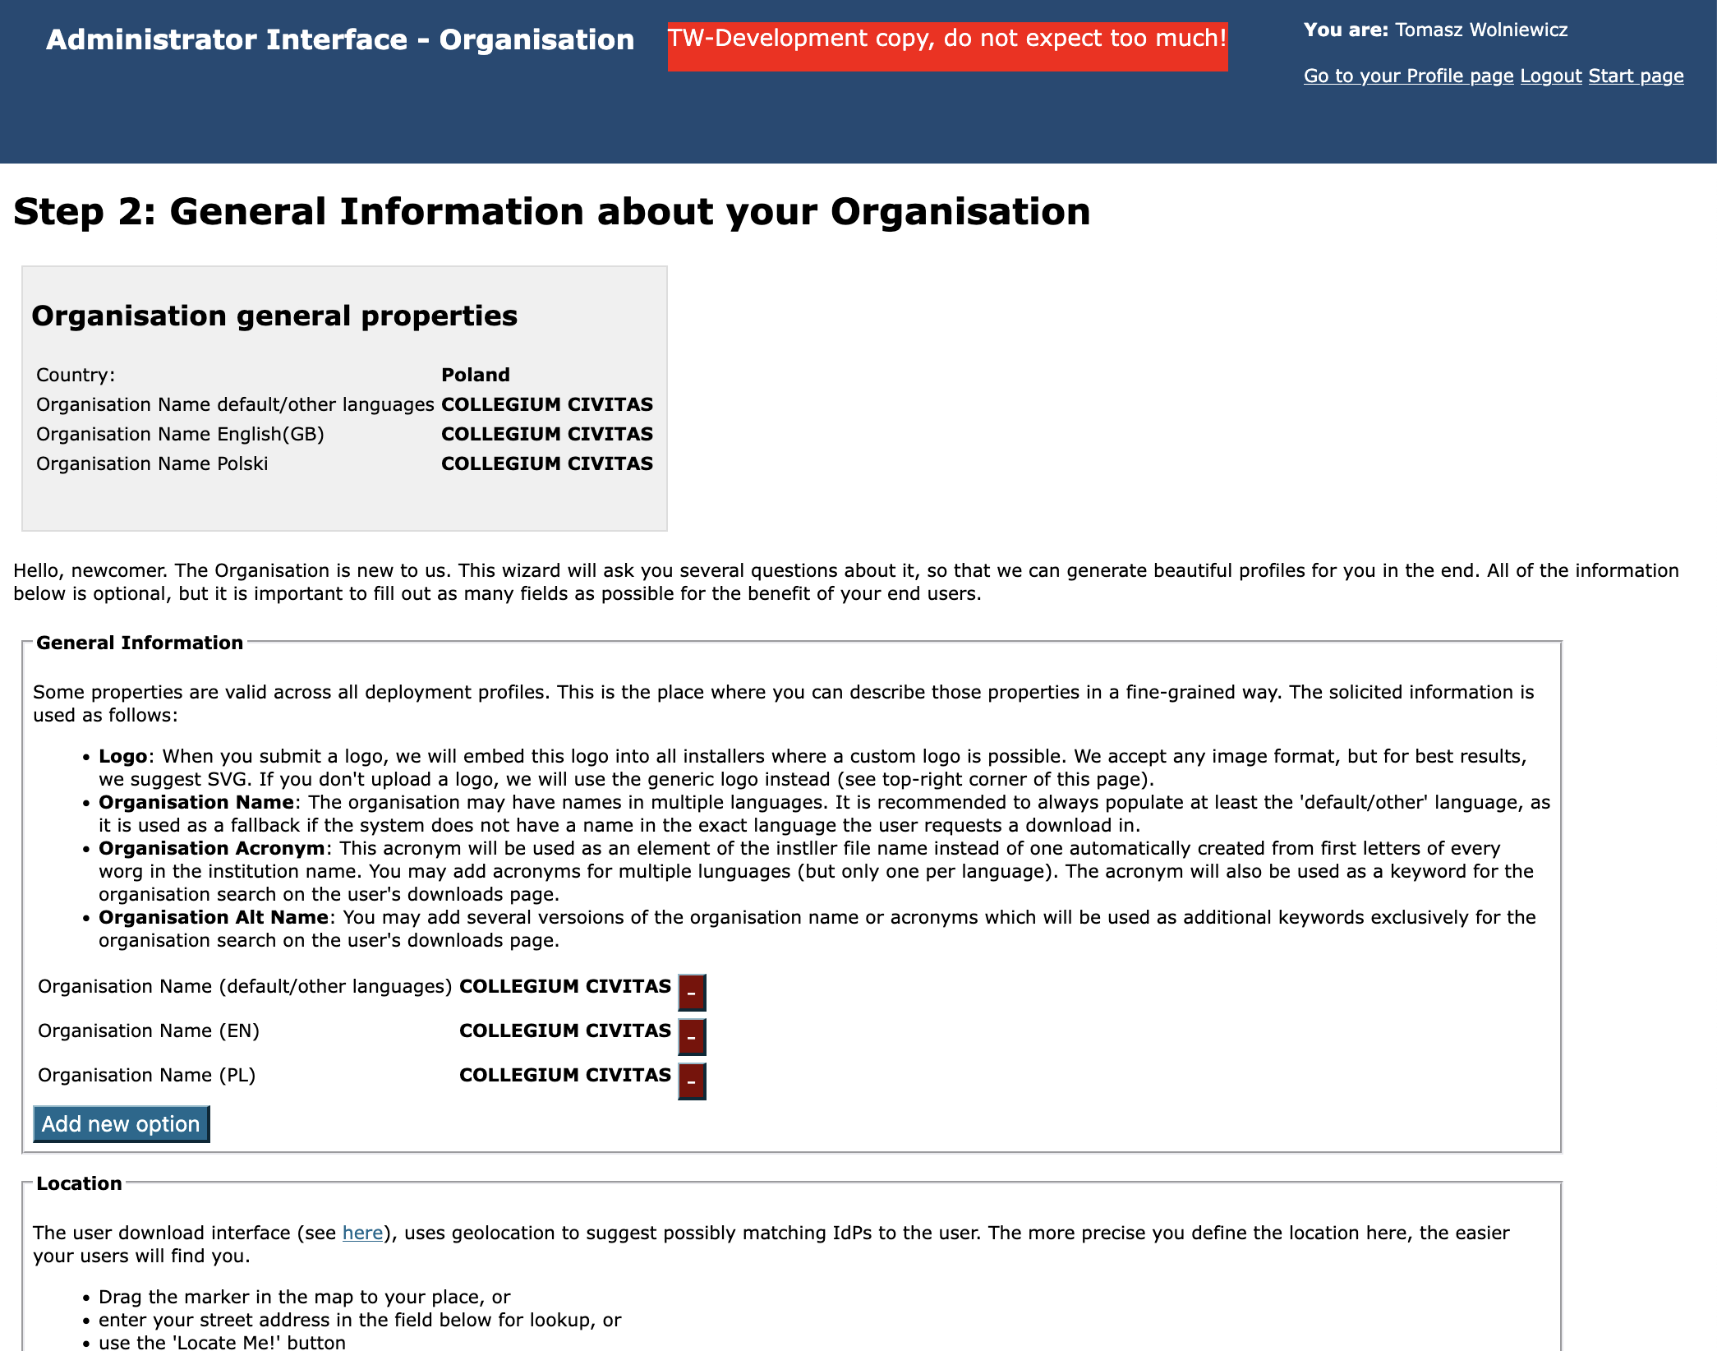

Slide 22
Self-registration based on pariwise-id and entitlement
Based on suggestions of Ralf Paffrath from DFN
The prerequisites
  the potential admin must log in with an eduGAIN registered IdP
  the IdP must provide pairwise-id attribute and not provide eduPersonTargetedID
  the IdP must provide the eduPersonEntitlement attribute with value that is either geant:eduroam:inst:admin or a federation-specific value set by the NRO
  in principle the user may present valid entitlements for more than one federation
There is an NRO option that must be set to enable this self-registration
  Self registration based on entitlement: add admins to CAT institutions
With this option set, when a person meeting the prerequisites logs in:
  the admin’s email address is retrieved from the SAML login
  the realm is retrieved from the pairwise-id scope
  CAT institutions are searched for realms within the user’s scope
  a list of proposed institutions for this admin is presented for confirmation

Slide 23
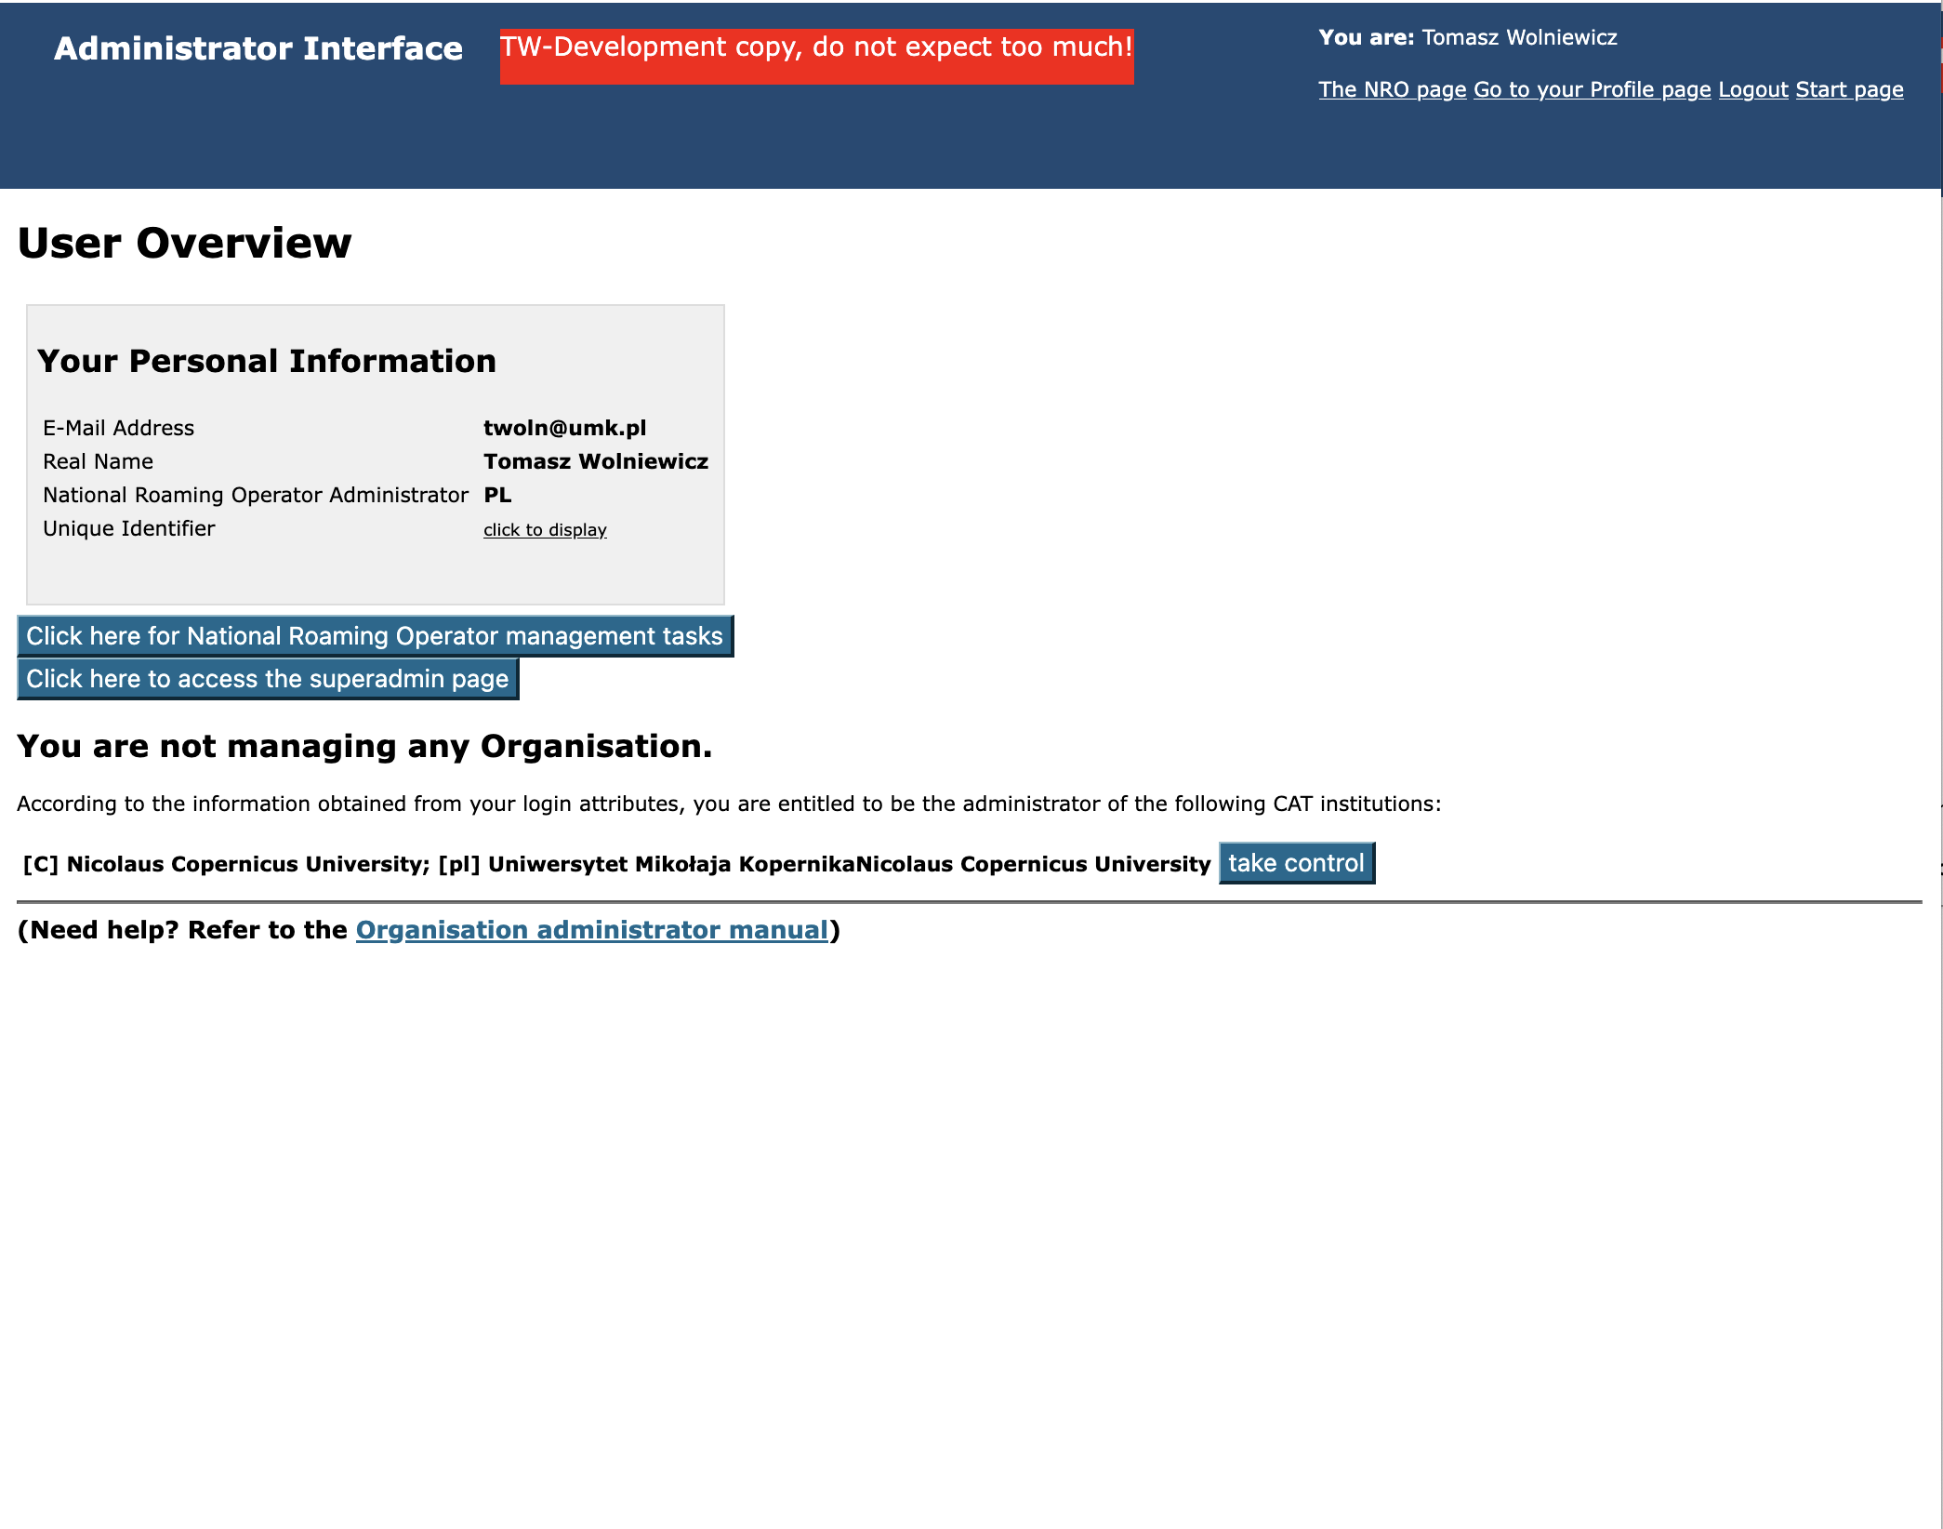

Slide 24
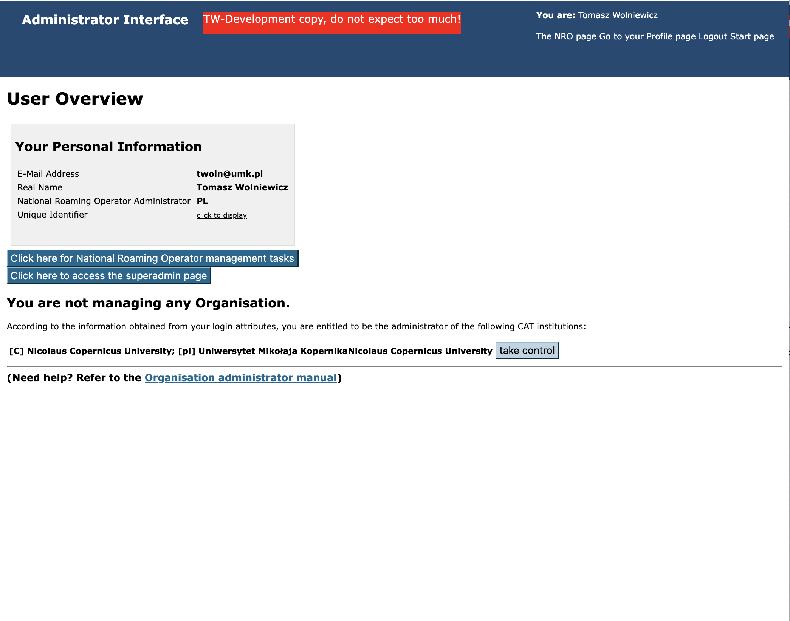

Slide 25
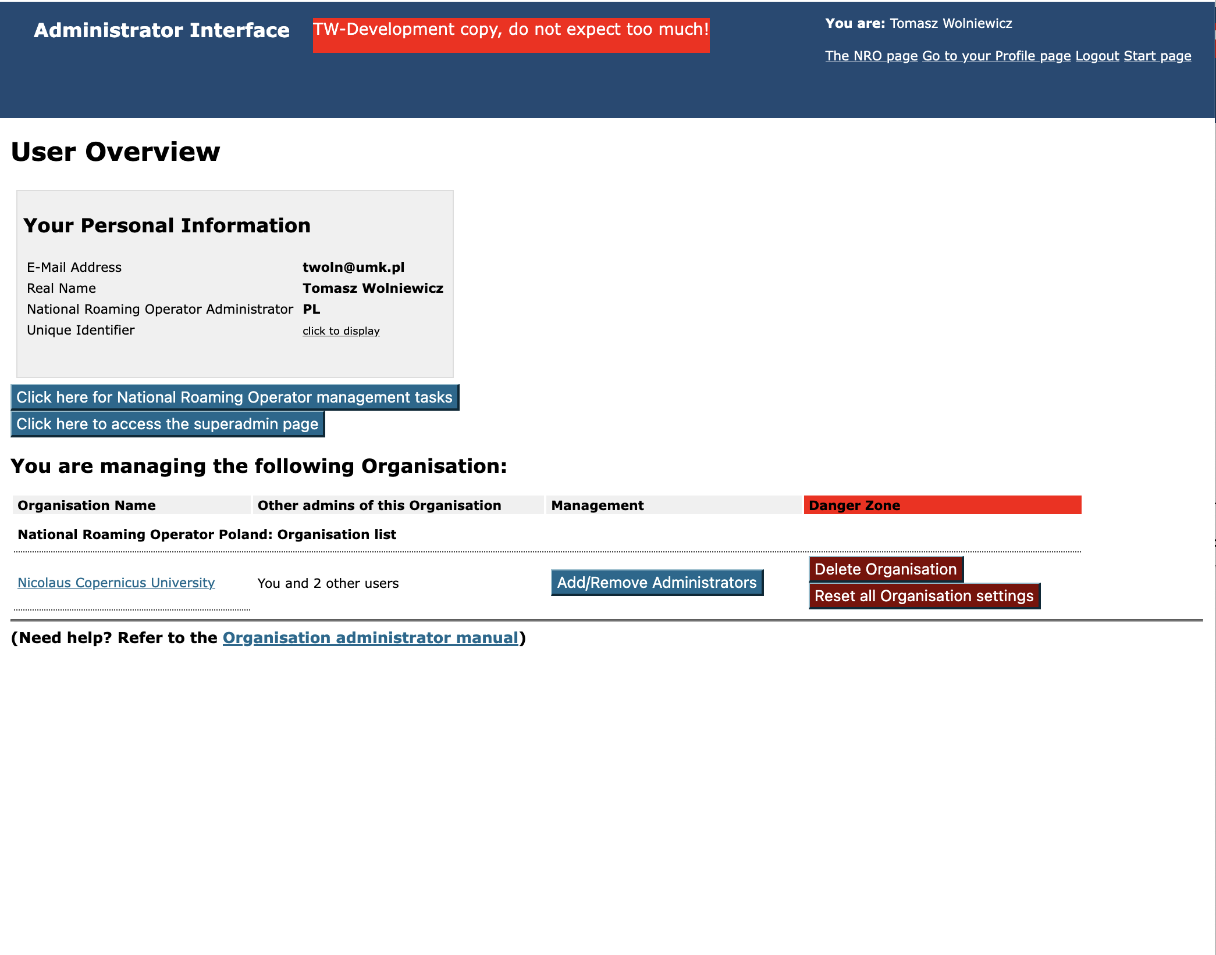

Slide 26
Some security considerations
We have to trust eduGAIN, in particular
  Federation operators verify that scopes listed in IdP metadata are restricted to domains registered for the given organisation
  Using eduGAIN technical API we can pinpoint the authenticating eduGAIN API to the master eduGAIN federation and from there to the list of countries it serves, this is then mapped to eduroam countries so an admin from country X will not be able to register in CAT institution from a country not served but the home eduGAIN federation
The scope passed as the part of pairwise-id is checked against the scopes listed in the metadata verified by the Federation, therefore the IdP cannot just add another organisation’s scope
The realms entered into CAT profiles must be limited to those owned by organisations
If a given federation does not allow a certain type of self-registration method, then it will never be applied “by mistake”
For entitlement-based self-registration we do not have enough certainty to propose creation of new CAT institutions.

Slide 27
Improved RADIUS/TLS certificate management for NRO
https://cat.eduroam.org/admin/overview_certificates.php
New page helping to understand problems with missing data in eduroam DB
Several new CAT-side checks catching the most obvious errors that will cause eduPKI failure
Most common eduPKI exceptions are caught with a meaningful message
We still miss a full list of eduPKI error messages so there may still be (rare) cases ending with a non-meaningful error – please report if you see one

Slide 28
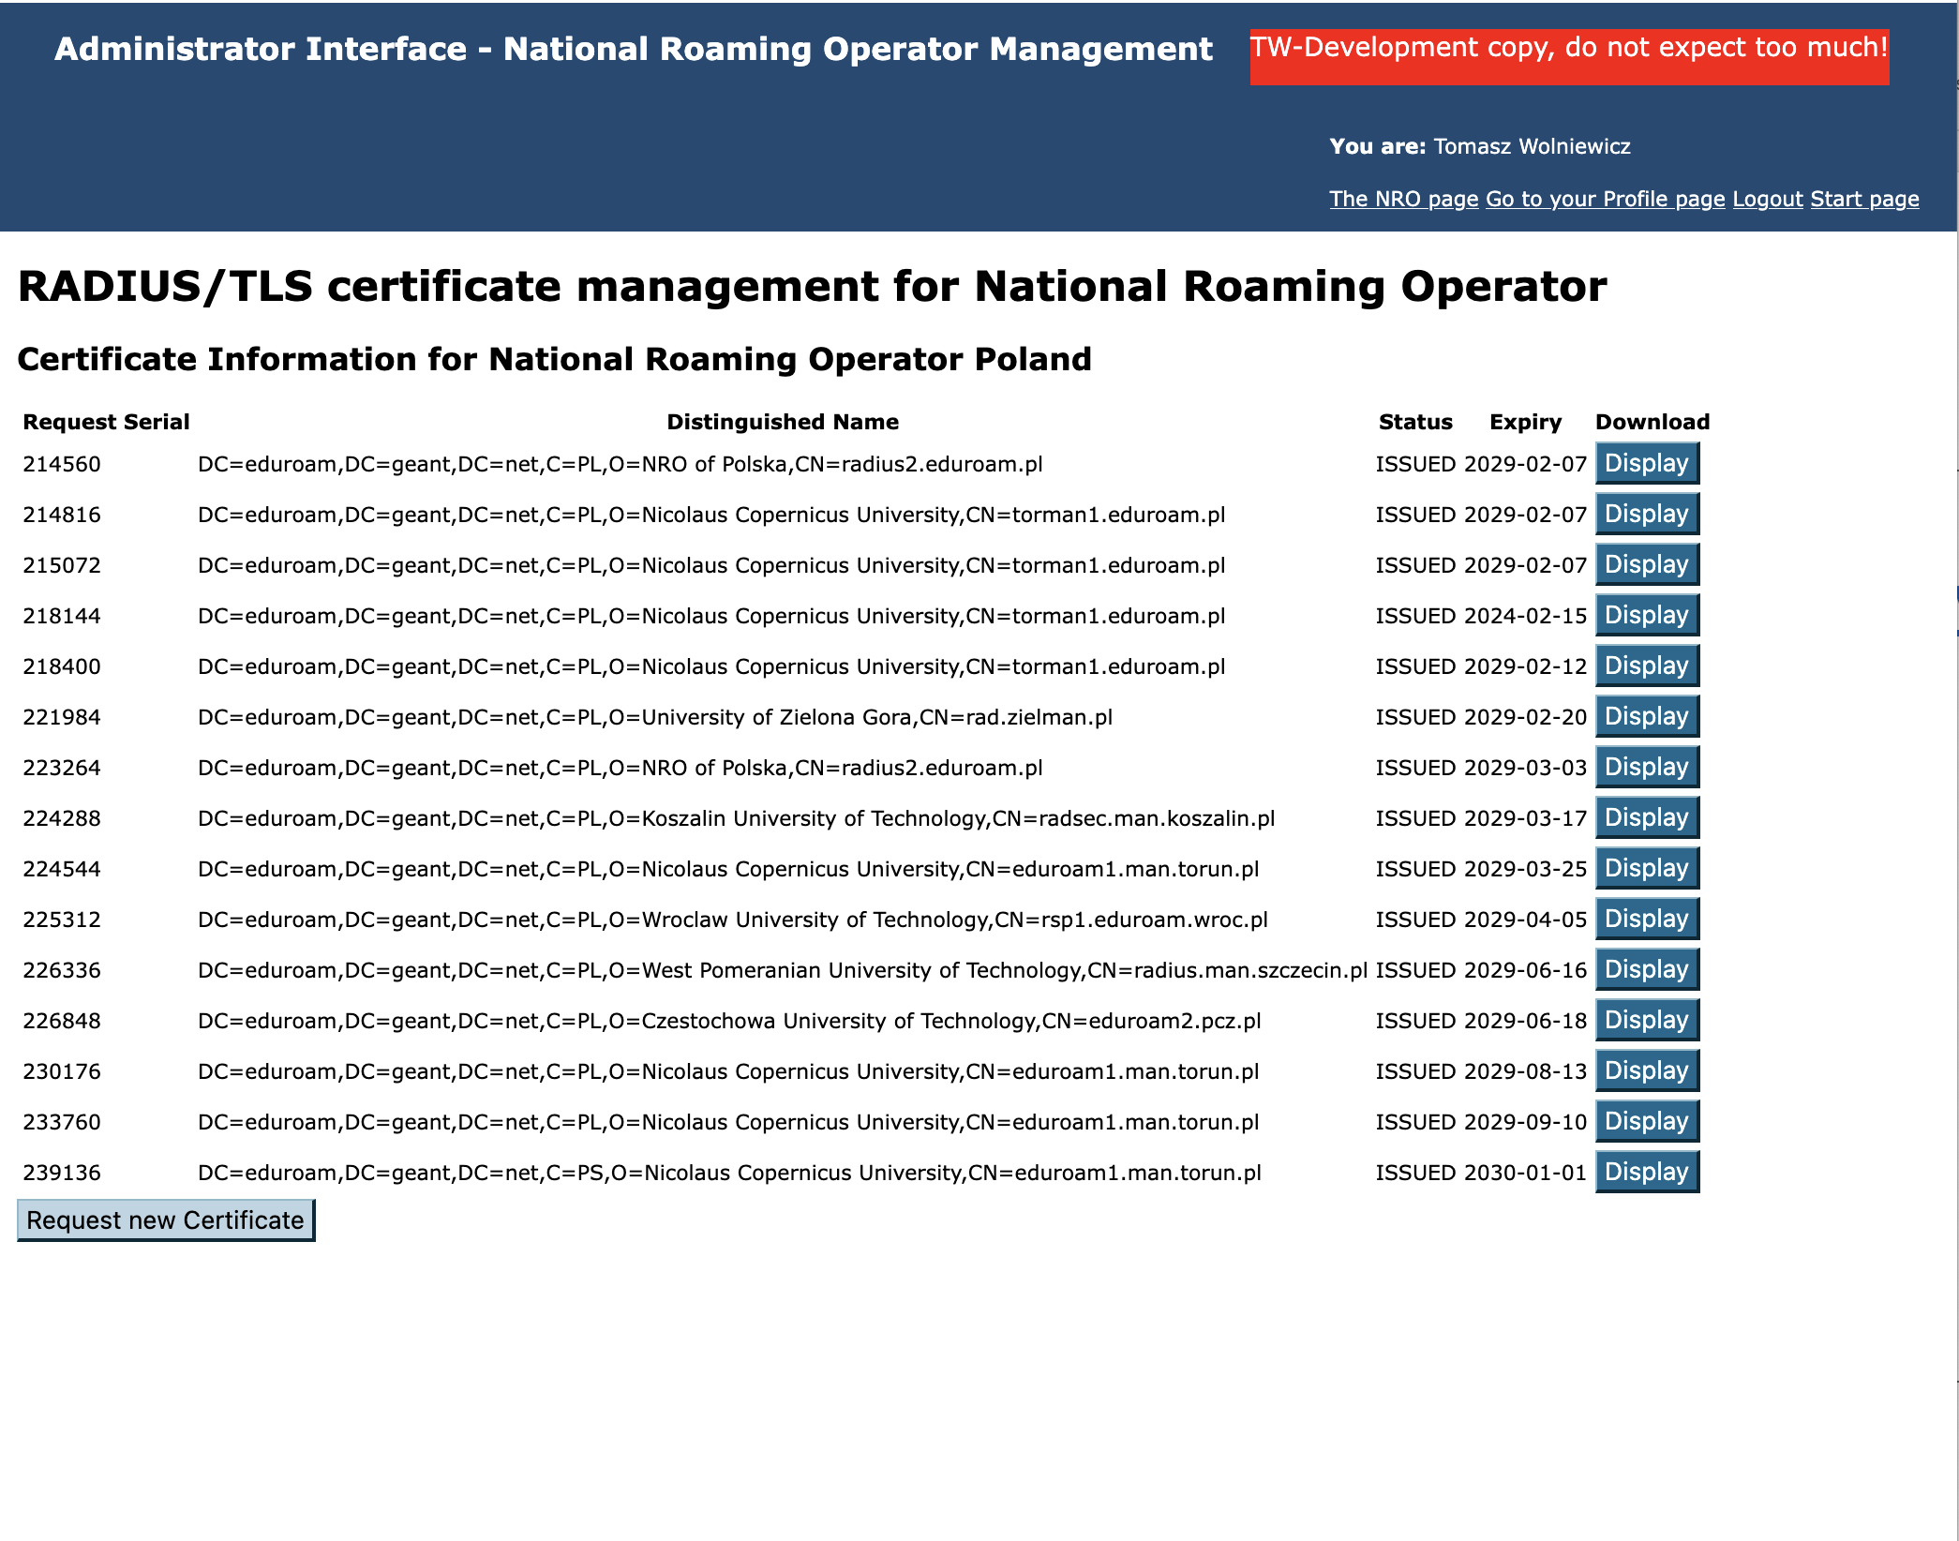

Slide 29
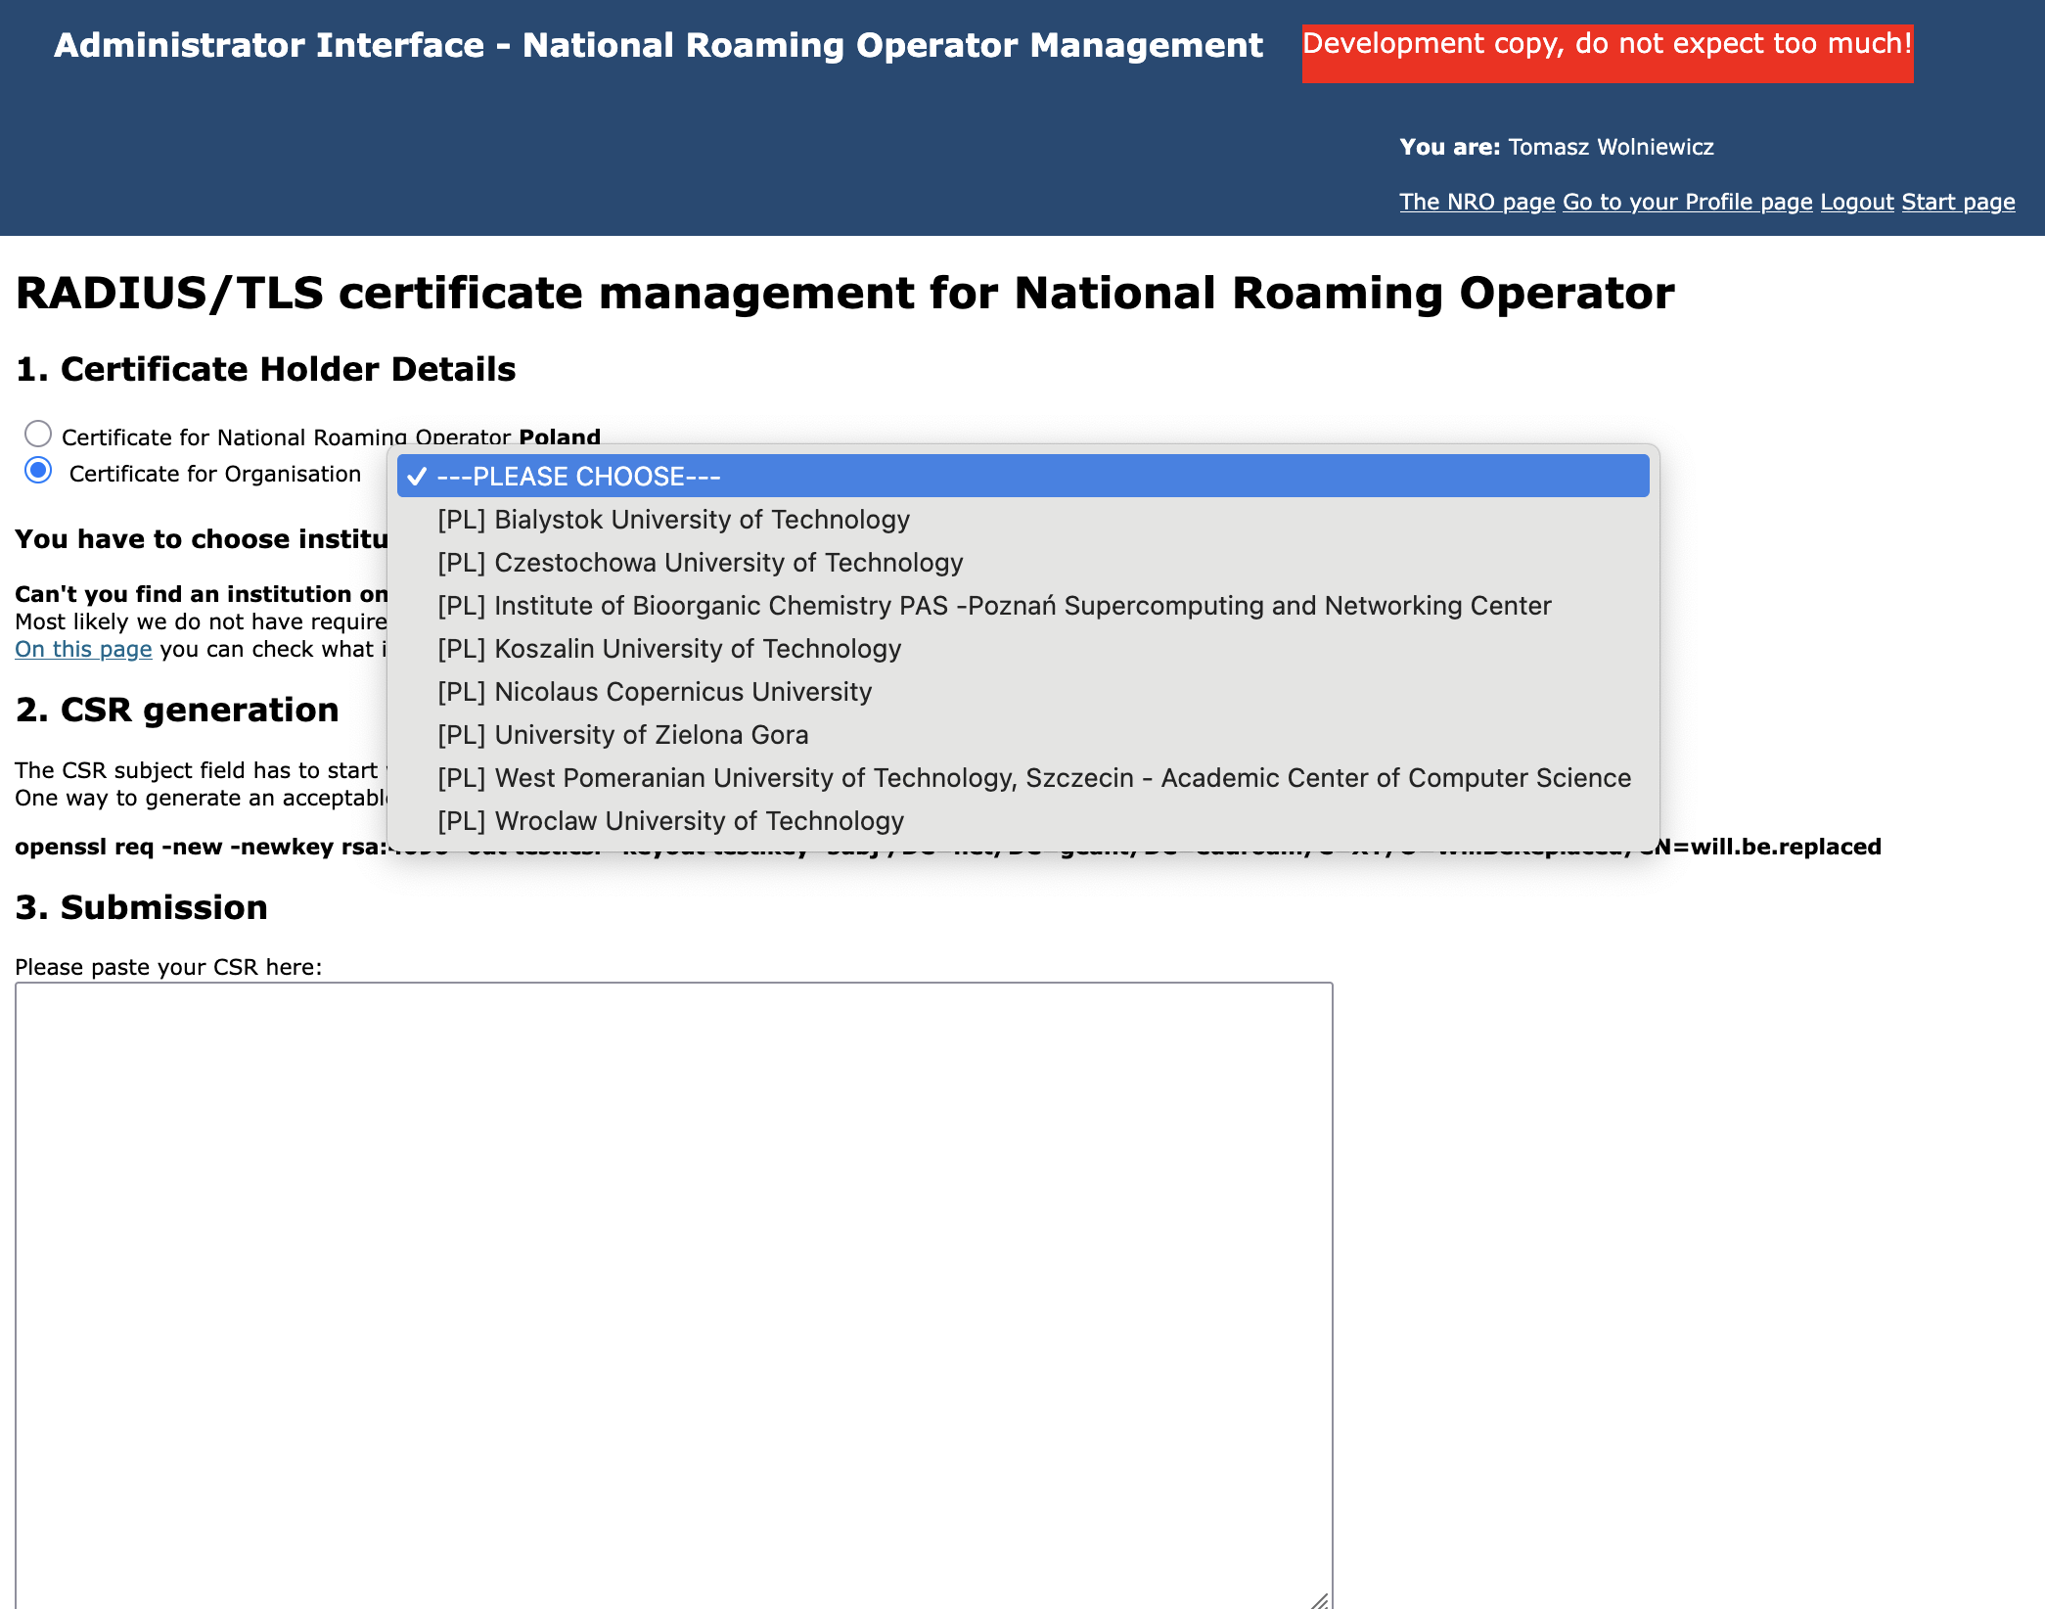

Slide 30
If you do not see the institution you need then check this page

Slide 31
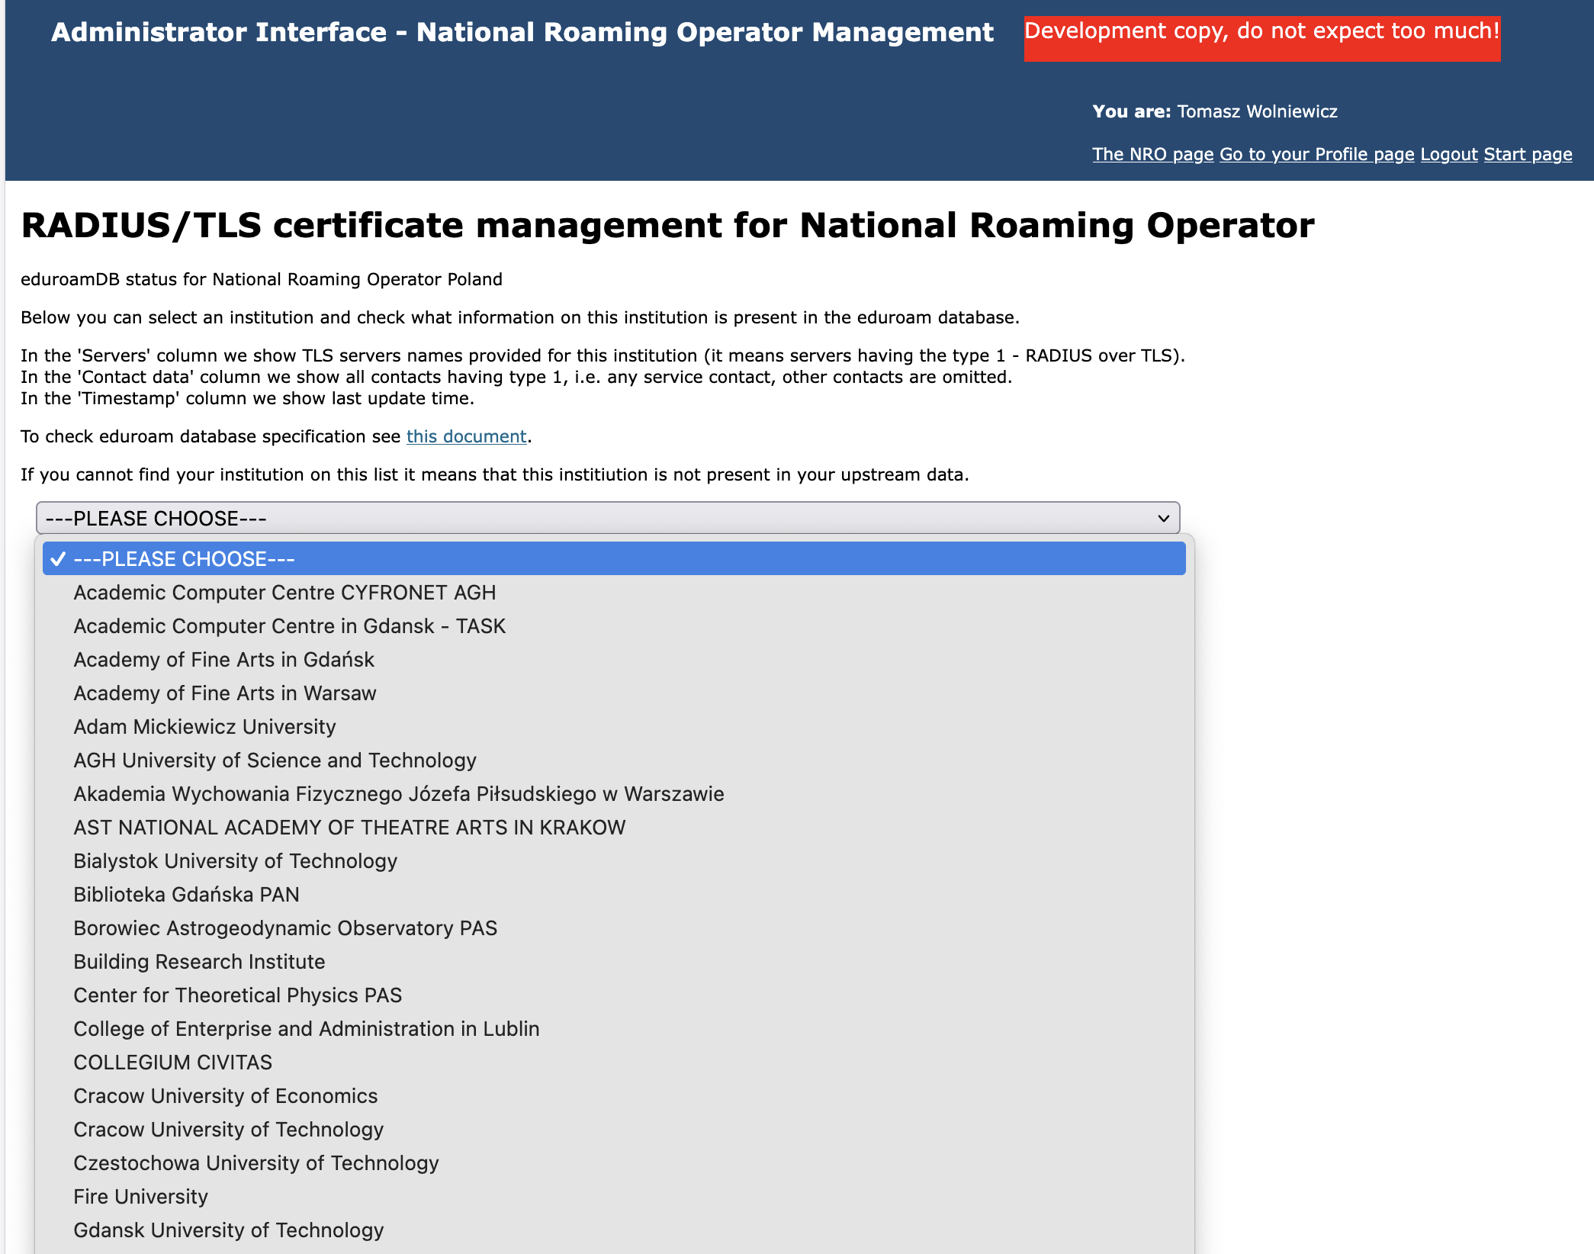

Slide 32
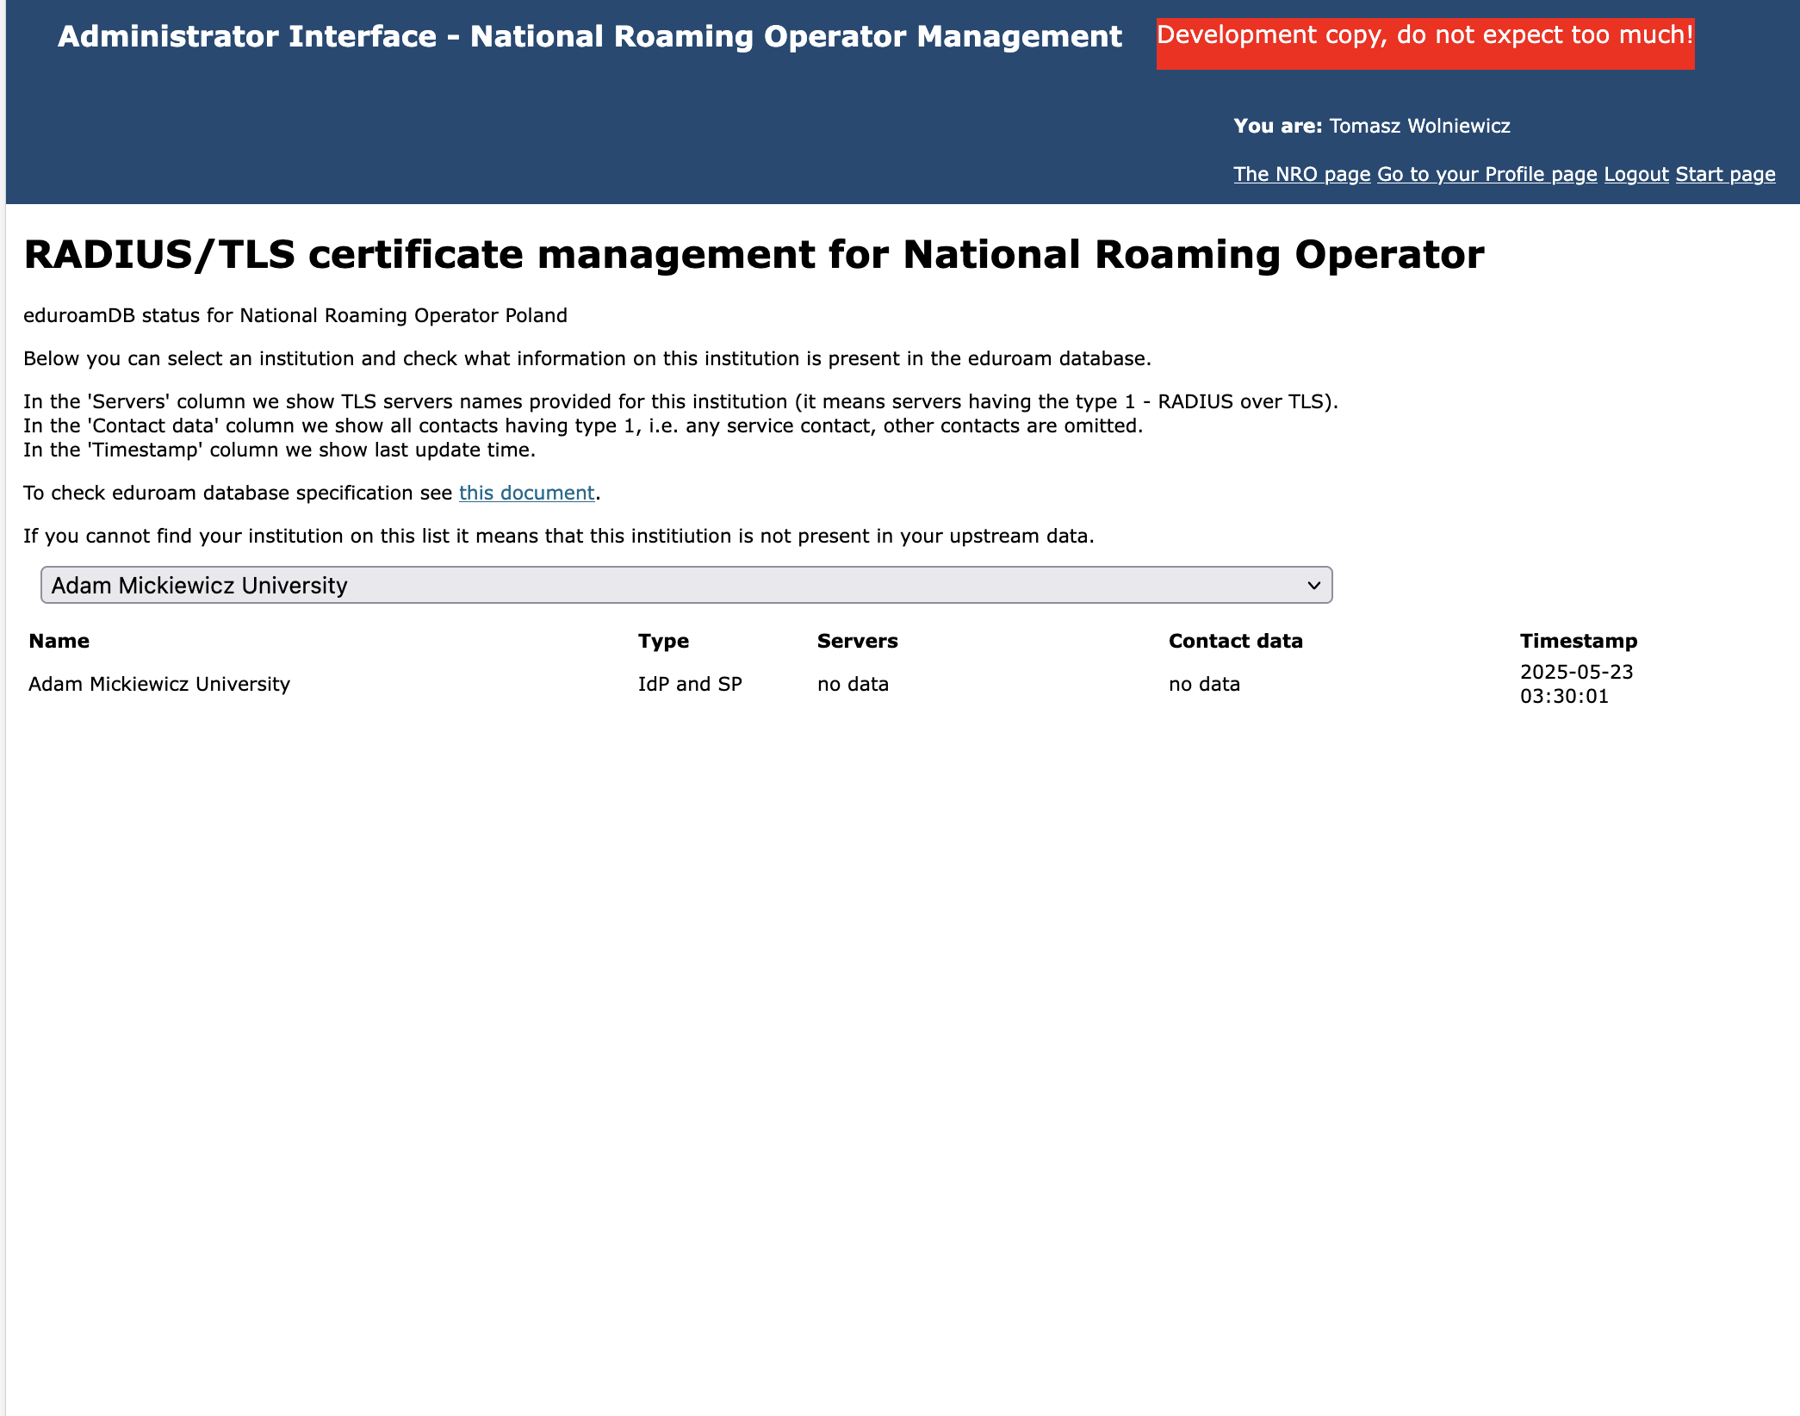

Slide 33
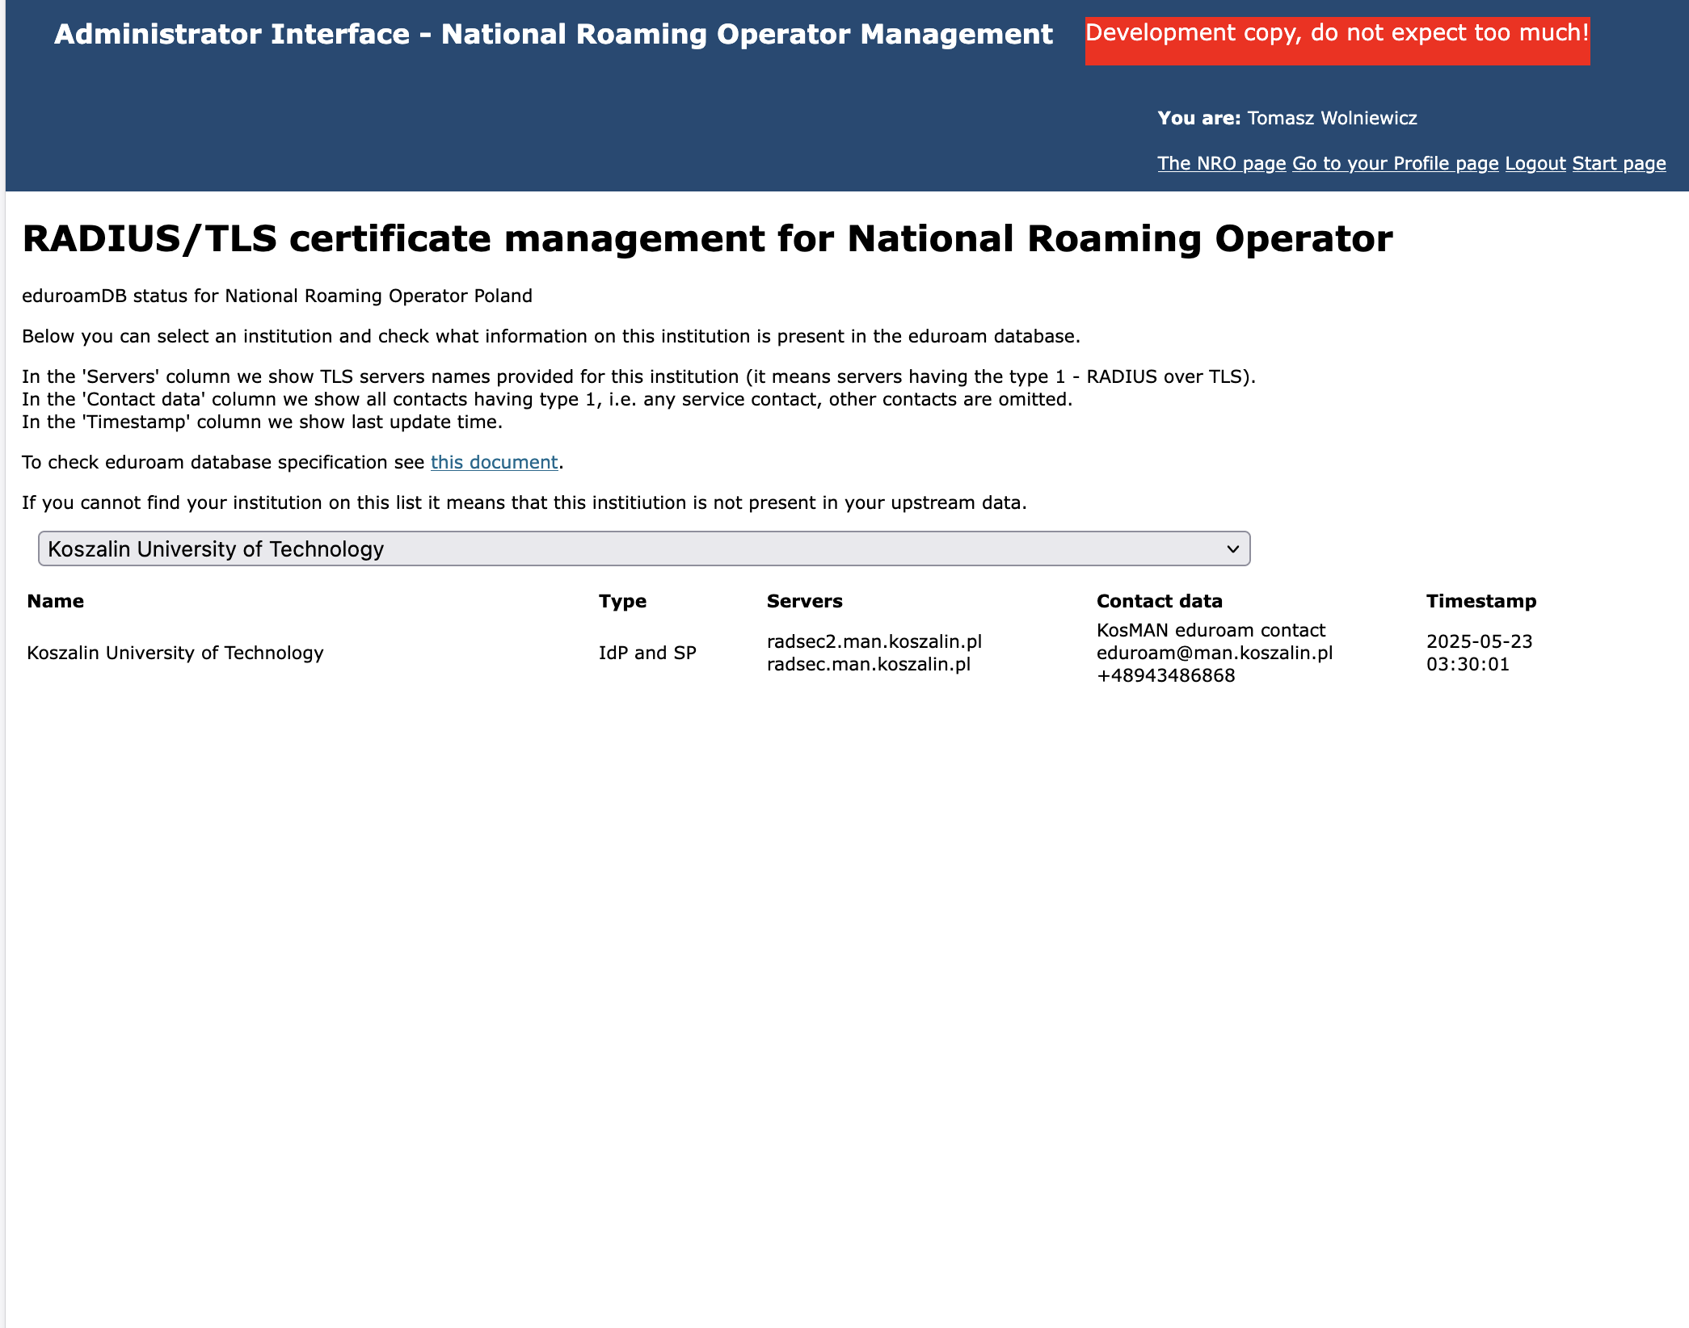

Slide 34
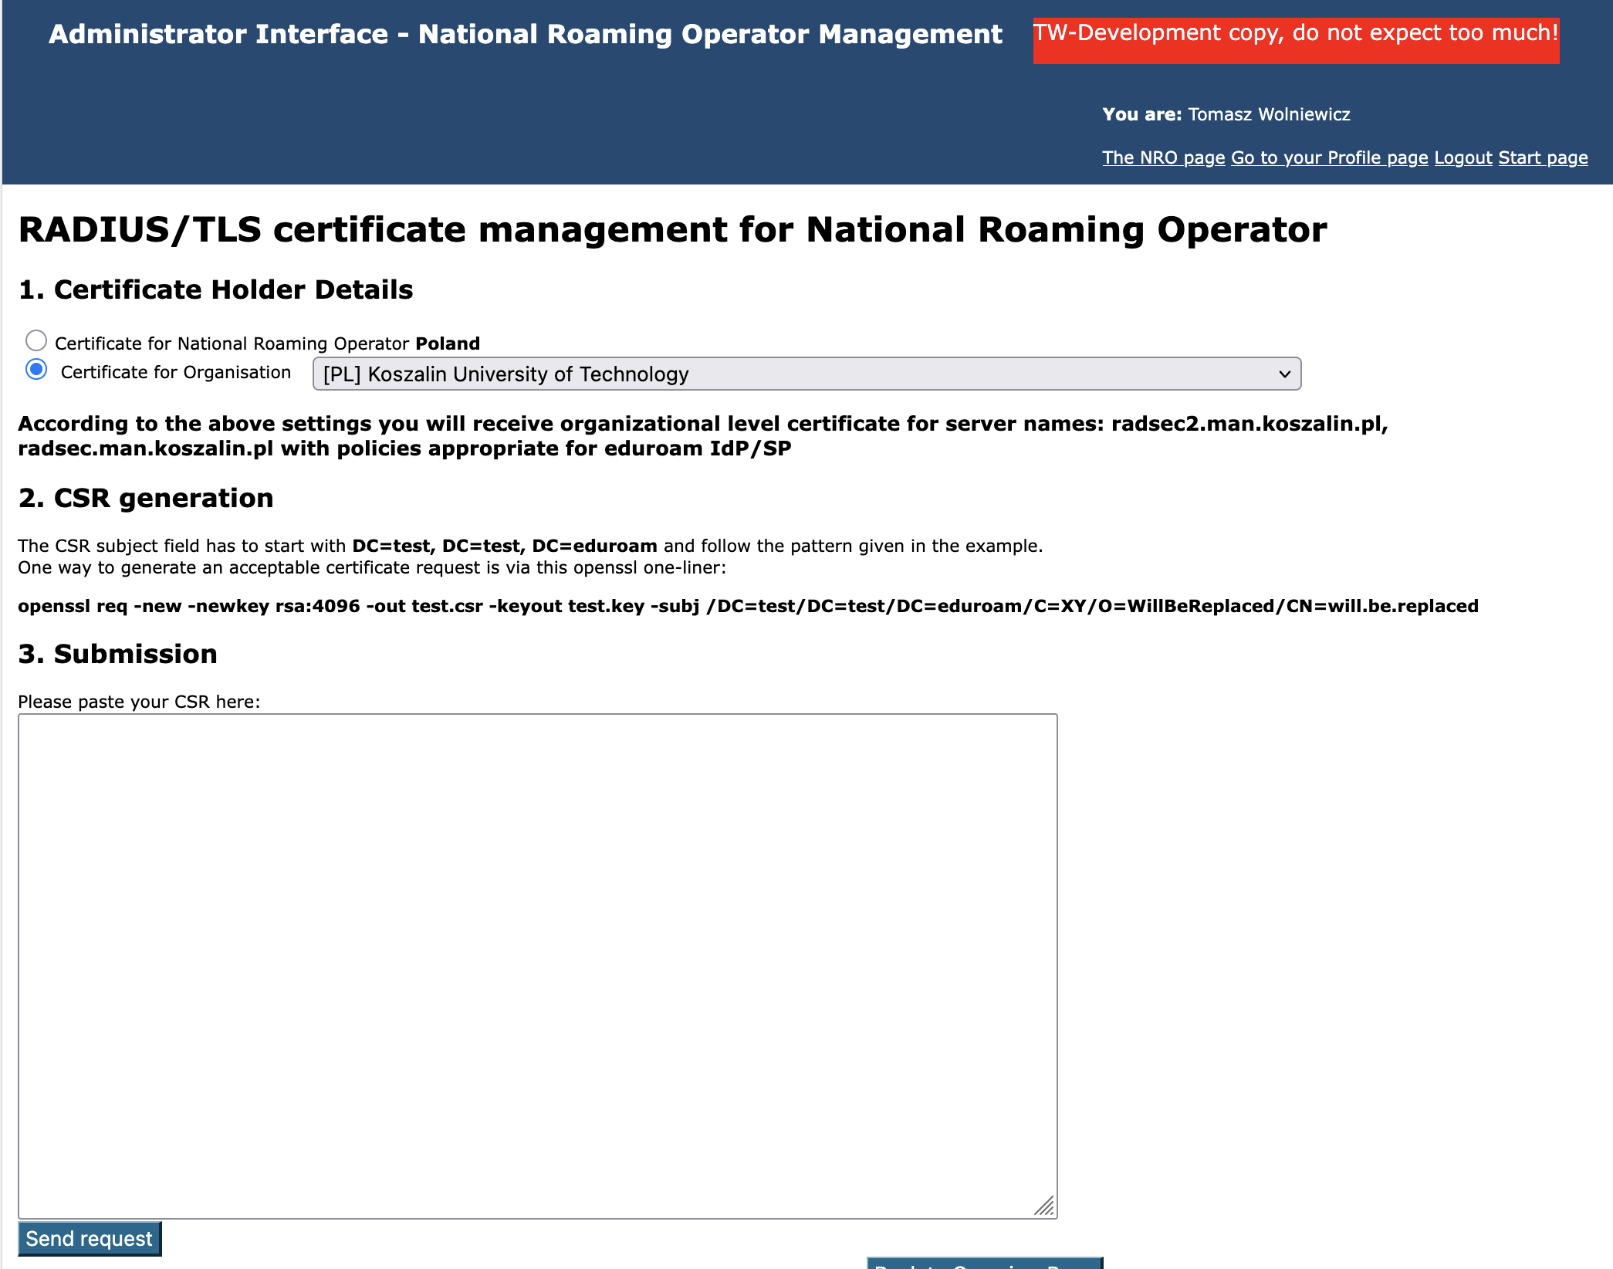

Slide 35
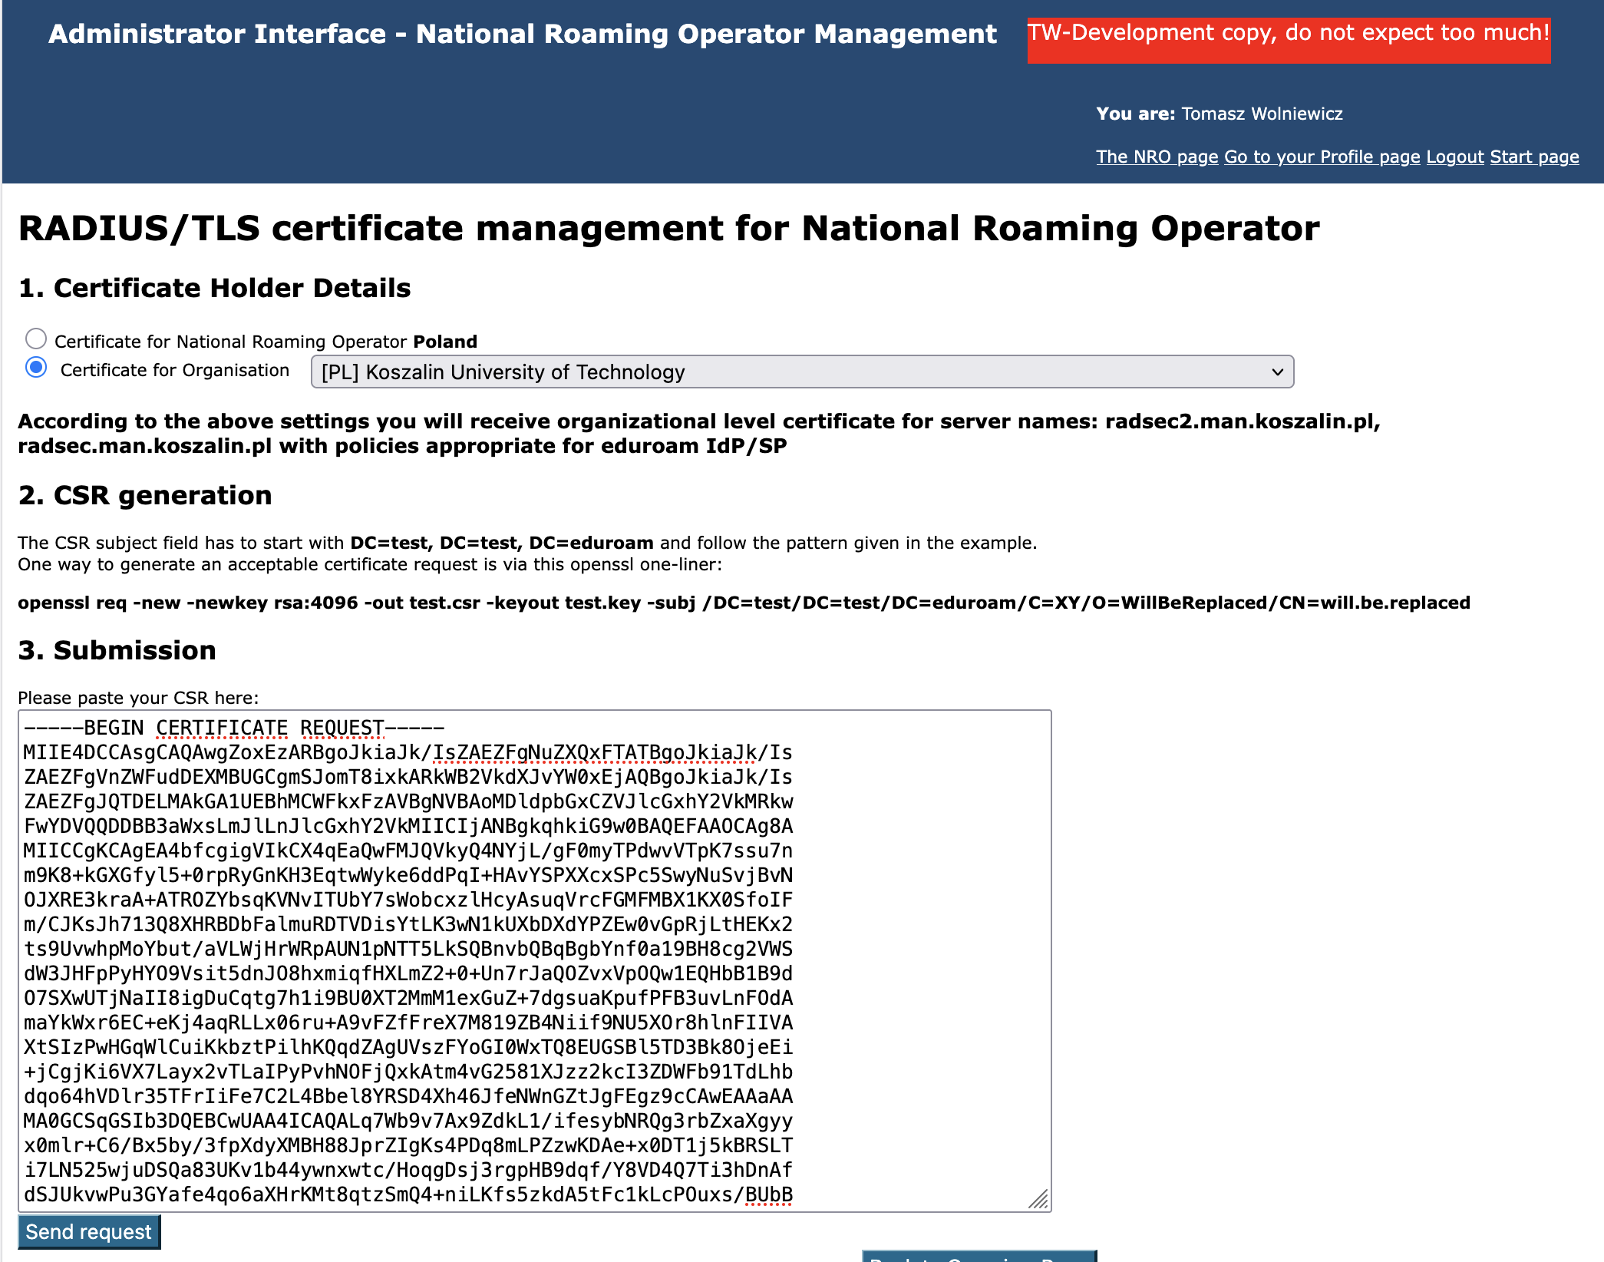

Slide 36
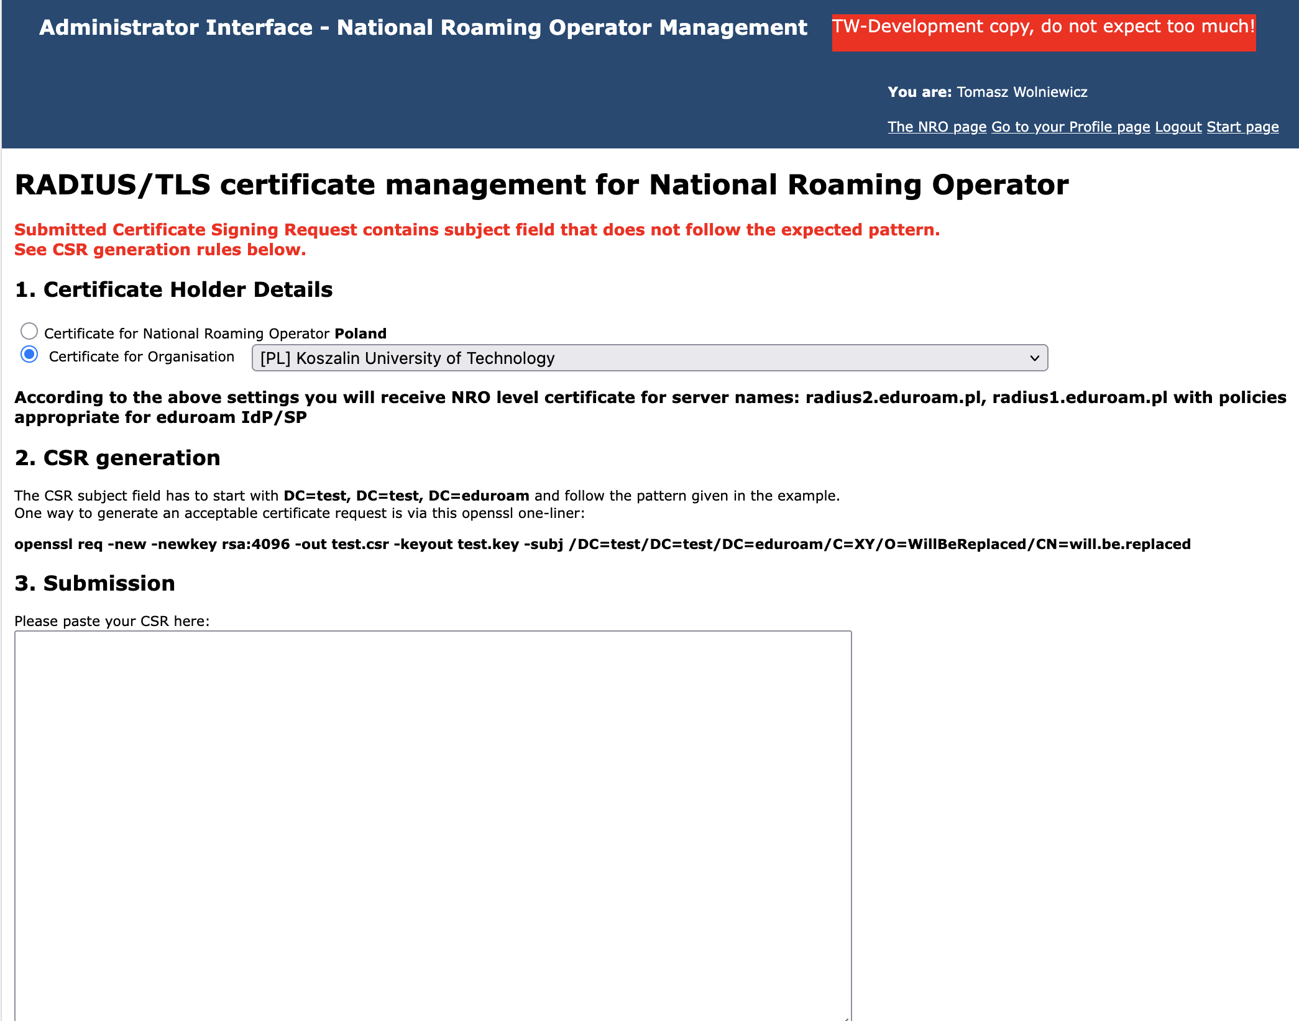

Slide 37
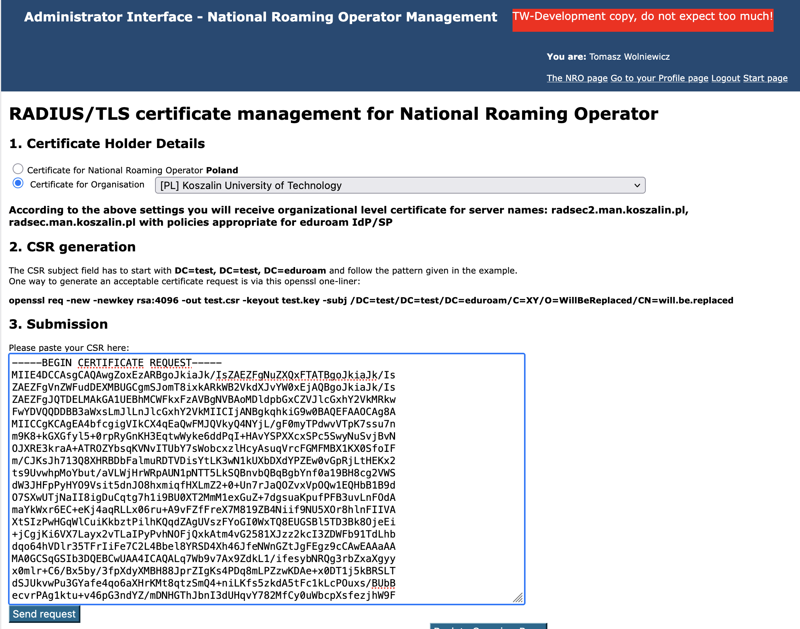

Slide 38
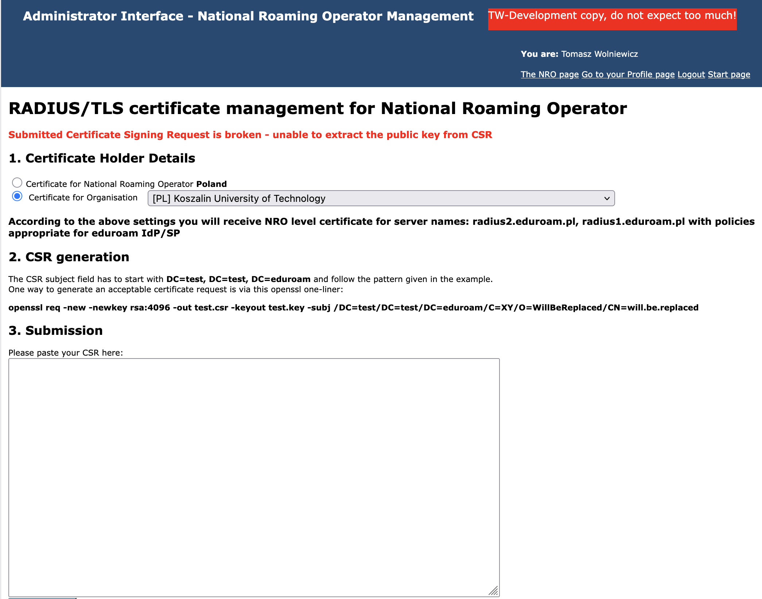

Slide 39
Expanded institution matching in user GUI
We use the DiscoJuice interface keywords capabilities to match
  realms
  institution names in all available languages
  institution acronyms
  institution alternative names

Slide 40
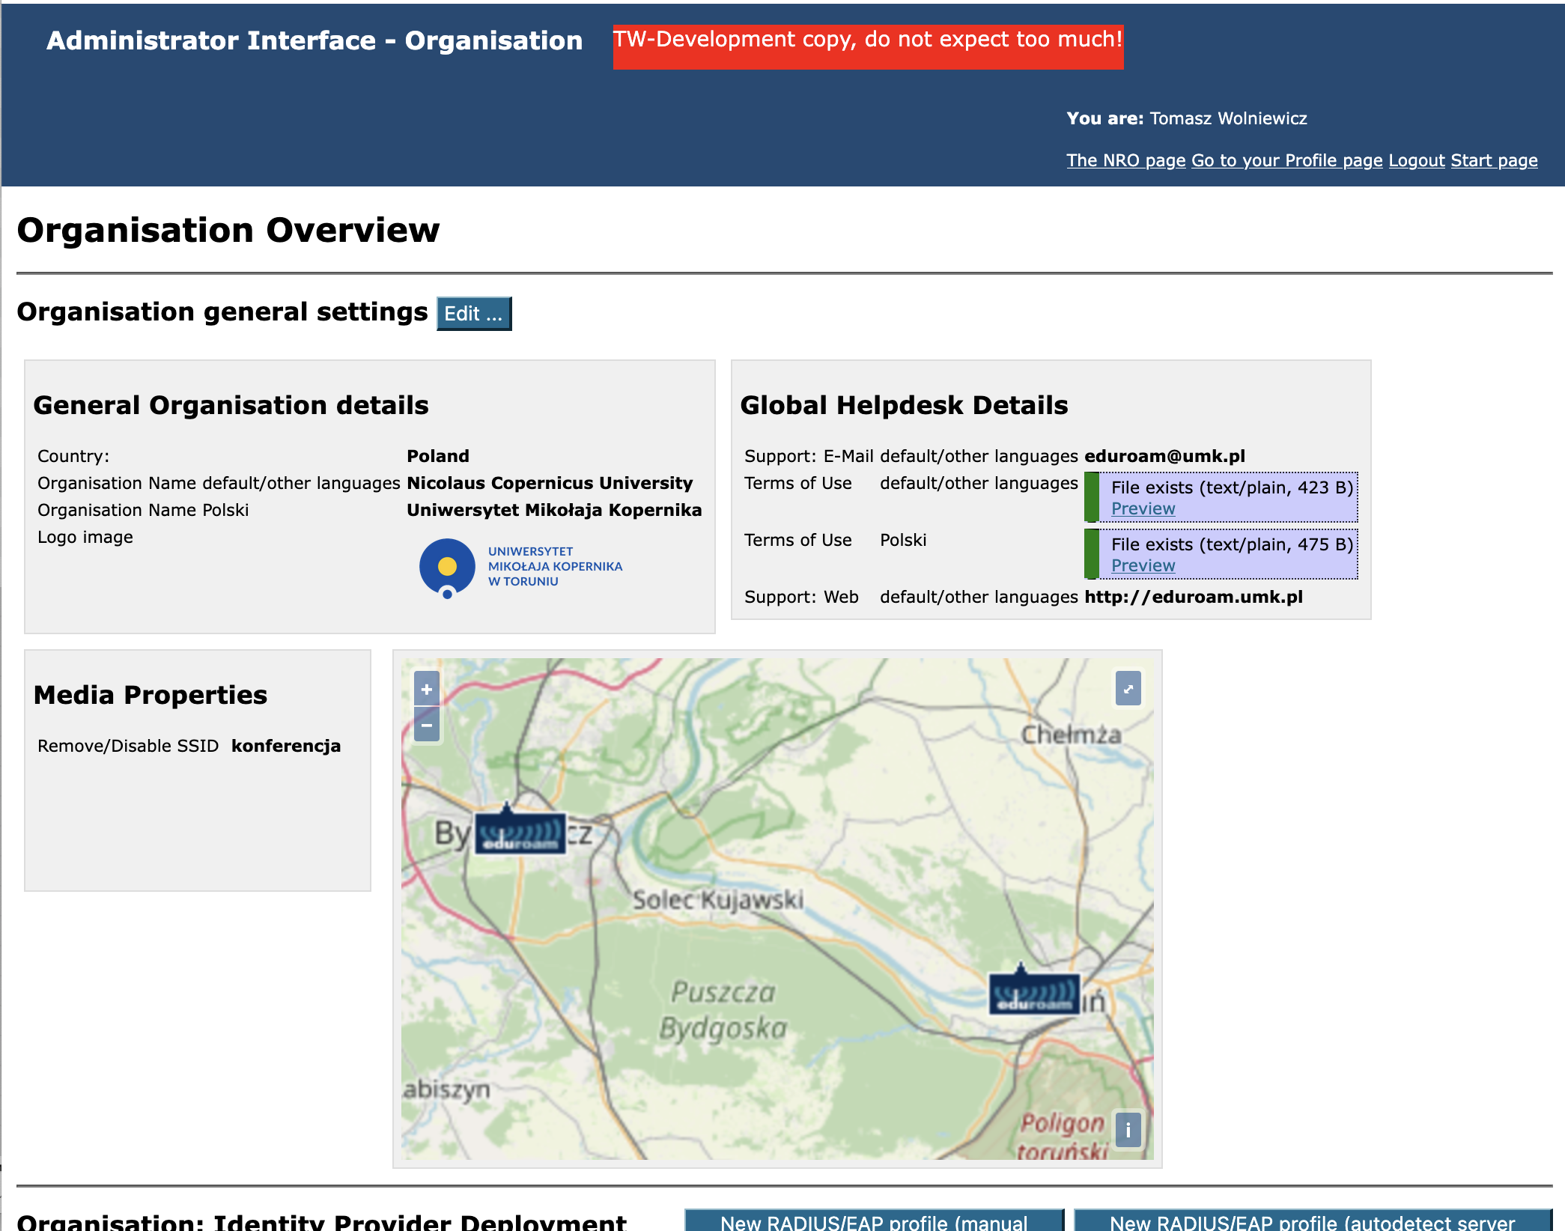
Standard institution info

Slide 41
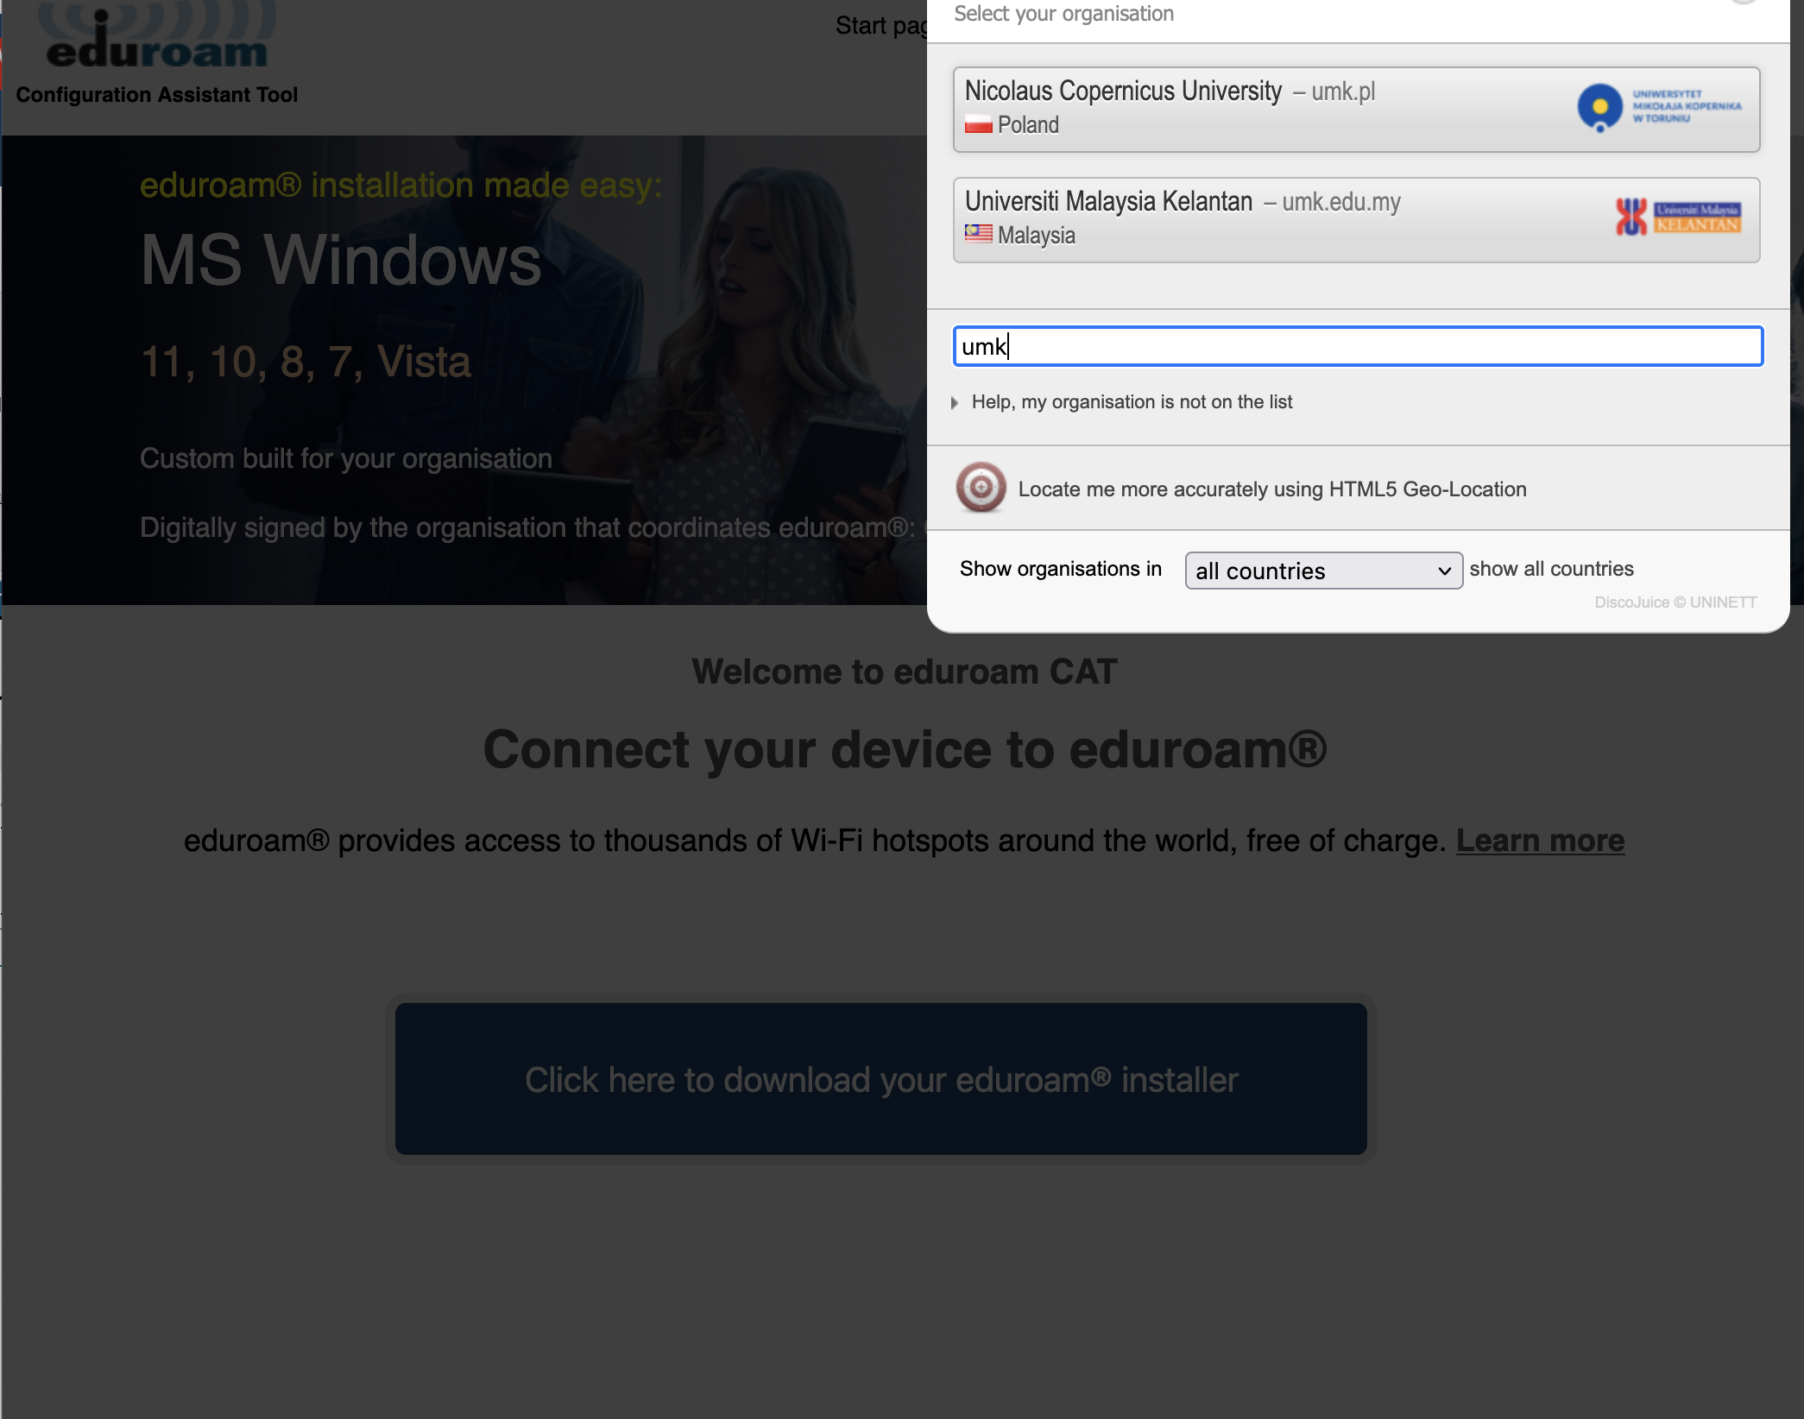
Search by matching the realm

Slide 42
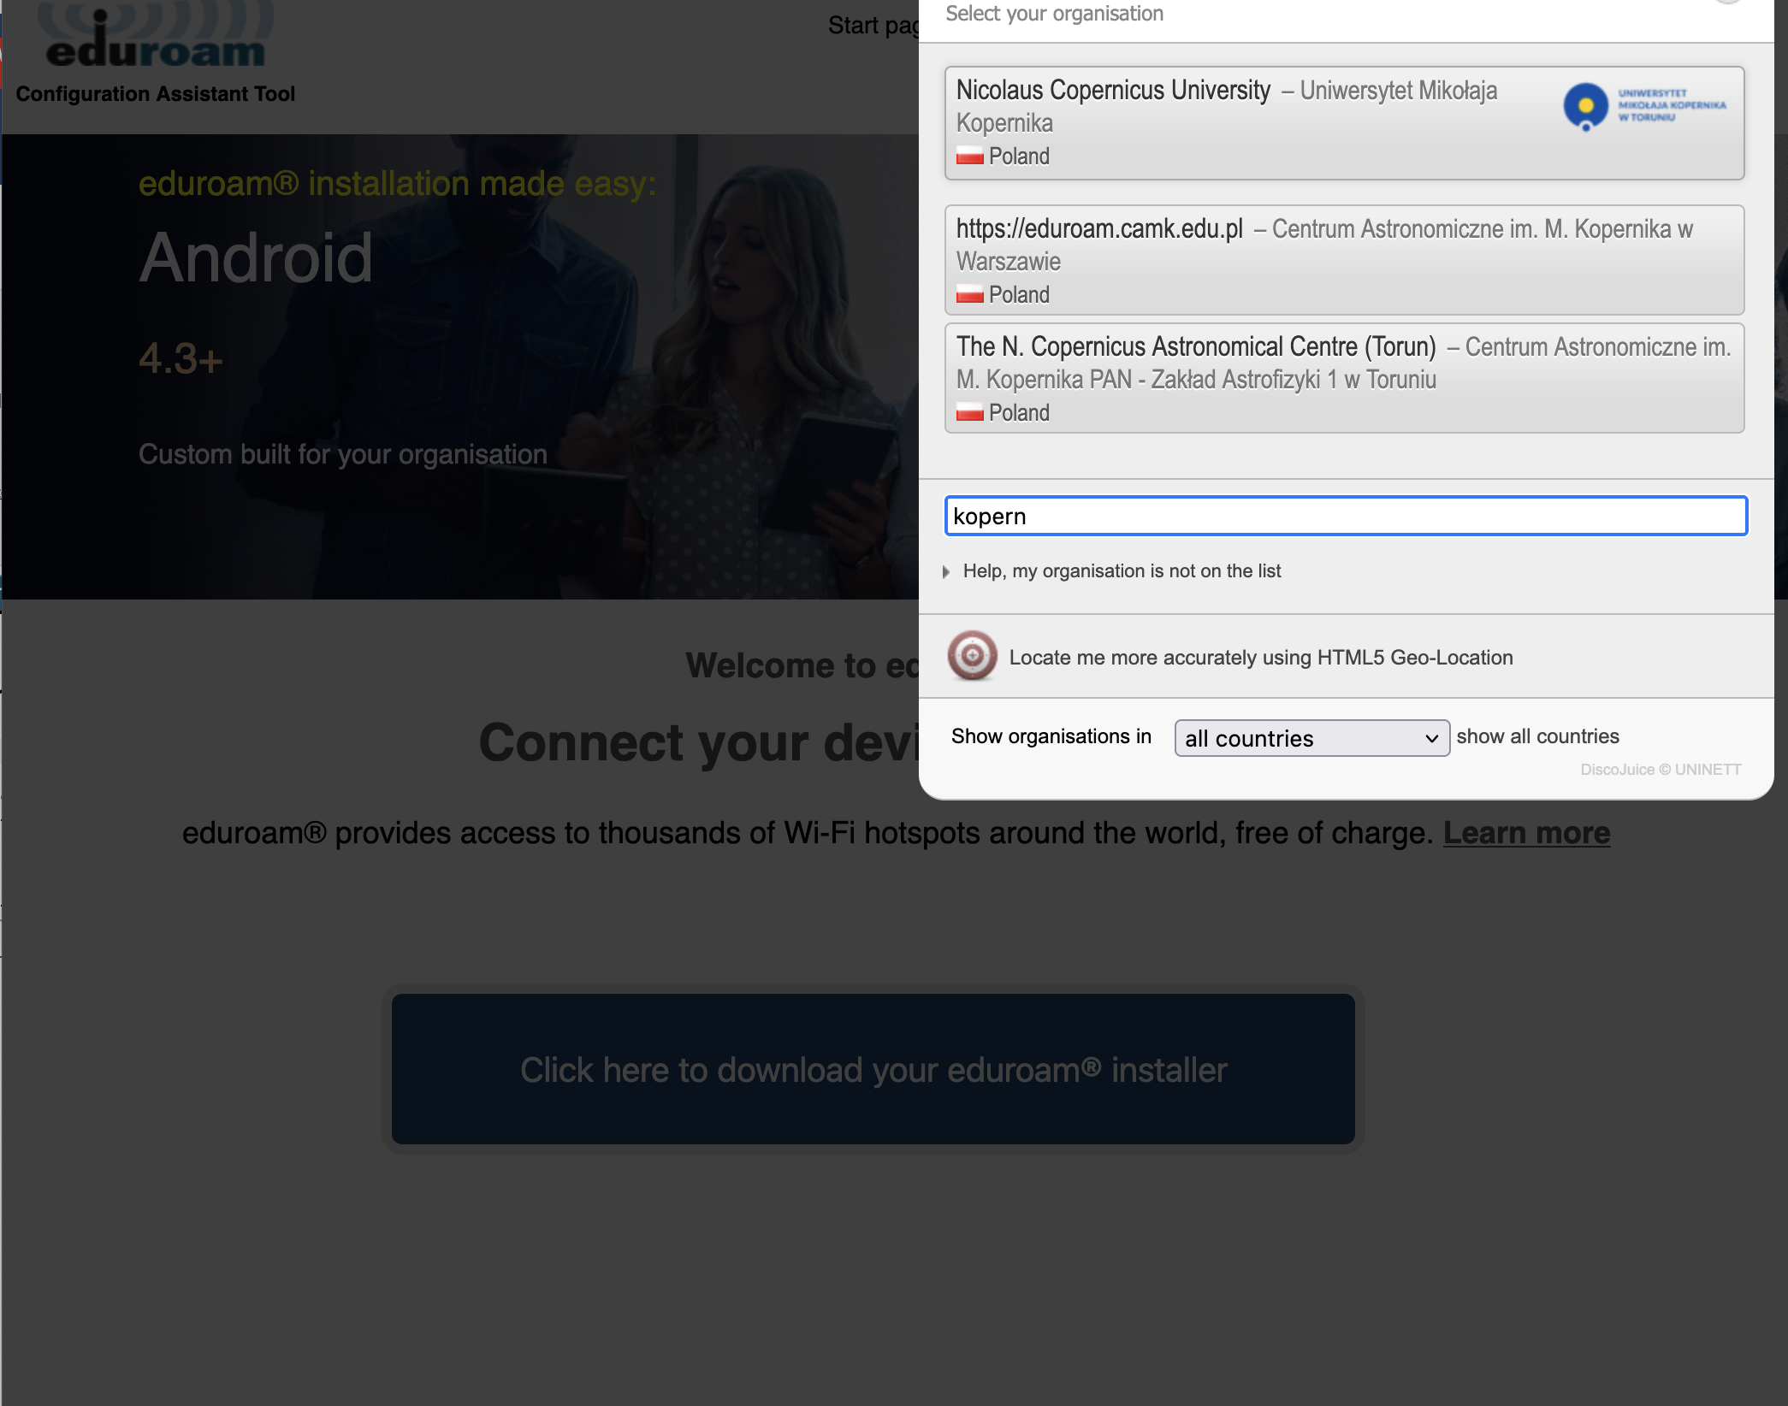
Search by matching the name in a different language

Slide 43
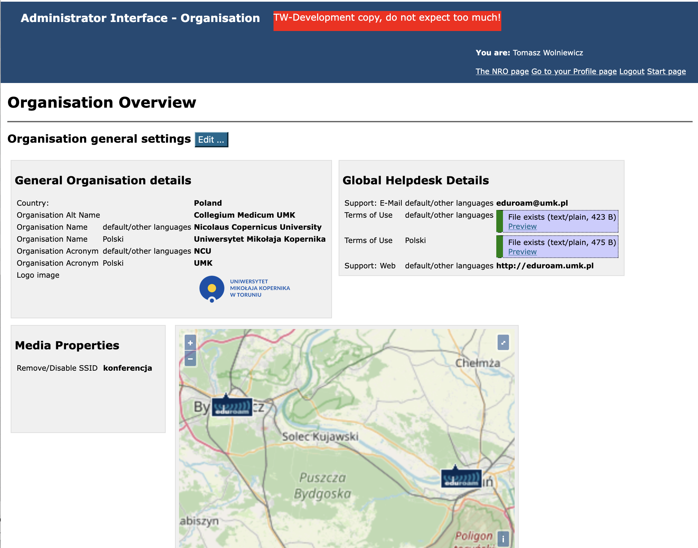
After adding more institution info

Slide 44
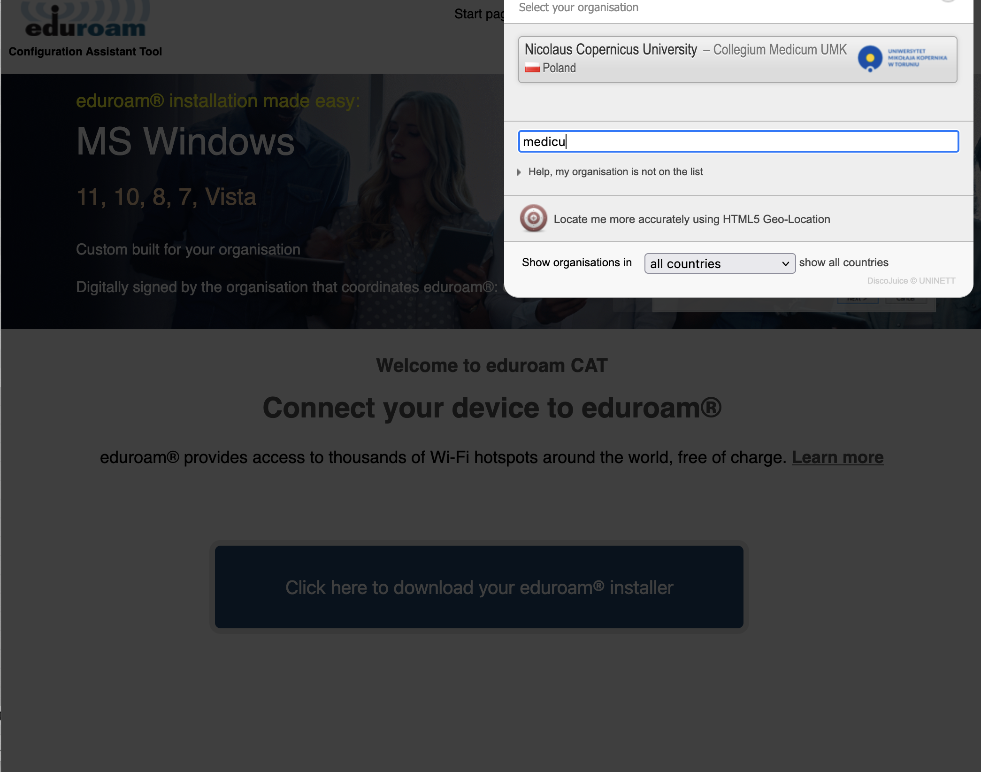
Search by matching the alternative name

Slide 45
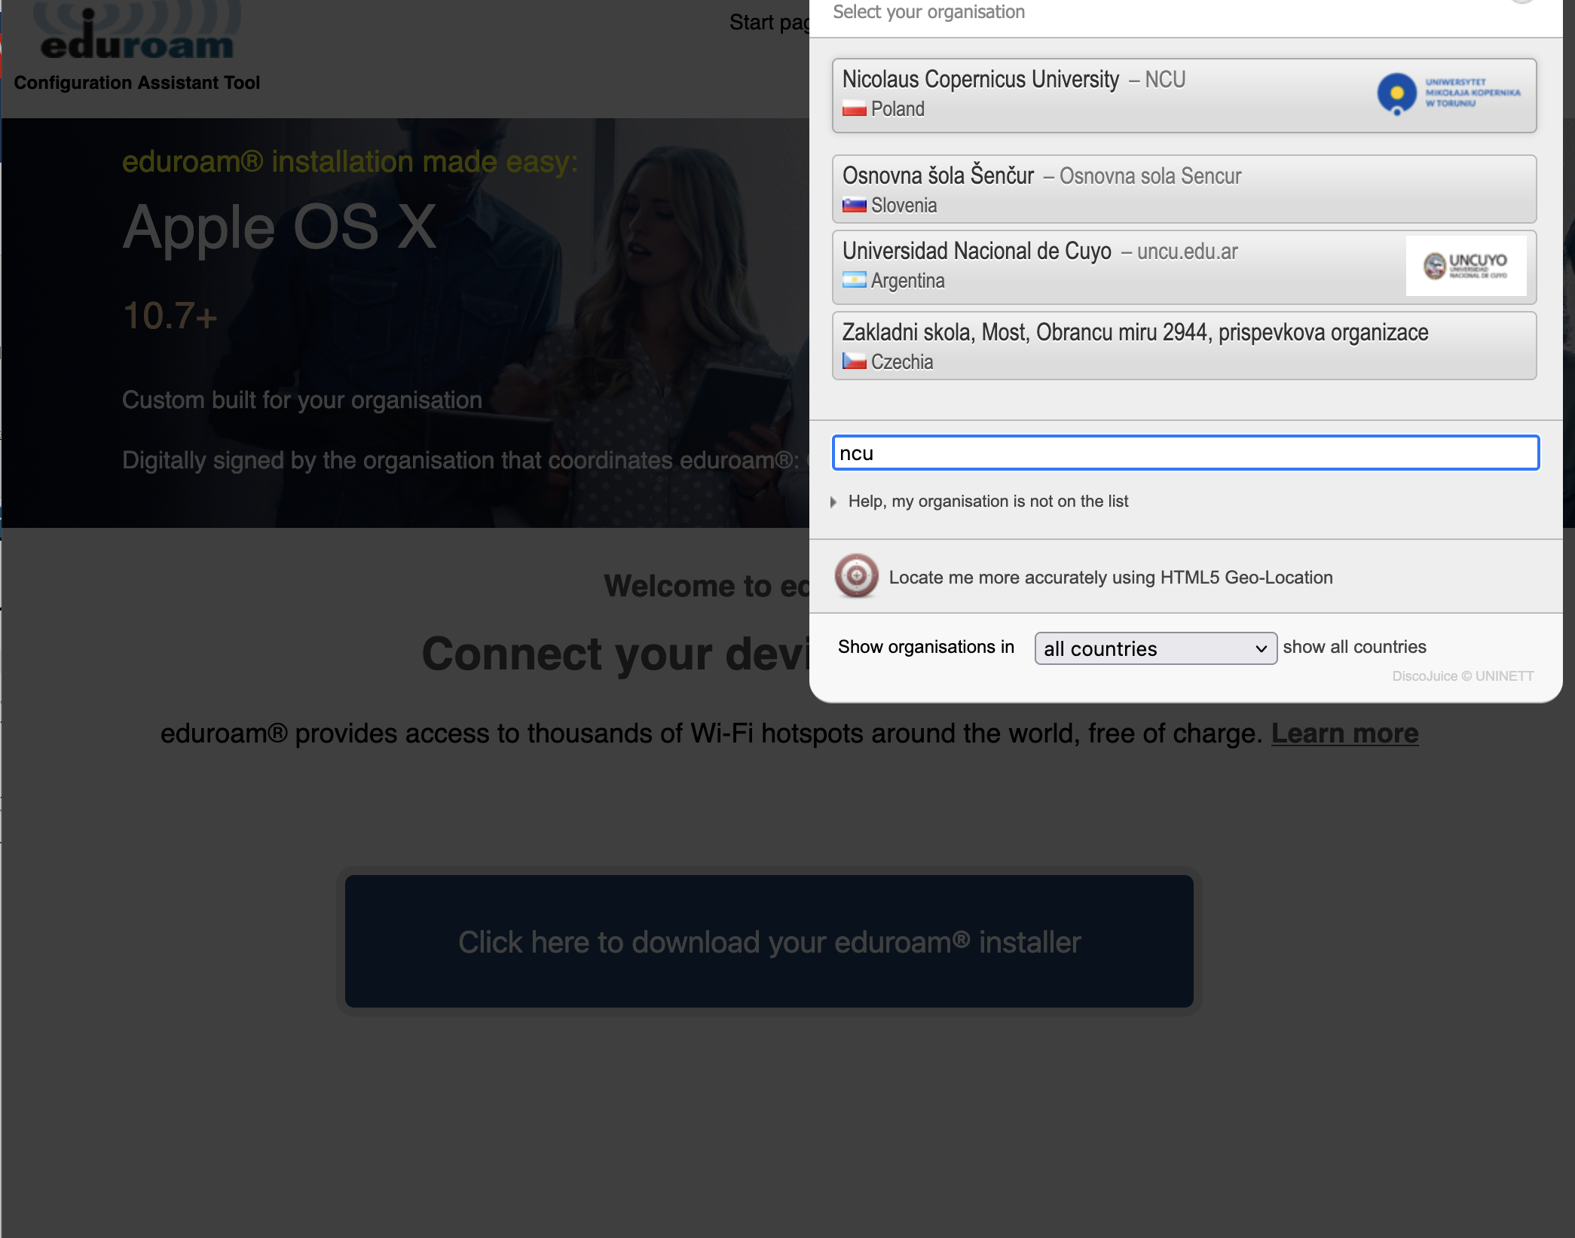
Search by matching the acronym

Slide 46
Profile sorting feature
We were requested to add this feature
In the standard approach the newest profile comes last – not always correct
You can now rearrange the profile order with drag/drop

Slide 47
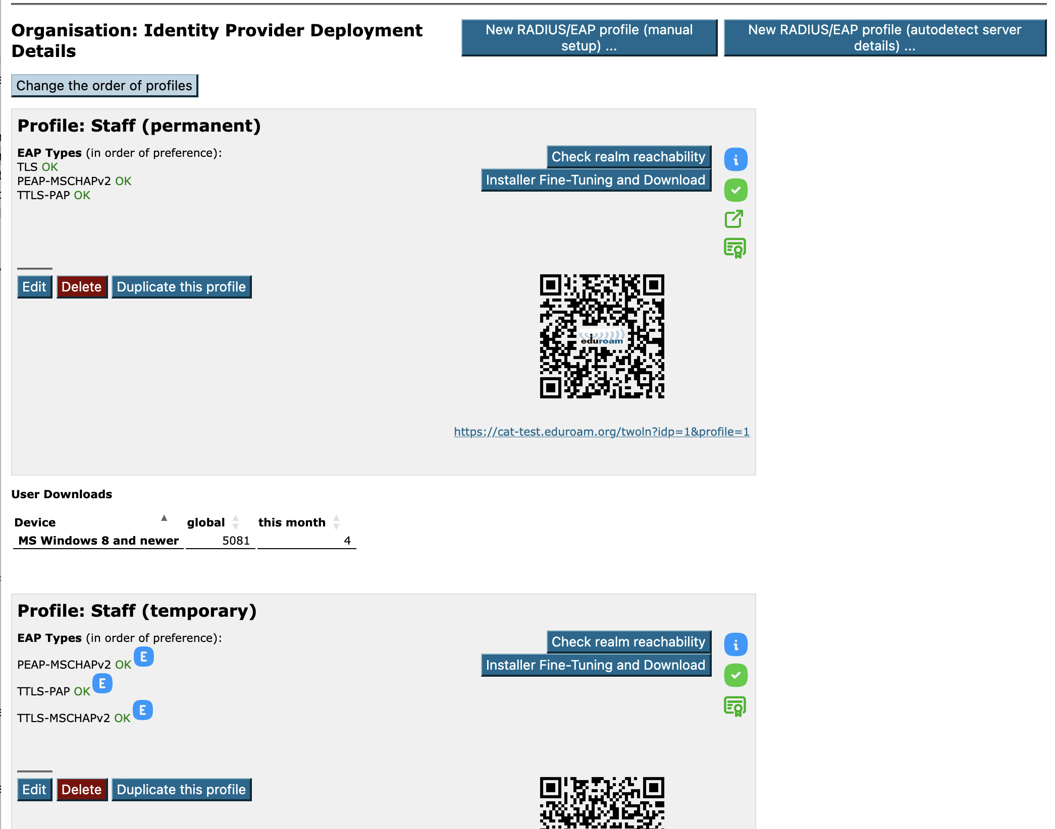

Slide 48
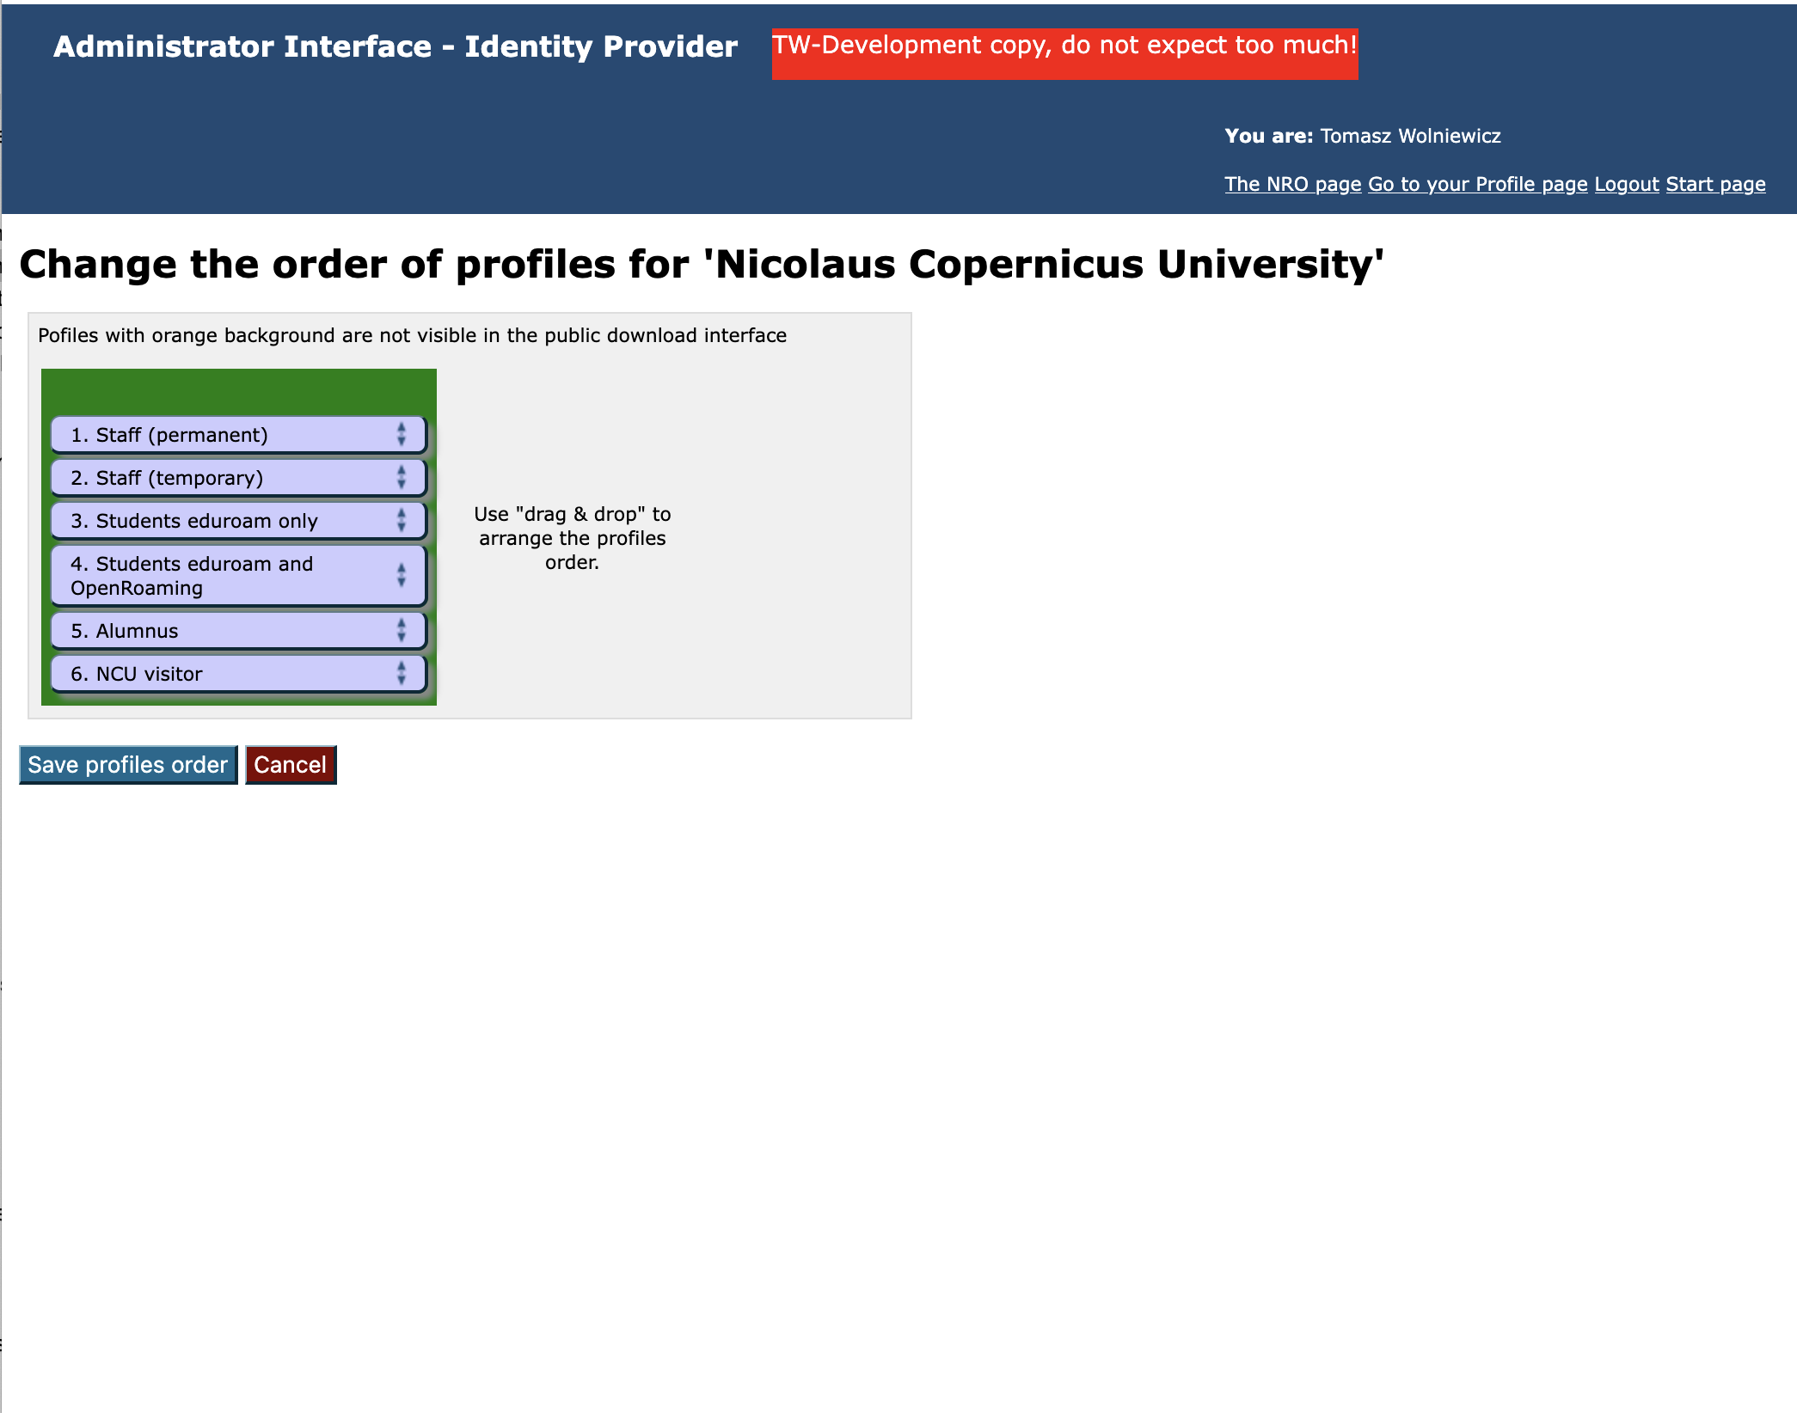

Slide 49
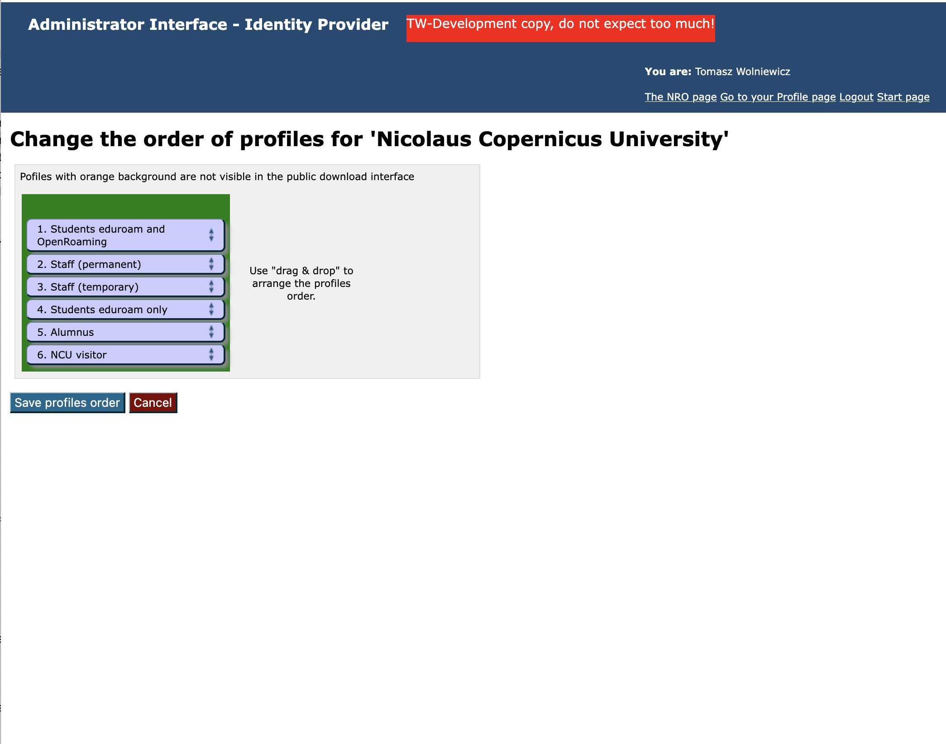

Slide 50
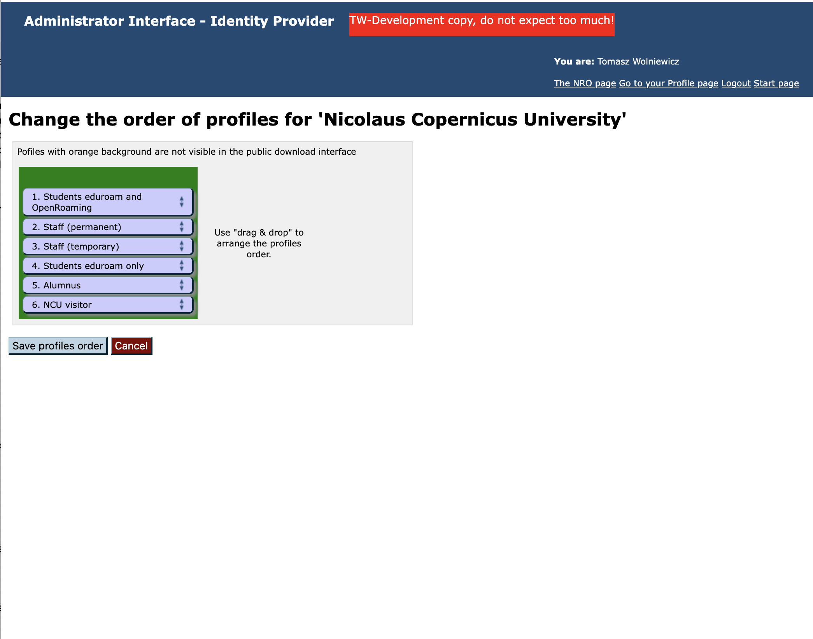

Slide 51
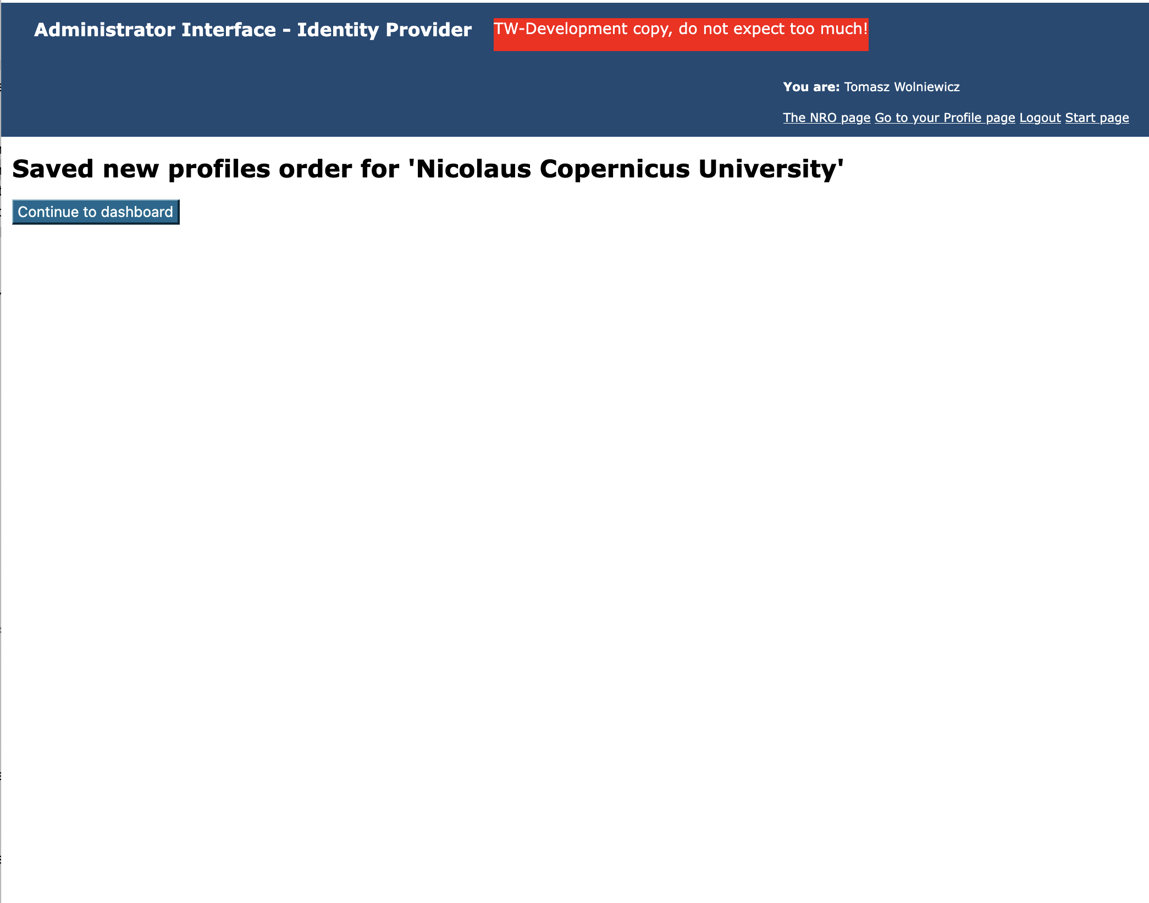

Slide 52
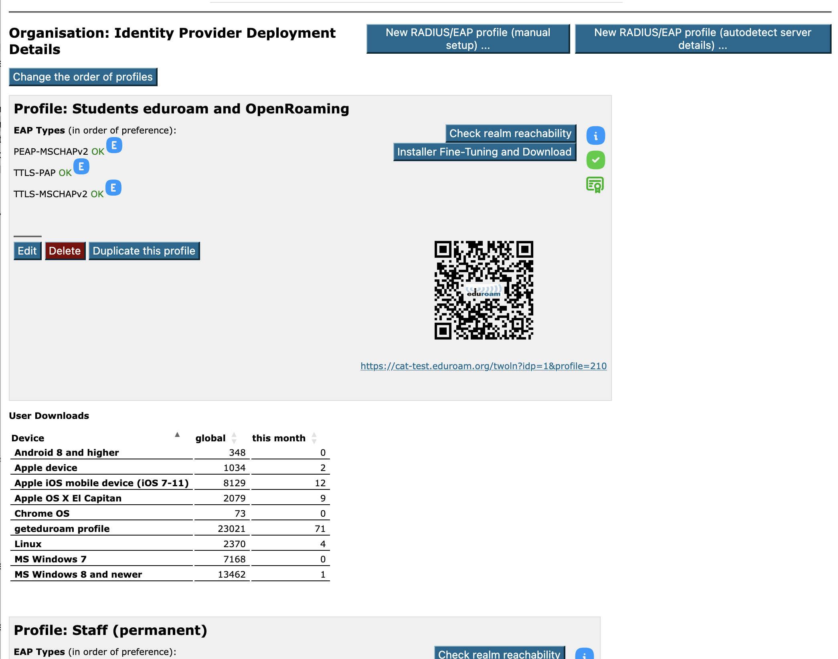

Slide 53
Profile duplication feature
Again, this was added on request from the users

Slide 55


Slide 56
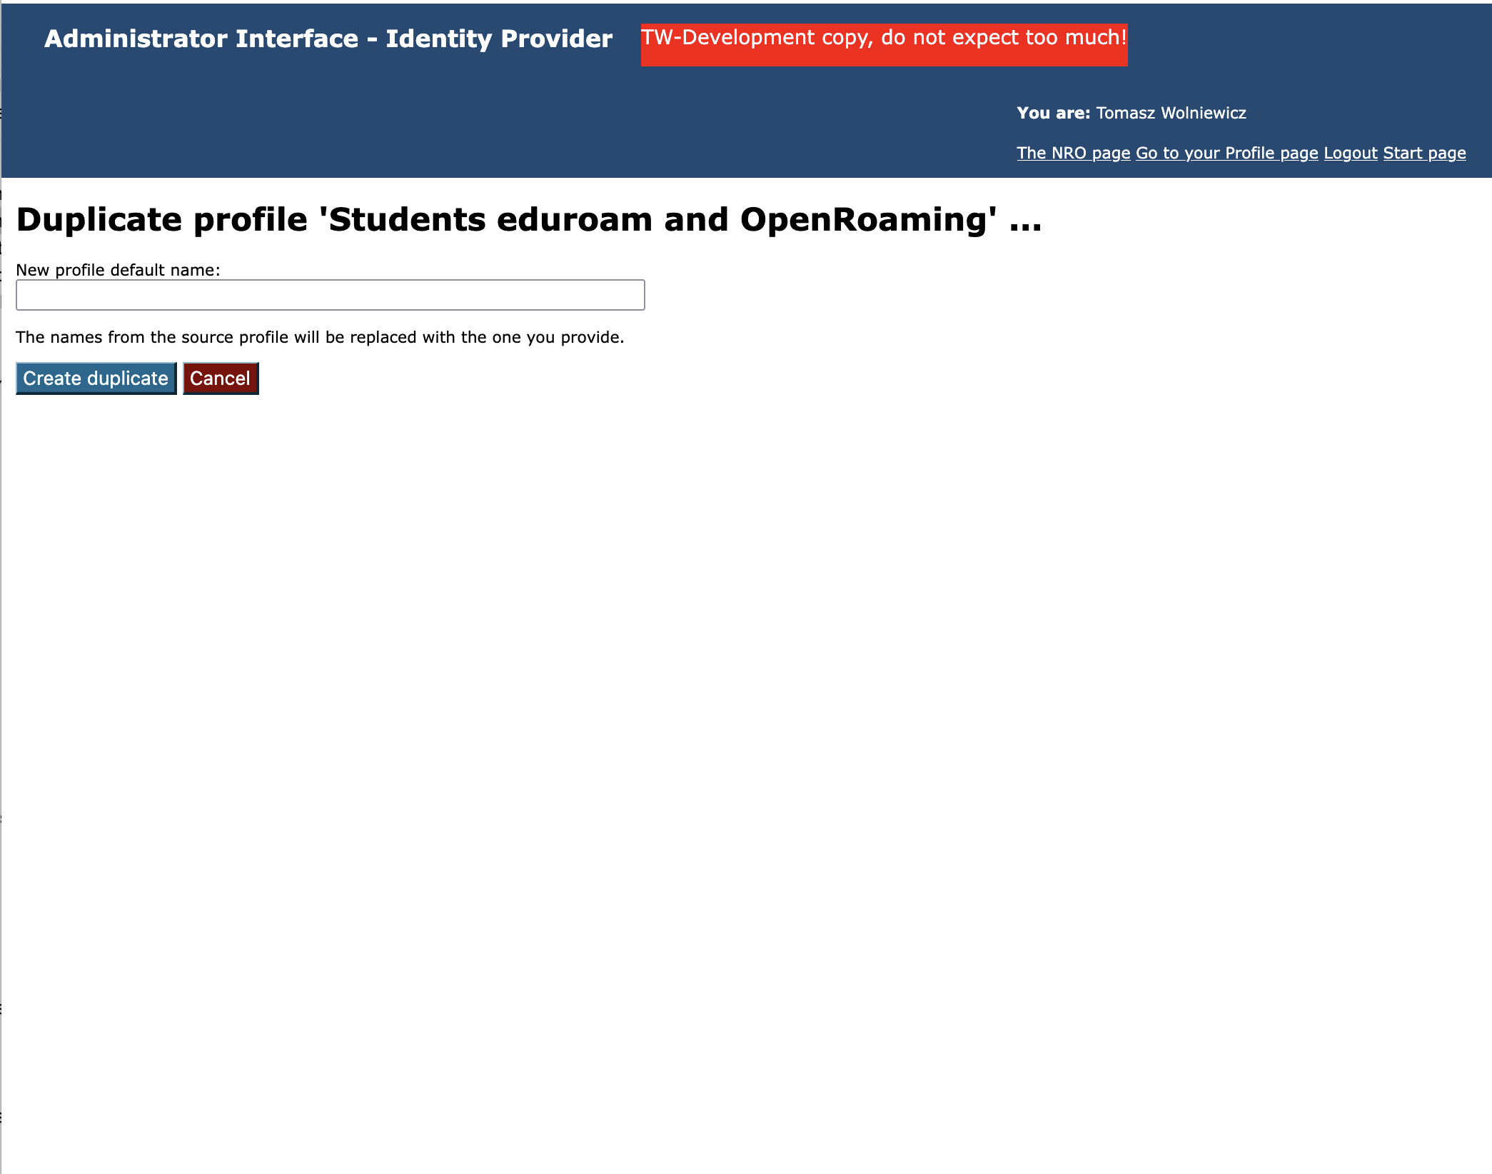

Slide 57
Monthly download statistics
Again, this was added on request from the users
We keep cumulative download statistics for every moth
Statistics from the current month are displayed on the institution overview page.
The listing table can be sorted on each of the columns

Slide 59
Thank You
The scientific work is published for the realization of the international project co-financed by Polish Ministry of Science and Higher Education from financial resources of the programme entitled "PMW"

